Slide 1
Installing software
SlicerIGT Tutorial Series

Slide 2

Two separate applications
PLUS: Software that communicates with hardware (scanners, trackers, etc.) and relays data to other applications (e.g. 3D Slicer). PLUS also comes with algorithms and small applications for data processing. Read more about PLUS: www.plustoolkit.org
3D Slicer (Slicer): Application with many data processing algorithms and visualization features. Has an extension mechanism that allows development of procedure-specific applications. Read more about Slicer: www.slicer.org

Slide 3
Software needs based on use case
optional
required
Real devices (e.g. trackers, ultrasound, etc.)
Hardware devices
PLUS
3D Slicer
Replay saved data to simulate devices
Saved data file
PLUS
3D Slicer
Load saved data directly into Slicer (no PLUS)
Saved data file
3D Slicer

Slide 4
Prerequisites
Download the SlicerIGT-Data folder from the SlicerIGT tutorial website:
http://www.slicerigt.org/wp/user-tutorial/
Unzip SlicerIGT-Data in your home folder.
Note: This tutorial was tested only on Windows. It is possible to follow all steps on Linux and Mac operating systems but specific screenshots are not added, so you may need to figure out the differences yourself.

Slide 5
Install the 3D Slicer application
Visit: http://download.slicer.org/
Download 3D Slicer version 4.11 or later.
Note: Some functions used in this tutorial are not available in earlier versions.
Run the installer and accept all default options when asked by the installer.

Slide 6
Intall PLUS (optional)
Visit: http://plustoolkit.org/ and click Downloads
Download the latest stable release of PLUS:
PlusApp_2.6...-Win32.exe – Typical for most users
PlusApp_2.6...-Win64.exe – 64-bit version. Can process large data. (E.g. for reconstruction of large ultrasound volumes.) But cannot connect to some 32-bit-only hardware devices.
PlusApp_2.6... -Telemed...exe – Supports specific hardware, e.g. Telemed ultrasound and MicronTracker.
Install PLUS using the downloaded installer, accept all default options.

Slide 7
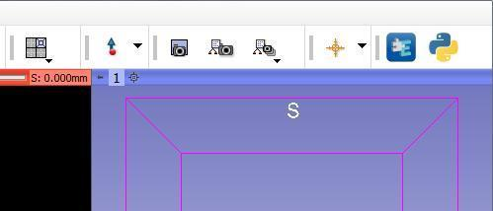
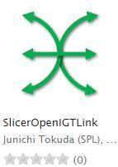
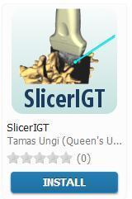

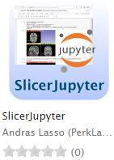
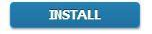

Install Slicer extensions
1.
Open the Slicer Extension Manager
Click Install for the following extensions :
SlicerOpenIGTLink
SlicerIGT
SlicerIGSIO
SlicerJupyter
Restart Slicer
2.
Note: During SlicerIGSIO installation, you will also need to agree to install Sequences
3.

Slide 8

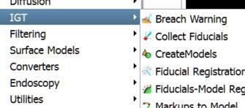

Check successful installation
1.
If extensions were installed successfully, you should see new modules in the Module browser, under the IGT category, a new “Sequences” category.

Slide 9
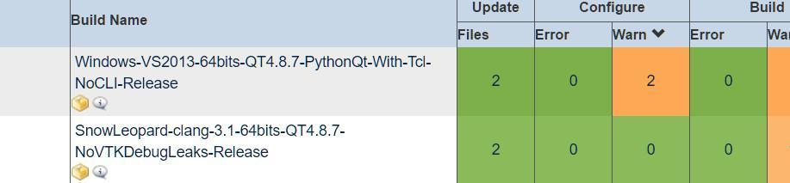
How to access earlier Slicer builds
Slicer is a continuously evolving software. For some tasks, you may need a build from a specific date.
Earlier Slicer builds are accessible from the Slicer Cdash: http://slicer.cdash.org/index.php?project=Slicer4
Click on Calendar menu to select a specific date
Click on yellow package to download the installer

