Slide 1
Tool models
SlicerIGT Tutorial Series

Slide 2
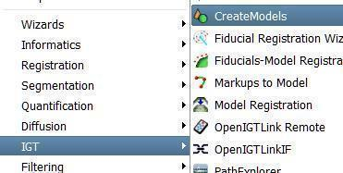
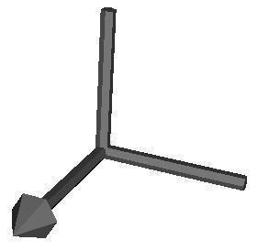
Create simple models
Select IGT / CreateModels module
Use the module widget on the left to create simple models with size parameters
In the coordinate system model, X is marked with an arrow tip, Y and Z are defined if right-handedness is assumed
Z
Y
X

Slide 3
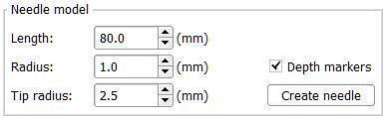
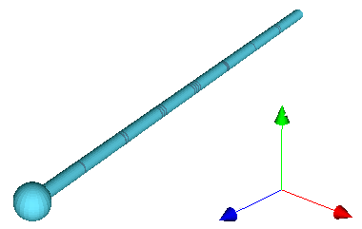
Needle / stylus models
Optional depth markers can be created for the needle model. Marks are 10 mm apart as in most medical needles.
Needle models and stylus models conventionally point towards the Z axis
X
Y
Z

Slide 4

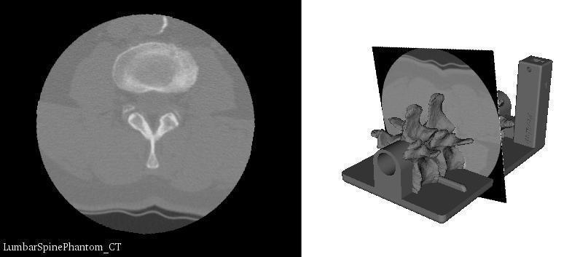
Load models from PLUS catalog
Select IGT / Plus model catalog browser module
Click Show/hide catalog to open the PLUS model catalog website
Click on .stl files to download a model
Additional files are also available, e.g. a CT volume of the spine model

Slide 5
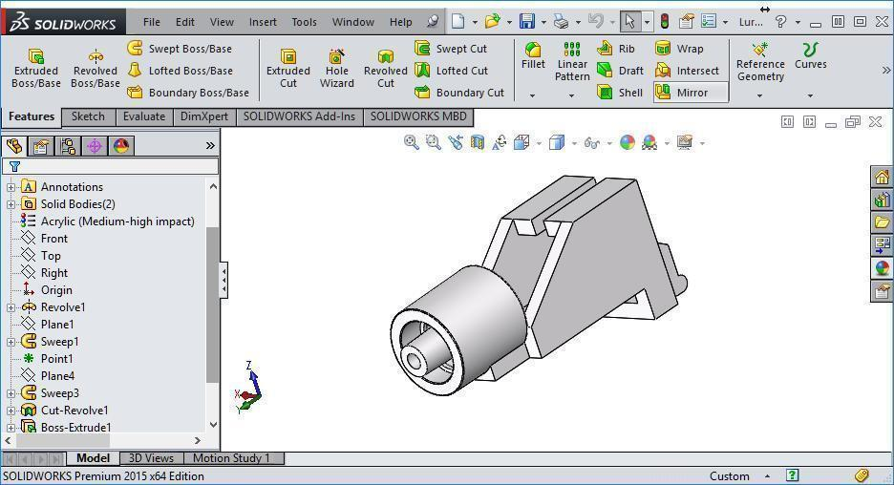
Create models in CAD software
FreeCAD, SolidWorks, Blender, etc.
Save in STL format, units should be millimeters
When exporting model in STL, choose and document an intuitive coordinate system

Slide 6
Models by image segmentation
Load SkullPhantom1mm.nrrd from the tutorial data folder
Select Segment Editor module
Click Add segment
Use the segmentation tools ("Effects") to segment
Hint: Such objects CT scanned in air can be quicly segmented using threshold followed by scissors
Select Segmentations module
Export a new model under the Export/import segments panel

Slide 7
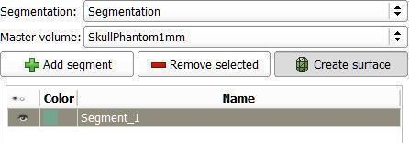
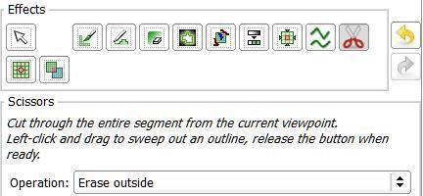
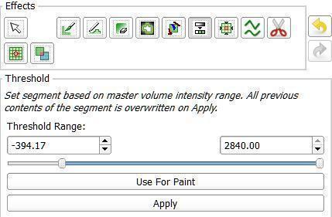
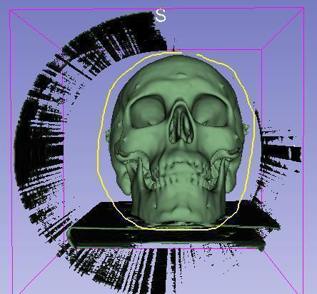
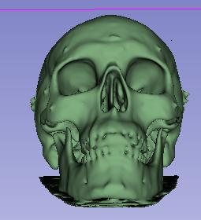
Skull model from segmentation
6
1
2
7
3
8
4
5
etc.

Slide 8
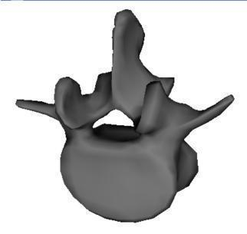
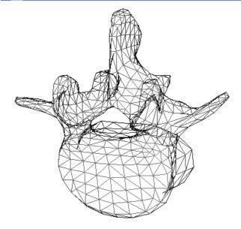
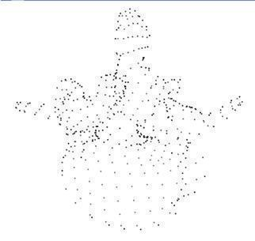
Models and Slicer model nodes
Models are thin/hollow surfaces, most common objects in computer graphics
Slicer wraps a vtkMRMLModelNode object around models, and keeps visualization properties in vtkMRMLModelDisplayNode
https://www.slicer.org/wiki/Modules:Models-Documentation
surfaces
lines
points

