Slide 1
Landmark registration
SlicerIGT Tutorial Series

Slide 2
Landmark registration
Computes transformation between point pairs
Points = landmarks = fiducials
Computation is fast, non-iterative, optimal result
Sensitive to outliers!
vtkLandmarkTransform based on [Horn 1987]
Y
Y
Reference
X
Ras
X
Z
Z
ReferenceToRas

Slide 3
Result transform type
Rigid
Translation + Rotation
Commonly used, because objects don't change size
Similarity
Translation + Rotation + Scaling
Used when changing units, e.g. pixels to millimeters
Warping
Splines, etc.
Used to model soft tissue deformations

Slide 4
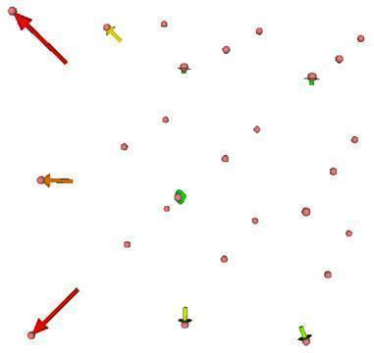
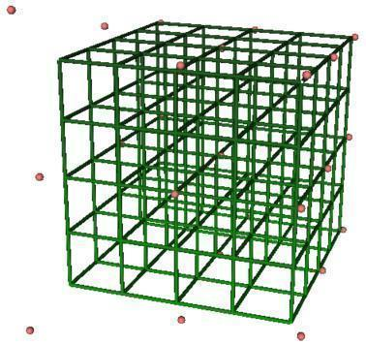
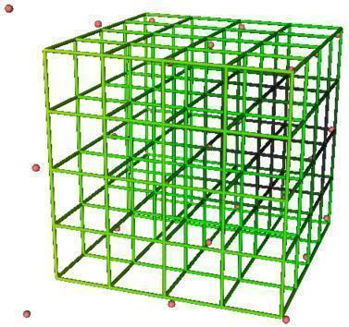
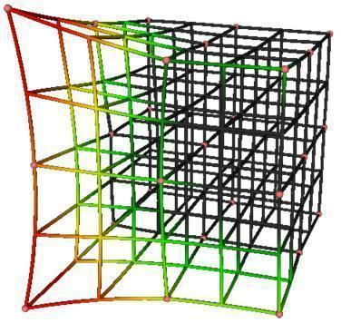
Fiducial displacement:
Rigid
Similarity
Warping
RMSE = 4.8
RMSE = 4.2
RMSE = 0.0

Slide 5

Load example data
Load scene: SlicerIGT-Data/Skull_GroundTruthLandmarks.mrb
Load additional transform: SlicerIGT-Data/Skull_StylusTipToStylus.h5
Create needle model
Set up stylus transform hierarchy in Data module:

Slide 6
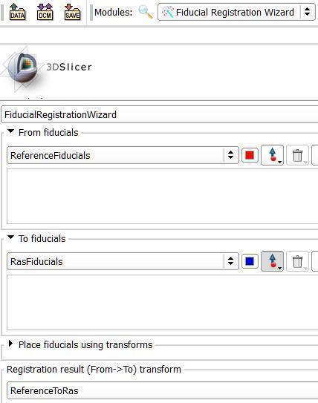
Create input and output nodes
Select IGT / Fiducial Registration Wizard module
Create From fiducials and name the list "ReferenceFiducials"
Create To fiducials and name the list "RasFiducials"
Create result transform as "ReferenceToRas"

Slide 7

Set up stylus as input
Expand Place fiducials using transforms group
Select Skull_StylusTipToStylus to place From fiducials
When pressing Place 'From' or Place 'To' buttons, fiducials are created at the origin (0,0,0) of the From (first) coordinate system of the selected transform, transformed by the transform hierarchy.
See explanation on next slide

Slide 8

How Place fiducials... work
Y
Y
Stylus
StylusToReference
Y
StylusTip
X
Z
X
Reference
Z
StylusTipToStylus
X
Z
adds this point in this coordinate system to this list
because of this selection and this transform hierarchy

Slide 9
Populate the 'From' and 'To' lists
Select SequenceBrowser node in the Sequence toolbar
Drag the time slider to points where you see the stylus placed in skull landmarks in the video
Rotate the 3D view so you see the same landmark point in the surface model
Press the Place 'From' button to add a From fiducial
Press the fiducial selector button in the To list and click on surface model to place a To fiducial
See next slide for illustration

Slide 10
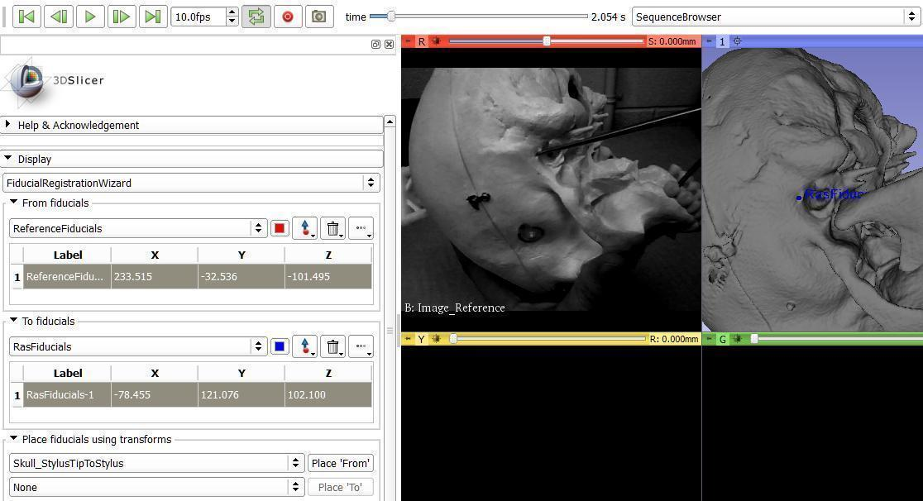
Adding first point pair
1.
4.
3.
2.

Slide 11
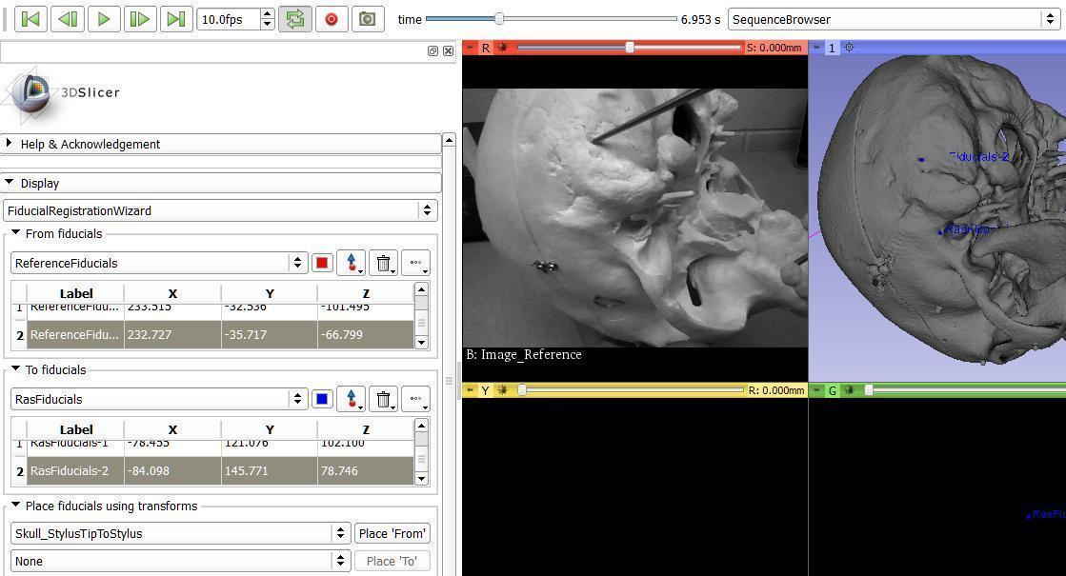
Adding second point pair
1.
4.
3.
2.

Slide 12
And so on for many point pairs...
... but how many?
At least 3 point pairs are needed for registration
More point will probably increase accuracy AND slightly increase the RMSE (root mean square error)
Accuracy will increase because random errors cancel each other out
RMSE will increase because of less overfitting
RMSE is an unknown mix of precision and accuracy!

Slide 13
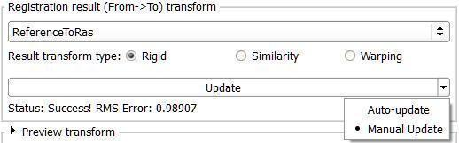
When all point pairs are added
It is a good idea to switch to Manual update from Auto-update to prevent errors when accidentally moving fiducials later in the scene
Save the ReferenceToRas transform, or save the entire scene, in case you want to check the result later

