Slide 1
Subject Hierarchy New way of organizing data in Slicer
Csaba Pinter
Laboratory for Percutaneous Surgery, Queen’s University, Canada
Notes:
Please interrupt me any time with questions

Slide 2
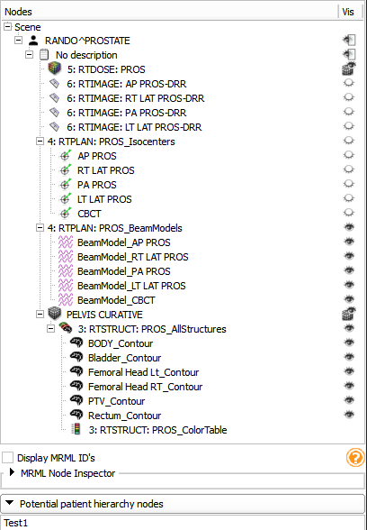
History
Original implementation extensively tested and improved as SlicerRT module
Tree view of data
Loaded in Slicer via the DICOM module
List of potential data nodes that could be drag&dropped into the tree view
Built-in RT support
This has been generalized
Patient hierarchy module widget from SlicerRT

Slide 3
Concept
Nice and intuitive way of organizing and handling data in Slicer
Vs. Data module (flat list with no visual guides)
Bring basic features in the tree view (all from Data module and more)
Support DICOM export
Extendable through plugins
Broad API allowing many customizations

Slide 4
Current state - Features
Tree view containing all data that is inserted into Subject Hierarchy
Custom icons for nodes provided by plugins
Show/hide
Re-parent through drag&drop
Create new nodes
Extendable context menu
List of ‘potential’ nodes under the tree view
Nodes can be added to SH through drag&drop

Slide 5
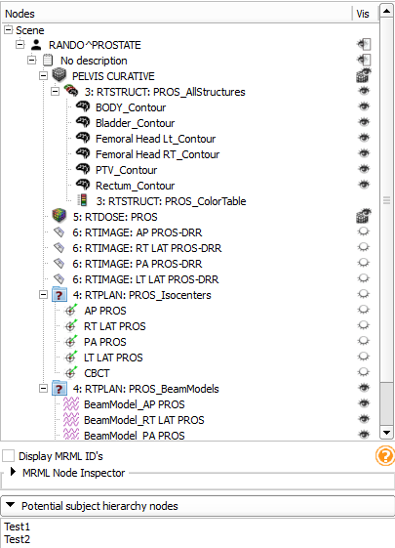
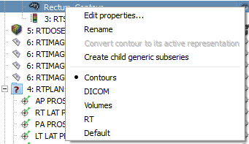
Current state - GUI
Context menu of a contour
Subject hierarchy module widget

Slide 6
Current state – Architecture: Overview
qSlicerSubject HierarchyModule
vtkMRMLHierarchyNode
MRML
Logic
vtkMRMLSubjectHierarchyNode
vtkSubjectHierarchyConstants
vtkSlicerSubjectHierarchyModuleLogic
Plugins
Default
qSlicerSubjectHierarchyPluginHandler <singleton>
qSlicerSubjectHierarchyAbstractPlugin <abstract>
Volumes
…
Widgets
qMRMLSubjectHierarchyTreeView
qMRMLSceneSubject HierarchyModel
qMRMLSortFilterSubject HierarchyProxyModel
qMRMLPotentialSubjectHierarchyListView
qMRMLScenePotential SubjectHierarchyModel
qMRMLSortFilterPotential SubjectHierarchyProxyModel

Slide 7
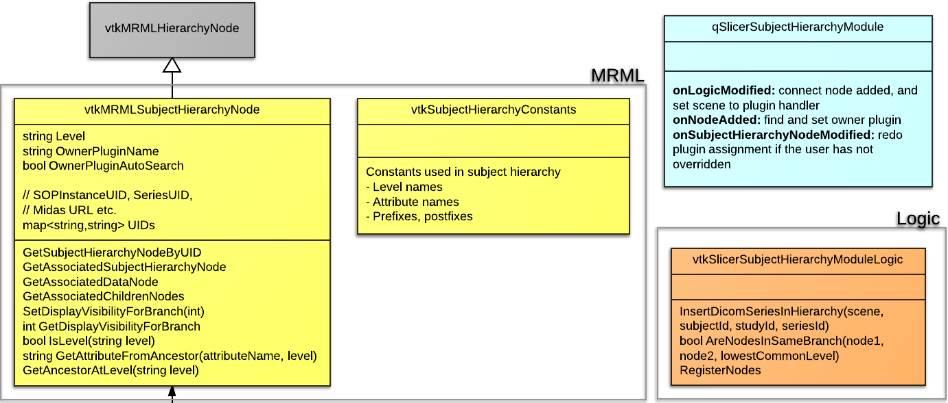
Current state – Architecture:
MRML
Keywords:
Level
Owner plugin
UID list
Nested association
Notes:
Separate node type: much faster filtering based on type than based on attributes (also attributes containing other metadata can be member variables)
Level
Multiple and generic UIDs
Nested associations: Conflict if a data node is associated to two hierarchy nodes (e.g. ModelHierarchy and SH). The first associated hierarchy node is returned by the utility function - non-deterministic behavior
SH -> MH -> DataNode (instead of SH -> DataNode <- MH)

Slide 8
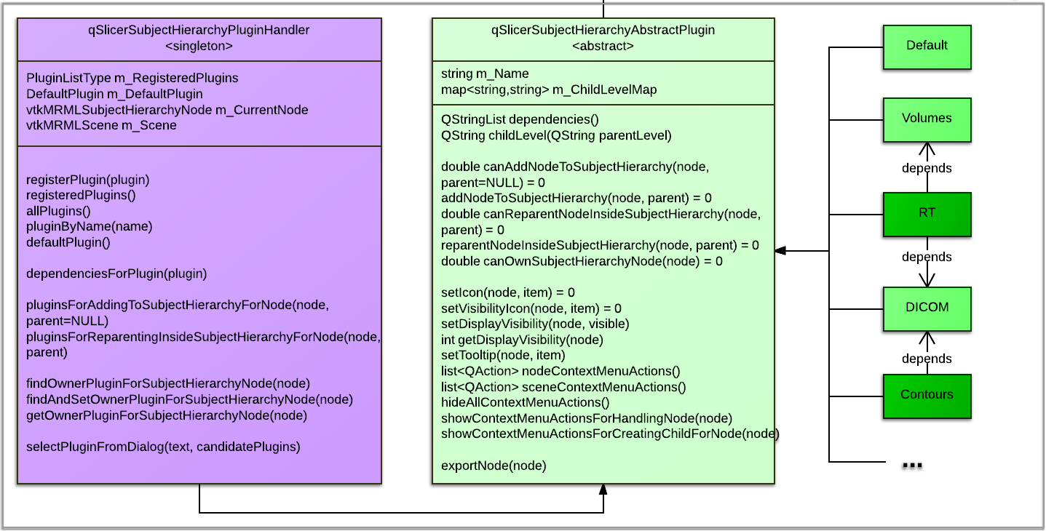
Current state – Architecture:
Plugins
Notes:
Plugins are registered to the singleton PluginHandler class, which is responsible for deciding which plugin will perform which operation (add, reparent, own)
Each Subject hierarchy node is “owned” by a plugin: Icon, tooltip, display visibility icon and show/hide functions, context menu actions (handle, create child)
Plugins depend on each other, e.g. the RT plugin uses some functions defined in the DICOM plugin
DICOM is not required to use Subject Hierarchy, but it is a core plugin right now (such as Default and Volumes)

Slide 9
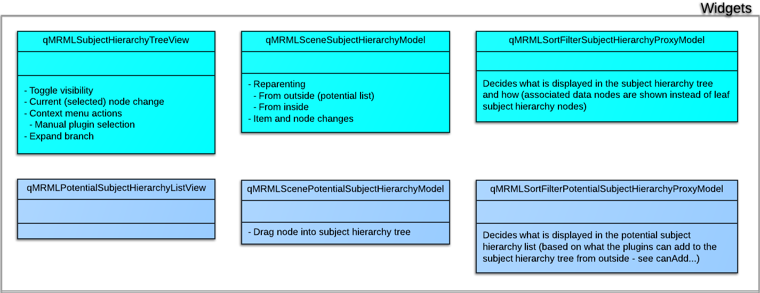
Current state – Architecture:
Widgets

Slide 10
Next steps #1
Plugins provide “roles” (descriptive names about how the plugin can handle the node)
These will be listed in the context menu instead of the plugin names
Plugins can offer multiple ways to handle the same node
Roles assign levels to the nodes too
Add sub-menu for the roles (Slicer core change needed)
Slicer core changes
Make vtkMRMLHierarchyNode::GetAssociatedNode and GetAssociatedChildren(d) virtual and override in SH

Slide 11
Next steps #2
Add more options to context menu
Delete node
Edit properties (similarly to Data module)
Expand all children
Plugins to add custom text into the help box
Plugins to determine early if a drop is possible
Automatic tests
Export
Integrate into Slicer core and utilize SH in all DICOM import plugins

Slide 12
Tentative roadmap
2014. May Implementation round 2 finished
Next steps items
Design questions consensus
2014. June (NA-MIC week) Integration into Slicer core

Slide 13
Design questions / Issues #1
Should having a UID be mandatory?
Should the MRML node ID be used as default UID?
Can we use subject hierarchy as a MRML node selector?
There could be a stripped down widget that pops up instead of the MRML node combobox (Easier for the user to pinpoint the node, as it looks exactly like in the subject hierarchy module)

Slide 14
Design questions / Issues #2
Two kinds of relationships
Parent-child and DICOM/other
DICOM references need to be handled in some way (currently by pre-defined “connection” attributes)
Possible solution: Allow inconsistencies on the basic SH level (e.g. when drag&drop an RT structure set on a CT → the referenced UIDs become invalid), and let export feature resolve this

Slide 15
Design questions / Issues #3
Editing DICOM tags before export
How to store them? Prefixed MRML attributes?
DICOM header widget could be re-used (it is a viewer for DCMTK objects, not an editor for MRML nodes)
Plugin mechanism relies on Qt. This can make batch processing and GUI-less usage hard or impossible
Separate plugins on the long run? Reparent(VTK) + NodeDisplay(Qt) + Export(VTK) ?

