Slide 1

Subject Hierarchy
Csaba Pinter
Queen’s University, Canada
csaba.pinter@queensu.ca
NA-MIC Tutorial Contest: Winter 2016
© 2016, All Rights Reserved

Slide 2
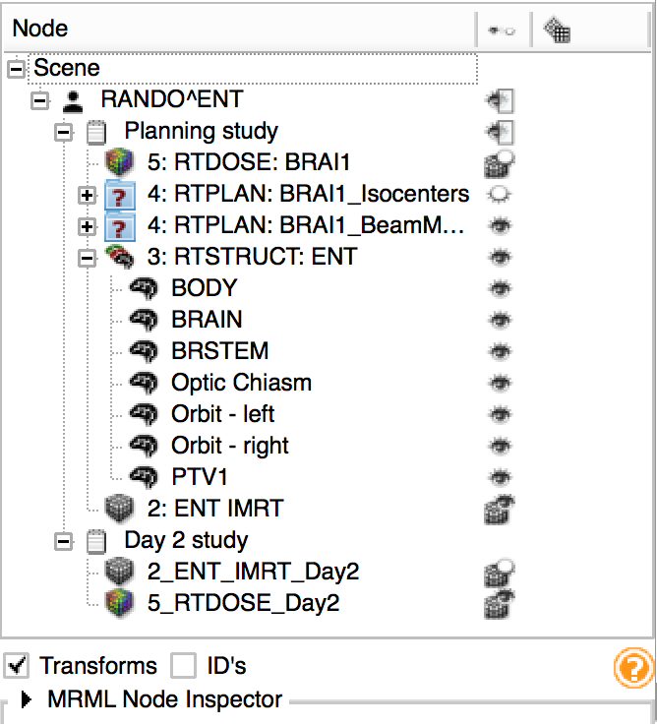
Learning Objective
This tutorial demonstrates the basic usage and potential of Slicer’s data manager module Subject Hierarchy using a two-timepoint radiotherapy phantom dataset.
© 2016, All Rights Reserved

Slide 3
Material
This tutorial requires the installation of the Slicer4.5 release and the tutorial dataset. They are available at the following locations:
Slicer download page:http://www.slicer.org/pages/Downloads/
Tutorial dataset: IGRT Tutorial Dataset
http://slicer.kitware.com/midas3/download/item/205404/SlicerRT_WorldCongress_TutorialIGRT_Dataset.zip
Wiki page: http://wiki.slicer.org/slicerWiki/index.php/Documentation/Nightly/Modules/SubjectHierarchy
© 2016, All Rights Reserved

Slide 4



Platforms
Developed and maintained on Windows 64bit, Mac OSX, and Linux 64bit & 32bit
Slicer requires
Minimum 2GB RAM
64 bit strongly suggested
© 2016, All Rights Reserved

Slide 5
General module information
Subject hierarchy is the main data manager module of 3D Slicer
Data type specific visualization and handling of different data objects
Organization of the data objects into hierarchies
Access select Slicer features applicable to the data objects directly from the tree
© 2016, All Rights Reserved

Slide 6
Overview
Install SlicerRT extension
Import and load planning data
Explore loaded data in Subject hierarchy
Load second timepoint data
Add loaded data into new study
Register second timepoint to planning study with Subject hierarchy
© 2016, All Rights Reserved

Slide 7
Part 1: Install SlicerRT extension
Enables loading radiotherapy data
Allows demonstrating support of “exotic” data types in Subject hierarchy
Multiple studies by nature
(Please ask the author about support of your data type if not yet available)
© 2016, All Rights Reserved

Slide 8
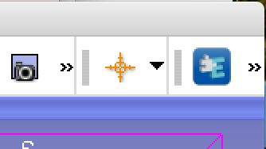

1/1: Install SlicerRT extension
Open Extension Manager from the toolbar:
Or from menu View / Extension Manager
© 2016, All Rights Reserved

Slide 9
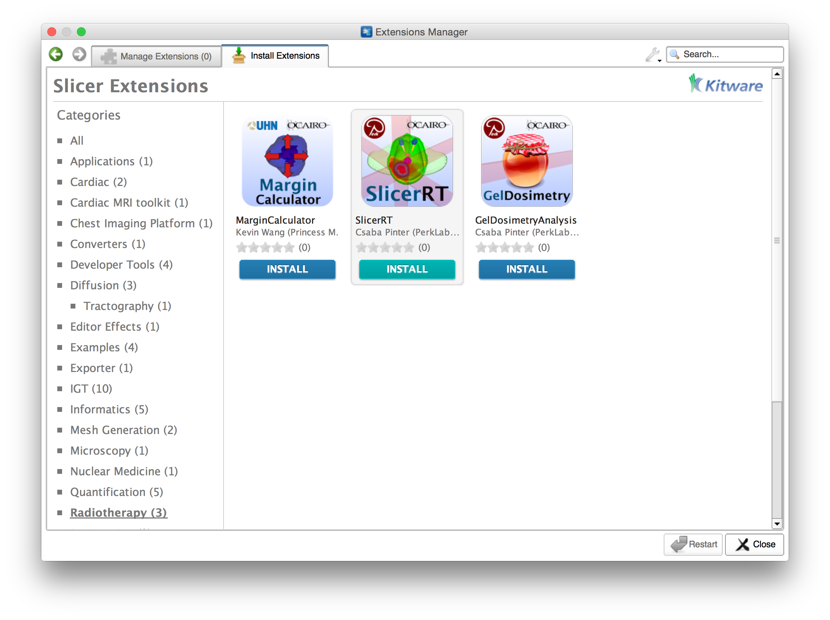
1/2: Install SlicerRT extension
1. Find Radiotherapy category
2. Click Install under SlicerRT
3. After done, click Restart
© 2016, All Rights Reserved

Slide 10
Part 2: Import and load planning data from DICOM
Phantom dataset taken from a RANDO¹ head&neck phantom
Study contains a CT grayscale image and radiotherapy data: contours, dose distribution, treatment beams, plan information
¹RSD RANDO: http://www.rsdphantoms.com/rt_art.htm
© 2016, All Rights Reserved

Slide 11
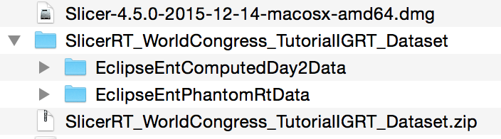
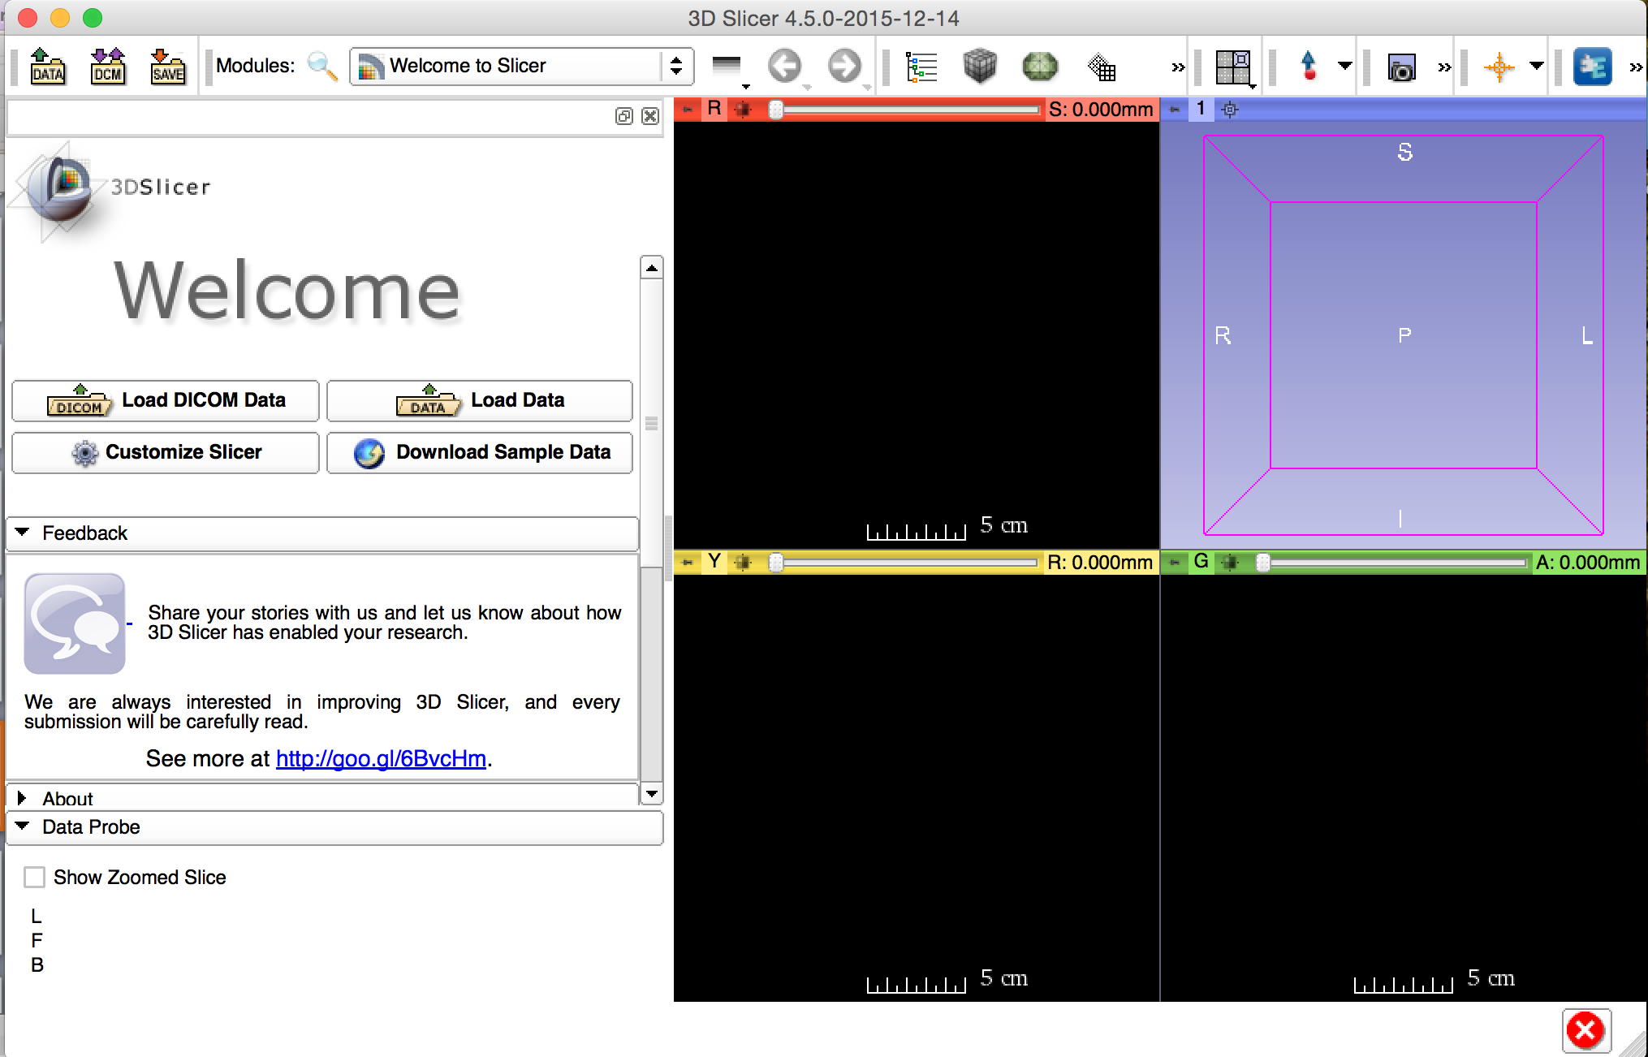
2/1: Import and load planning data from DICOM
Drag&drop ‘EclipseEntPhantomRtData’ onto the Slicer window
© 2016, All Rights Reserved

Slide 12
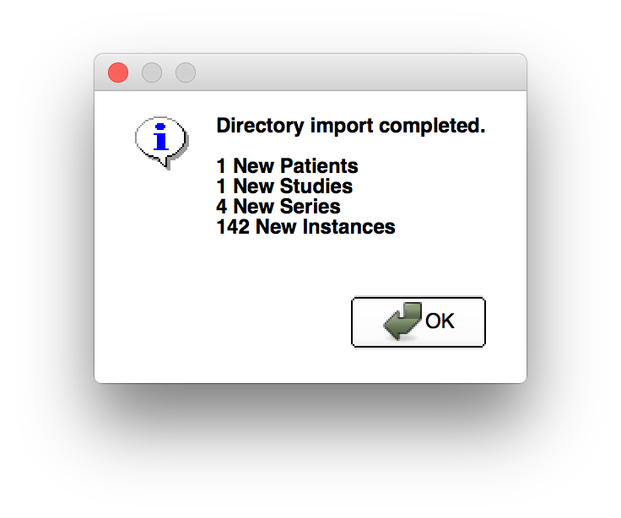
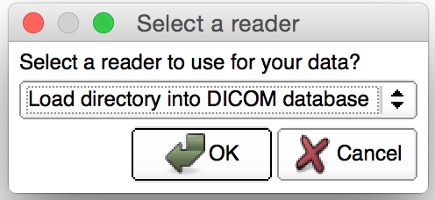
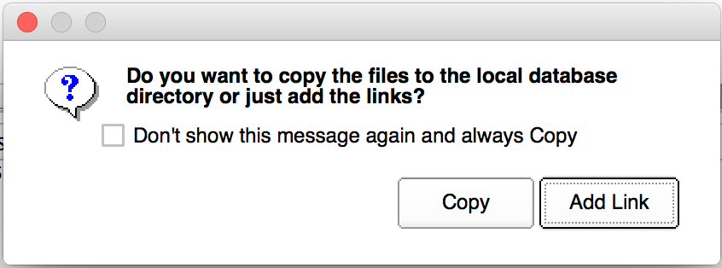
2/2: Import and load planning data from DICOM
© 2016, All Rights Reserved

Slide 13
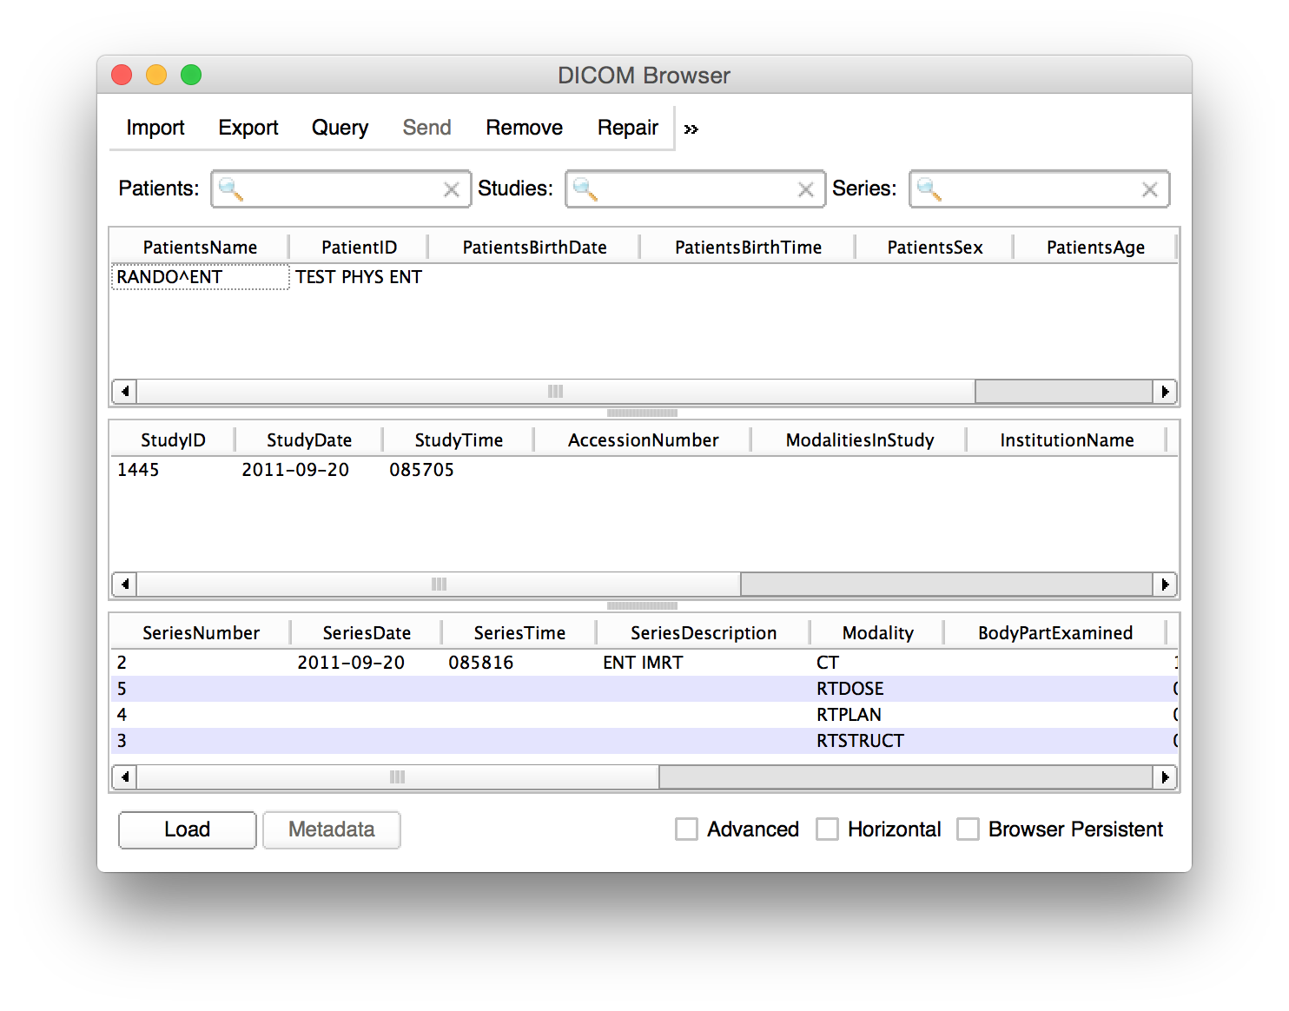
2/3: Import and load planning data from DICOM
New patient appears
1. Select patient ‘RANDO ENT’
2. Click ‘Load’
© 2016, All Rights Reserved

Slide 14
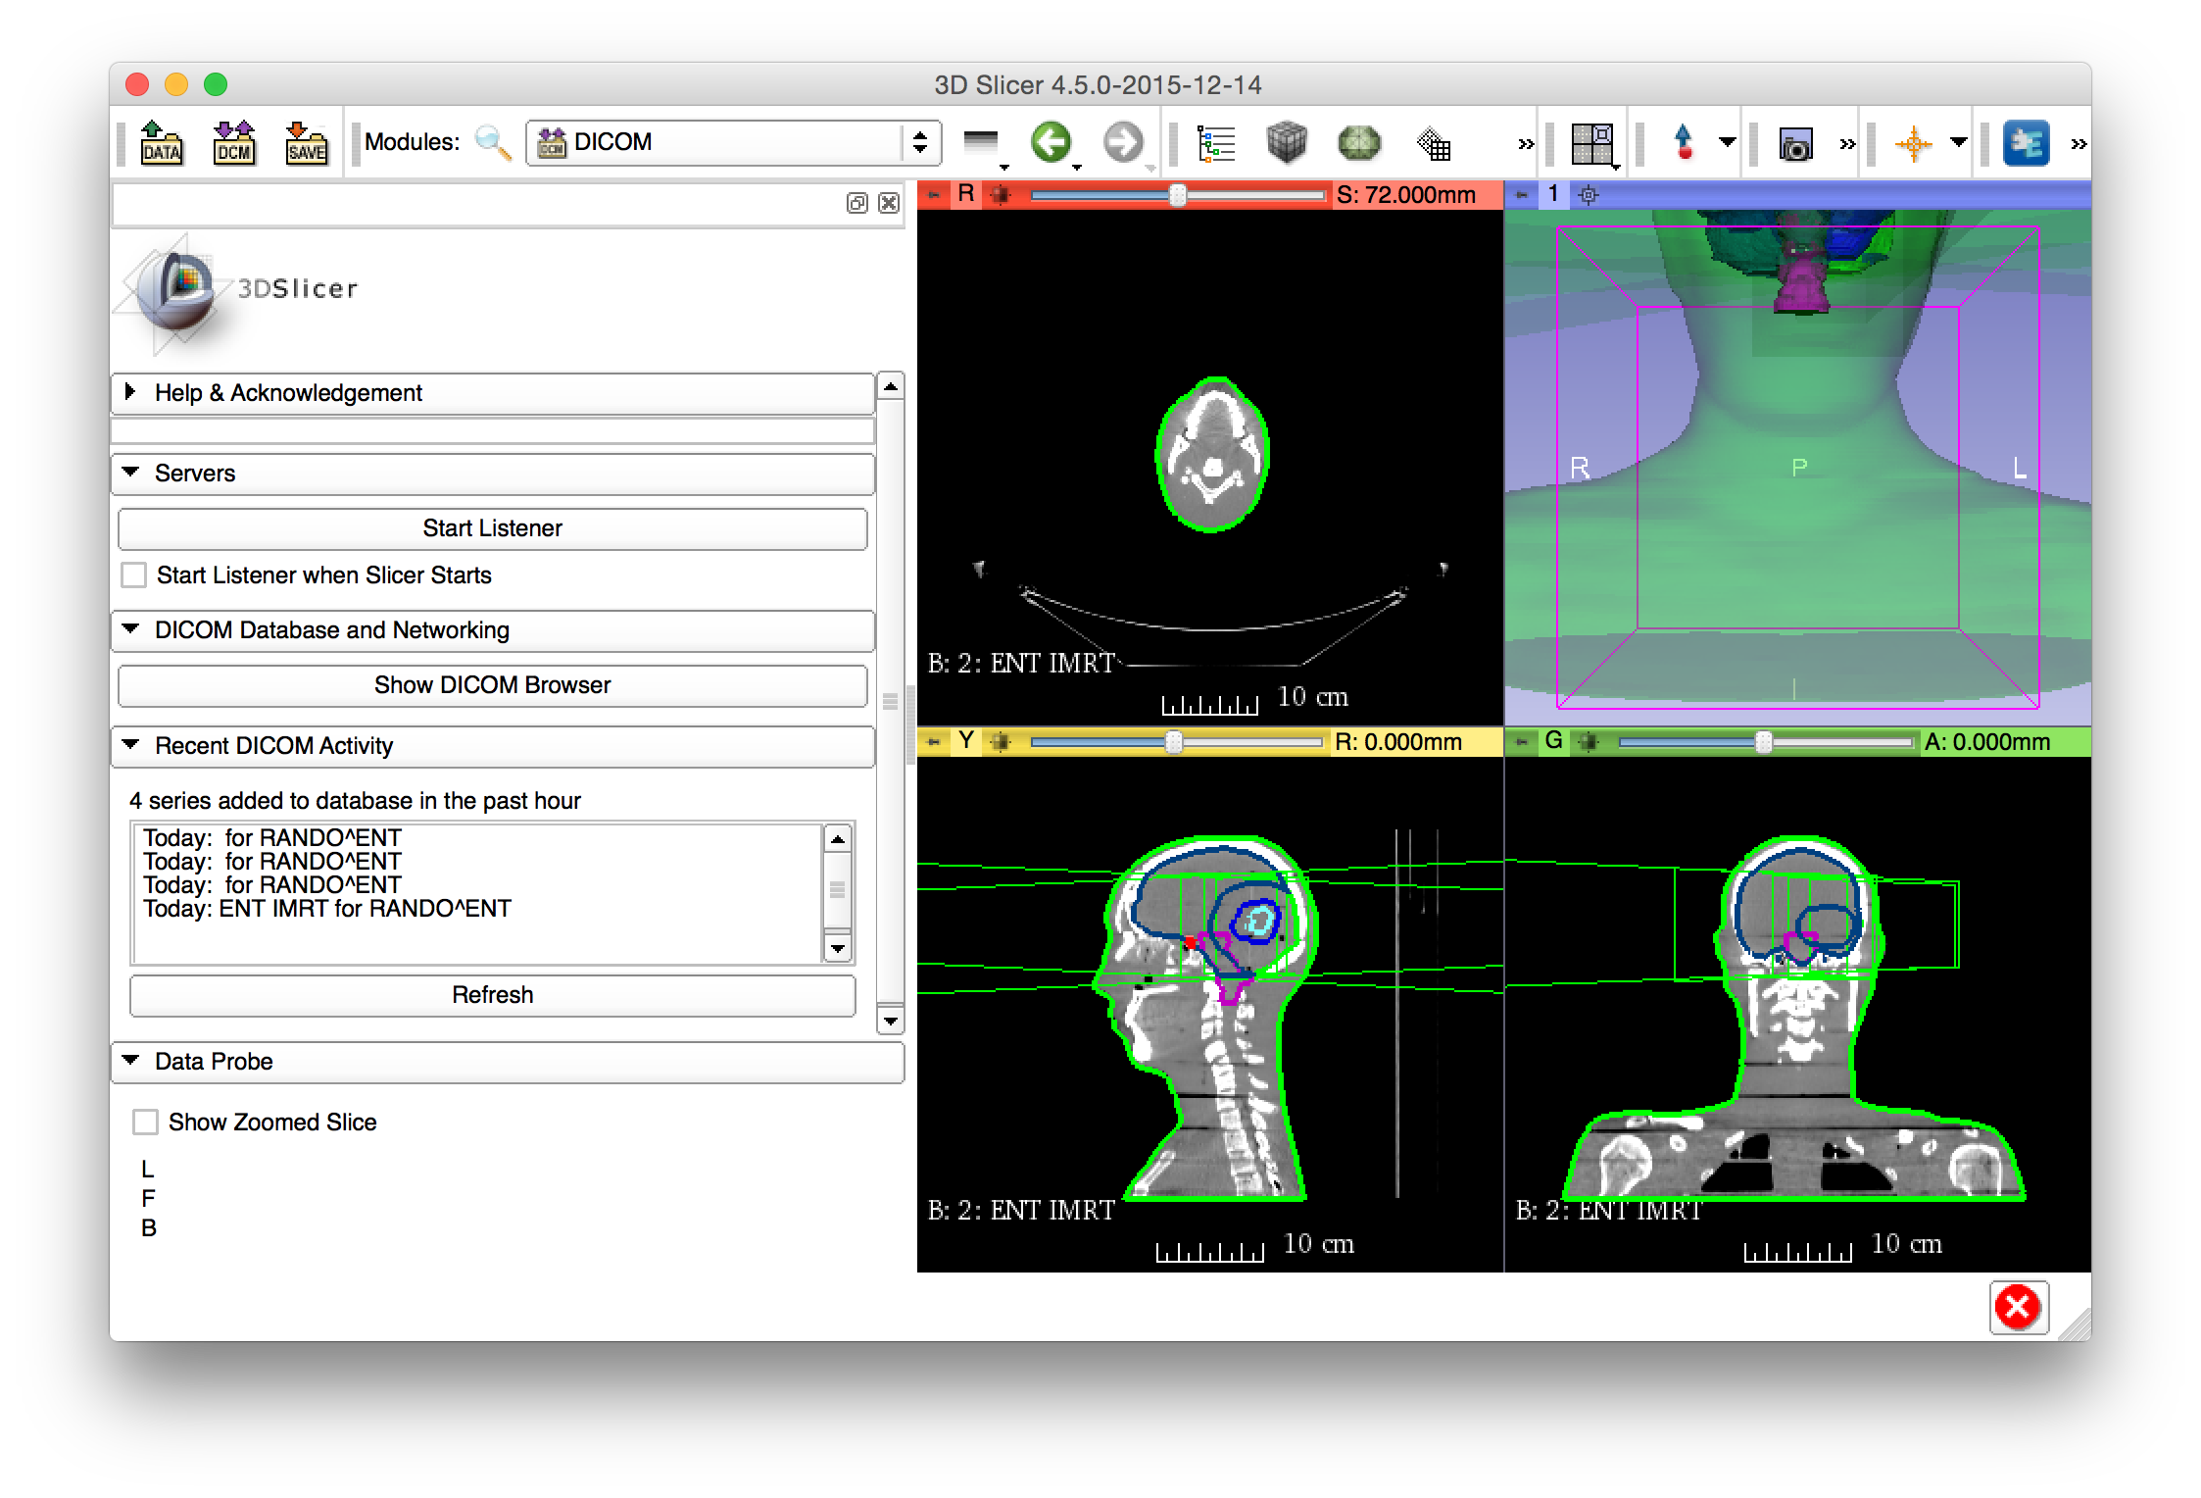
2/4: Import and load planning data from DICOM
Phantom patient is loaded to Slicer
© 2016, All Rights Reserved

Slide 15
Part 3: Explore loaded data in Subject hierarchy
Subject hierarchy automatically creates hierarchy for supported DICOM types
DICOM support can be added for any modality if not yet available
© 2016, All Rights Reserved

Slide 16
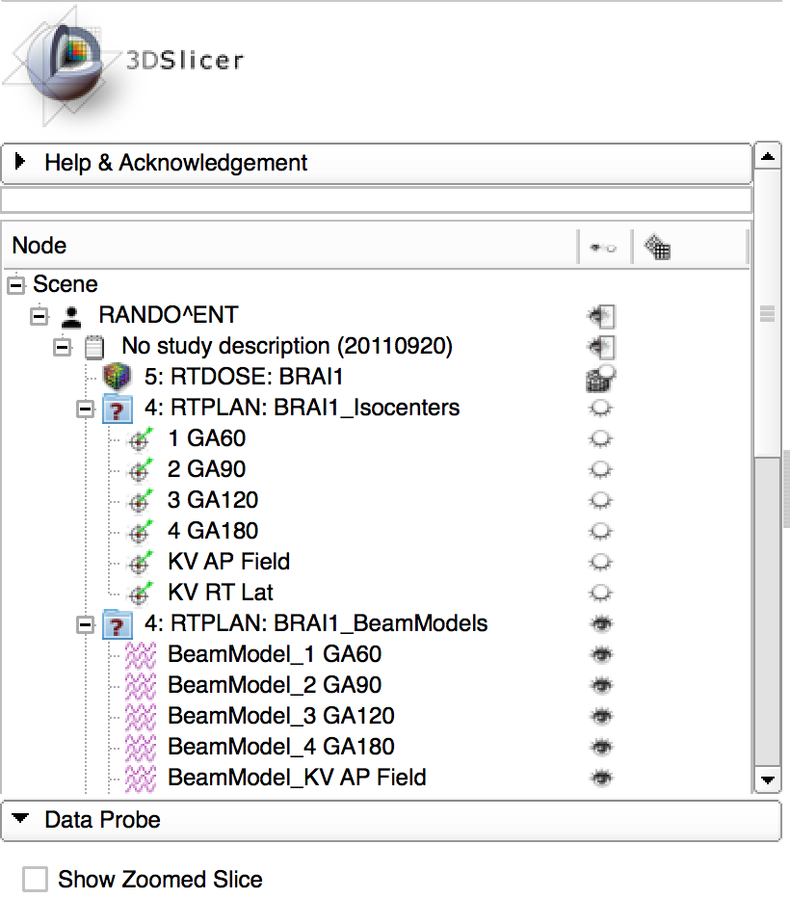
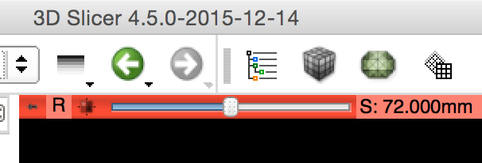
3/1: Explore loaded data in Subject hierarchy
Open Subject hierarchy module from the toolbar or from the module list
- Choose ‘Yes to All’
© 2016, All Rights Reserved

Slide 17
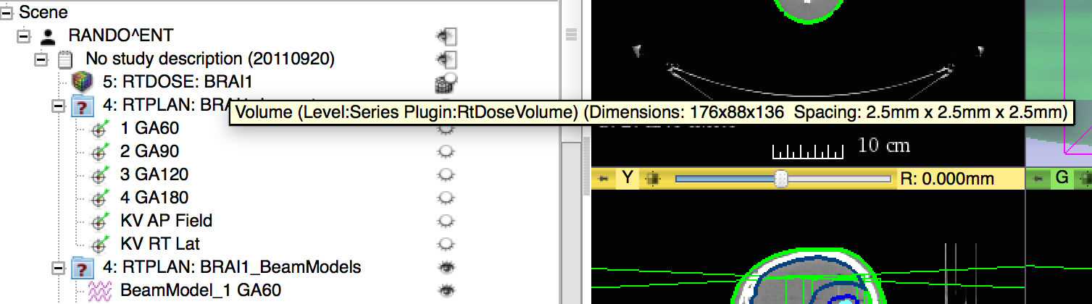
3/2: Explore loaded data in Subject hierarchy
Get more information about nodes by moving the mouse over the node in the tree
© 2016, All Rights Reserved

Slide 18
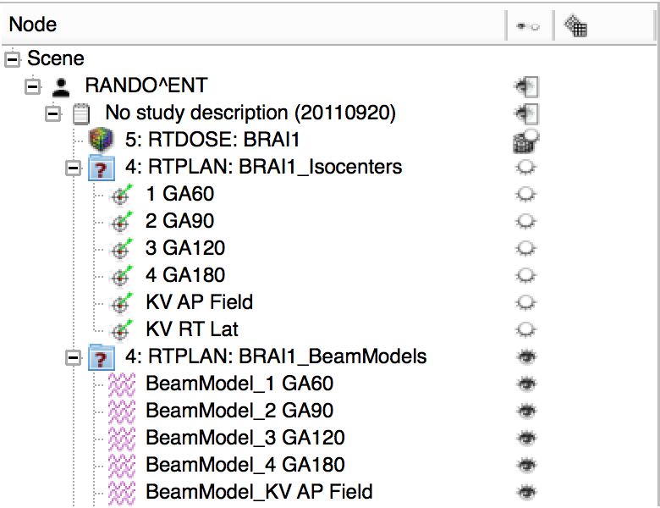
3/3: Explore loaded data in Subject hierarchy
Collapse branches by clicking the box next to the node’s icon
© 2016, All Rights Reserved

Slide 19
3/4: Explore loaded data in Subject hierarchy
Show/hide nodes or entire branches by clicking the eye icon in the node’s row
© 2016, All Rights Reserved

Slide 20
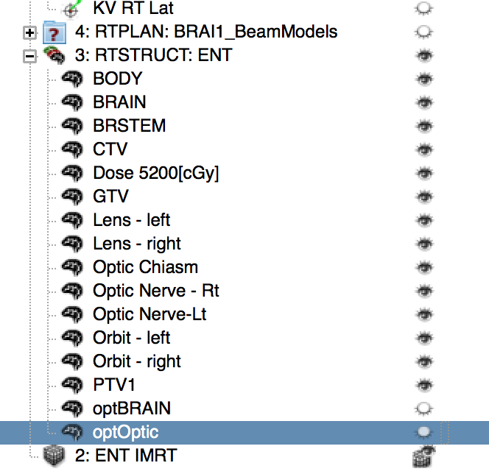
3/5: Explore loaded data in Subject hierarchy
1. Hide and collapse beam models to make the tree more compact
2. Hide structures ‘optBRAIN’ and ‘optOptic’ to see the inner organs in the head in the 3D view
© 2016, All Rights Reserved

Slide 21
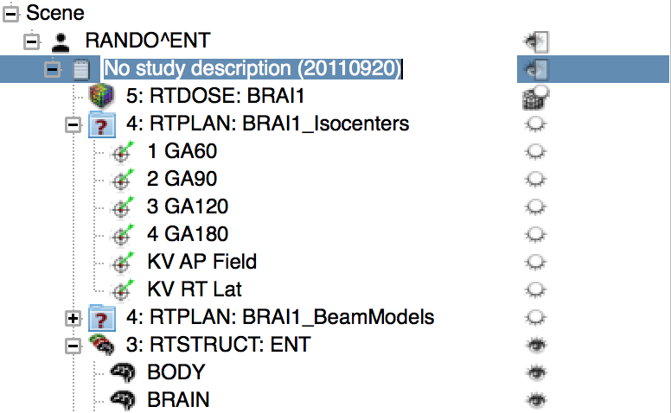
3/6: Explore loaded data in Subject hierarchy
1. Enter renaming mode for the study node by double clicking on its name ‘No study description…’. 2. Rename it to ‘Planning study’
3. Press Enter
© 2016, All Rights Reserved

Slide 22
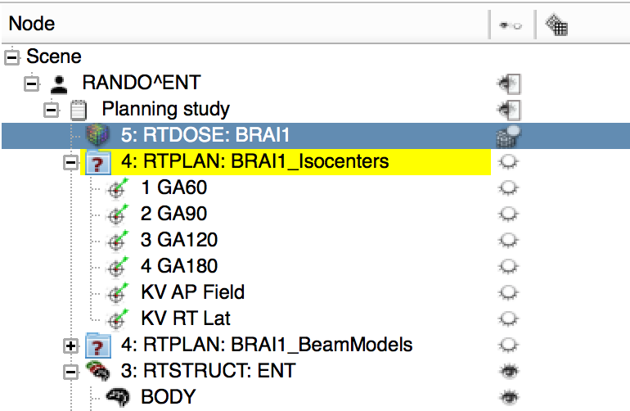
3/7: Explore loaded data in Subject hierarchy
Data objects referenced in DICOM by the selected node are highlighted in yellow
© 2016, All Rights Reserved

Slide 23
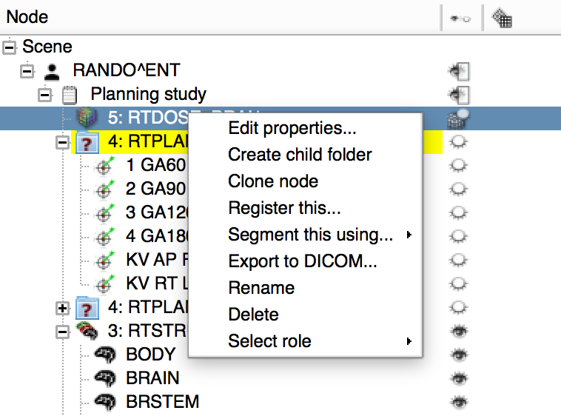
3/8: Explore loaded data in Subject hierarchy
1. Right-click on a node to access all actions associated to it.
2. Click ‘Edit properties…’ to switch to the module that handles the node
© 2016, All Rights Reserved

Slide 24
Part 4: Load second timepoint data
Simulated second timepoint for the same phantom dataset
Artificial deformation field applied on phantom CT and dose distribution
Illustrates “day two” scenario of a hypothetical radiotherapy patient
Stored in NRRD files
© 2016, All Rights Reserved

Slide 25
4/1: Load second timepoint data
Drag&drop ‘EclipseEntComputedDay2Data’ onto the Slicer
© 2016, All Rights Reserved

Slide 26
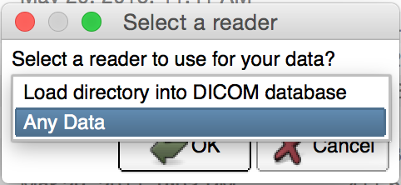
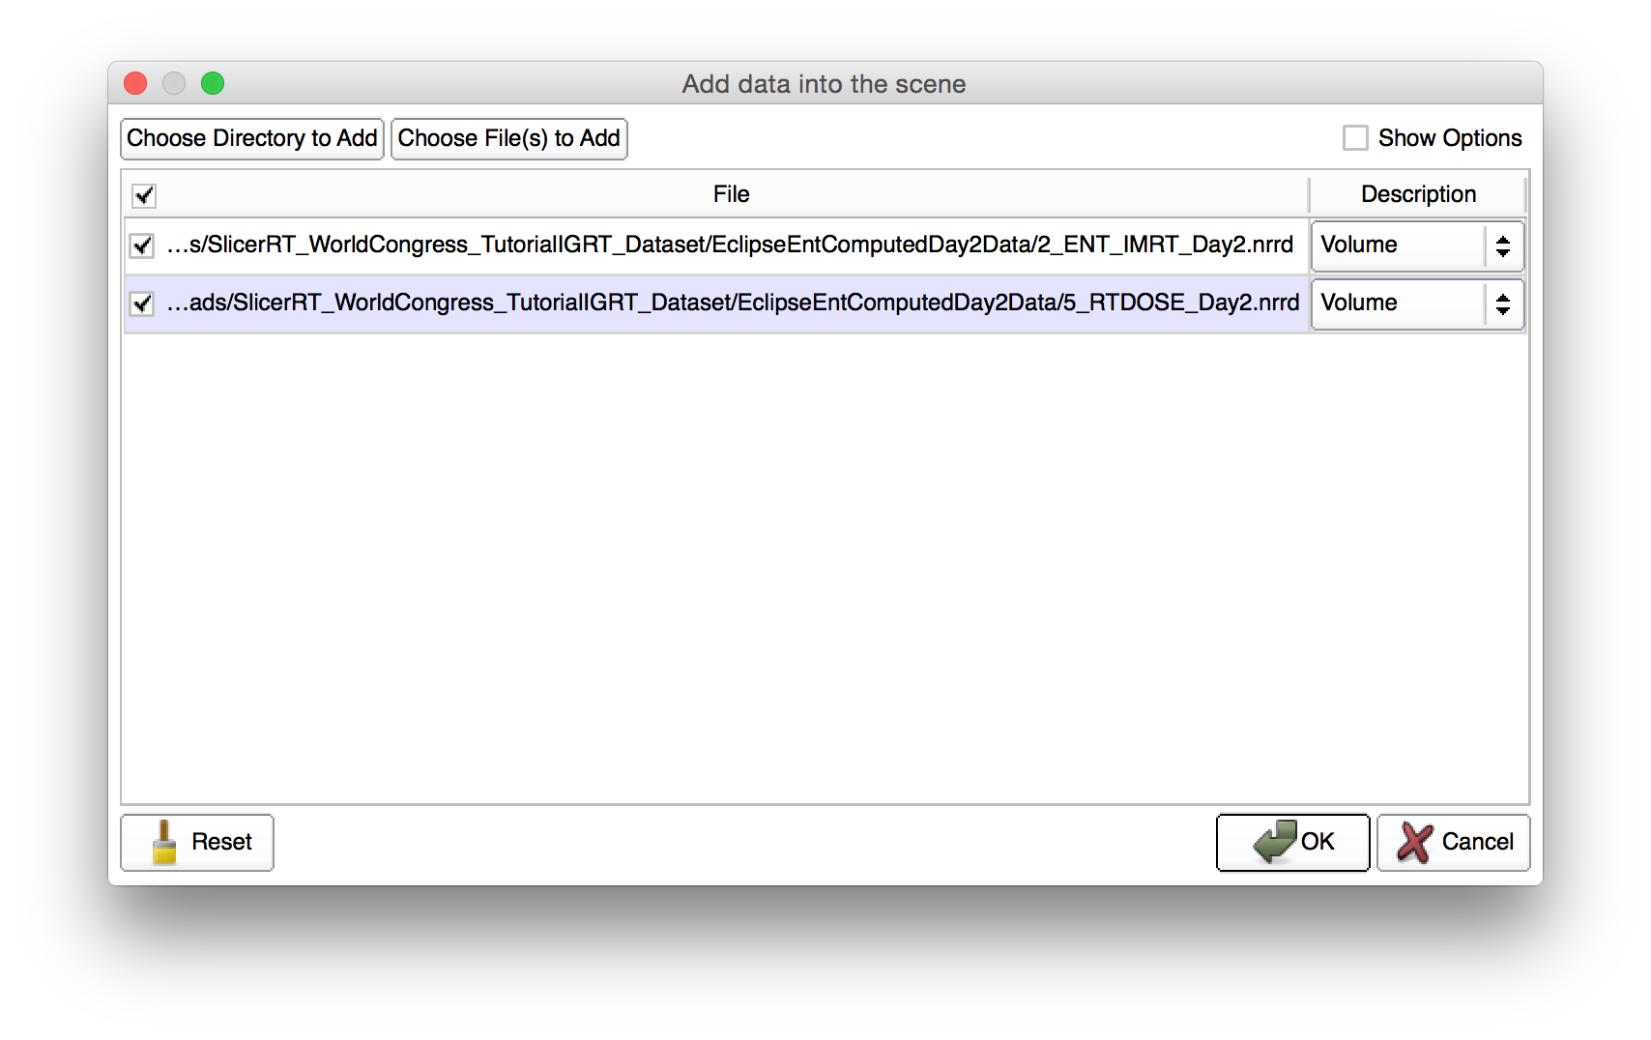
4/2: Load second timepoint data
1. Choose ‘Any Data’ in the pop-up dialog
2. Click OK. Add data window appears.
3. Click OK
© 2016, All Rights Reserved

Slide 27
Part 5: Add day two data into new study
Non-DICOM data such as NRRD are not automatically added to hierarchy
Manual assignment of data into studies is possible
(Solution is in place for automatic arrangement for data loaded from local directory structure – please consult module wiki page)
© 2016, All Rights Reserved

Slide 28
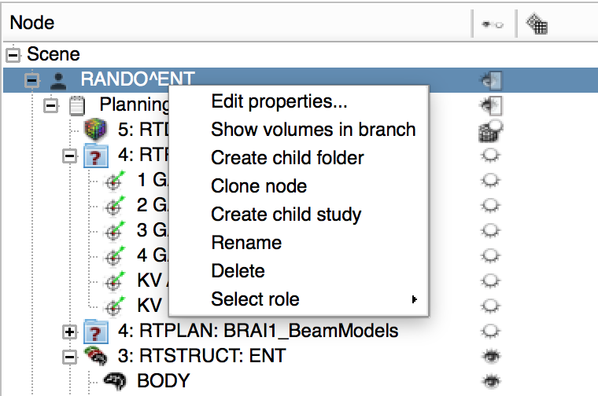
5/1: Add day two data into new study
Two volumes appeared on the bottom. Let’s create a new study for them.
1. Right-click the patient
2. Select ‘Create child study’
© 2016, All Rights Reserved

Slide 29
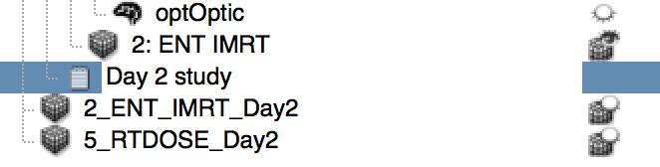
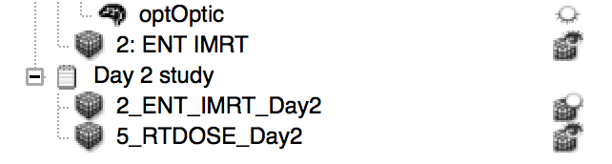
5/2: Add day two data into new study
1. Rename new study (appearing under the data in the planning study) to ‘Day 2 study’ after double-clicking its name
2. Select the two nodes by clicking the first one, then holding shift button and clicking the second one
3. Drag&drop the two selected nodes onto Day 2 study
© 2016, All Rights Reserved

Slide 30
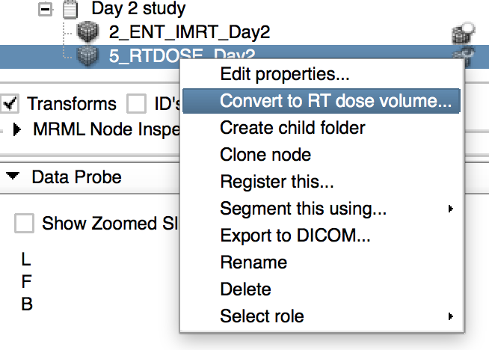
5/3: Add day two data into new study
Let’s use a modality-specific action.
1. Right-click on the volume named ‘5_RTDOSE_Day2’
2. Choose ‘Convert to RT dose volume…’
3. Click OK on both dialogs
4. Notice the icon change
© 2016, All Rights Reserved

Slide 31
Part 6: Register day two study to planning study
Allows accumulation of dose for both day’s treatment sessions
Demonstrates actions defined by Subject hierarchy plugins facilitating direct access of functions from the hierarchy
(Please ask the author about potential new actions)
© 2016, All Rights Reserved

Slide 32
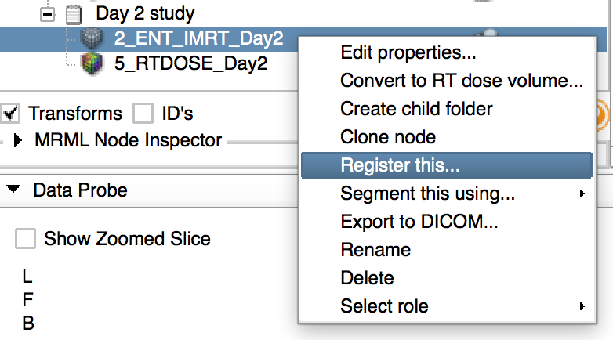
6/1: Register day two study to planning study
1. Right-click on ‘2_ENT_IMRT_Day2’
2. Select ‘Register this…’
© 2016, All Rights Reserved

Slide 33
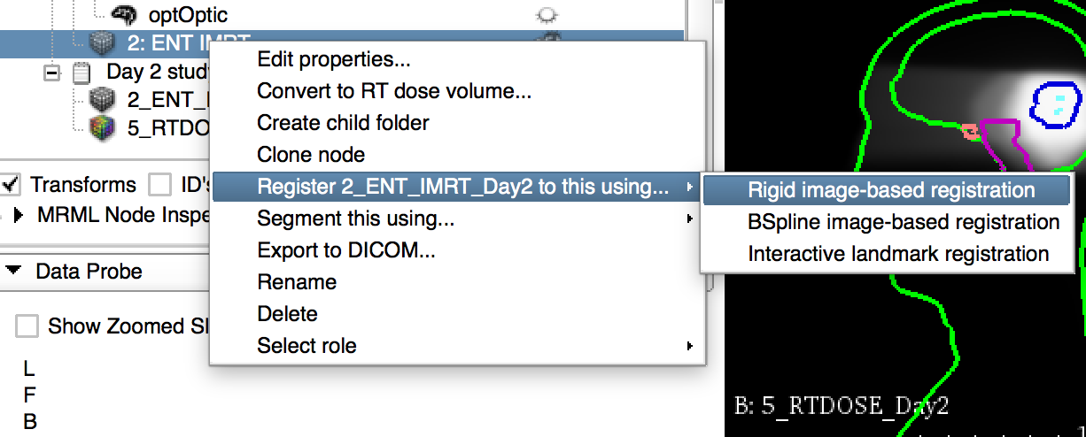
6/2: Register day two study to planning study
1. Right-click ‘2: ENT IMRT’ from the planning study
2. Go to ‘Register 2_ENT_…’
3. Select ‘Rigid image-based registration’
© 2016, All Rights Reserved

Slide 34
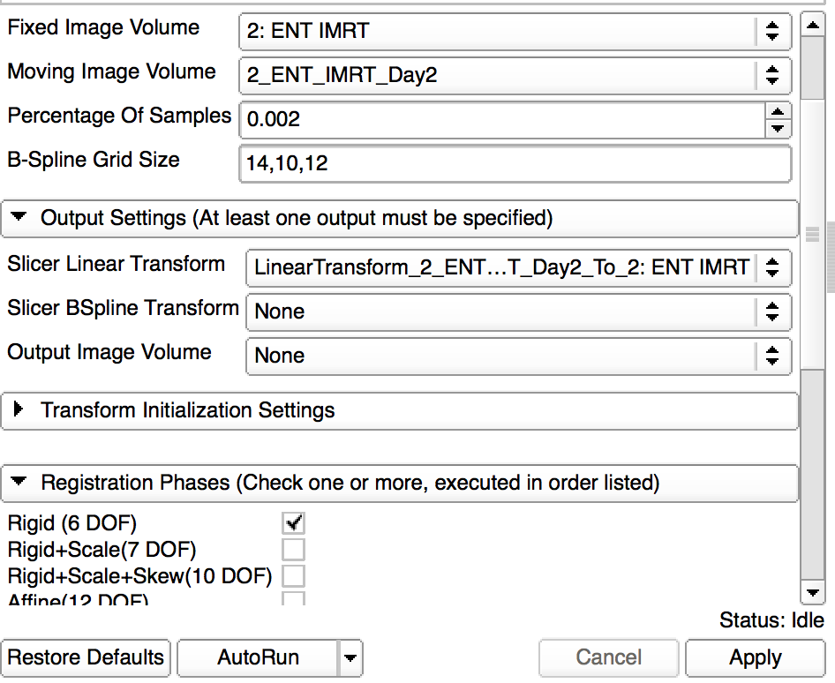
6/3: Register day two study to planning study
Notice that
- BRAINS registration module was selected
- Inputs were selected
- Output transform was created
- Rigid (6 DOF) phase was selected
1. Click Apply
© 2016, All Rights Reserved

Slide 35
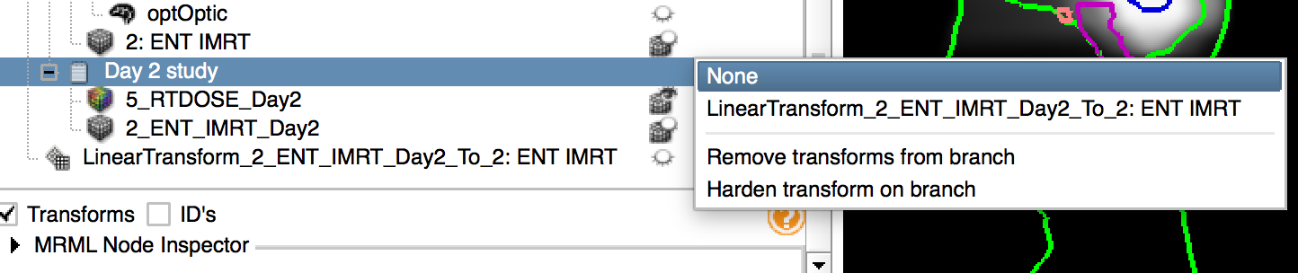
6/4: Register day two study to planning study
1. Once registration is done, switch back to Subject hierarchy
2. Notice that the transform was already applied to the CT volume
3. Double-click on the empty space in the rightmost transform column of Day 2 study
4. Open the selector by clicking ‘None’, and select the transform
© 2016, All Rights Reserved

Slide 36
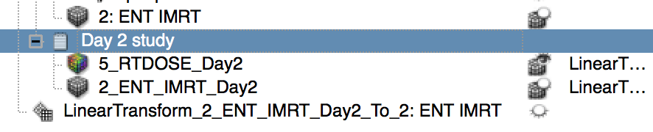
6/5: Register day two study to planning study
Notice that the transform was also set to the dose volume. Using the same action, any transform can be applied to whole branches.
This step allowed us to accumulate dose distributions for a patient delivered over two time points.
© 2016, All Rights Reserved

Slide 37
Conclusion
Subject hierarchy is a central access point to review and organize data loaded into Slicer, while offering direct access to Slicer functions.
New data types and actions can be added to Subject hierarchy.
© 2016, All Rights Reserved

Slide 38



Acknowledgments
National Alliance for Medical Image Computing
NIH U54EB005149
Cancer Care Ontario
Ontario Consortium for Adaptive Interventions in Radiation Oncology
© 2016, All Rights Reserved

