Slide 1
Dynamic management of segmented structures in 3D Slicer
Csaba Pinter, Andras Lasso, and Gabor Fichtinger
Laboratory for Percutaneous Surgery, School of Computing, Queen’s University, Kingston, ON, Canada

Slide 2
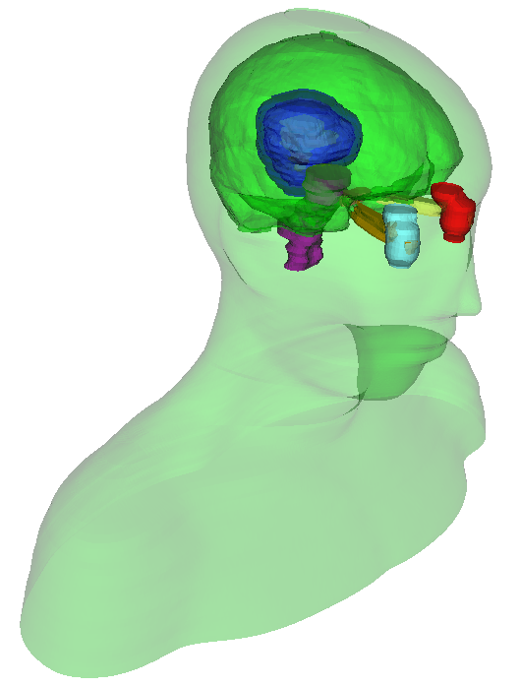
Segmentation
Also known as contouring
Delineates structures of interest
Manual contouring: Slice by slice
Automatic / semi-automatic
Omnipresent in medical imaging
Surgical/radiation therapy planning
Intra-surgery navigation
Volume/shape analysis
3D printing (interventions)
Education
Head and neck RT phantom case

Slide 3
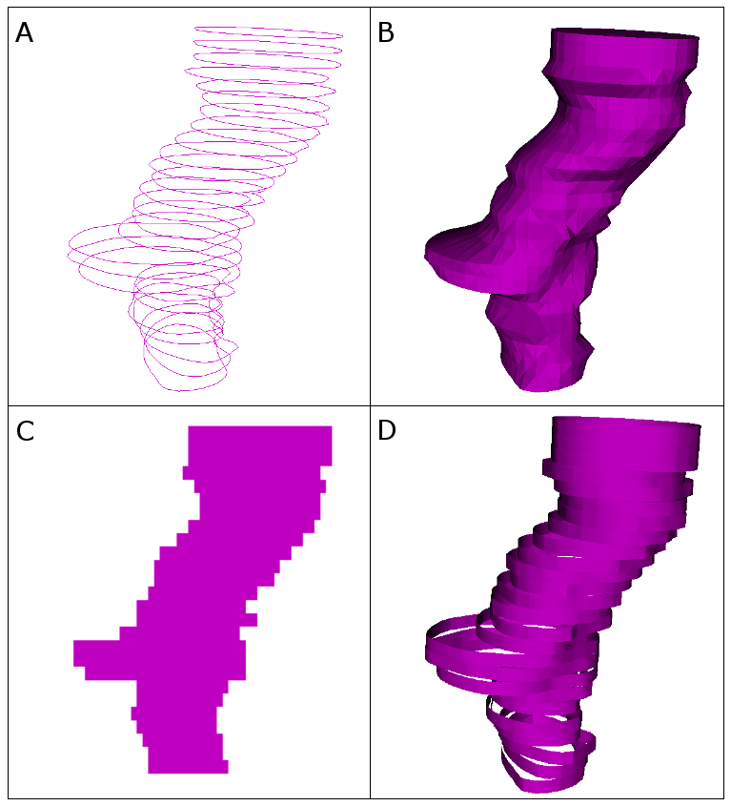
Various representations
Each optimal for
either storage (A)
or analysis (C)
or visualization (B,D)
Imposed needs
Conversion
Simultaneous
Visualization
Transformation
Typical representations: A: Contours, B: Surface, C: Image, D: Ribbons

Slide 4
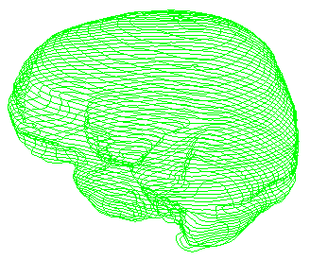

Difficulty #1: Operation
Operation
User needs to be aware of the need for conversion, and also
How to perform it
Brain
Analysis ?
Volume
Surface area
Dose volume histogram
Dice coefficient
…
Brain
Analysis ✓
Notes:
Want to perform analysis on brain.
Need to convert to image so that analysis can be done. The user needs to know this.

Slide 5


Difficulty #2: Identity
Operation
Brain
Tumor
Identity
Need to keep track of where the structures came from and what they represent
? origin ?
(provenance)
Brain1
Tumor1
? identity ?

Slide 6

Difficulty #3: Validity
Operation
Brain (contour)
Tumor (contour)
Identity
?
Validity
No invalid data should be accessible at any time
Brain (image)
Tumor (image)

Slide 7
Difficulty #4: Coherence
Patient
Operation
Patient
Brain (contour)
Tumor (contour)
Identity
Validity
Brain (image)
?
Coherence
Forming a unified whole
Notes:
“the quality of forming a unified whole”

Slide 8
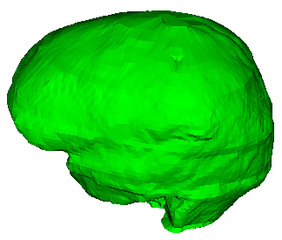

Segmentation “object”
Patient
1 segmentation contains N segments (structures)
Coherence ✓
Patient
Brain
Brain (contour)
Tumor
Tumor (contour)
Each segment contains multiple representations
Identity ✓
Provides automatic conversions
Operation ✓

Slide 9



Master representation
“Promoted” representation
Patient
Conversions use it as source
Tumor
image
When changed, the other representations are cleared
And re-converted as needed
When saving to disk, this representation is written
surface
Solves Validity ✓
Notes:
Most commonly the representation the data was acquired or stored in the first place
The representation most genuinely contains the data

Slide 10
Automatic conversion
Driven by a dynamic graph
Nodes are the representations
Edges are the converters
Can be dynamically added
Can define representations
Cost metrics for edges
Automatic conversion follows cheapest path
Happens when an absent representation is requested
Ribbon
1.5
Contours
2.5
3.5
Binary image
2.5
Surface
2.0
2.0
Fractional image
4.0

Slide 11


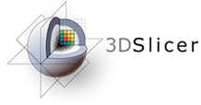



Implementation
Software library SegmentationCore
Contains all the listed features
Uses only the VTK library
Can be integrated in many applications
Segmentations module in SlicerRT
Advanced conversion options
Simultaneous real-time transformation
Advanced visualization in 2D and 3D
Extension of the 3D Slicer platform
W. Schroeder et al. 2006
C. Pinter et al. 2012
A. Fedorov et al. 2012
Notes:
+ Segment editor tool for contouring directly into a segmentation object
+ Storage capabilities to DICOM and to research file formats
+ Advanced memory management by only storing the effective extent (excluding most of the empty background)
+ Automatic opacity calculation for better 3D visualization

Slide 12
Architecture: 36 classes (C++)
vtkMRMLLabelMapVolumeNode
Slicer MRML
VTK storage
VTK logic
N
vtkMRMLSegmentationNode
vtkSegmentation
vtkSegment
SegmentationDisplayNode
SegmentationStorageNode
vtkSegmentationConverter
vtkOrientedImageData
N
vtkSegmentationConverterFactory
vtkSegmentationConverterRule
vtkOrientedImageDataResample
Module and widget
Displayable managers
Converter roles
Subject hierarchy plugins
vtkClosedSurfaceToBinaryLabelmapConversionRule
...

Slide 13
Example use case: MRI/US fusion for prostate HDR brachytherapy

Slide 14


Example use case: Finding most similar RT plan in the cloud
Initialize daily adaptive RT plan from most similar one
By geometrical similarity based on segmentation comparison
Highly parallel computations
Very large amount of data
Self-driven scripts in cloud
Andrea et al., IUPESM World Congress 2015
Scripted analysis
Local control

Slide 15


Future work
Fractional image representation
More efficient storage of structures
Enables using stochastic methods
Integration into 3D Slicer core
Ontologies support
Hierarchical organization of structures
Standard ontologies used in clinics
Binary image
Fractional image

Slide 16



Thank you for your attention!

Slide 17
Appendix

Slide 18
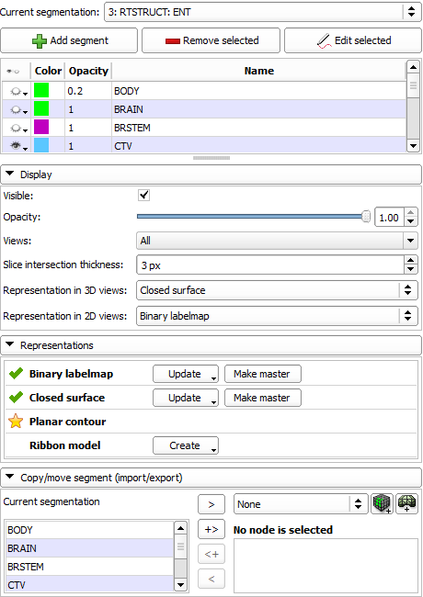
Segmentations user interface
Managing segments and their properties
Advanced display options
Explicit handling of representations
Convenient import/export

Slide 19
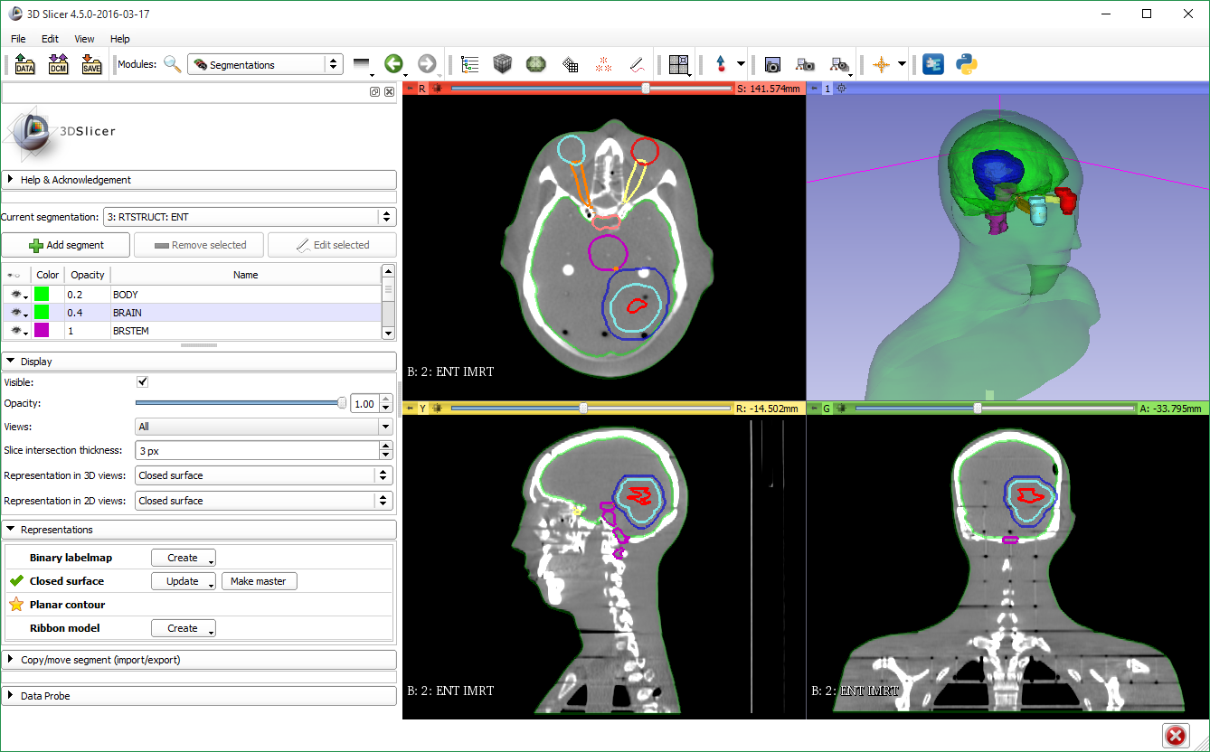

Slide 20
Difficulties with conversion
Operation: User needs to know that conversion is needed, and how to perform the conversion
Identity: Relationships between converted objects need to be preserved to be able to determine their origin and identity
Validity: When a representation changes, the others need to follow, otherwise invalid data is accessible
Coherence: Structures belonging together must be converted together to contain the same data types

