Slide 1
Tutorial: Dose surface histogram calculation
Csaba Pinter
Laboratory for Percutaneous Surgery, Queen’s University, Kingston, ON, Canada

Slide 2
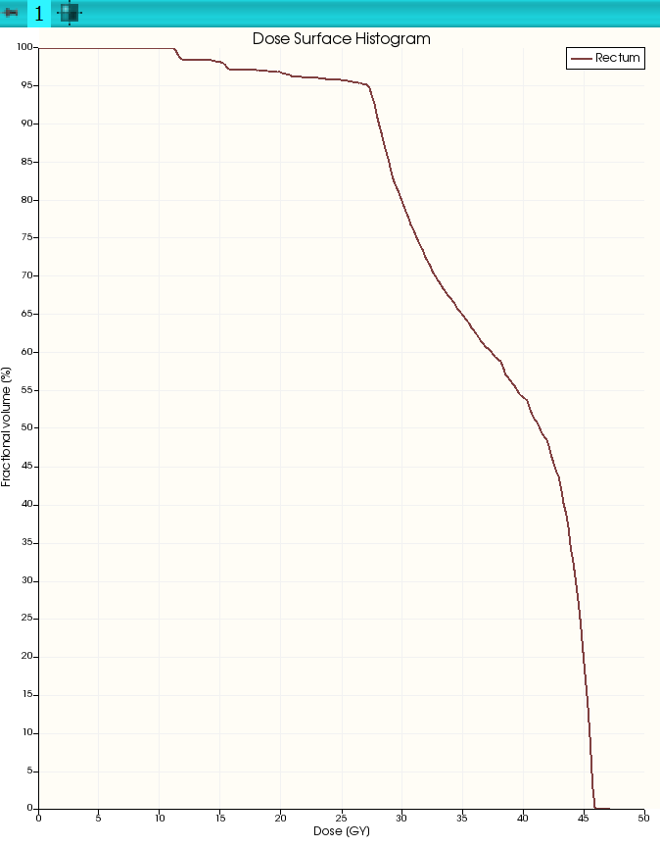
Learning objective
This tutorial demonstrates how to compute dose surface histogram for a structure set from a dose volume.
Computed dose surface histogram

Slide 3
Overview
Install required software
Load data from DICOM (structure set and dose volume)
Calculate dose volume histogram

Slide 4
1/1. Install 3D Slicer
Download 3D Slicer preview from https://download.slicer.org/
Find the downloaded 3D Slicer package on your computer
Follow the usual steps to install an application
Different for each operating system

Slide 5
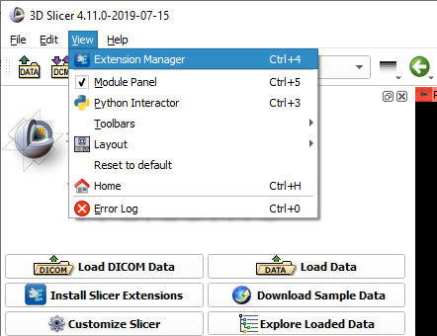

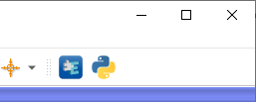
1/2. Install SlicerRT extension
or

Slide 6
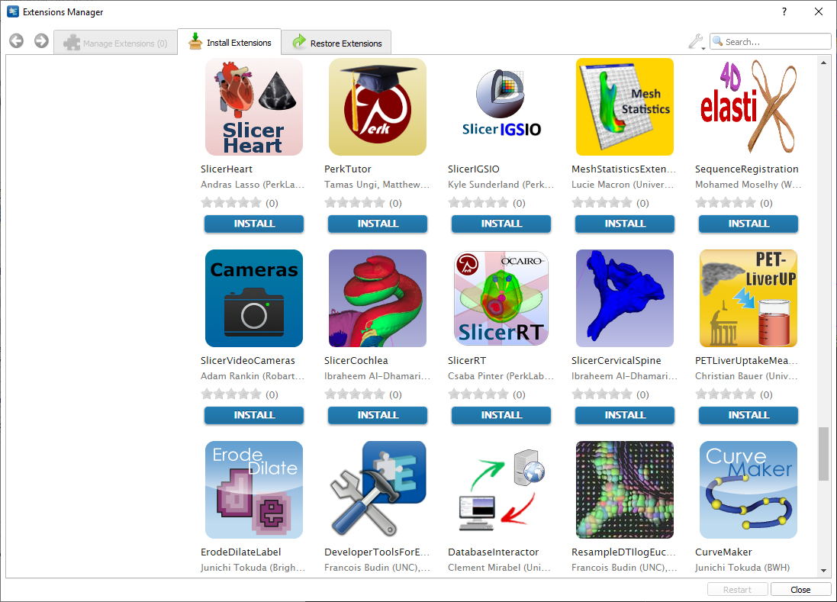
1/3. Install SlicerRT extension

Slide 7
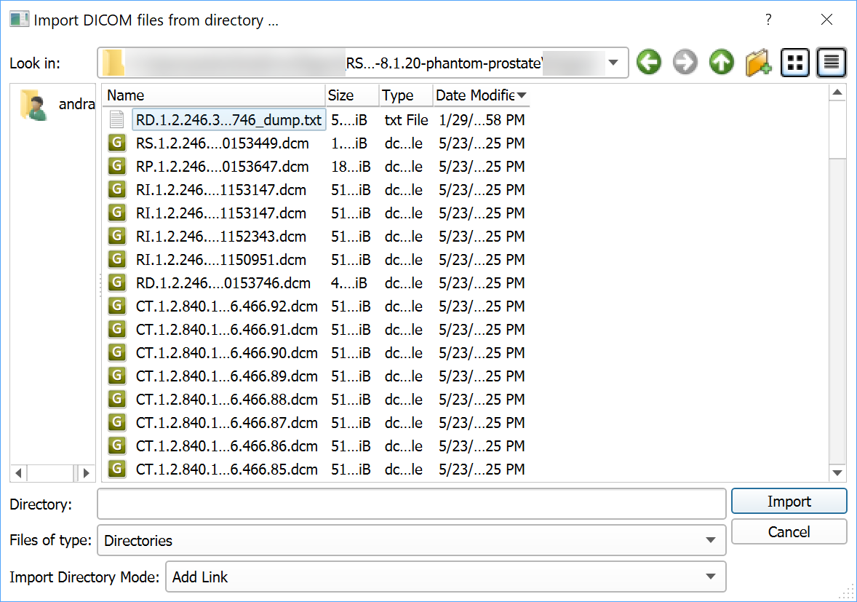
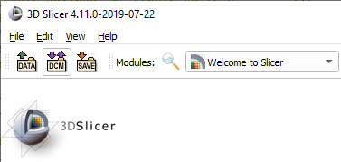
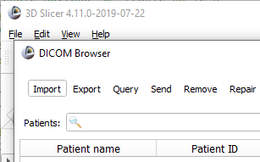
2/1. Import DICOM dataset

Slide 8
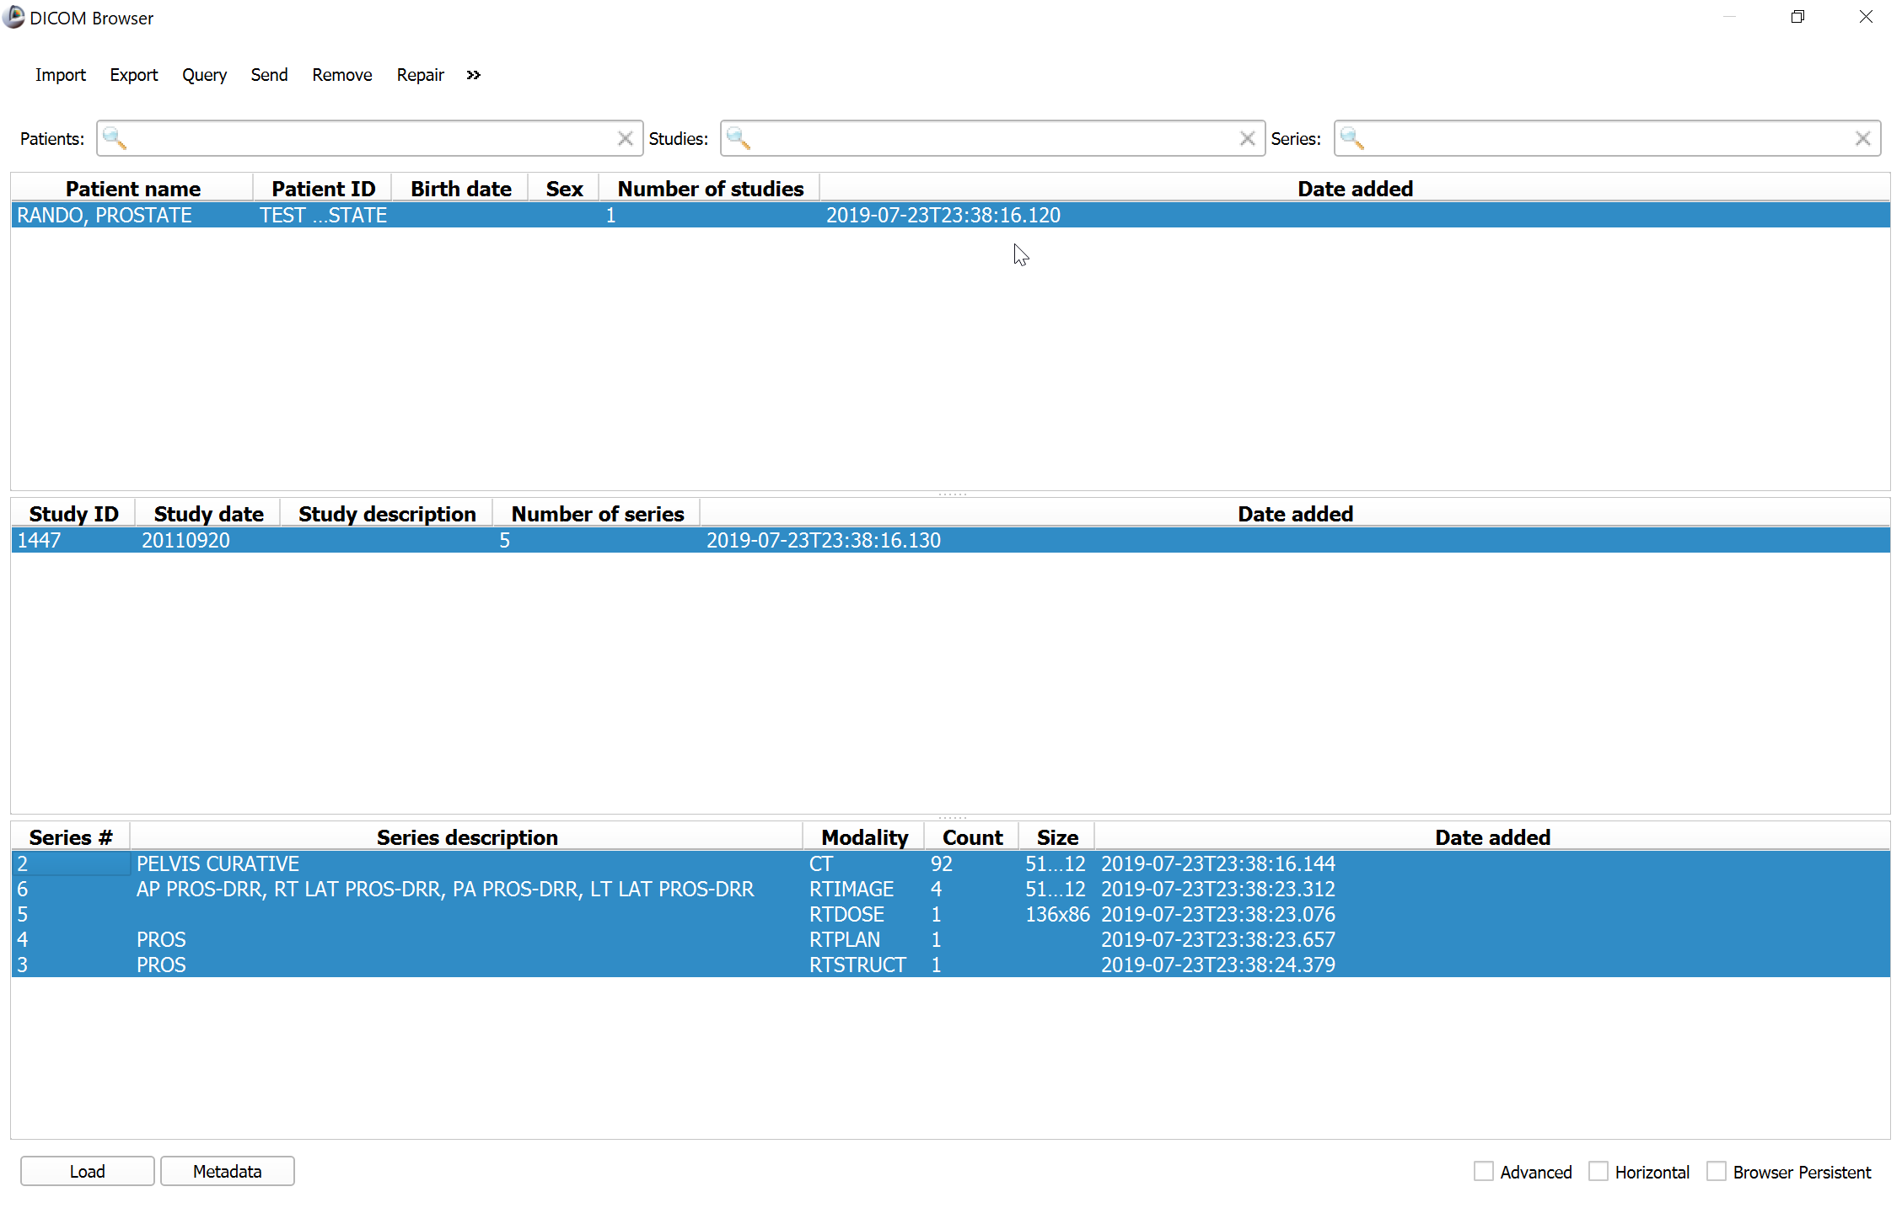
2/2. Load DICOM dataset

Slide 9
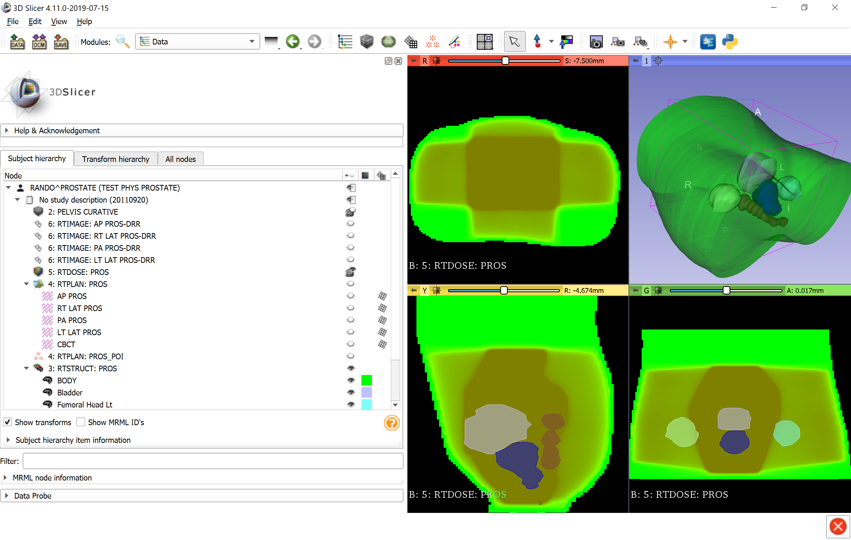
2/3. Data loaded
Phantom data loaded
Switch to Data module to check loaded objects

Slide 10
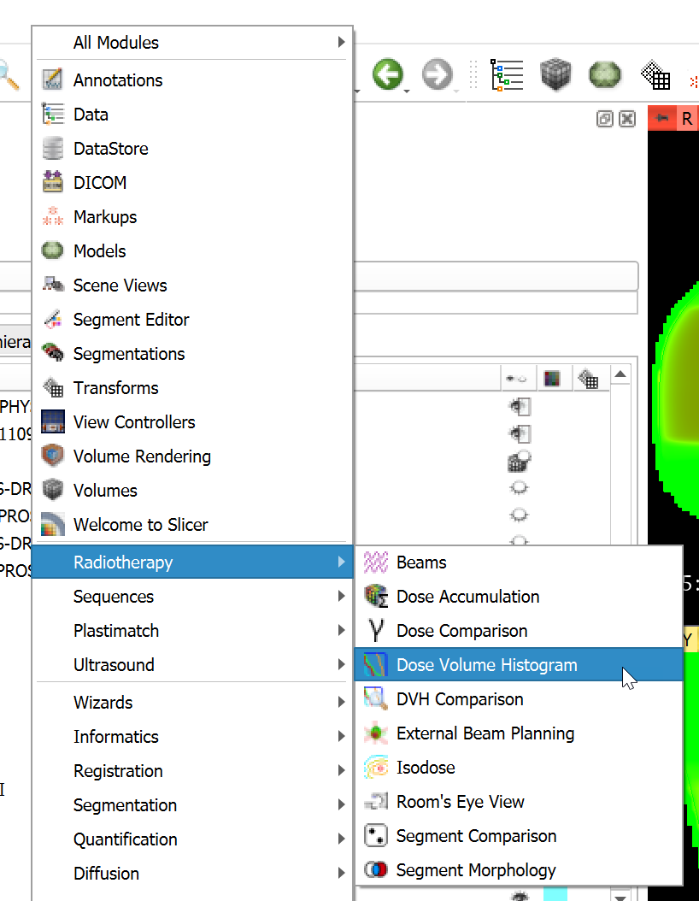
3/1. Switch to Dose Volume Histogram module

Slide 11
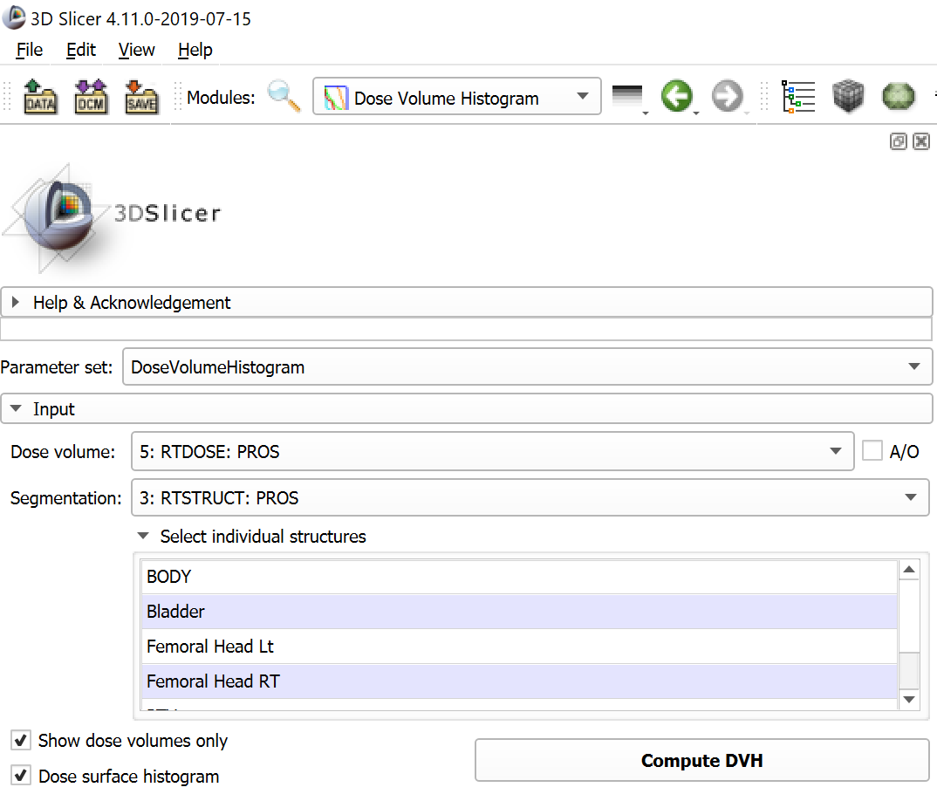
3/2. Set inputs and compute
Select dose volume and segmentation
Click “Compute DVH” to start computation
Enable “Dose surface histogram”

Slide 12
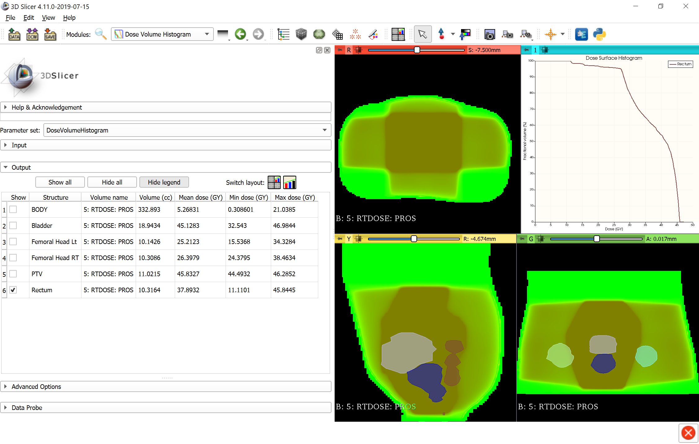
3/3. Output dose is visualized
Dose surface histogram metric table
Dose surface histogram plot
Click to show dose surface histogram plot

Slide 13

Congratulations!

