Slide 1
Tutorial: Orthovoltage radiation therapy dose calculation
Csaba Pinter
Laboratory for Percutaneous Surgery, Queen’s University, Kingston, ON, Canada

Slide 2
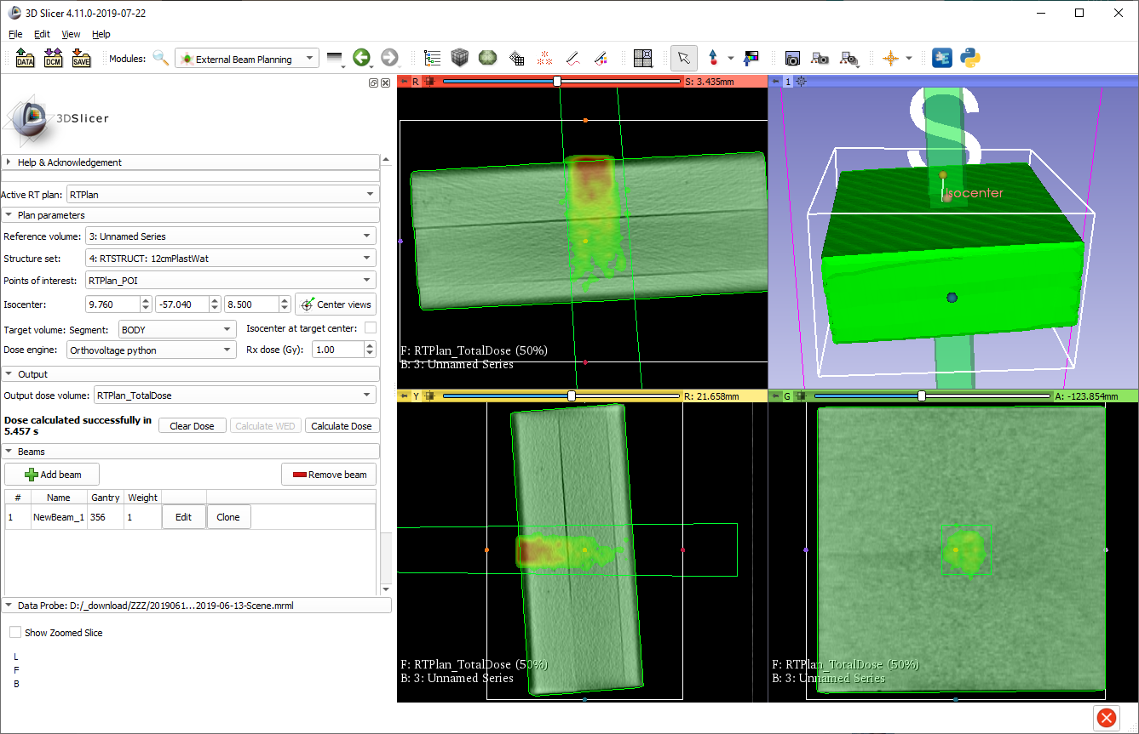
Learning objective
This tutorial demonstrates how to create an orthovoltage radiation therapy plan and calculate dose distribution.
Computed approximated orthovoltage dose

Slide 3
Overview
Install required software
Load data from DICOM
Create treatment plan
Setup orthovoltage engine parameters
Calculate dose

Slide 4
1/1. Install 3D Slicer
Download 3D Slicer preview from https://download.slicer.org/
Find the downloaded 3D Slicer package on your computer
Follow the usual steps to install an application
Different for each operating system

Slide 5
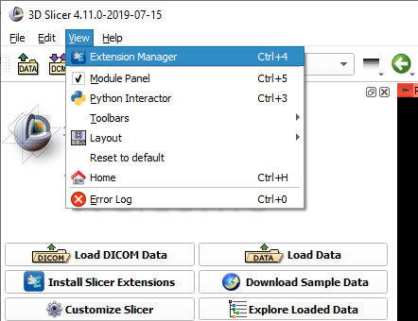

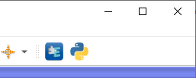
1/2. Install SlicerRT extension
or

Slide 6
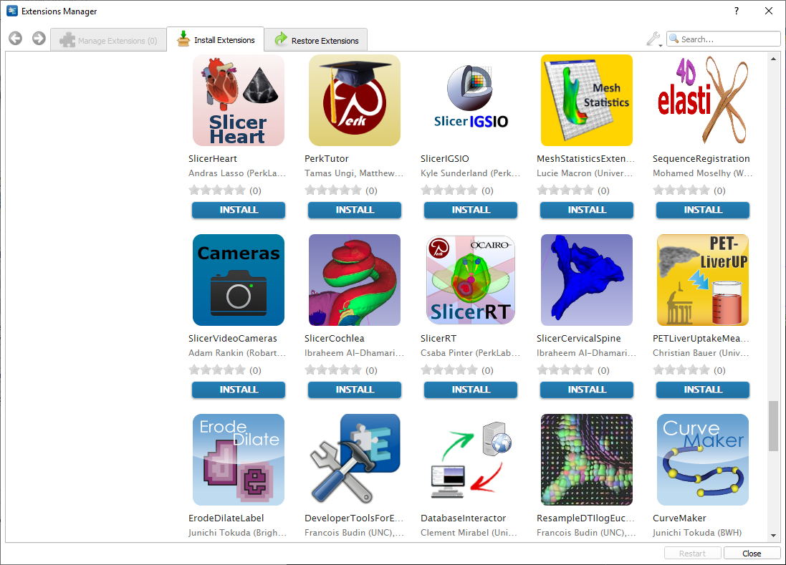
1/3. Install SlicerRT extension

Slide 7
1/4. Install EGSnrc
Follow the instructions on the EGSnrc wiki page: https://github.com/nrc-cnrc/EGSnrc/wiki/install-EGSnrc-on-windows

Slide 8
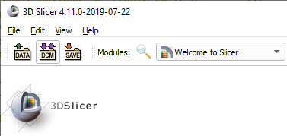
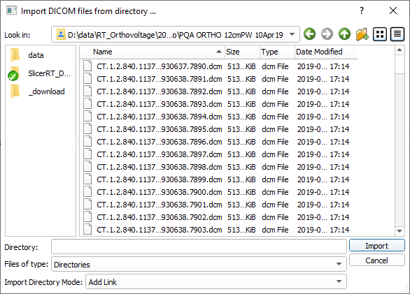
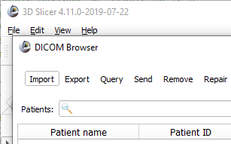
2/1. Import DICOM dataset

Slide 9
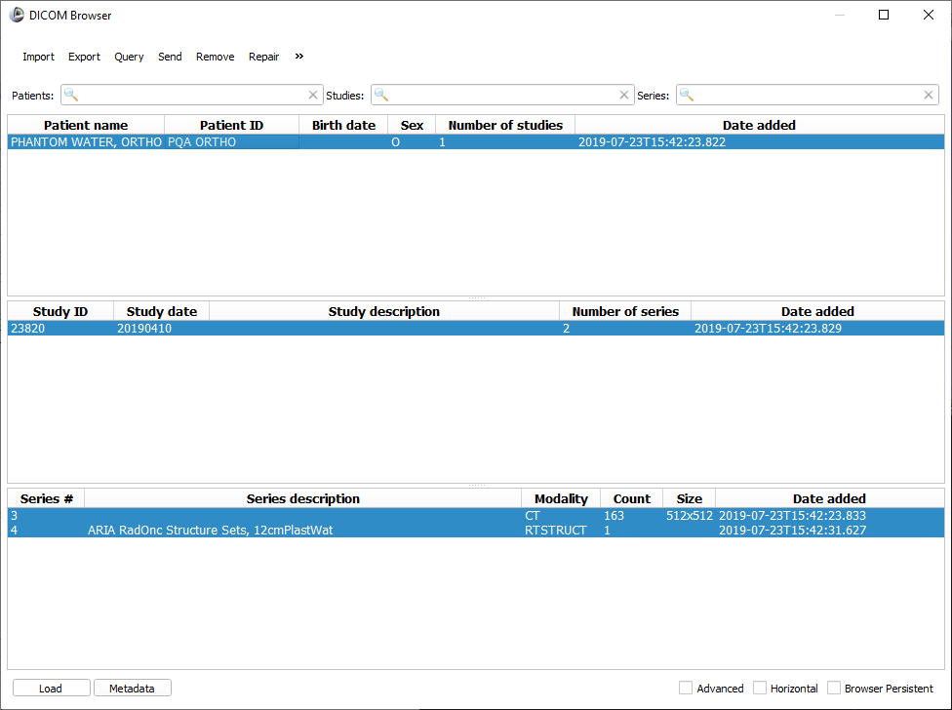
2/2. Load DICOM dataset

Slide 10
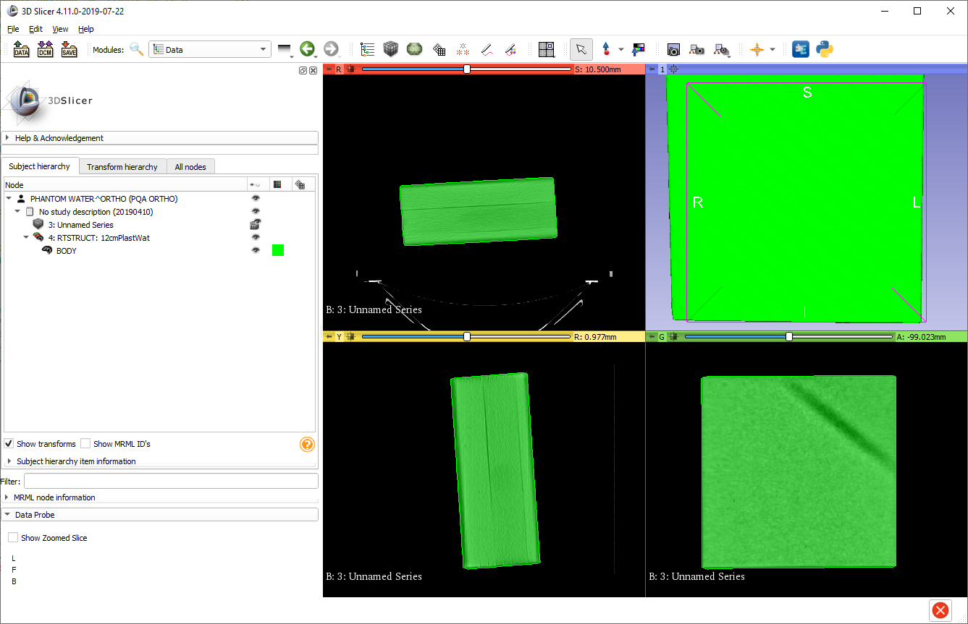
2/3. Data loaded
Phantom data loaded
Switch to Data module to check loaded objects

Slide 11
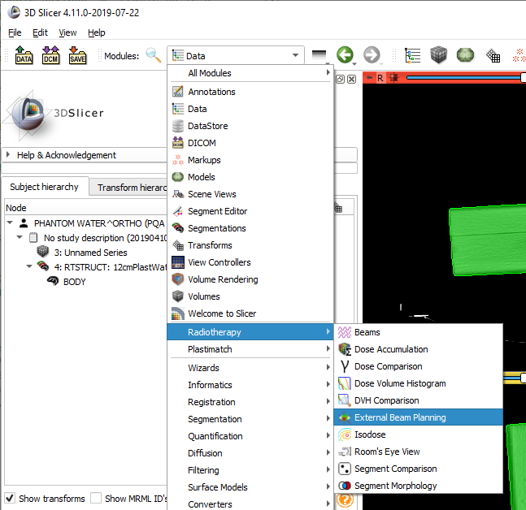
3/1. Switch to planning module

Slide 12
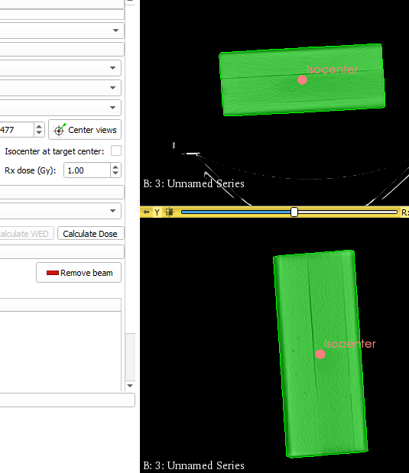

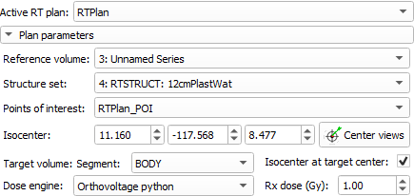
3/2. Create and setup plan
1. Disable automatic isocenter placement 2. Drag&drop isocenter
Select CT, segmentation, target, dose engine, and set prescription

Slide 13


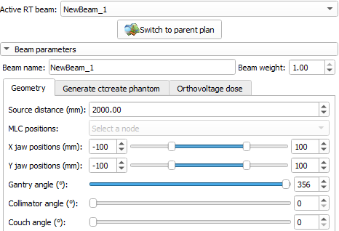
3/3. Create and setup beam
Clicking the Edit button switches to the Beams module
Set geometry

Slide 14

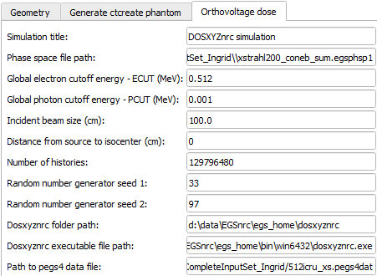
4/1. Set EGSnrc paths and inputs
Phase space file contains properties of incident particles from source. It is different for each machine and energy, and needs to be created individually.

Slide 15
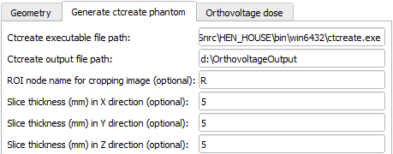
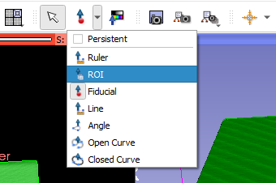
4/2. Set ‘phantom’ parameters
2
2
2
1
1
1
‘Phantom’ is EGSnrc’s file format for the CT
1. Set sensible voxel size so the input size does not exceed limits
Optional: Create ROI to restrict the area of the CT that participates in dose computation

Slide 16
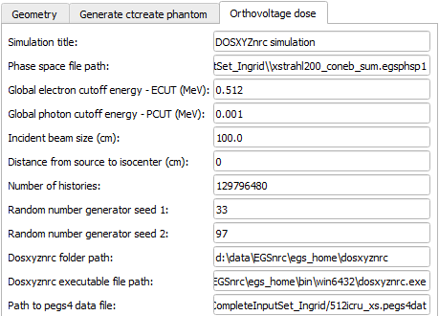
4/3. Set dose parameters
Change dose parameters as necessary.
For approximated dose calculations (while geometry etc. is being finalized), decrease “Number of histories” for faster computation.

Slide 17
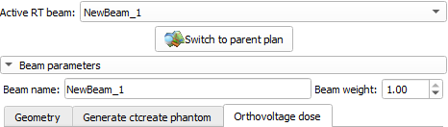

5/1. Calculate dose

Slide 18
5/2. Output dose is visualized

Slide 19

Congratulations!

