Slide 1
Tutorial: Isocenter shifting image-guidance in SlicerRT
Csaba Pinter¹, Andras Lasso¹, An Wang², Gregory C. Sharp³, David Jaffray², and Gabor Fichtinger¹
¹Laboratory for Percutaneous Surgery, Queen’s University, Kingston, ON, Canada ²University Health Network, Toronto, ON, Canada
³Department of Radiation Oncology, Massachusetts General Hospital, Boston, MA, USA

Slide 2
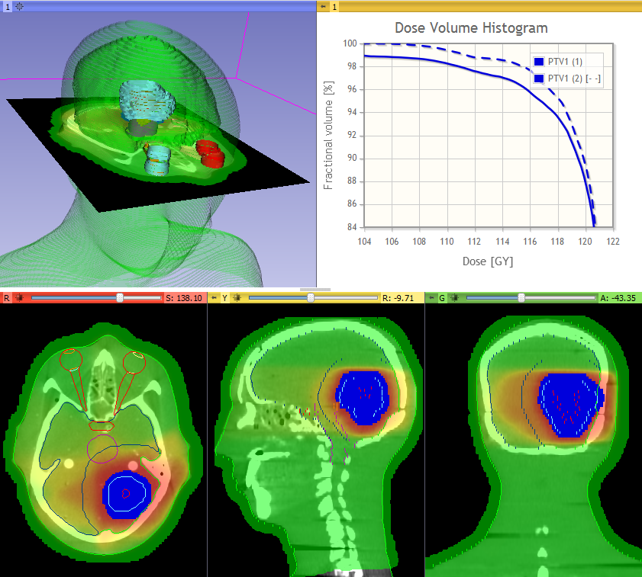
Learning objective
This tutorial demonstrates how to perform a radiation therapy research workflow using the SlicerRT toolkit:
Isocenter shifting image-guidance
Isocenter shifted and uncorrected DVH of the PTV

Slide 3



Material
Dataset available on the Slicer Training page: https://www.slicer.org/wiki/Documentation/Nightly/Training#Slicer4_Radiation_Therapy_Tutorial
Supported platforms: Windows, Mac OSX, Linux
32-bit is not supported!

Slide 4
Overview
Install SlicerRT extension
Load data from DICOM and nrrd files
Perform rigid registration on CT images
Transform day 2 dose volume
Accumulate dose distributions
Compute dose volume histogram
+1. Create isodose lines and surfaces
+2. Compare dose distributions using gamma

Slide 5
1/1. Install 3D Slicer
Download latest 3D Slicer from http://download.slicer.org
Follow the usual steps to install an application
Different for each operating system

Slide 6
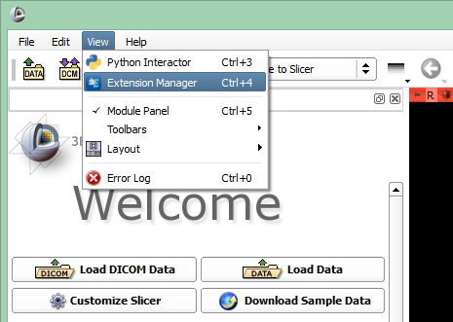

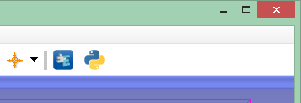
1/2. Install SlicerRT extension
or

Slide 7
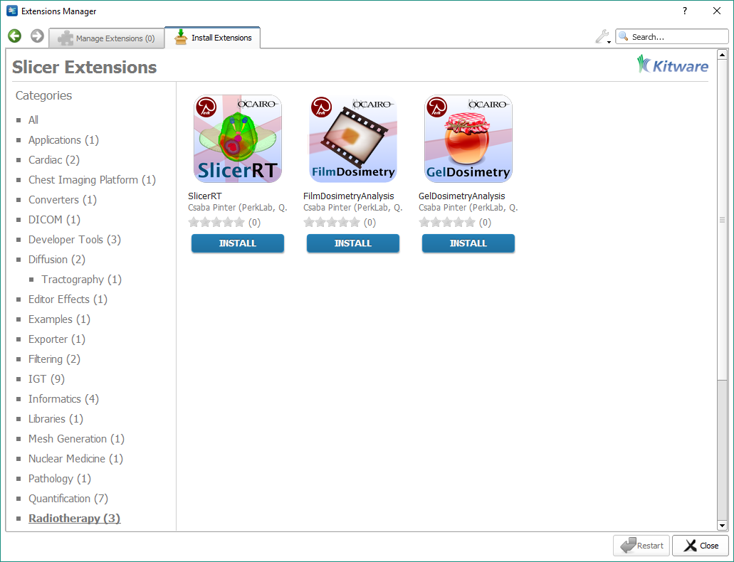
1/3. Install SlicerRT extension

Slide 8
2/1. Unpack tutorial datasets
Find the dataset you downloaded named SlicerRT_WorldCongress_TutorialIGRT_Dataset.zip
Unpack it to a local folder of your choice
Different for each operating system
Notes:
ENT RANDO phantom dataset and simulated day 2 CT and dose

Slide 9
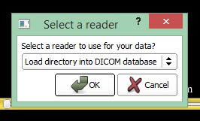
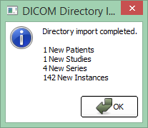
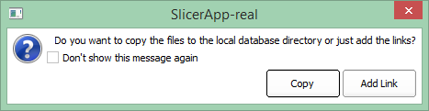
2/2. Import planning DICOM data
Drag&drop folder named EclipseEntPhantomRtData onto Slicer
You’ll be prompted for database folder here

Slide 10

Note
If not importing via drag&drop, DICOM data can be imported and loaded from the DICOM browser that can be opened from the toolbar

Slide 11
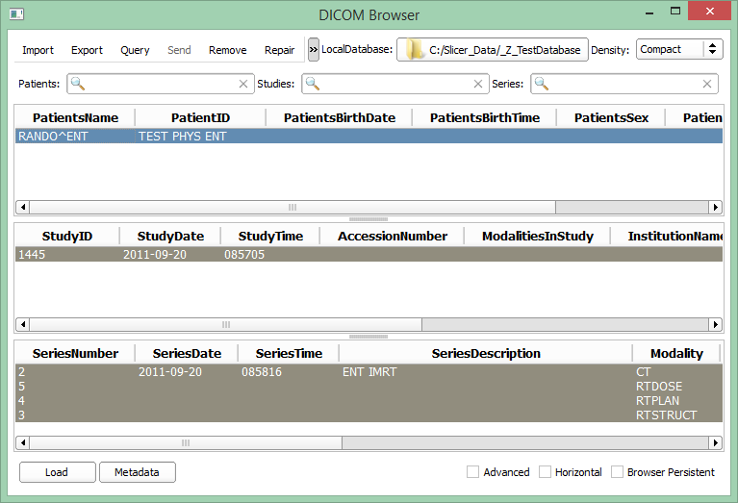
2/3. Load planning study
1. Click patient ‘RANDO ENT’
2. Click ‘Load’

Slide 12
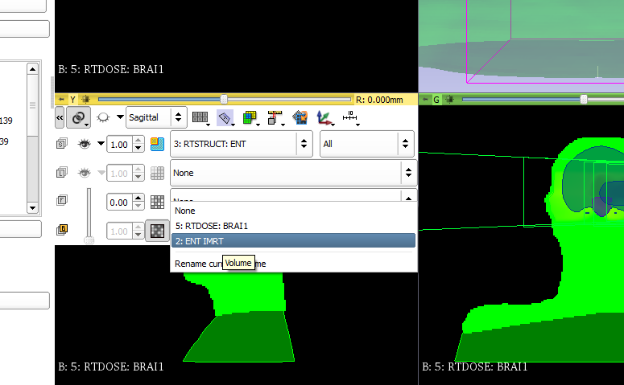
2/4. Change shown volumes
1. Open slice controls
2. Link slices together
3. Choose shown volume to CT: ‘2: ENT IMRT’

Slide 13
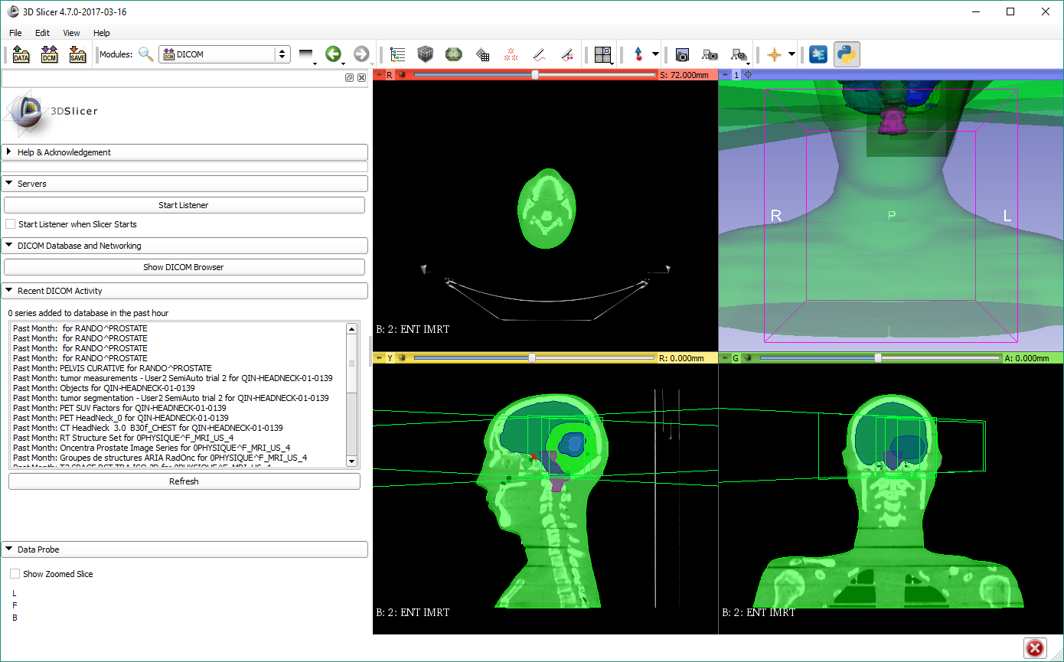
2/5. Tweak display
1. Reset 3D view
3. Adjust window/level
Click&drag left button
2. Manipulate 3D view
Rotate with left button
Zoom with right button
4. Navigate slice view
Change slice by scrolling
Zoom with right button
Pan with middle button (Shift+click&drag on Mac)

Slide 14
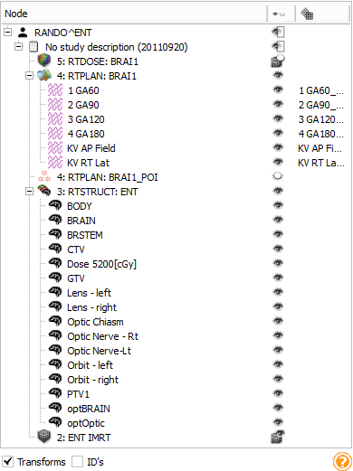

2/6. Explore loaded data
Subject hierarchy:
Explore data in tree view
Show/hide branches clicking the eye buttons
Access options by right click

Slide 15
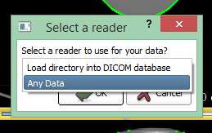
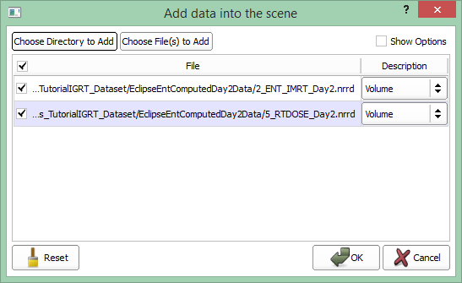
2/7. Load day 2 data
Drag&drop folder named EclipseEntComputedDay2Data onto Slicer

Slide 16


Note
Data type selection dialog does not appear if you drag&drop files rather than folders, as files will be handled as non-DICOM
Non-DICOM data can be also loaded in the dialog that appears after clicking
Data can be saved using

Slide 17
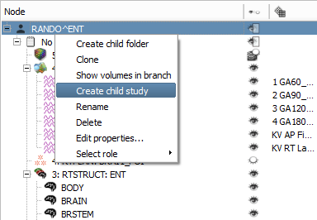
2/8. Add day 2 non-DICOM data to subject hierarchy
1. Right-click the patient
2. Create child study
3. Right-click (or double-click) new study item
4. Rename to ‘Day 2’

Slide 18
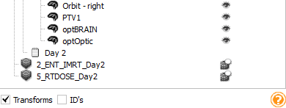
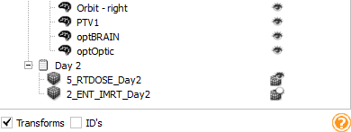
2/9. Add day 2 non-DICOM data to subject hierarchy
1. Drag&drop ‘2_ENT_IMRT_ Day2’ on the study ‘Day 2’
2. Do the same with ‘5_RTDOSE-Day2’
Note: You can select both nodes while holding the Control/Cmd or Shift button, then drag&drop both at the same time

Slide 19
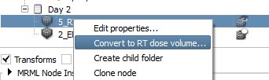
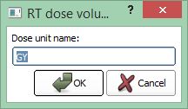
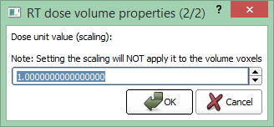

2/10. Convert day 2 dose volume actually a dose

Slide 20
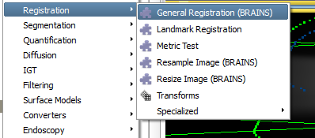
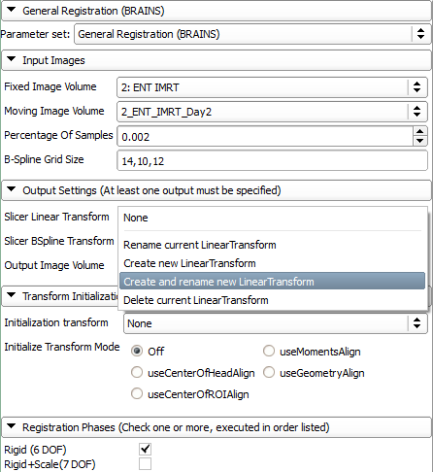
3/1. Register CT volumes
1. Go to module Registration / General Registration (BRAINS)
Set up parameters as shown: 2. Choose ‘2: ENT_IMRT’ as fixed image 3. Choose day 2 CT ‘2_ENT_
IMRT_Day2’ as moving image 4. Create linear transform
and rename it to
Transform_Day2ToDay1_Rigid 5. Choose ‘Rigid (6 DOF)’
6. Click ‘Apply’

Slide 21
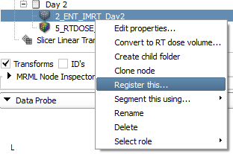
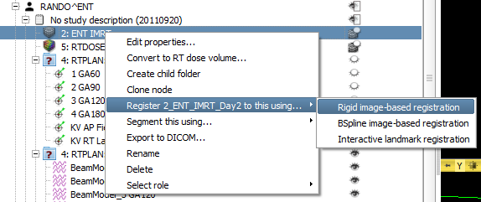
Note
You can also initiate registration from subject hierarchy (alternative way for previous step):

Slide 22
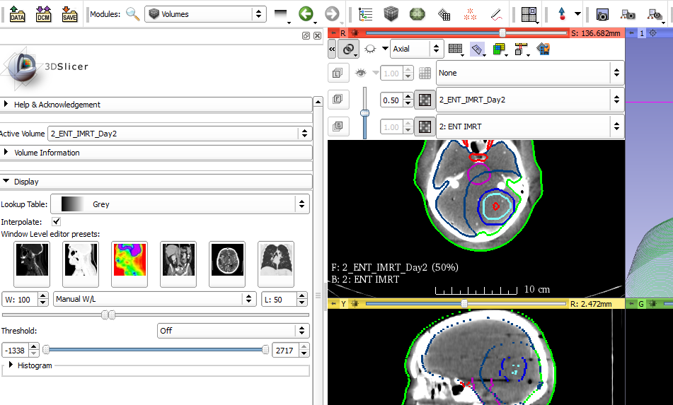
3/2. Explore volume differences
1. Open slice layers ‘>>’
2. Set volume on foreground layer
3. Change foreground opacity
Optional: Set the same W/L in Volumes module

Slide 23
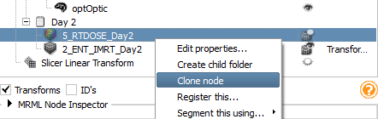
4/1. Clone dose volume
To be able to compare the non-registered (= uncorrected) and the registered (= isocenter shifted) results.
1. Switch to Subject hierarchy
2. Select ‘Clone node’ in context menu for day 2 dose
3. Rename it to ‘5_RTDOSE_Day2 Rigid’

Slide 24
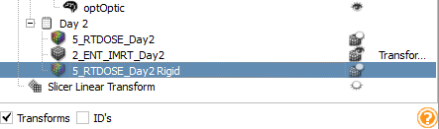
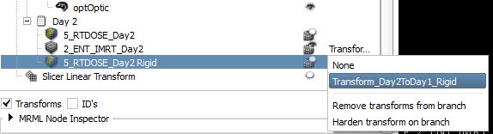
4/2. Transform cloned dose volume
1. Double-click transform column of cloned dose
2. Click ‘None’ to open drop-down

Slide 25

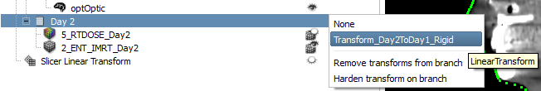
Note
We can transform the whole study too if we want to transform multiple objects (an alternative way for previous step):
1. Double-click transform column of study
2. Click ‘None’ to open drop-down

Slide 26
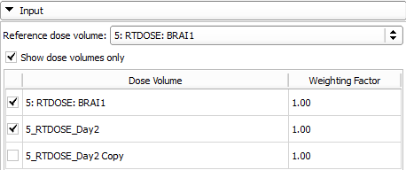
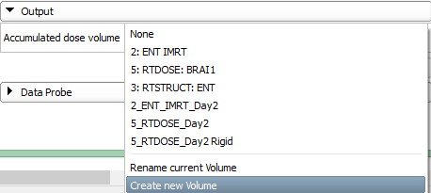
5/1. Accumulate dose distributions
1. Go to module Radiotherapy / Dose Accumulation
2. Choose reference, then planning and day 2 dose volumes
3. Create output volume
4. Click ‘Apply’

Slide 27
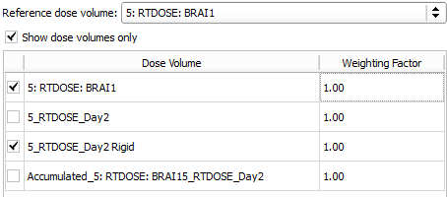
5/2. Accumulate dose distributions
1. Uncheck day 2 dose volume
2. Select registered day 2 dose
3. Create new output volume
4. Click ‘Apply’

Slide 28
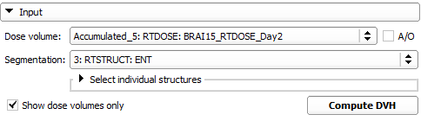
6/1. Compute DVH for unregistered
1. Go to module Radiotherapy / Dose Volume Histogram
2. Choose unregistered accumulated dose
3. Choose ‘3: RTSTRUCT: ENT’
Optional: Choose individual structures to speed up computation
4. Click ‘Compute DVH’

Slide 29
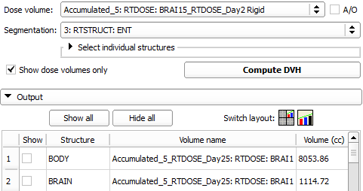
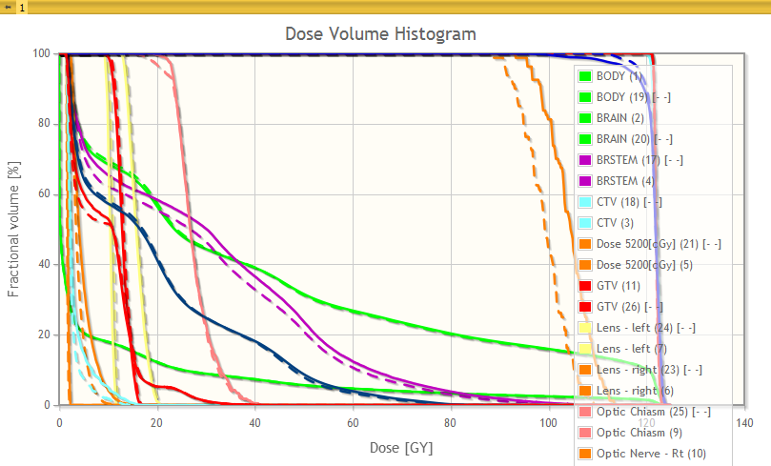
6/2. Compute DVH for registered
1. Choose registered accumulated dose
2. Click ‘Compute DVH’
3. Click ‘Show all’
DVH curves appear

Slide 30
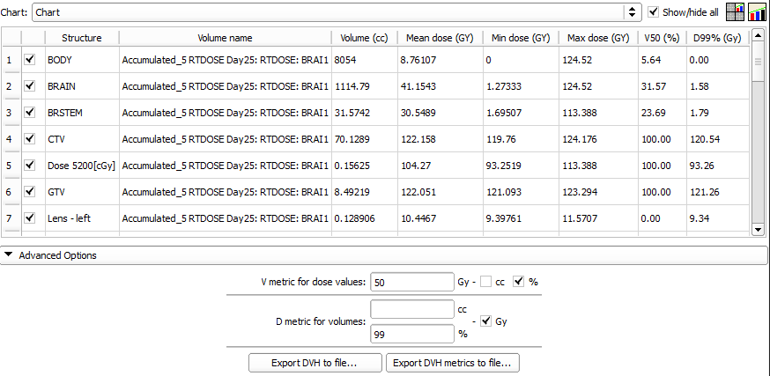
6/3. Quantify improvement

Slide 31
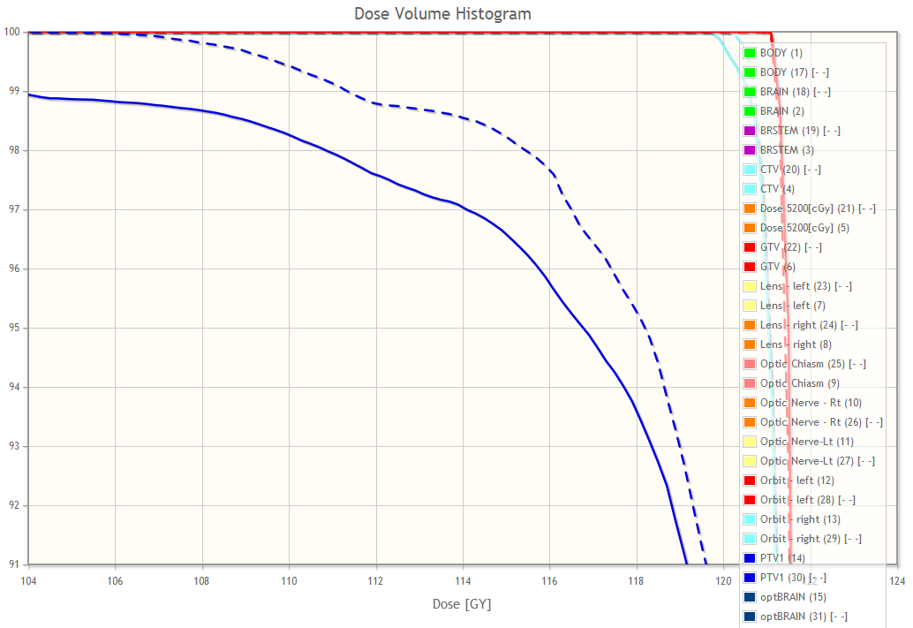
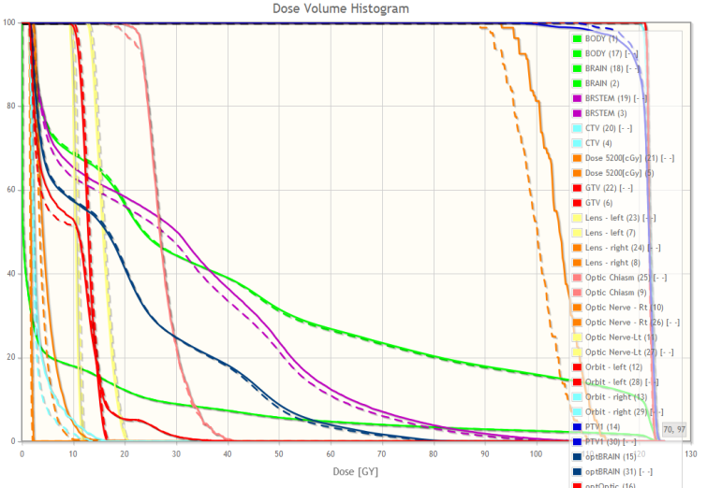
6/4. Visualize improvement
Zoom using left mouse button click&drag
(Reset zoom: double left-click)

Slide 32

Congratulations!
Thanks for attending!

Slide 33
Appendix: Optional steps for IGRT

Slide 34
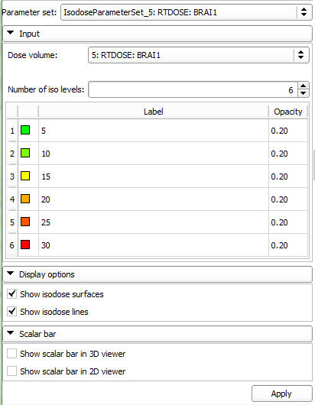
Optional 1/1. Isodose lines/surfaces
1. Choose Radiotherapy / Isodose module
3. Select ‘5: RTDOSE: BRAI1’ volume as Dose volume
2. Click Apply
3. Select ‘5_RTDOSE_Day2’ volume as Dose volume
4. Click Apply

Slide 35
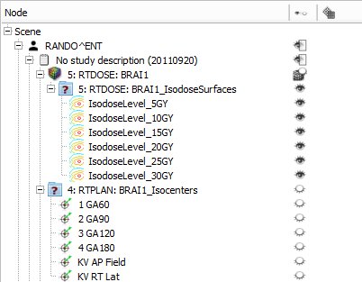
Optional 1/2. Visualize isodose lines
1. Switch to Subject Hierarchy
2. Turn on and off visualization of isodose line and surface groups by clicking the eye icon next to the parent node
Note: Display volumes in the 2D viewers by clicking the volume show/hide icon next to the volumes

Slide 36
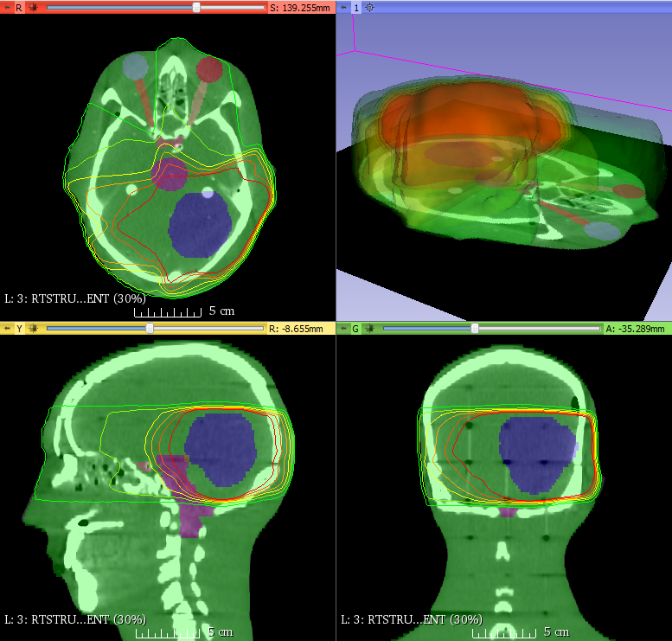
Optional 1/3. Isodose lines/surfaces

Slide 37
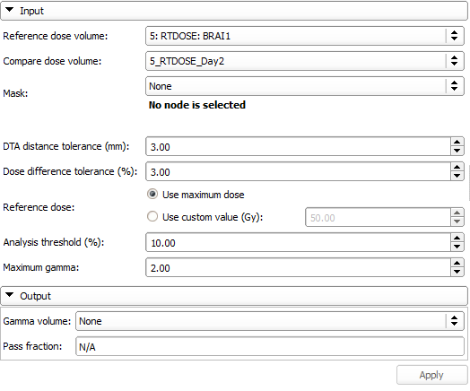
Optional 2/1. Compare dose volumes using gamma comparison
1. Go to module Radiotherapy / Dose Comparison
2. Set input volumes you want to compare
3. Create new output gamma volume
4. Click ‘Apply’

Slide 38
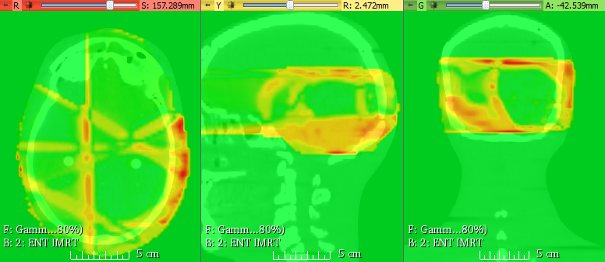
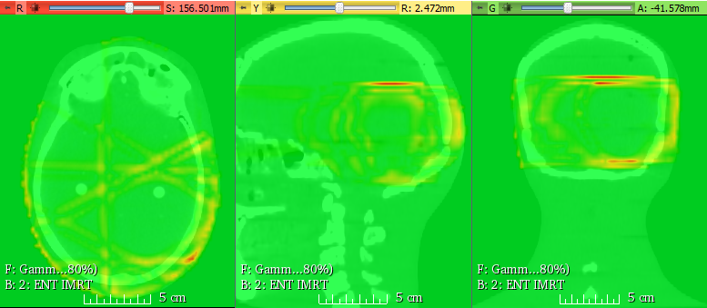
Optional 2/2. Evaluate improvement
Plan dose vs
Uncorrected Day 2 dose
Plan dose vs
Corrected Day 2 dose

