Slide 1
Next item on agenda
Acquire and build SlicerRT (on an existing Slicer)
Use python console in Slicer

Slide 2
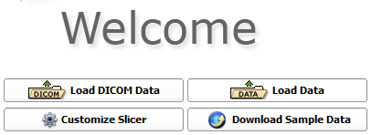
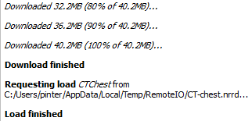
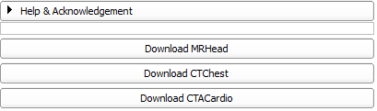
Launch Slicer and load data
cd ~/Support/Slicer4-SuperBuild-Debug/Slicer-build
./Slicer
Notes:
Open new terminal tab: Ctrl+Shift+T
Switching between tabs: Alt+[tab#]

Slide 3
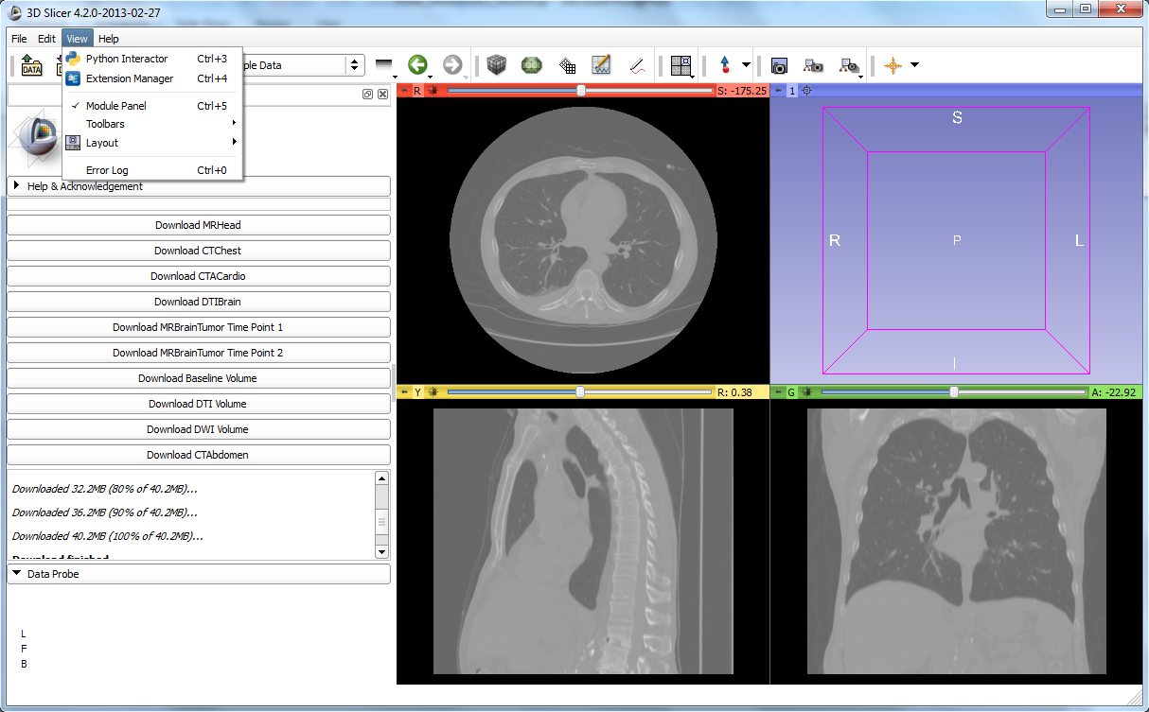
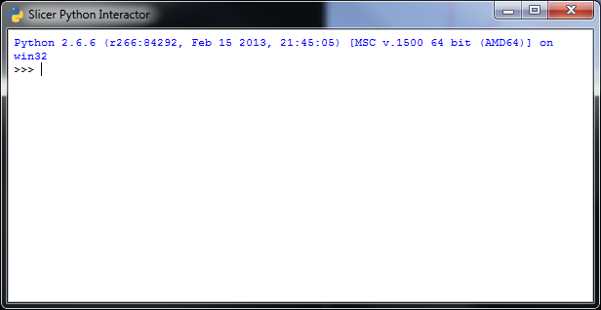
Introducing the python console

Slide 4
Accessing the MRML scene and nodes
Accessing MRML scene directly
c = slicer.mrmlScene.GetNodesByName('CTChest')
c.GetNumberOfItems()
v = c.GetItemAsObject(0)
Also useful: slicer.mrmlScene.GetNodeByID()
Using utility functions
v = slicer.util.getNode('CTChest')
OR
v = slicer.util.getNode('CT*') Also useful (returns a list!): slicer.util.getNodes('CT*')
Notes:
Press tab to get suggestions
Verify object by giving its name;

Slide 5
Manipulating MRML objects
Setting window/level values programmatically
d = v.GetDisplayNode()
d.SetAutoWindowLevel(0)
d.SetWindowLevel(350,40)
Setting color palette programmatically
c = slicer.util.getNode('Ocean')
d.SetAndObserveColorNodeID(c.GetID())
Slicer classes reference
http://www.slicer.org/doc/html/classes.html
Notes:
Press tab to get suggestions
Verify object by giving its name
Mention similar VTK and ITK references

