Slide 1
Next item on agenda
Acquire and build SlicerRT (on an existing Slicer)
Use python console in Slicer
Create extension and module skeletons
Use extension template
Use scripted module template
Use SlicerRT

Slide 2
Add SlicerRT to the paths
Start Slicer
Add SlicerRT to the additional module paths
Go to Edit / Application settings / Modules
Click the “>>” button next to the Additional module paths section
Add all sub-directories from:
/home/slicer/Support/SlicerRT_R64-bin/inner-build/lib/Slicer-4.2
Press Restart
Notes:
Check if the modules are there

Slide 3
Load RT data
Go to module list / Testing / TestCases / SlicerRT Demo RSNA2012 Self Test
Click Load data
Click (This step is not necessary, it just shows the DICOM browser which has to be used when loading one’s own data, not downloaded automatically from script)
When the data is loaded, save the scene for faster future loading using

Slide 4
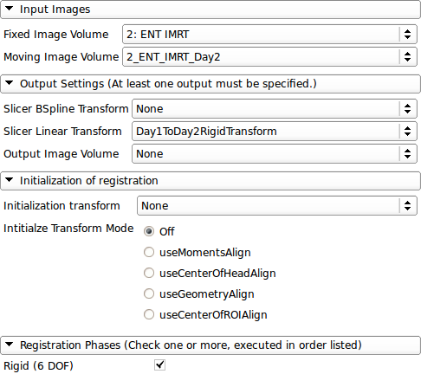
Registering CT volumes
Go to module list / Registration / General Registration (BRAINS)
Set the module parameters as seen in this image an click Apply
Select Create and rename…
Notes:
Everybody sees the message “completed” after the registration?

Slide 5
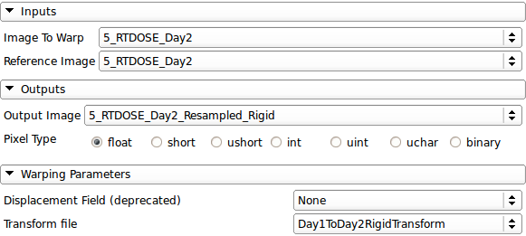
Resampling the day 2 dose volume
Go to module list / Registration / Resample Image (BRAINS)
Set the module parameters as seen in this image an click Apply

Slide 6
Accumulating doses
Go to module list / Radiotherapy / Dose Accumulation
Un-check Show dose volumes only checkbox
Select reference dose volume 5: RTDOSE
Check volumes
5: RTDOSE
5_RTDOSE_Day2
Open combobox in the Output section
Select Create new Volume
Click Apply
Accumulate these volumes in the same way
5: RTDOSE
5_RTDOSE_Day2_Resampled_Rigid

Slide 7
Computing dose volume histograms
Go to Radiotherapy / Dose Volume Histogram
Select the first accumulated dose volume from the list
Select PTV as the structure set
Click Compute DVH
Select second accumulated dose volume
Compute DVH
Do it for other structures, such as BRSTEM or optOptic
Click Select Chart
Click Create new Chart
Check Show/hide all
Notes:
Probably crashes on linux

