Slide 1
Next item on agenda
Acquire and build SlicerRT (on an existing Slicer)
Use python console in Slicer
Create extension and module skeletons
Use extension template
Use scripted module template
Use SlicerRT
Write a simple scripted module

Slide 2

Write our scripted module #1
Open MyExtension/MyScriptedModule/MyScriptedModule.py
Rename the module and put it in our extension category
Create widgets to specify inputs: Under look for input volume selector, and change and
Create second input selector
Rename outputSelector to input2Selector everywhere setUp and onApplyButton and onSelect functions
Set the same settings as for the first one
Notes:
Explain the module: Center of Masses
Emphasize that when creating a real module, then more things have to be changed: file and class names, comments, error handling

Slide 3
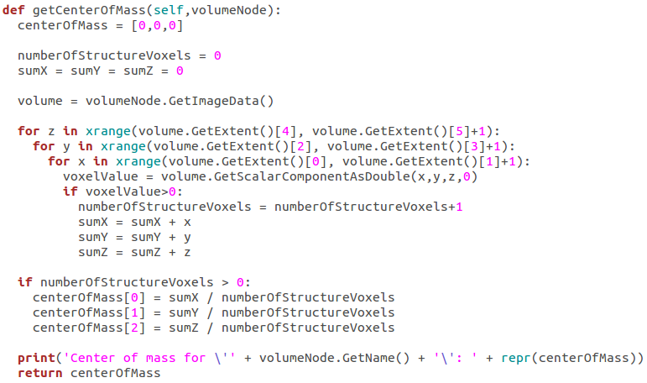
Write our scripted module #2
Look for class MyScriptedModuleLogic on the bottom
Insert this code above the Run function
Notes:
Take extra care of the indentation! 2 spaces before the whole thing and 2 spaces before each sub-block

Slide 4
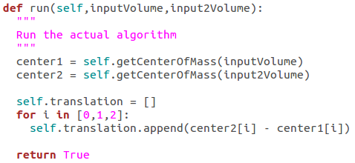
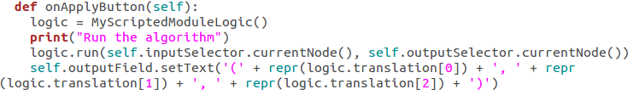
Write our scripted module #3
Insert this code in the Run function above the return statement
Displaying the output
Create the text field under the Apply button

Slide 5
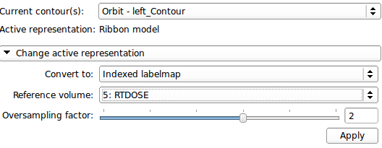
Try our scripted module
Build the extension (go to its bin directory and make)
Load data using the demo module (load the scene we saved)
Convert two structures, for example the two eyeballs (Orbit…) using the Radiotherapy / Contours module
Go to our module in MyExtension / Center of Masses
Set the two labelmaps as input
Press Apply

Slide 6
Last item on agenda
Acquire and build SlicerRT (on an existing Slicer)
Use python console in Slicer
Create extension and module skeletons
Use extension template
Use scripted module template
Use SlicerRT
Write a simple scripted module
Write a simple CLI module

Slide 7

Write our CLI module #1
Open MyExtension/SuperCLIModuleTemplate/SuperCLIModuleTemplate.xml
Rename the module and put it in our extension category
Notes:
Explain the module: Morphology

Slide 8
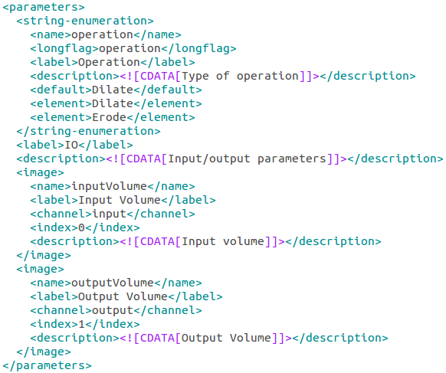
Write our CLI module #2
Create controls
Notes:
Explain the module: Morphology

Slide 9

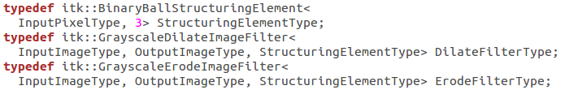
Write our CLI module #3
Open MyExtension/SuperCLIModuleTemplate/SuperCLIModuleTemplate.cxx
Include needed headers
Define used types (replace FilterType definition)
Notes:
Explain the module: Morphology

Slide 10
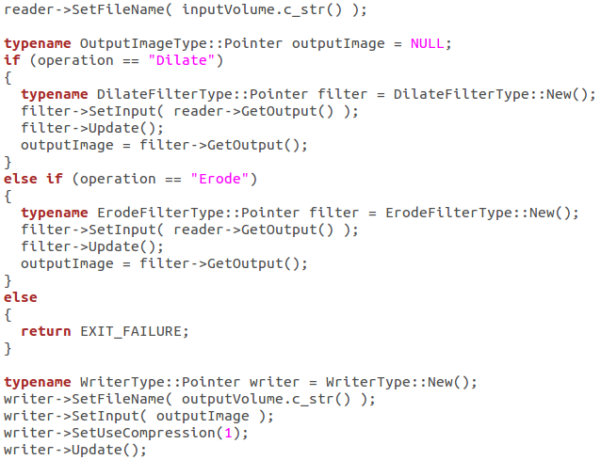
Write our CLI module #4
Add processing code
Notes:
Explain the module: Morphology

Slide 11
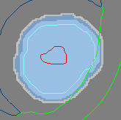
Try our CLI module
Load data using the demo module (load the scene we saved)
Convert one structure, for example PTV using the Contours module
Go to our module in MyExtension / Morphology
Set the PTV labelmap as input
Create output volume
Press Apply
Change Operation to Erode
Create output volume
Press Apply
Show volumes in the viewers: access slice toolbar, expand and turn on lock ( ), select output volumes and PTV labelmap

Slide 12
Congratulations!
Thanks for attending!

