Slide 1
Tutorial: Image-guided radiation therapy via isocenter shifting
Csaba Pinter
Laboratory for Percutaneous Surgery, Queen’s University, Kingston, ON, Canada

Slide 2
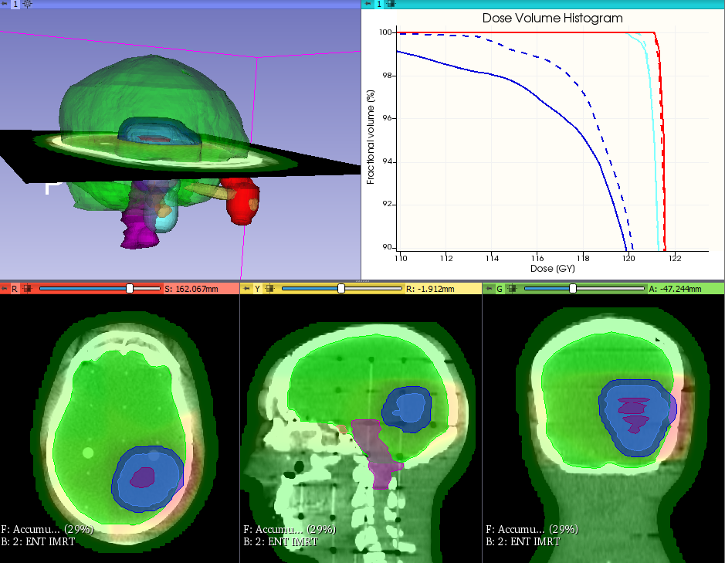
Learning objective
This tutorial demonstrates how to perform a full radiation therapy workflow using the SlicerRT toolkit:
Image-guided RT using isocenter shifting technique
Isocenter shifted and uncorrected DVH of the PTV

Slide 3
Overview
Install required software
Download and load tutorial dataset
Perform rigid registration on CT images
Transform day 2 dose volume
Accumulate dose distributions
Compute dose volume histogram
+1. Create isodose lines and surfaces
+2. Compare dose distributions using gamma

Slide 4
1/1. Install 3D Slicer
Download 3D Slicer preview from https://download.slicer.org/
Find the downloaded 3D Slicer package on your computer
Follow the usual steps to install an application
Different for each operating system

Slide 5
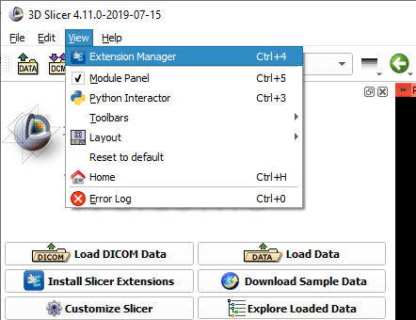

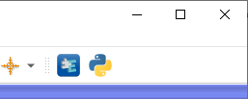
1/2. Install SlicerRT extension
or

Slide 6
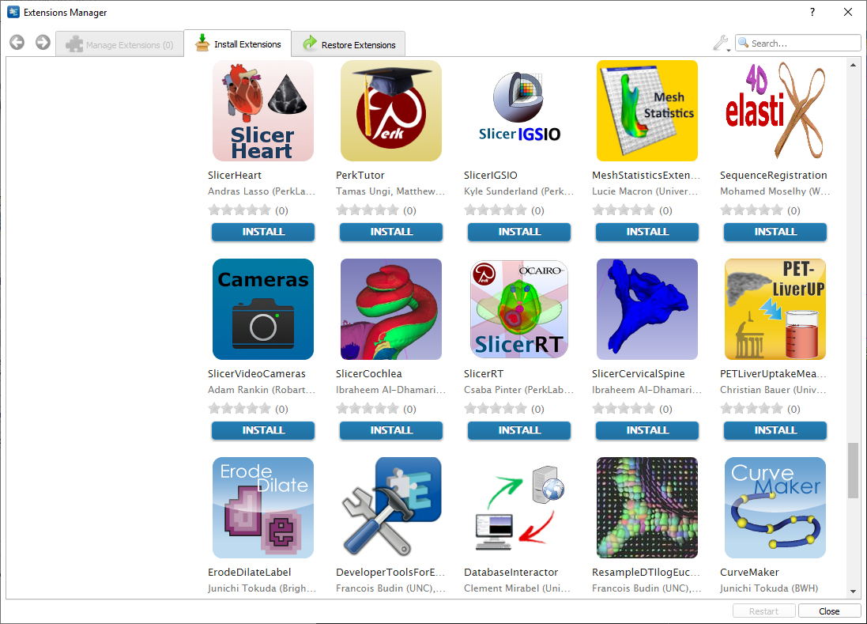
1/3. Install SlicerRT extension

Slide 7
2/1. Download tutorial dataset
Download planning study from https://pocus.cs.queensu.ca/#item/5d4c7c9b01d4930406c46b5d
Unzip it in a folder
Note: Same as eclipse-8.1.20-phantom-ent dataset
Download day 2 data
CT: https://pocus.cs.queensu.ca/#item/5d4c7c9601d4930406c46b57
Dose: https://pocus.cs.queensu.ca/#item/5d4c7c9701d4930406c46b5a
Note: Can download whole folder instead: https://pocus.cs.queensu.ca/#collection/5cc8811601d4930406c40465/folder/5d4c7b2d01d4930406c46b55

Slide 8
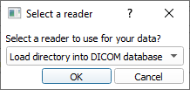
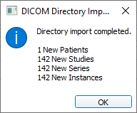
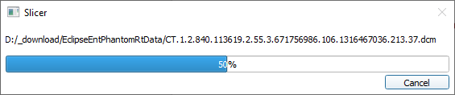
2/2. Import DICOM dataset
Drag&drop folder named EclipseEntPhantomRtData onto Slicer
You may be prompted for a database folder here
You may be asked whether to ‘Copy’ or ‘Add link’. Choose ‘Add link’

Slide 9
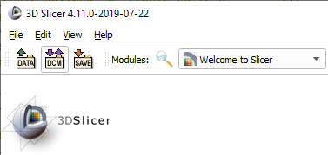
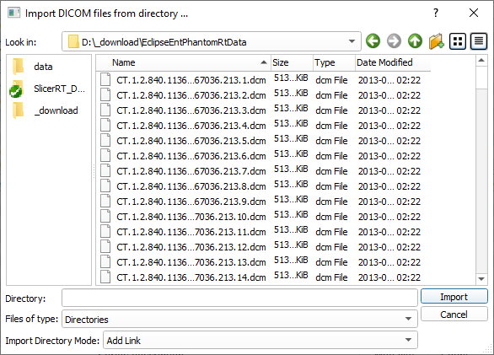
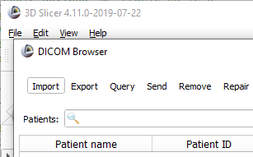
2/2A. Alternative import

Slide 10
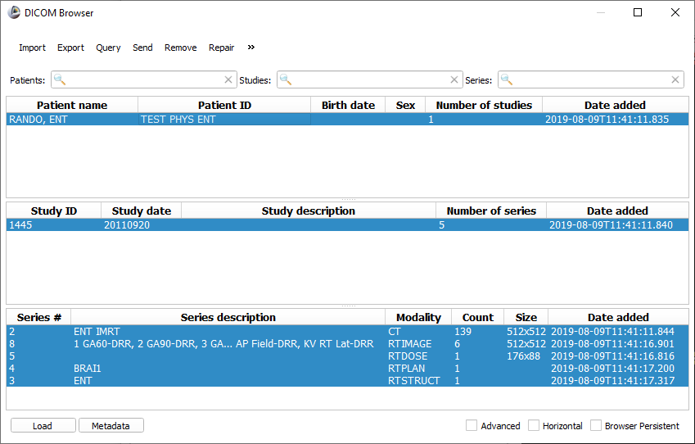
2/3. Load DICOM dataset
Note: You can add/remove selected items with Ctrl+click

Slide 11
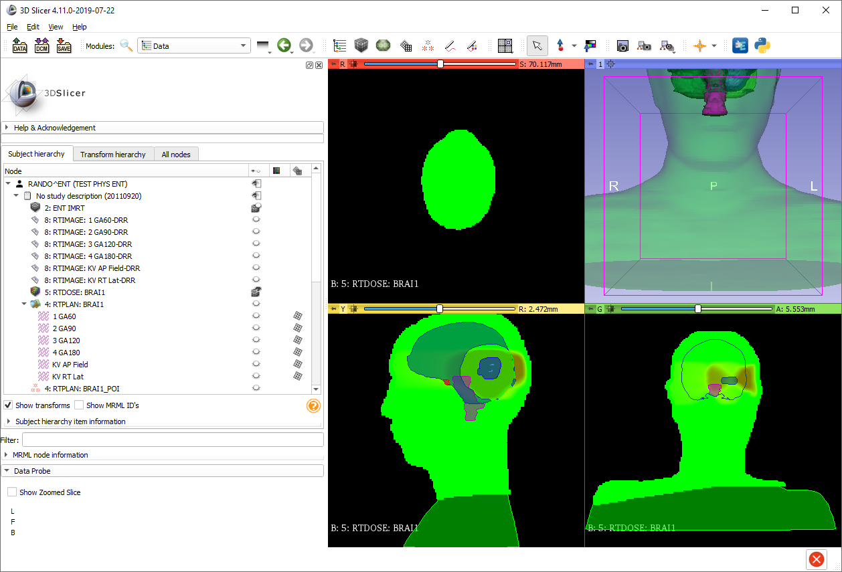
2/4. Data loaded
Data loaded
Switch to Data module to check loaded objects

Slide 12
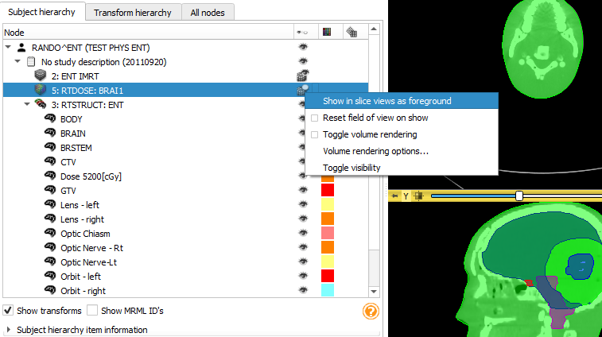
2/5. Show CT and dose
- Left-click visibility icon to show/hide items, including volumes - Right-click visibility icon to access visibility options

Slide 13
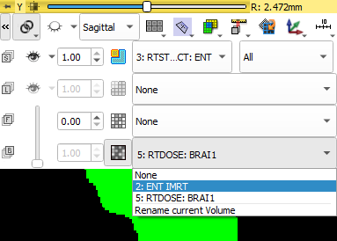
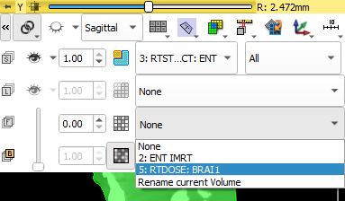
2/5A. Alternative volume visibility
1. Open slice controls
2. Link slices 3. Choose CT
4. Choose dose as foreground
5. Adjust foreground opacity

Slide 14
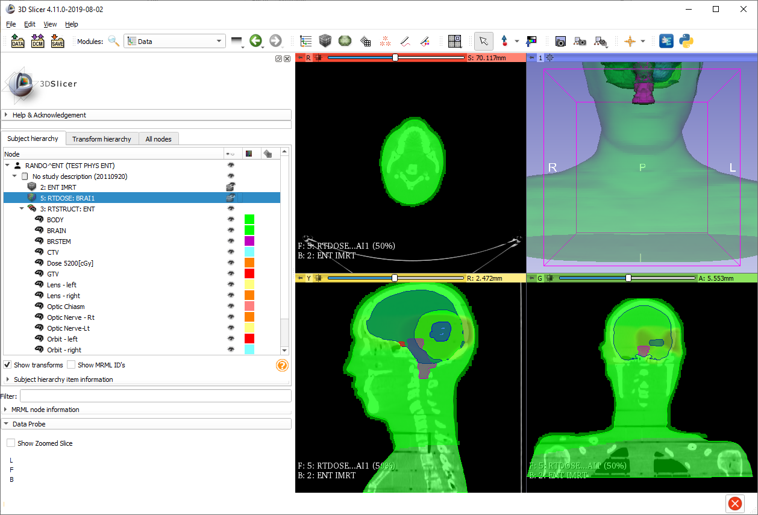
2/6. Tweak display
3
1
3
1. Reset 3D view
3. Adjust window/level
Switch to W/L mode
Click&drag left button
2
2. Manipulate 3D view
Rotate with left button
Zoom with right button
4. Navigate slice view
Change slice by scrolling
Zoom with right button
Pan with middle button (Shift+click&drag on Mac)
‘3D cursor’ by Shift+Move
4

Slide 15
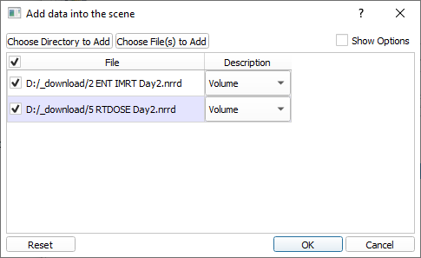
2/7. Load day 2 data
Drag&drop ‘2 ENT IMRT Day2.nrrd’ and ‘5 RTDOSE Day2.nrrd’ onto Slicer

Slide 16
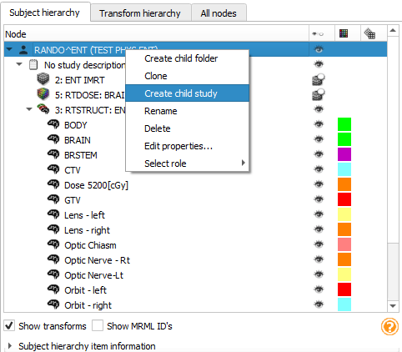
2/8. Add day 2 non-DICOM data to the same patient
1. Right-click the patient
2. Create child study
3. Double-click new study
4. Rename to ‘Day 2’
Note: You may want to minimize Data Probe to see more of the data tree

Slide 17
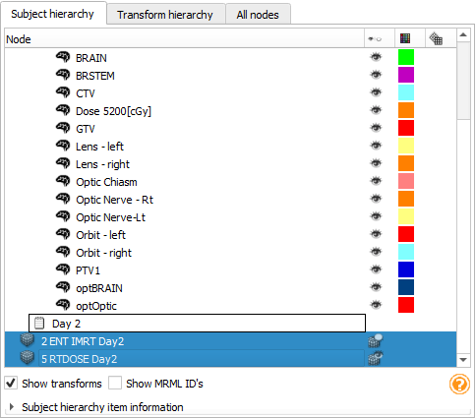
2/9. Add day 2 non-DICOM data to the same patient
1. Select day 2 CT and dose with Ctrl+click or Shift+click
2. Drag&drop on new study

Slide 18
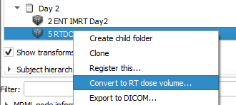
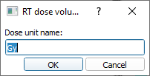
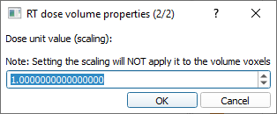

2/10. Convert day 2 dose image to an actual dose volume

Slide 19
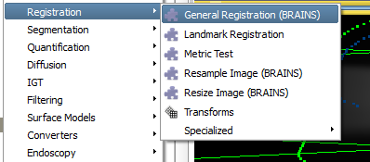
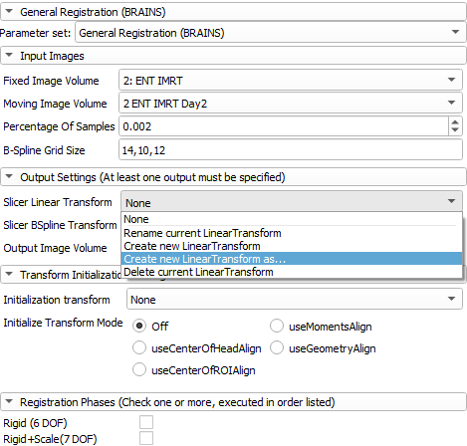
3/1. Register CT volumes
1. Go to module Registration / General Registration (BRAINS)
Set up parameters as shown: 2. Choose ‘2: ENT IMRT’ as fixed image 3. Choose day 2 CT ‘2 ENT
IMRT Day2’ as moving image 4. Create linear transform
and rename it to
Transform_Day2ToDay1_Rigid 5. Choose ‘Rigid (6 DOF)’
6. Click ‘Apply’

Slide 20
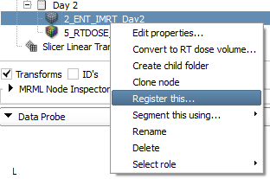
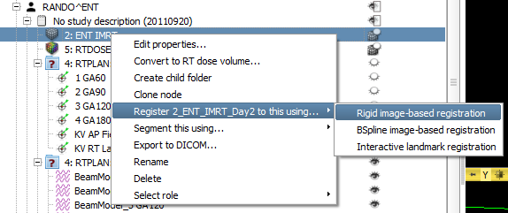
3/1A. Alternative registration
You can also initiate registration from subject hierarchy (alternative way for previous step):

Slide 21
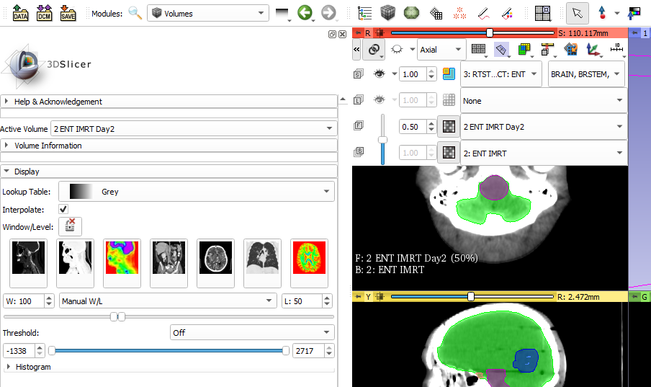
3/2. Explore registration result
1. Show both volumes as previously shown
2. Set color table and/or window/level presets in Volumes module
3. Change opacity to see differences Hint: Ctrl+drag up/down also changes opacity

Slide 22
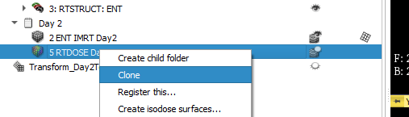
4/1. Clone day 2 dose volume
To be able to compare the non-registered (= uncorrected) and the registered (= isocenter shifted) results.
1. Switch to Data module / subject hierarchy
2. Select ‘Clone node’ in context menu for day 2 dose
3. Rename it to ‘5 RTDOSE Day2 Rigid’

Slide 23
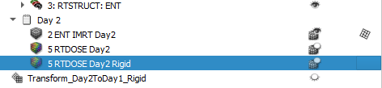
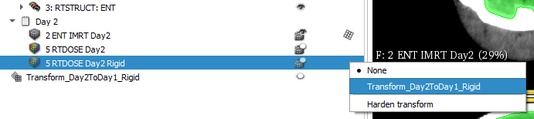
4/2. Transform cloned dose volume
Double-click transform column of cloned dose

Slide 24
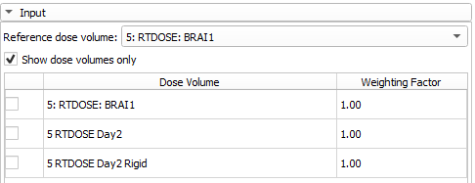
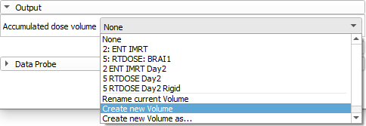
5/1. Accumulate dose distributions
1. Go to module Radiotherapy / Dose Accumulation
2. Choose reference, then planning and day 2 dose volumes
3. Create output volume
4. Click ‘Apply’

Slide 25
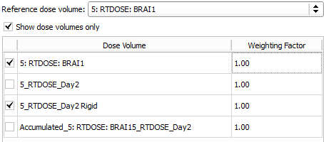
5/2. Accumulate dose distributions
1. Uncheck day 2 dose volume
2. Select registered day 2 dose
3. Create new output volume
4. Click ‘Apply’

Slide 26
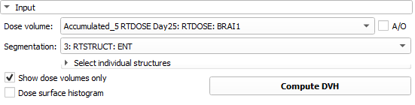
6/1. Compute DVH for unregistered
1. Go to module Radiotherapy / Dose Volume Histogram
2. Choose unregistered accumulated dose
3. Choose ‘3: RTSTRUCT: ENT’
Optional: Choose individual structures to speed up computation
4. Click ‘Compute DVH’

Slide 27
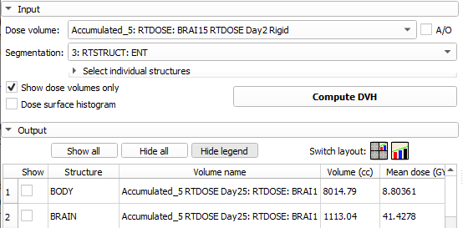
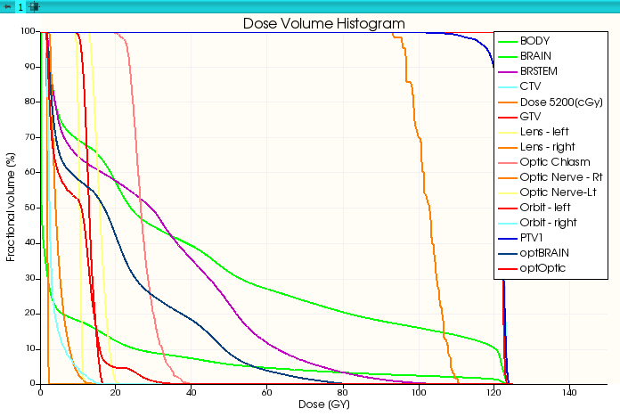
6/2. Compute DVH for registered
1. Choose registered accumulated dose
2. Click ‘Compute DVH’
3. Click ‘Show all’
4. DVH curves appear

Slide 28
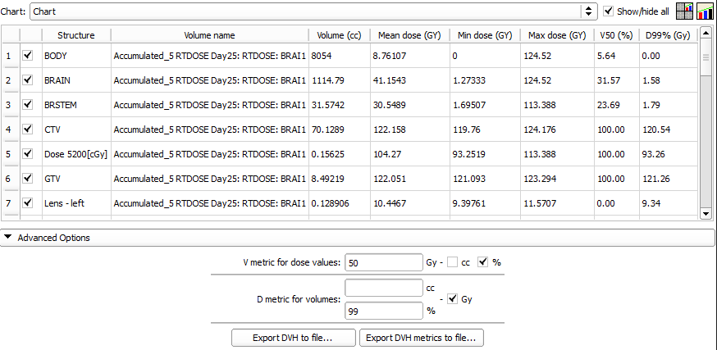
6/3. Quantify improvement

Slide 29
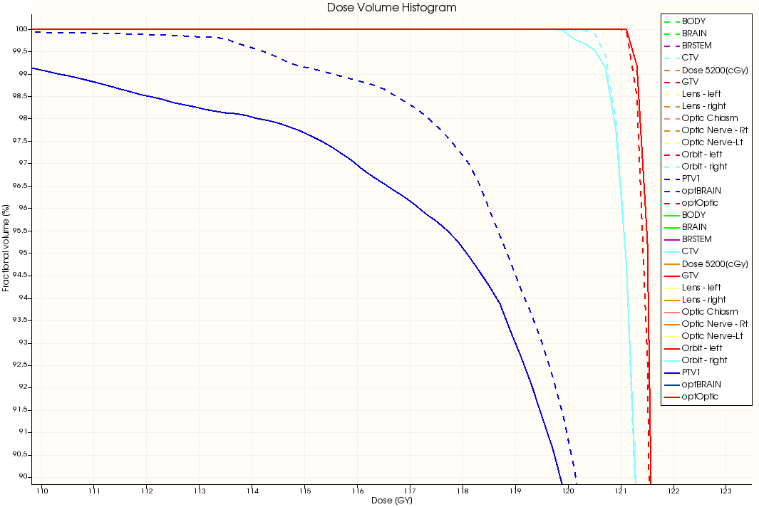
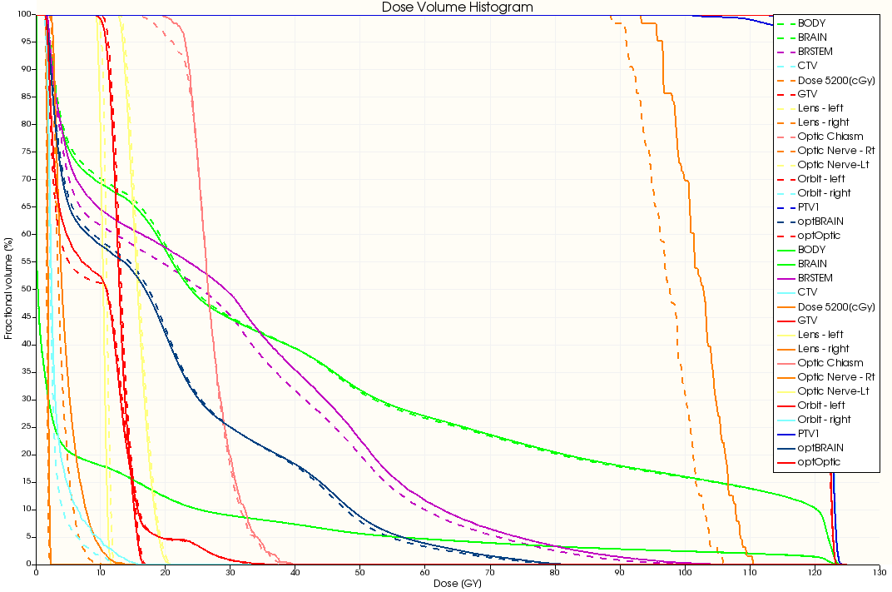
6/4. Visualize improvement
Zoom by scroll, pan by left mouse button
(Reset zoom: double middle-click)

Slide 30

Congratulations!

Slide 31
Appendix: Optional steps for IGRT

Slide 32
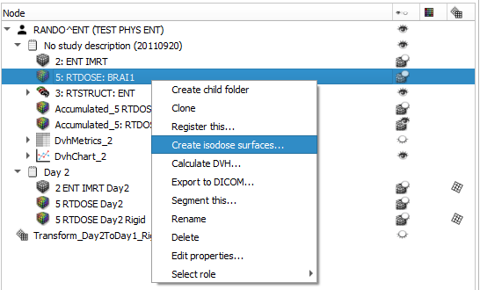
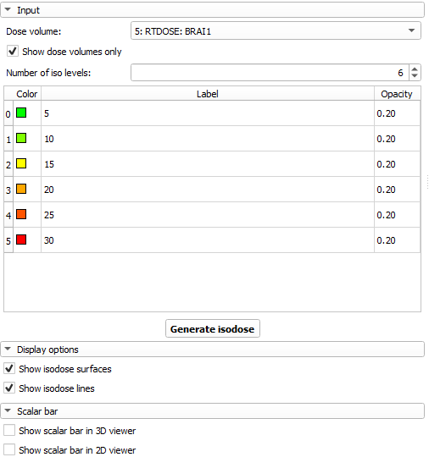
Optional 1/1. Isodose lines/surfaces

Slide 33
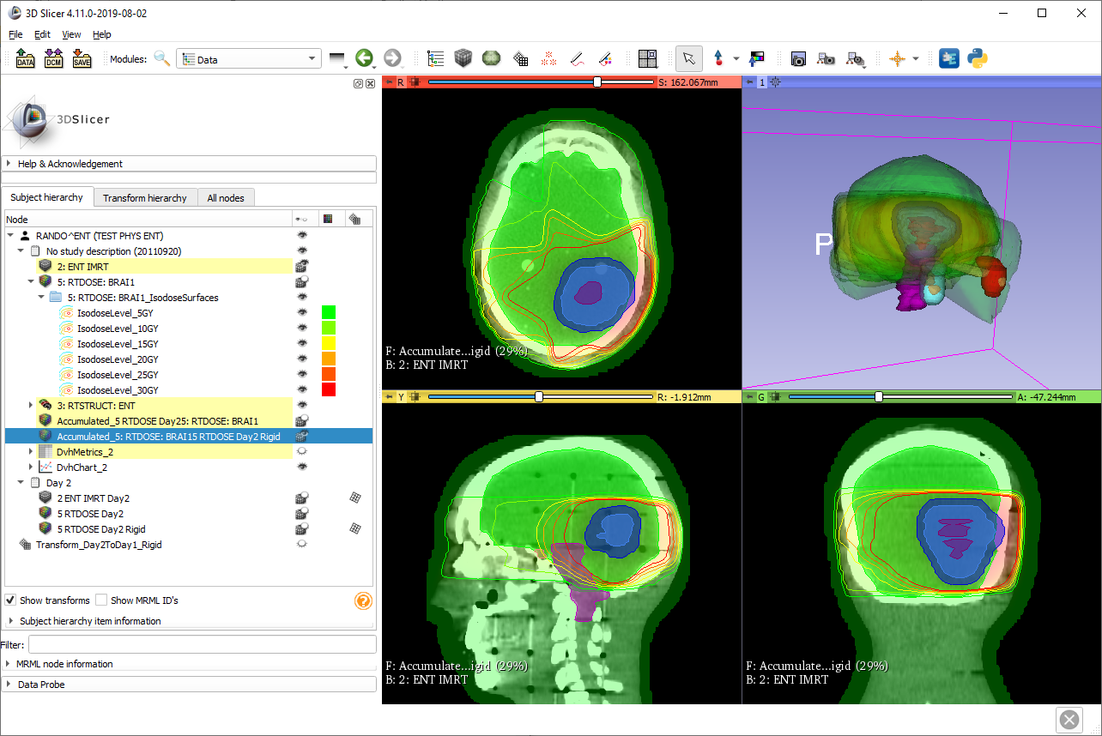
Optional 1/2. Isodose lines/surfaces

Slide 34
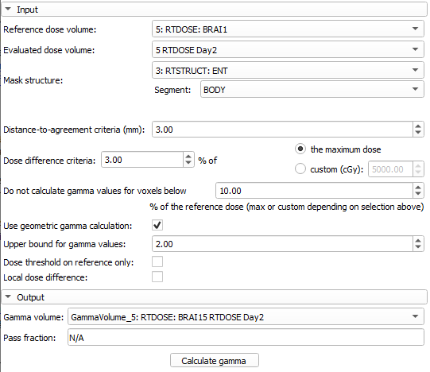
Optional 2/1. Compare dose volumes using gamma comparison
1. Go to module Radiotherapy / Dose Comparison
2. Set input volumes you want to compare
3. Create new output gamma volume
4. Click ‘Calculate gamma’

Slide 35
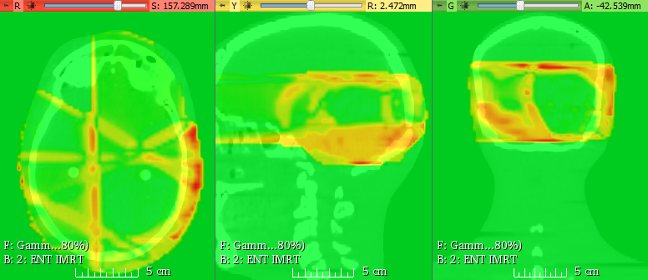
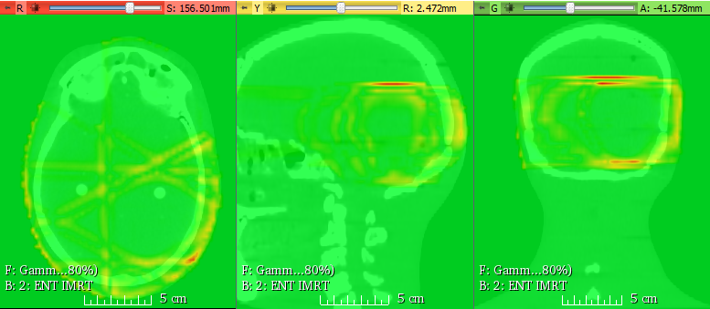
Optional 2/2. Evaluate improvement
Plan dose vs
Uncorrected Day 2 dose
Plan dose vs
Corrected Day 2 dose

