Slide 1

SlicerRT Extension
Csaba Pinter¹, Andras Lasso¹, Kevin Wang²
¹¹Laboratory for Percutaneous Surgery, Queen’s University, Canada
²University Health Network, Toronto, ON, Canada
pinter@cs.queensu.ca
NA-MIC Tutorial Contest: Summer 2013
© 2013, All Rights Reserved

Slide 2
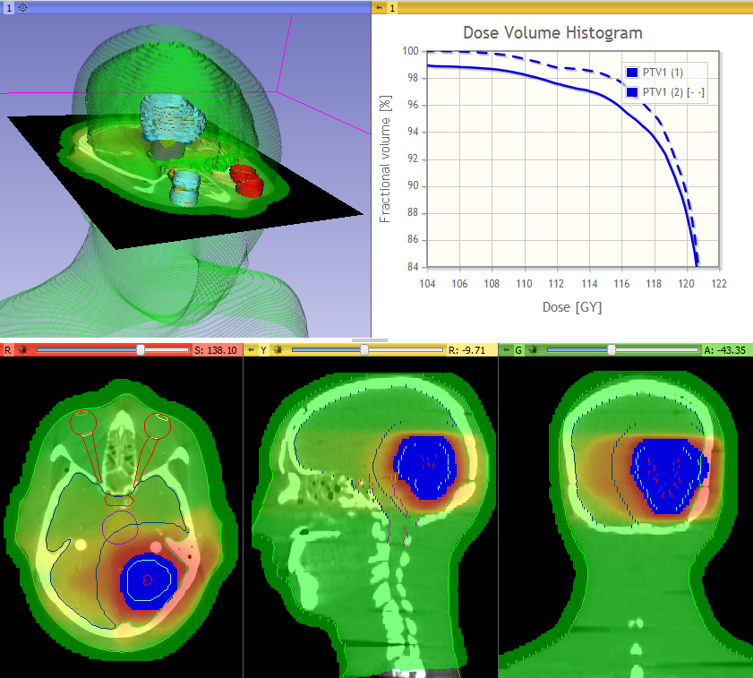
Learning Objective
This tutorial demonstrates how to perform a radiation therapy research workflow using the SlicerRT extension:
Evaluation of the isocenter shifting adaptation method
[picture to illustrate
the learning objective]
© 2013, All Rights Reserved

Slide 3
Pre-requisite
Pre-requisite tutorial:
  Data Loading and Visualization
  Sonia Pujol, Ph.D.
  http://www.slicer.org/slicerWiki/images/c/c7/DataLoadingAndVisualizationSlicer4.1_SoniaPujol.pdf
© 2013, All Rights Reserved

Slide 4
Material
This tutorial requires the installation of the most recent Slicer nightly release and the tutorial dataset. They are available at the following locations:
Slicer download page
http://www.slicer.org/pages/Downloads/
Tutorial dataset: SlicerRtTutorial_Namic2013June http://slicer.kitware.com/midas3/download/folder/1345/SlicerRtTutorial_Namic2013June.zip
© 2013, All Rights Reserved

Slide 5



Platforms
All major desktop platforms are supported
© 2013, All Rights Reserved

Slide 6
Overview
Install SlicerRT extension
Load data from DICOM and nrrd
Create isodose lines and surfaces
Perform rigid registration on CT images
Resample day 2 dose volume
Compare dose distributions
Accumulate dose distributions
Compute dose volume histogram
© 2013, All Rights Reserved

Slide 7
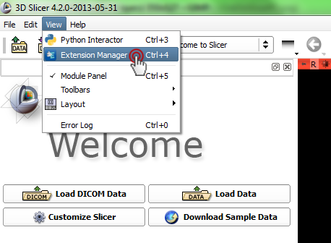
1/1. Install SlicerRT extension
© 2013, All Rights Reserved

Slide 8
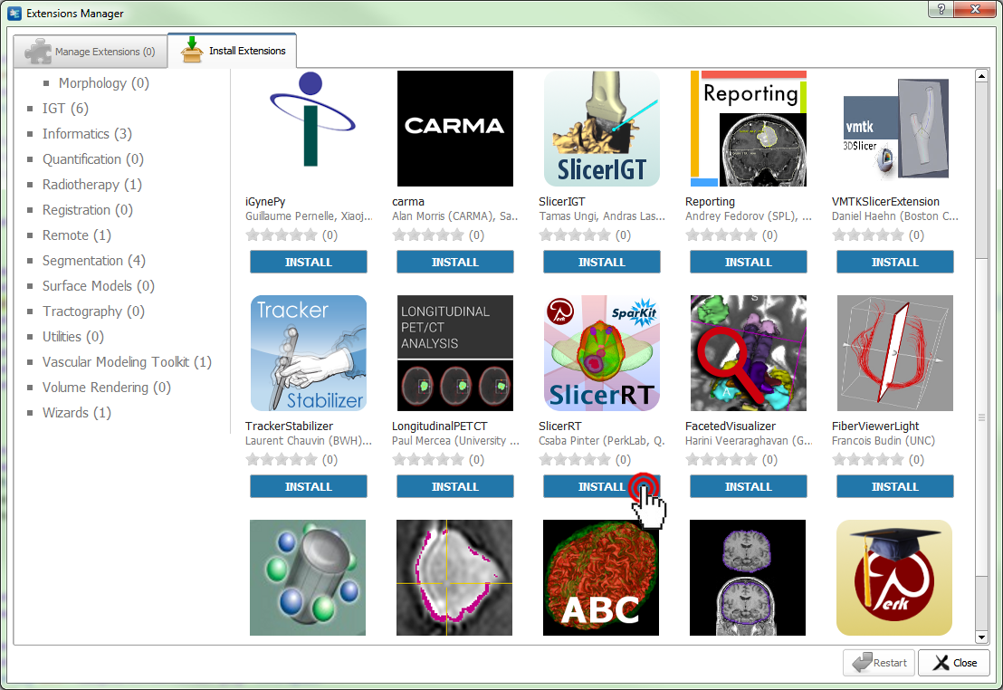
1/2. Install SlicerRT extension
© 2013, All Rights Reserved

Slide 9
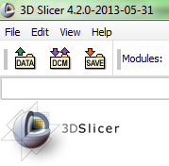
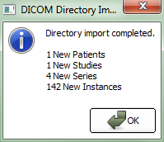

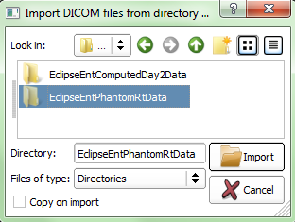
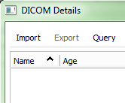
2/1. Import planning data
Browse
© 2013, All Rights Reserved

Slide 10
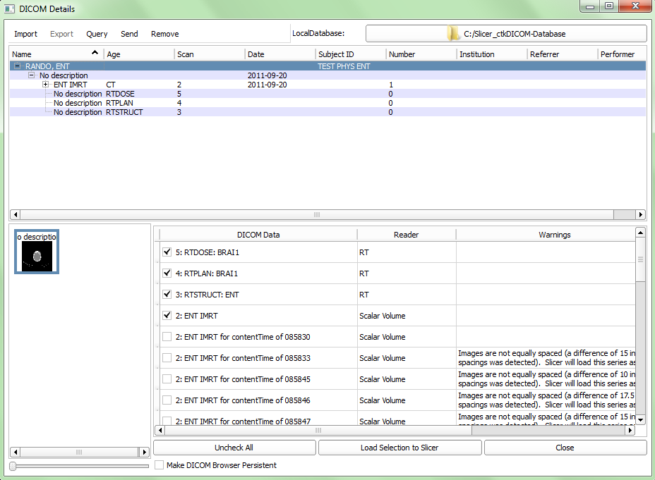
2/2. Load planning data
1. Click patient ‘RANDO, ENT’
2. The loadables appear in the bottom
3. Click ‘Load Selection to Slicer’
© 2013, All Rights Reserved

Slide 11
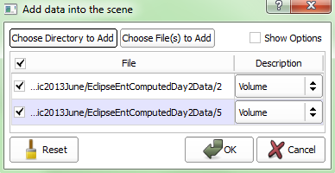
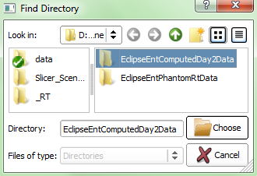
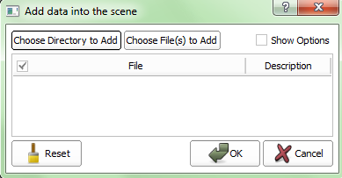
2/3. Load day 2 data
Browse
© 2013, All Rights Reserved

Slide 12
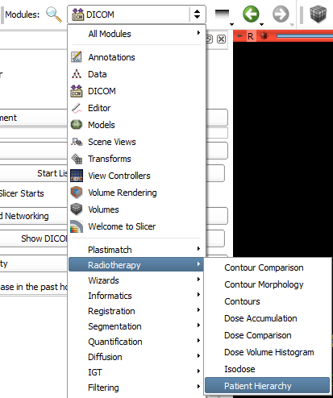
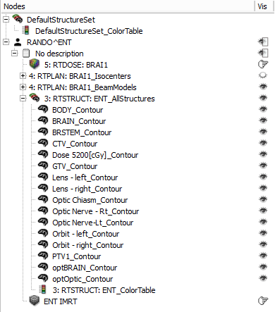
2/4. Add day 2 non-DICOM data to patient hierarchy
1. Right-click
the patient
2. Choose
‘Create child node’
3. Right-click the
new node
4. Rename to ‘Day 2’
© 2013, All Rights Reserved

Slide 13
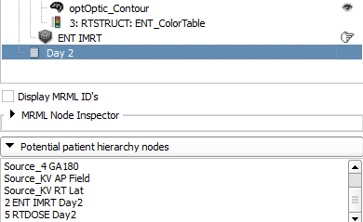
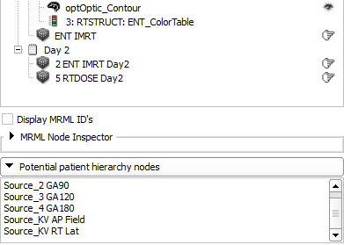
2/5. Add day 2 non-DICOM data to patient hierarchy
1. Drag&drop ‘ENT IMRT
Day2’ on the study ‘Day 2’
2. Do the same with ‘5 RTDOSE Day2’
© 2013, All Rights Reserved

Slide 14
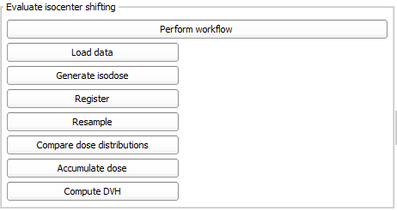
Note: Automatic loading
Test data can be automatically downloaded, imported
and loaded using the self test module:
Testing / SlicerRT Tests / SlicerRT NA-MIC Tutorial
2013June Self Test
© 2013, All Rights Reserved

Slide 15
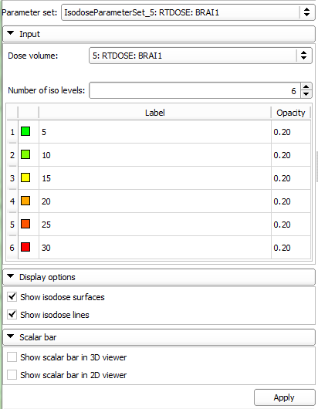
3/1. Create isodose lines
1. Choose Radiotherapy /
Isodose module
2. Click Apply
3. Choose ‘5 RTDOSE Day2’
volume as Dose volume
4. Click Apply
© 2013, All Rights Reserved

Slide 16
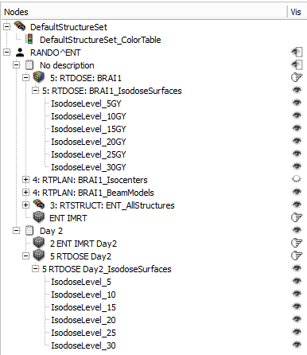
3/2. Visualize isodose lines
1. Switch back to Patient Hierarchy
2. Turn on and off visualization
of isodose line and surface
groups by clicking the eye icon
next to the parent node
3. Display volumes in the 2D
viewers by clicking the hand
icon next to the volumes
© 2013, All Rights Reserved

Slide 17
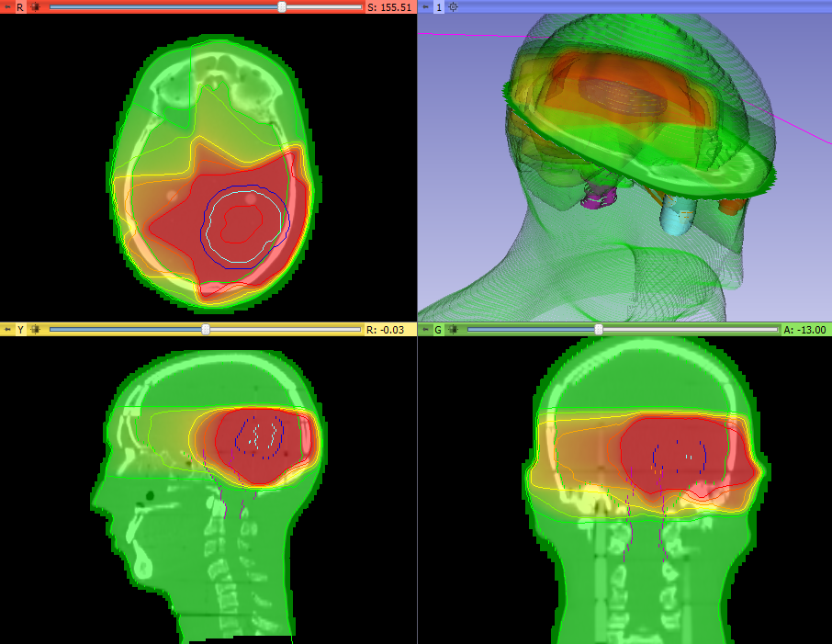
3/3. Relevant data showed
© 2013, All Rights Reserved

Slide 18
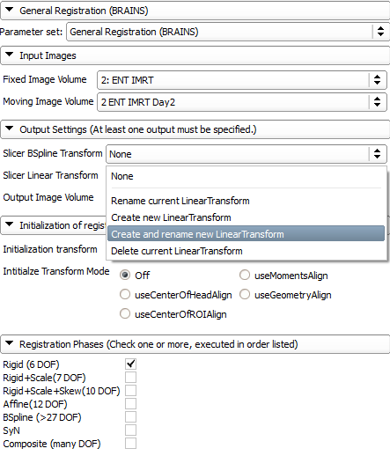
4. Register CT volumes
1. Go to module Registration /
General Registration (BRAINS)
Set up parameters as shown:
2. Choose planning CT as
fixed image
3. Choose day 2 CT as
moving image
4. Create transform and rename it
to Transform_Day2ToDay1_Rigid
5. Choose ‘Rigid (6 DOF)
6. Click ‘Apply’
© 2013, All Rights Reserved

Slide 19
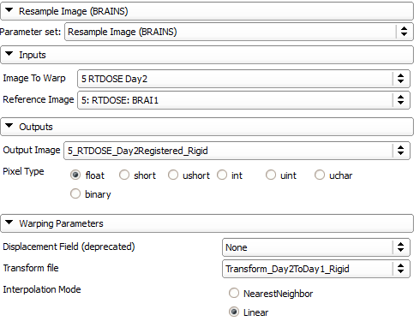
5. Resample day 2 dose
1. Go to module Registration /
Resample Image (BRAINS)
2. Set parameters as indicated
(output image needs to be
created and renamed)
3. Click ‘Apply’
© 2013, All Rights Reserved

Slide 20
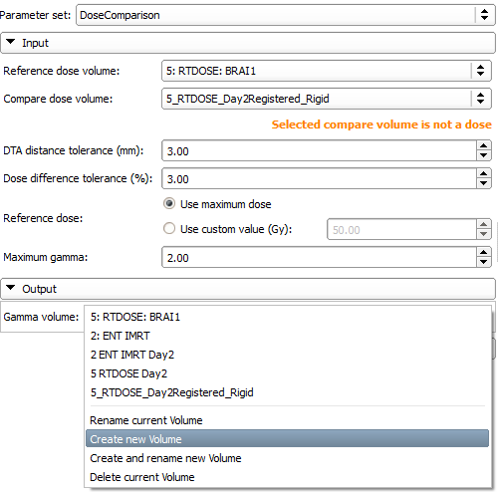
6/1. Compare dose volumes
1. Go to module Radiotherapy /
Dose Comparison
2. Set inpit volumes:
Reference: Planning dose
Compare: Registered day 2 dose
3. Create output
(no rename necessary)
4. Click ‘Apply’
© 2013, All Rights Reserved

Slide 21
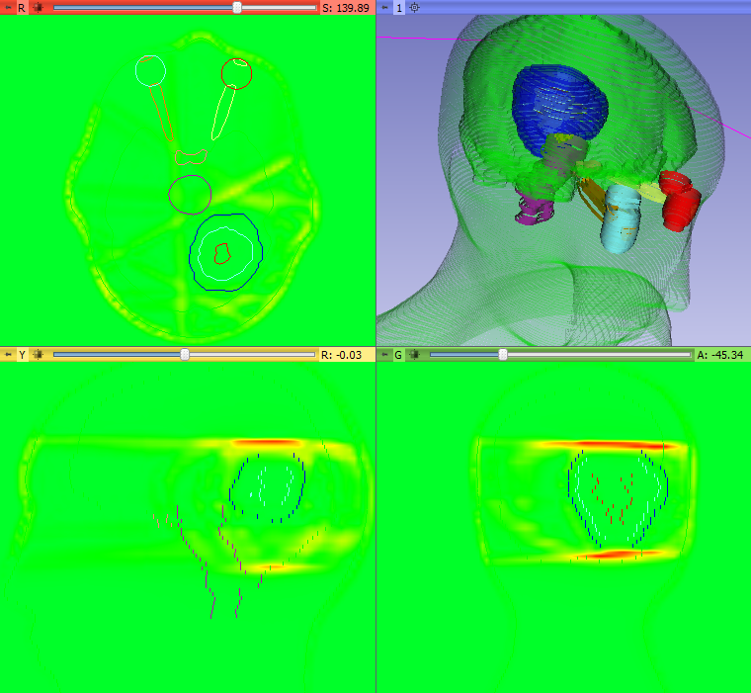
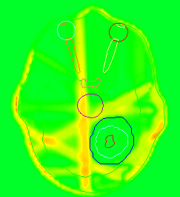
6/2. Verify registration
The ‘warmer’ the gamma
volume, the bigger the difference
Try comparing the planning dose
with the unregistered day 2 dose
© 2013, All Rights Reserved

Slide 22
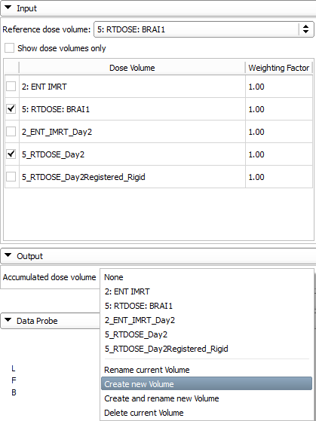
7/1. Accumulate doses unregistered = no adaptation
1. Go to module Radiotherapy /
Dose Accumulation
2. Uncheck ‘Show dose volumes
only’ (dose attributes are not yet
automatically added to the nodes)
3. Choose reference, then
planning and day 2 dose volumes
4. Create output volume
5. Click ‘Apply’
© 2013, All Rights Reserved

Slide 23
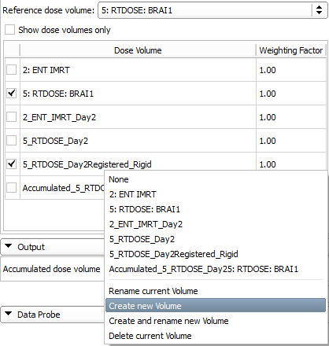
7/2. Accumulate doses registered = isocenter shift
1. Uncheck day 2 dose volume
2. Select registered day 2 dose
3. Create output volume
4. Click ‘Apply’
© 2013, All Rights Reserved

Slide 24
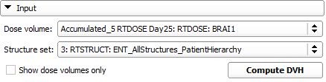
8/1. Compute dose volume histogram for unregistered
1. Go to module Radiotherapy /
Dose Volume Histogram
2. Choose unregistered
accumulated dose
3. Uncheck ‘Show dose volumes only’
4. Choose
‘3: RTSTRUCT: ENT_AllStructures_PatientHierarchy’
5. Click ‘Compute DVH’
© 2013, All Rights Reserved

Slide 25
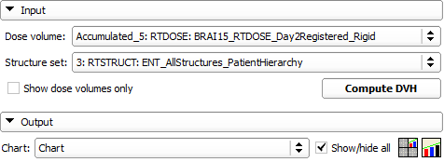
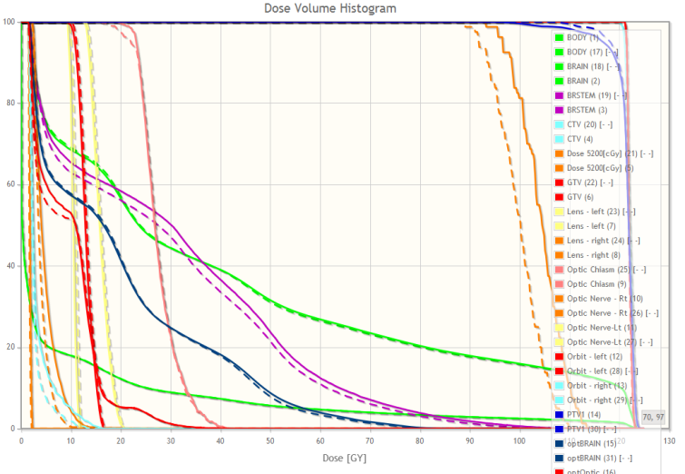
8/2. Compute dose volume histogram for registered
1. Choose registered
accumulated dose
2. Click ‘Compute DVH’
3. Create chart
4. Click ‘Show/hide all’
5. DVH curves appear
© 2013, All Rights Reserved

Slide 26
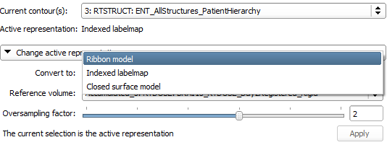
Note: Structures have been rasterized
Structures are automatically rasterized during DVH
computation. In this state, they can be seen as labelmaps
over the volumes in the 2D viewers. To show the models
again, convert back in the Radiotherapy / Contours module.

Slide 27
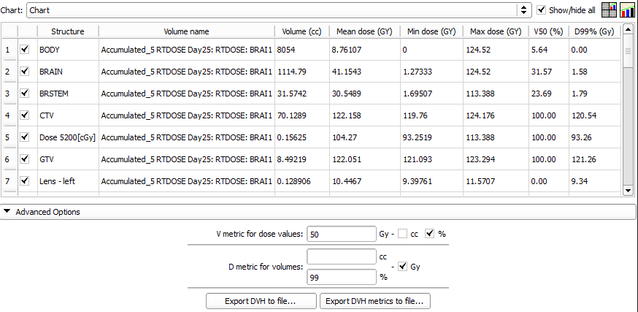
8/3. Quantify improvement
© 2013, All Rights Reserved

Slide 28
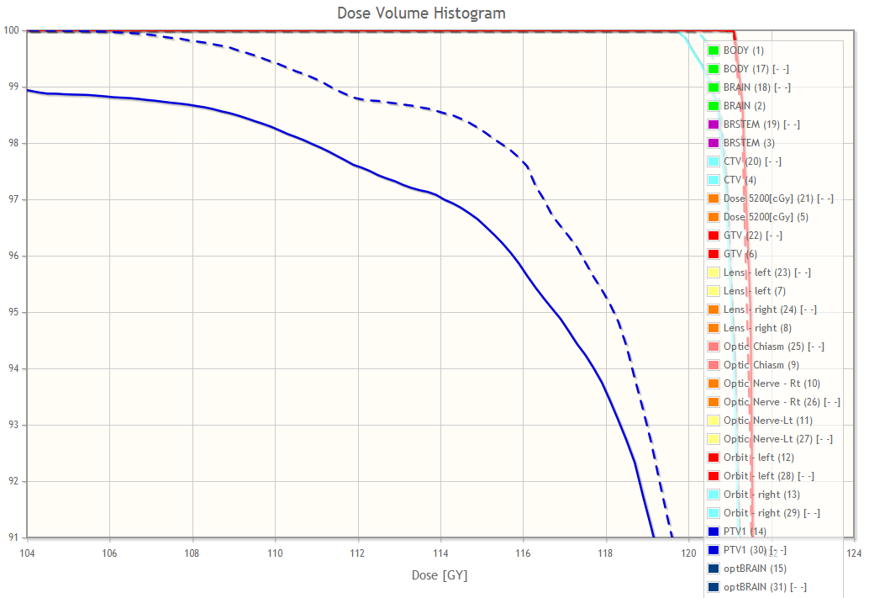
8/4. Visualize improvement
Zoom
© 2013, All Rights Reserved

Slide 29
Conclusion
Creating and performing radiation therapy research workflows are easy using the BRAINS registration tools along with the numerous SlicerRT modules
© 2013, All Rights Reserved

Slide 30
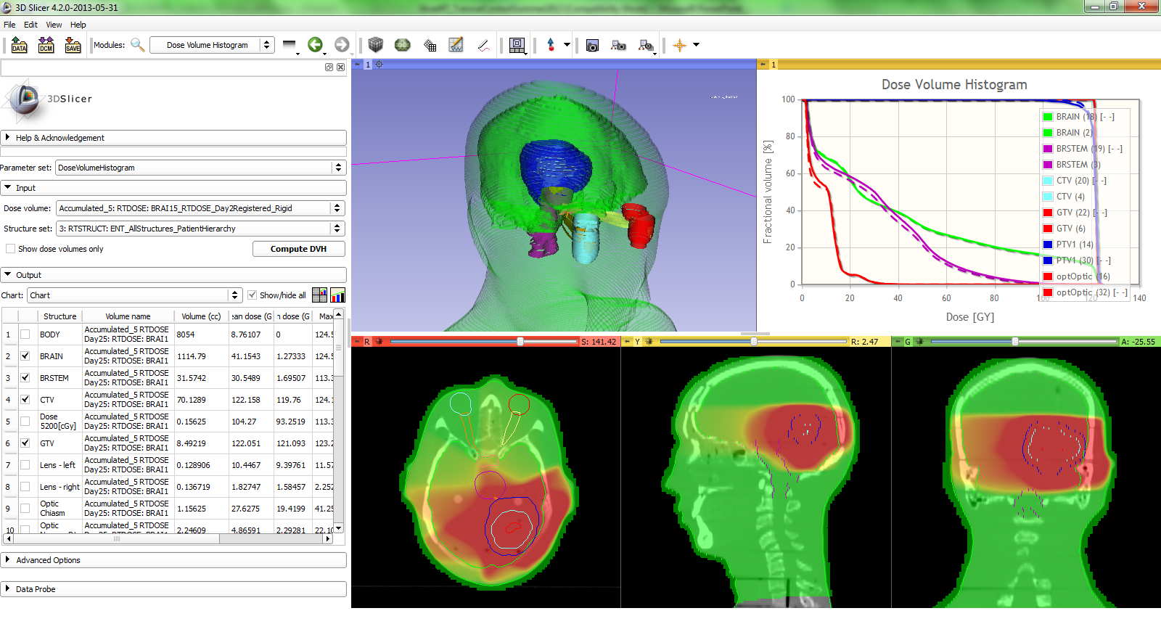
Reference and webpage
Overview paper: Csaba Pinter, Andras Lasso, An Wang, David Jaffray, and Gabor Fichtinger, “SlicerRT: Radiation therapy research toolkit for 3D Slicer”, Med. Phys. 39 (10), October 2012
Project homepage: http://www.SlicerRT.org/
© 2013, All Rights Reserved

Slide 31



Acknowledgments
National Alliance for Medical
Image Computing
NIH U54EB005149
Cancer Care Ontario
SparKit
(Software Platform and Adaptive Radiotherapy Kit)
© 2013, All Rights Reserved

