Slide 1
Tutorial: Isodose surfaces
Csaba Pinter
Laboratory for Percutaneous Surgery, Queen’s University, Kingston, ON, Canada

Slide 2
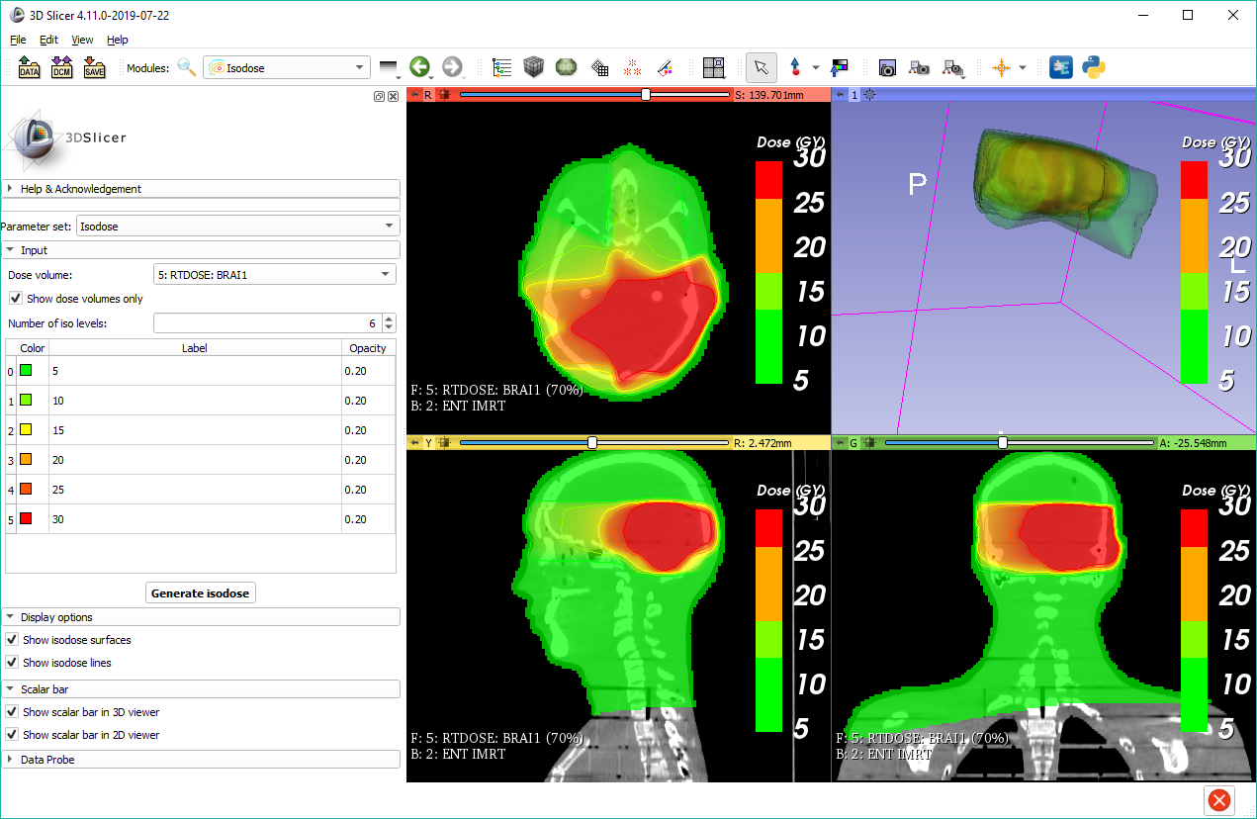
Learning objective
This tutorial demonstrates how to calculate isodose surfaces from dose distributions.
Isodose lines and surfaces

Slide 3
Overview
Install required software
Load data from DICOM
Create isodose surfaces
Setup visualization

Slide 4
1/1. Install 3D Slicer
Download 3D Slicer preview from https://download.slicer.org/
Find the downloaded 3D Slicer package on your computer
Follow the usual steps to install an application
Different for each operating system

Slide 5
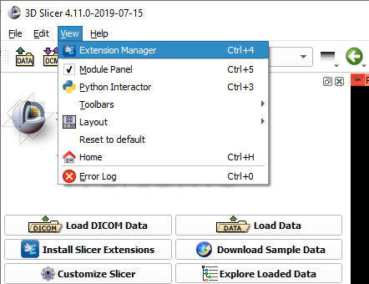

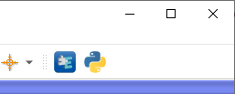
1/2. Install SlicerRT extension
or

Slide 6
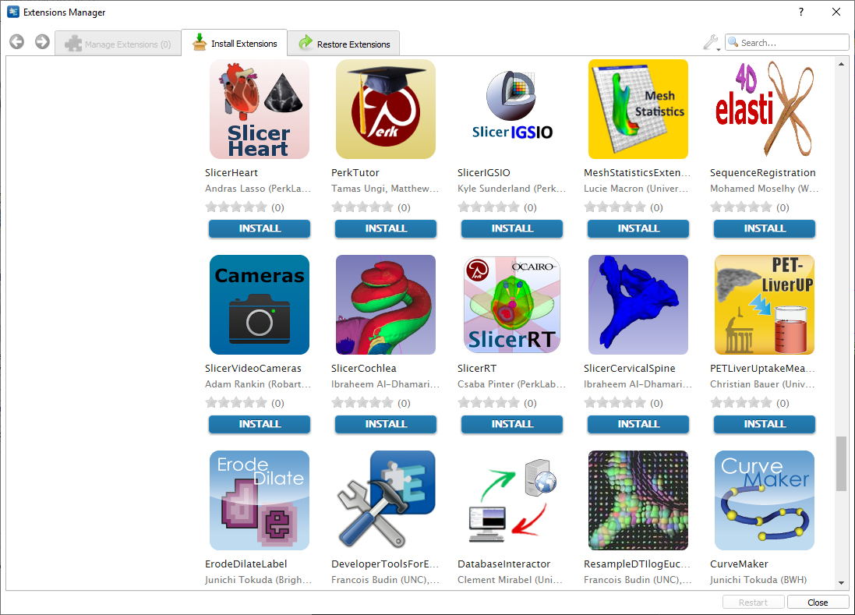
1/3. Install SlicerRT extension

Slide 7
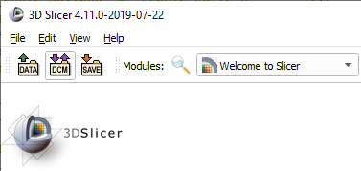
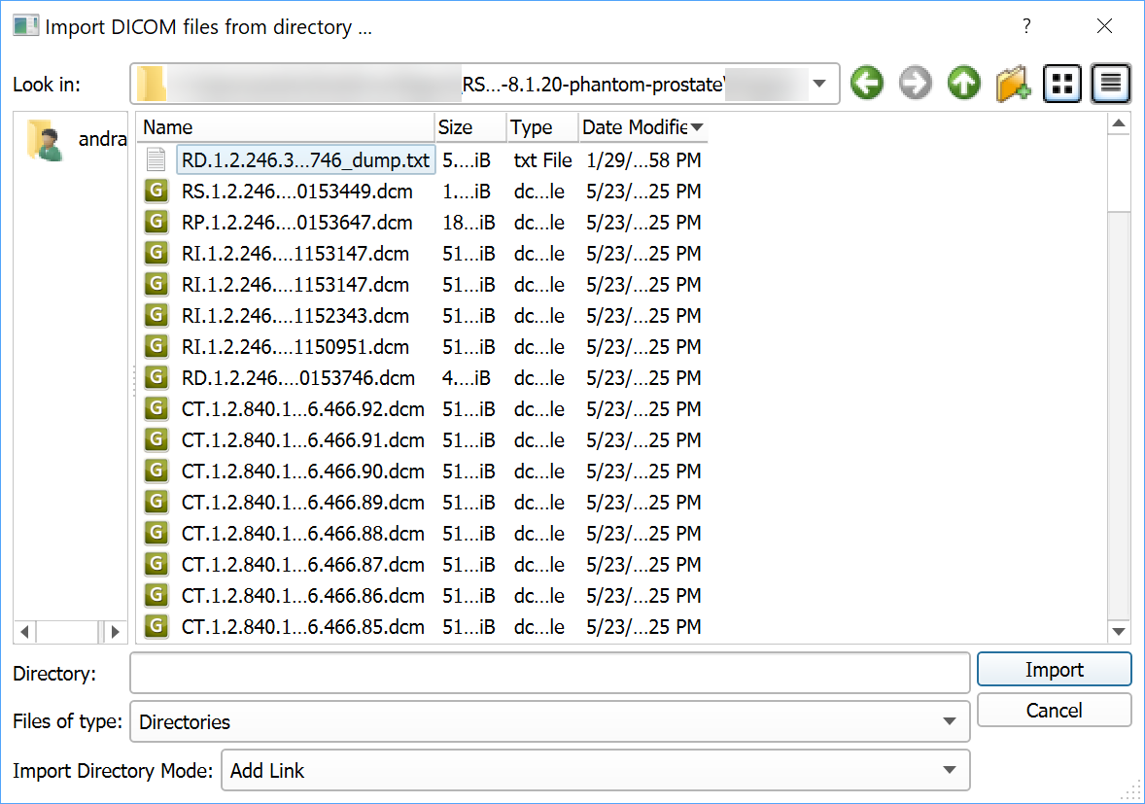
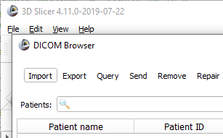
2/1. Import DICOM dataset

Slide 8
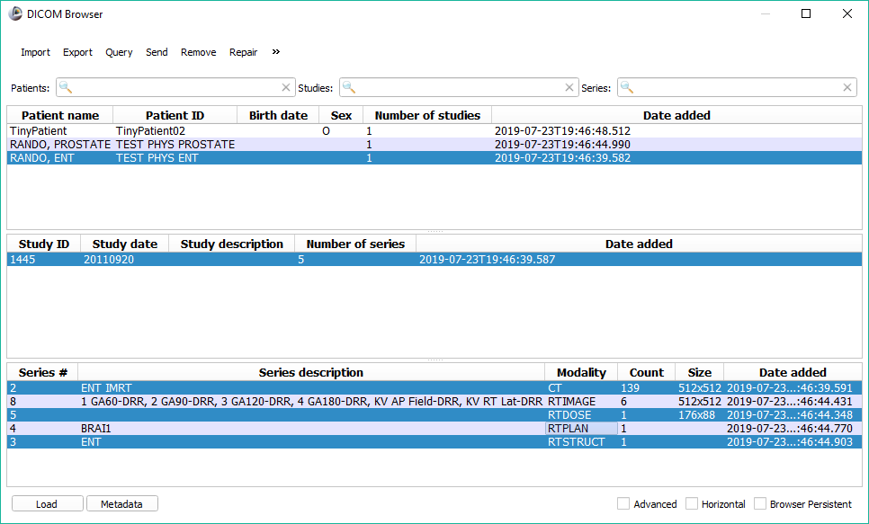
2/2. Load DICOM dataset
Ctrl+click to select/unselect series

Slide 9
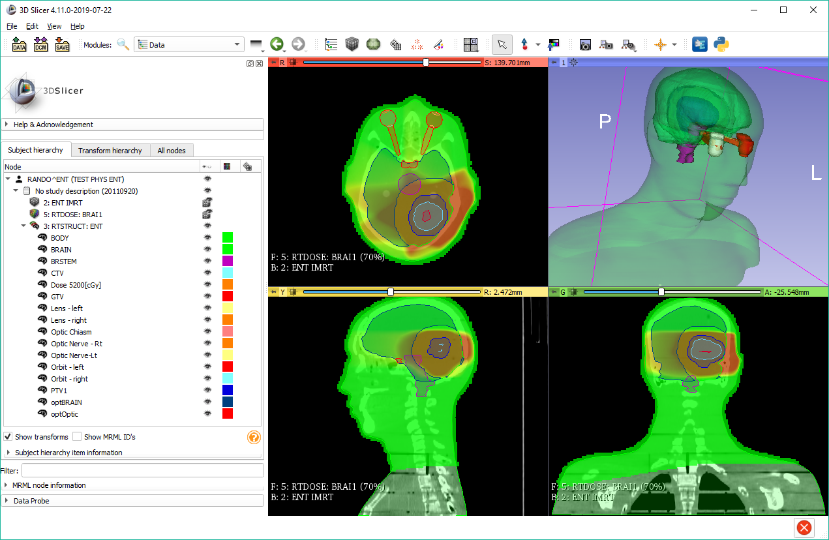
2/3. Data loaded
Data loaded
Switch to Data module to check loaded objects

Slide 10
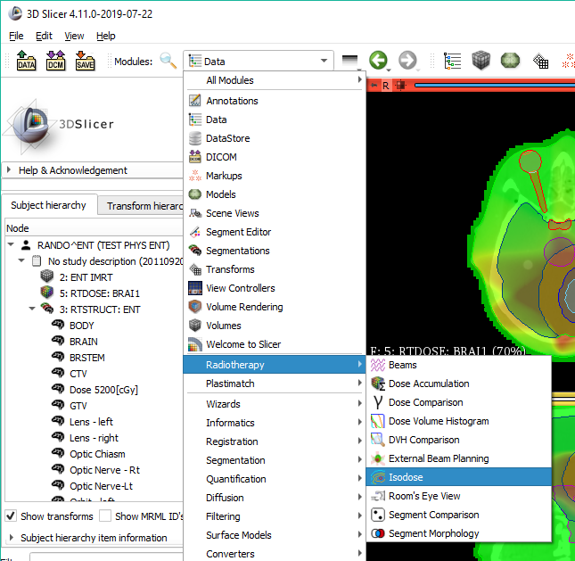
3/1. Switch to isodose module

Slide 11
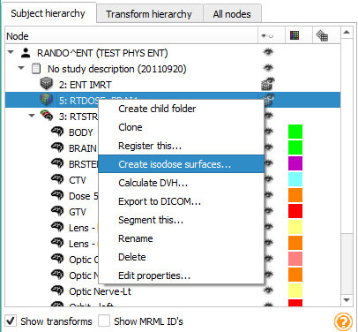
3/1a. Isodose from Data module
1. Right-click the dose volume (if your dose volume does not come from DICOM you can convert it to dose also in the context menu)
2. Choose ‘Create isodose surfaces…’
3. The dose volume will be selected as input

Slide 12
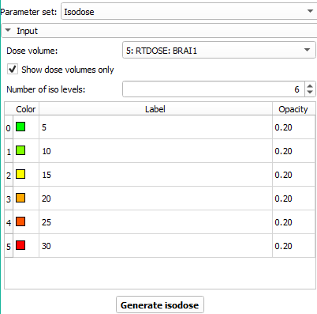
3/2. Set isodose levels and generate
1. Set number of levels
2. Set dose levels by entering the dose value for each
3. You can change color and opacity if needed
4. Click ‘Generate isodose’

Slide 13
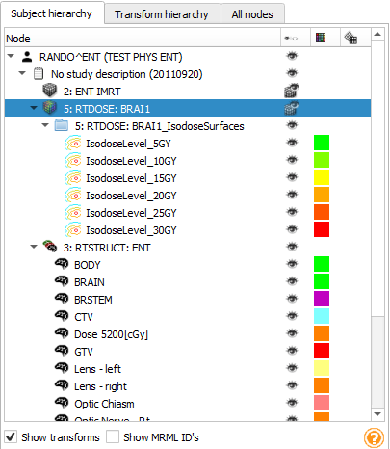
4/1. Show/hide data
Switch back to Data module Click eye icon to show/hide data (e.g. hide segmentation to avoid clutter)

Slide 14
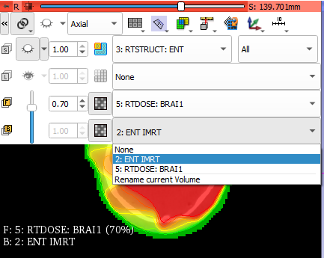
4/2. Adjust volume visibility
1. Click the chain icon to link slice views 2. Select foreground and background volume 3. Adjust opacity of foreground volume

Slide 15
4/3. Show scalar bars

Slide 16

Congratulations!

