Slide 1
Tutorial: DICOM Registration Objects
Csaba Pinter
Laboratory for Percutaneous Surgery, Queen’s University, Kingston, ON, Canada

Slide 2
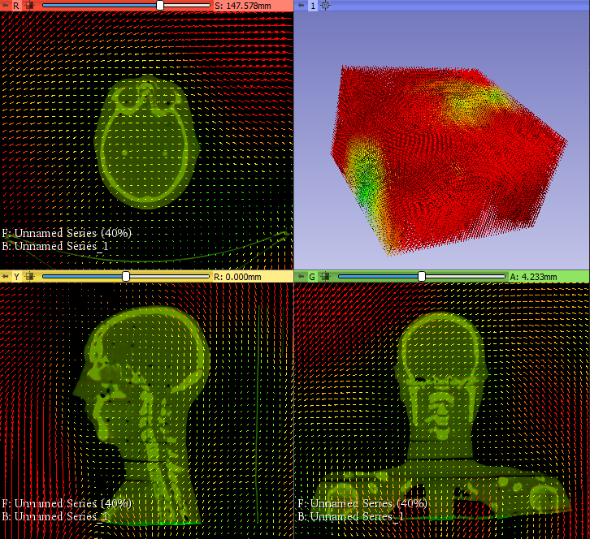
Learning objective
This tutorial demonstrates how to save registration to DICOM Spatial Registration Object and how to explore the registration transformation.
Deformable transform visualization

Slide 3
Overview
Install required software
Load data from DICOM
Register two images
Export DICOM Spatial Registration
Import and use DICOM SRO

Slide 4
1/1. Install 3D Slicer
Download 3D Slicer preview from https://download.slicer.org/
Find the downloaded 3D Slicer package on your computer
Follow the usual steps to install an application
Different for each operating system

Slide 5
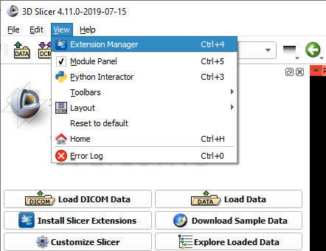

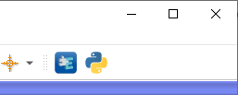
1/2. Install SlicerRT extension
or

Slide 6
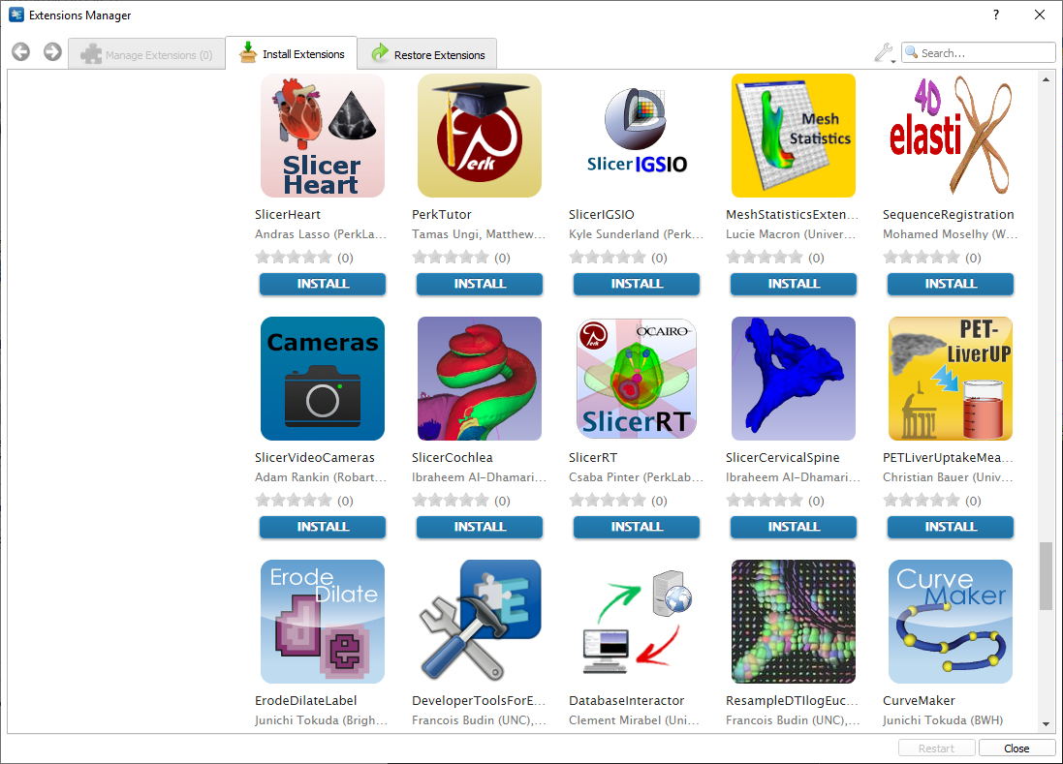
1/3. Install SlicerRT extension

Slide 7
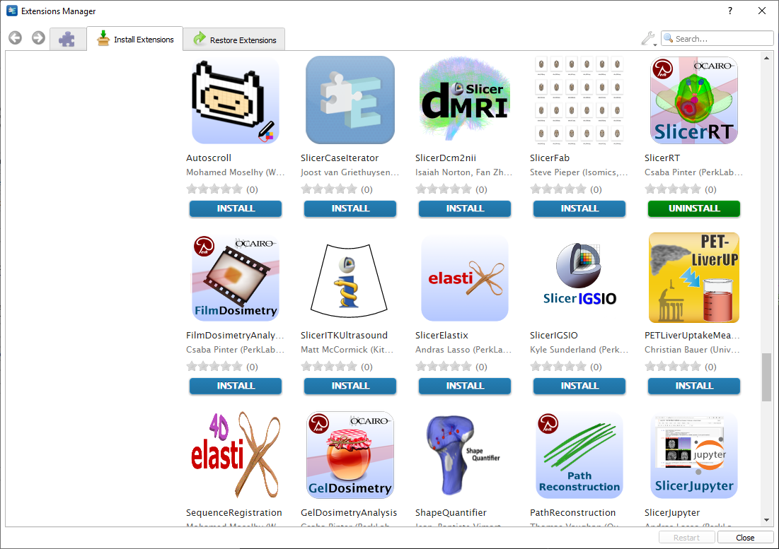
1/4. Install SlicerElastix extension

Slide 8
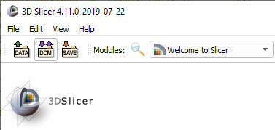
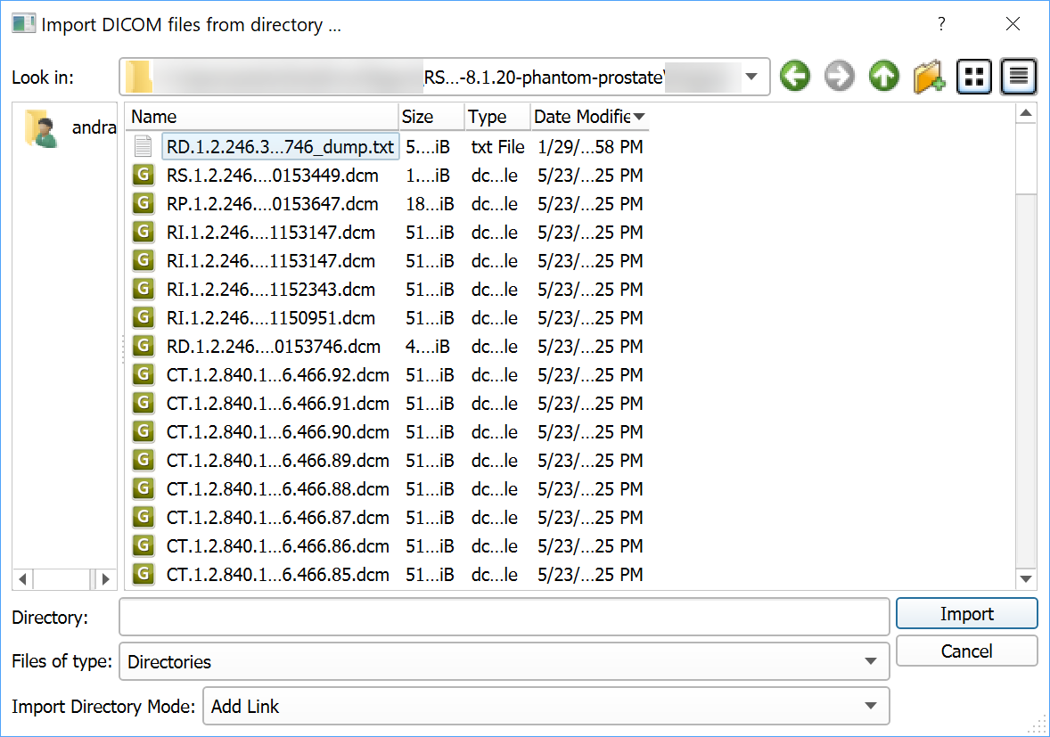
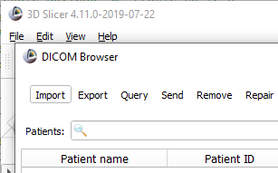
2/1. Import DICOM datasets

Slide 9
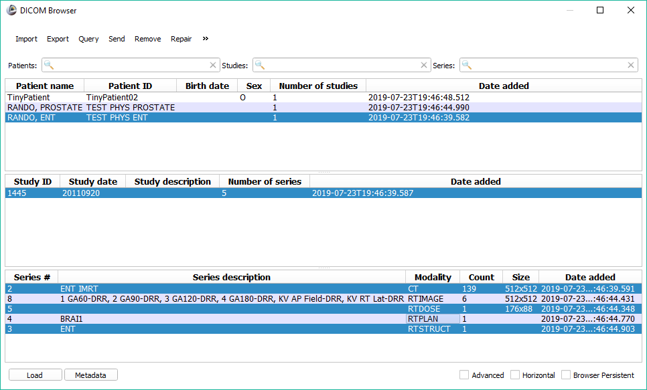
2/2. Load DICOM datasets to register
Ctrl+click to select/unselect series

Slide 10
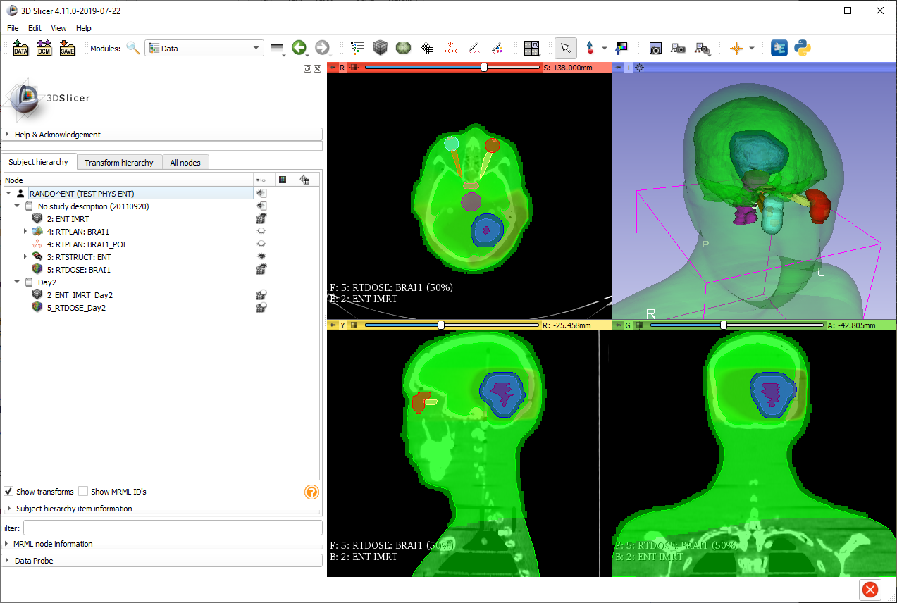
2/3. Data loaded
Data loaded (contains two images to register)
Switch to Data module to check loaded objects

Slide 11
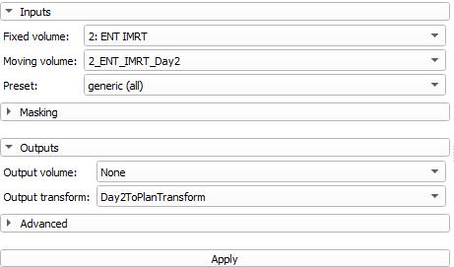
3/1. Perform registration
Automated
SlicerElastix (recommended)
BRAINS (see Slicer training page)
ModelRegistration in SlicerIGT
Landmark
FiducialRegistration in Slicer core
FiducialRegistration Wizard in SlicerIGT
...and more

Slide 12
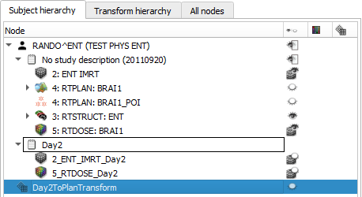
4/1. Prepare study to export
Make sure the transform to export is in a study
Create subject in scene if needed (right-click empty area)
Create study in subject if needed (right-click subject)
Drag&drop transform under study

Slide 13
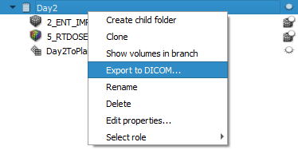
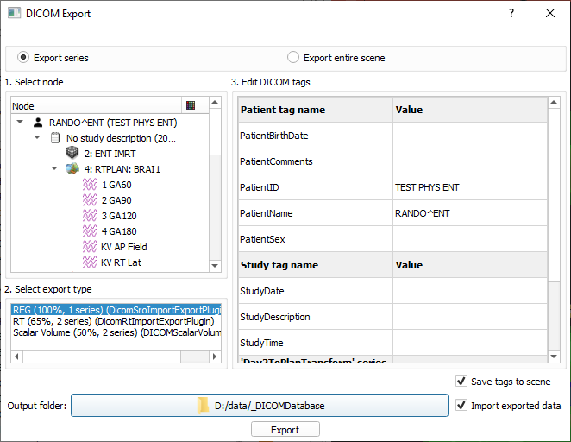
4/2. Select exported study

Slide 14
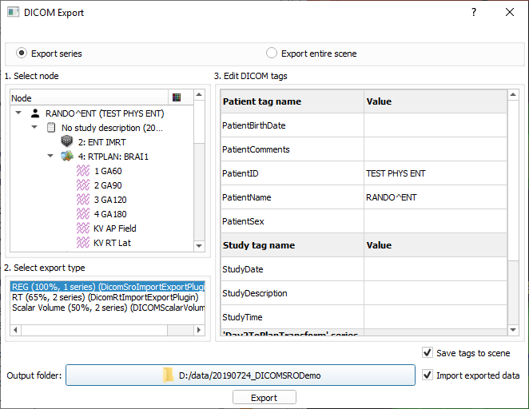
4/3. Export DICOM SRO
1. Make sure the ‘REG’ plugin is selected
2. Edit DICOM tags as needed
3. Choose output folder
4. Make sure ‘Import exported data’ is checked if you want to easily import the SRO back to Slicer
5. Click ‘Export’

Slide 15
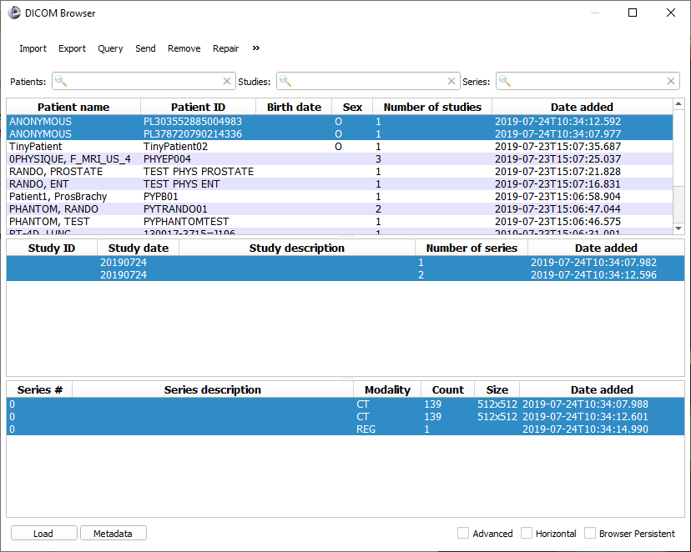
4/4. SRO exported
If ‘Import exported data’ was checked, then the studies appear in the DICOM browser. One study for each registered image, along with the registration object in the transformed study.

Slide 16
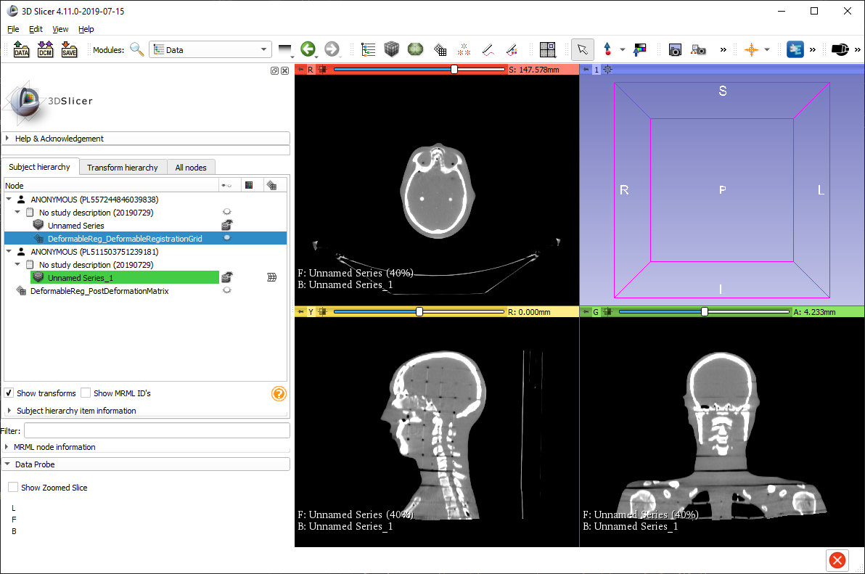
5/1. Load DICOM SRO
If we load back the studies, then we get the two images and the transform.

Slide 17
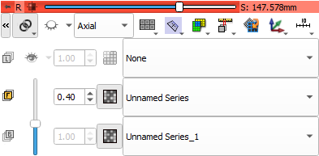
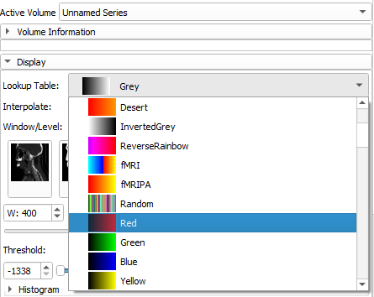
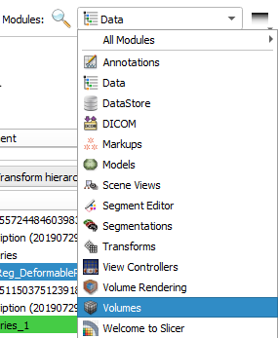
5/2. Explore registered volumes
Change color table for the volumes for better visibility of differences:
Red for one
Green for the other
Show both volumes
Go to Volumes module

Slide 18
5/3. Explore transform
1. Switch to Transforms module
2. Select transform to explore 3. Open Display section
4. Check ‘Visible’ in Visualization section 5. For 3D visualization select ‘Region’

Slide 19

Congratulations!

