Slide 1
SlicerRT 3DSlicer extensions for radiotherapy research
Andras Lasso¹, Csaba Pinter¹, Kevin Wang², Steve Pieper³, Greg Sharp⁴, and Gabor Fichtinger¹
¹Laboratory for Percutaneous Surgery, Queen’s University, Canada; ²University Health Network, Toronto, ON, Canada; ³Isomics; ⁴Massachussetts General Hospital, Boston, MA, USA

Slide 2
SparKit project overview
Goal: provide open-source platform for translational clinical research, mainly cancer
Funding: about $700k/year (including matching funding), for 5 years, started in 2011
PI & co-PI: Gabor Fichtinger (Queen’s), David Jaffray (Toronto UHN), Terry Peters (Robarts)
Themes:
SlicerRT: radiotherapy toolkit for 3D Slicer
SlicerIGT: Image-guided therapy with 3D Slicer

Slide 3
SlicerRT theme overview
Motivation: commercial treatment planning software are costly and closed, existing research tools & applications (CERR, PLUNC, dicompyler, ...) are limited
Goal: provide a free, open-source software platform for radiotherapy (RT) research
Approach:
Use 3DSlicer as platform
Implement DICOM-RT data import: mapping RT data structures to existing 3DSlicer data types
Utilize existing 3DSlicer functionalities: registration, visualization, ...
Develop missing RT-specific functionalities: DVH analysis, ...
Export results in DICOM-RT (for importing into treatment planning system) or for further analysis (in Matlab, ...)

Slide 4
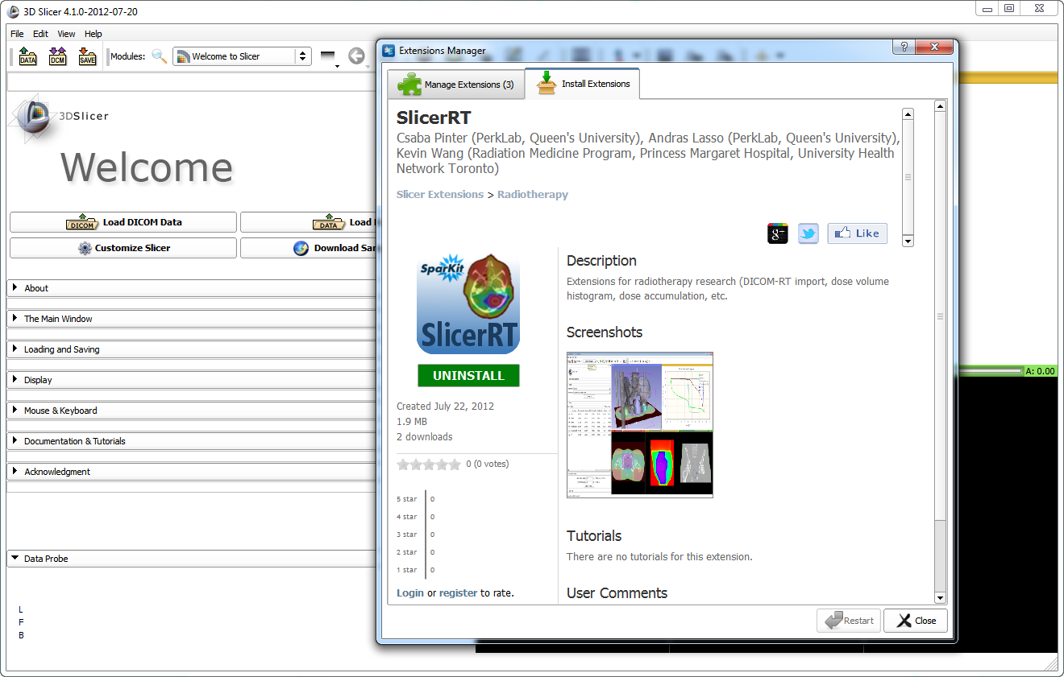
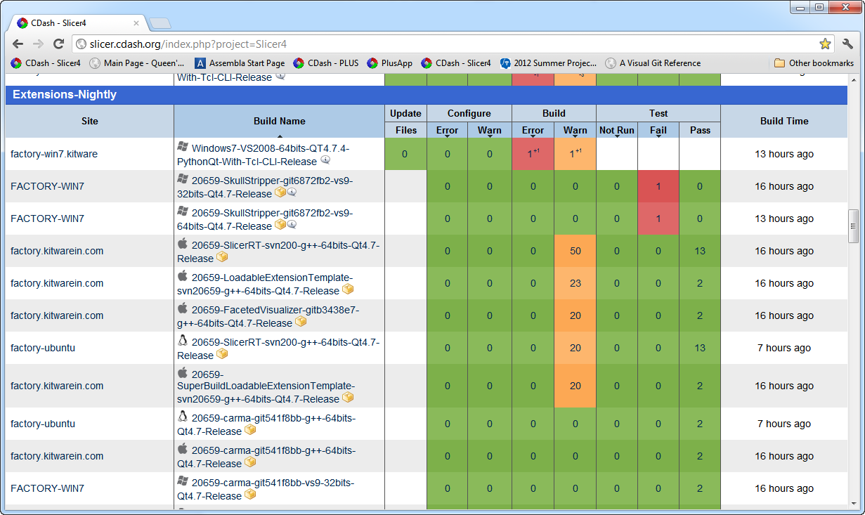
SlicerRT extension for 3D Slicer
Collection of RT-specific modules
Distributed as a 3D Slicer extension: can be downloaded, installed, upgraded using the extension manager in Slicer
Extensive automatic testing done on multiple platforms
Dashboard showing automatic test results
SlicerRT in the 3D Slicer app store (free)

Slide 5
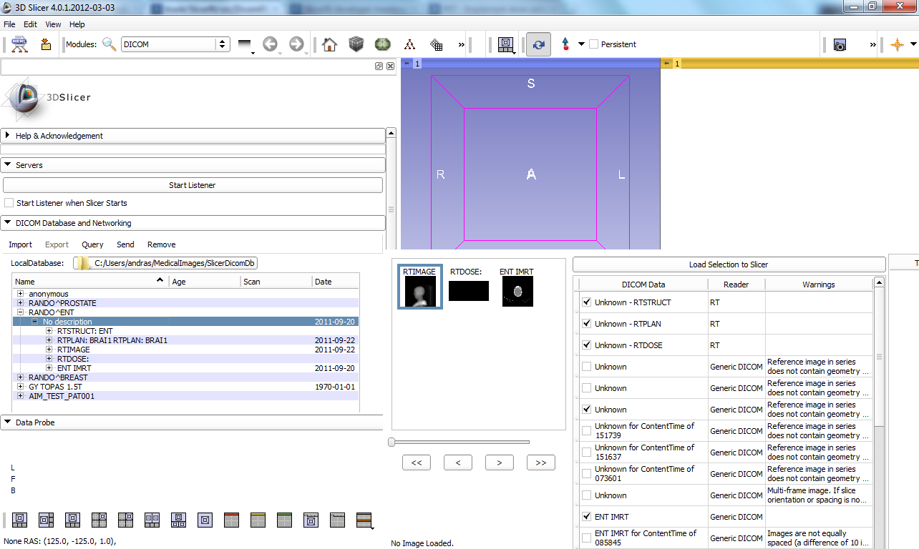
DICOM-RT import module
Integrated into core DICOM import module
Mapping to existing structures:
Structure sets -> each structure set is imported as either a model (for planar contour ROI) or a fiducial point (for point ROI)
Structure set color -> model color
Structure set name -> model node name
Slice thickness (for planar contour) -> ribbon filter width
Dose map -> scalar volume
dose unit -> MRML node attribute
RT image -> read as regular volume
Planning CT, MR, etc. -> read as regular volume
RT plan -> only isocenter positions imported
Source code: https://www.assembla.com/code/sparkit/subversion/nodes/trunk/SlicerRt/src/DicomRtImport

Slide 6
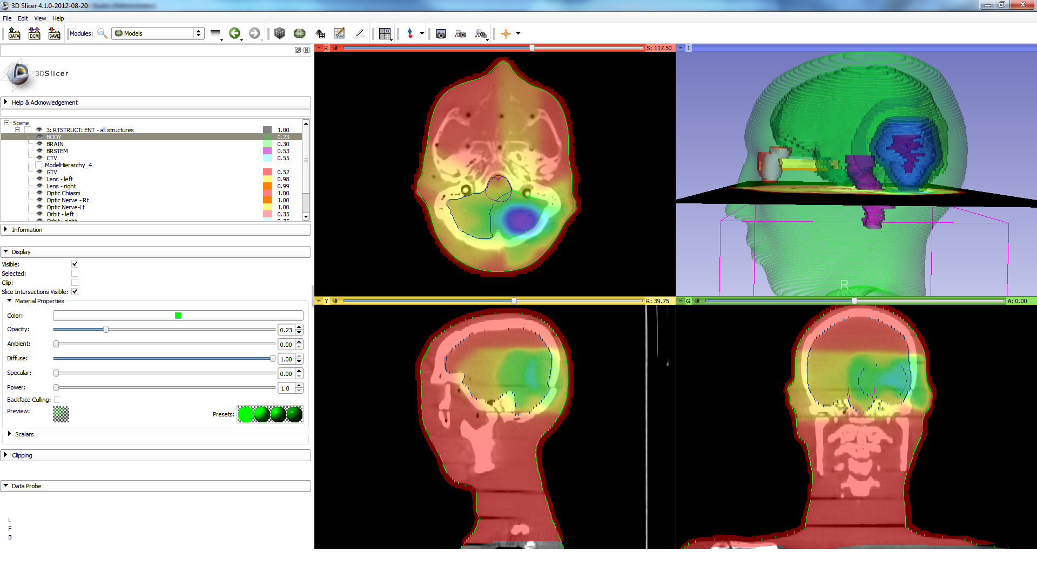
Imported structure sets, dose map, CT

Slide 7
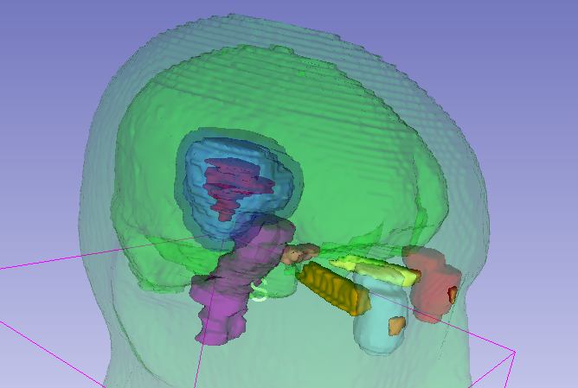
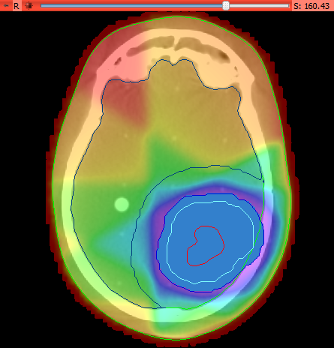
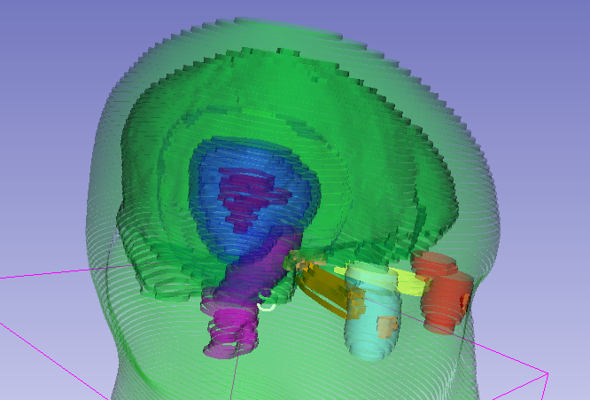
Imported contours can be converted to closed surface models, displayed on the image slices, transformed, etc.
Contours converted to closed surface
Imported contours (surface model, ribbons)
Contours converted to labelmap

Slide 8
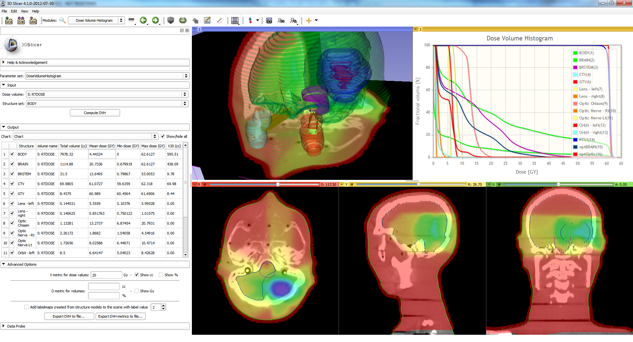
Dose Volume Histogram module

Slide 9
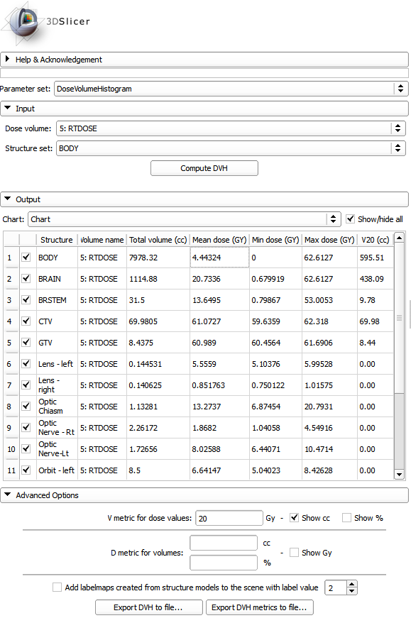
Dose metrics
Available metrics:
Total volume
Min, max, mean dose
V metrics: for user-defined levels, results in cc and %
D metrics: for user-defined levels in cc and %
Values can be exported to CSV file for further analysis.

Slide 10
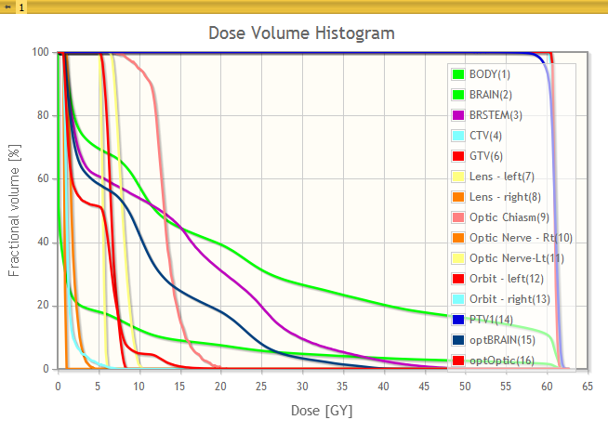
DVH plot
Displayed on screen; zoom, trace, etc. available
Bin values can be exported CSV file

Slide 11
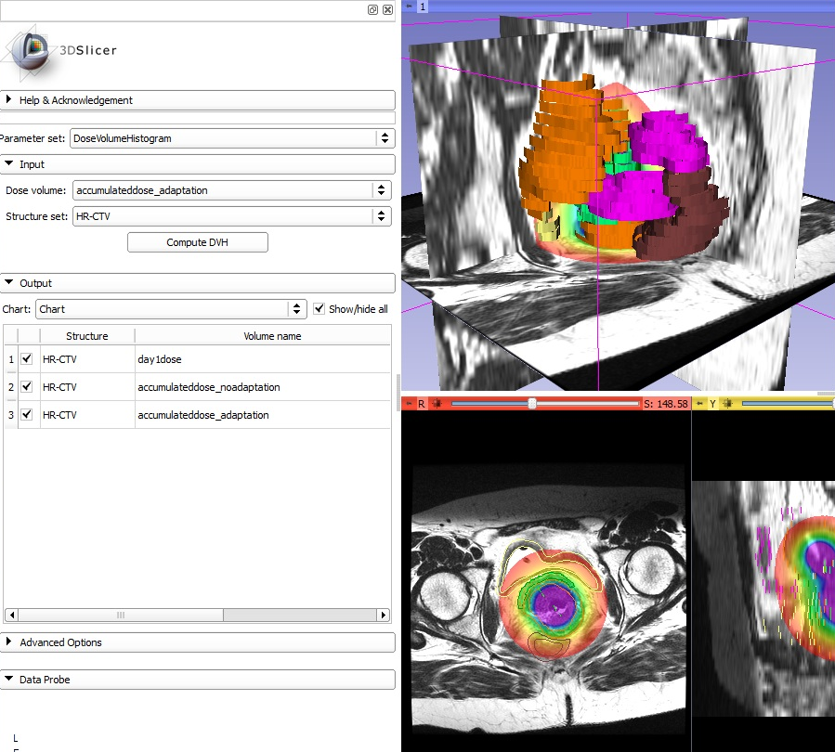
Dose accumulation module
Computes a weighted sum of selected dose volumes.

Slide 12
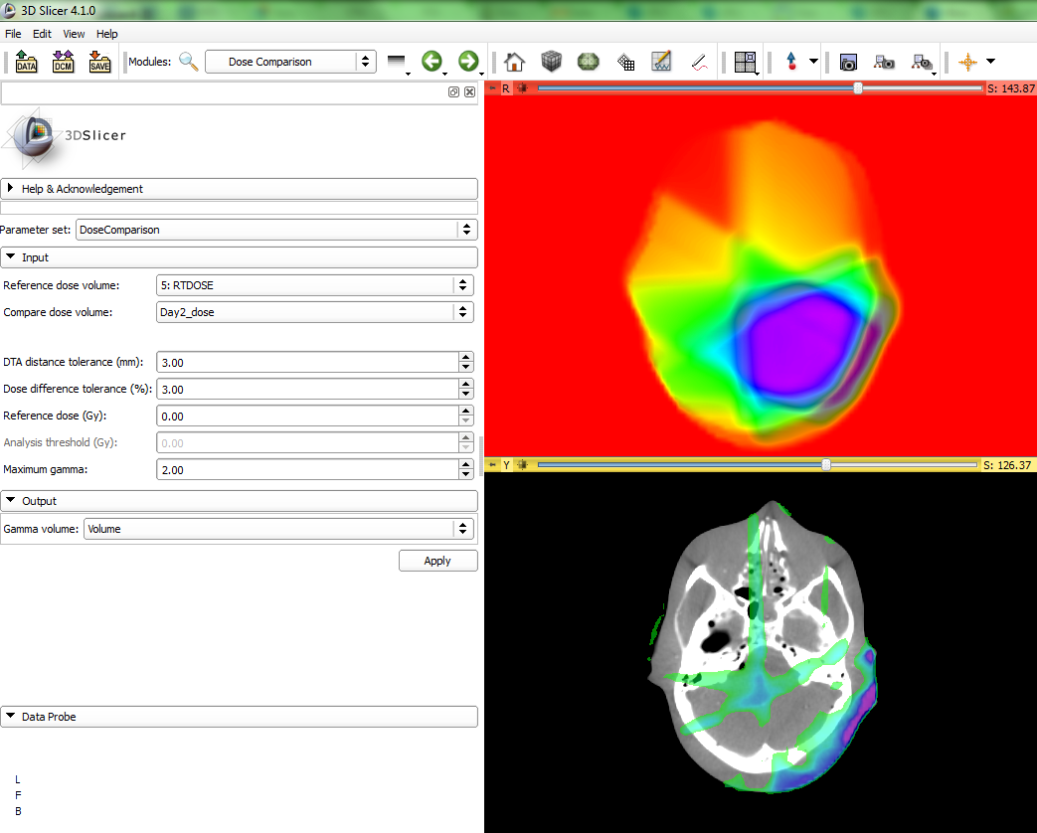
Dose comparison module
Computes dose difference using the gamma function

Slide 13
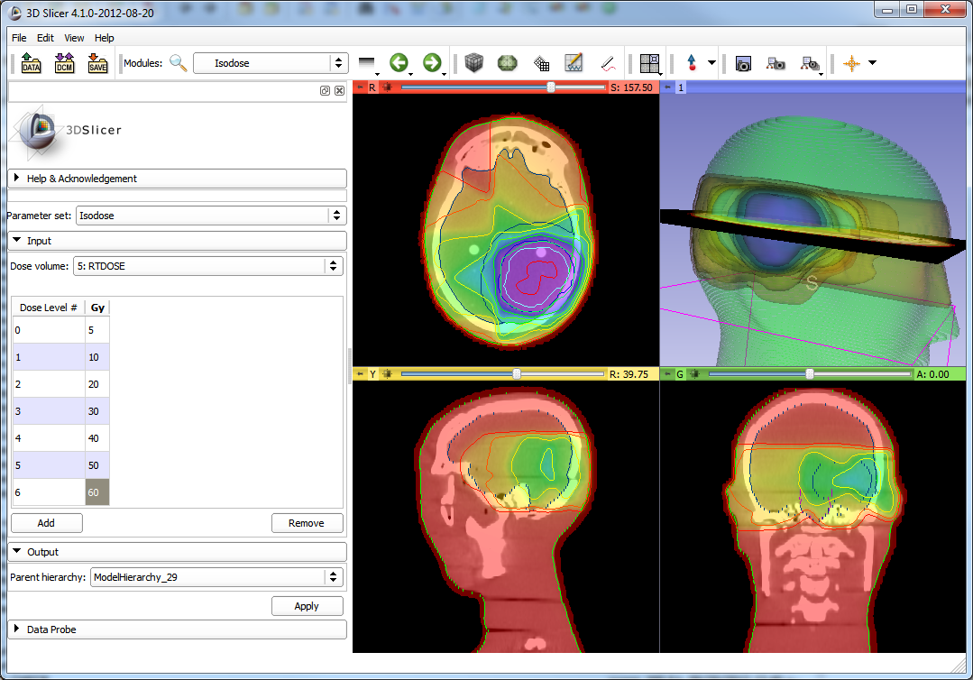
Isodose module
Creates isosurfaces from an input dose volume and a series of defined isodose levels

Slide 14
SlicerRT development plan
Planned high-level features:
Extensive validation, comparison of computation results to commercial TPS software
Dose volume histogram comparison
Structure set comparison
DICOM-RT export
Matlab bridge: data exchange with Matlab, running Matlab scripts
Detailed plan: https://www.assembla.com/spaces/sparkit/tickets

Slide 15
More details
SparKit: https://www.assembla.com/spaces/sparkit/
SlicerRT: https://www.assembla.com/spaces/sparkit/wiki/SlicerRt
Questions, feature requests contact: Andras Lasso (lasso@cs.queensu.ca)

Slide 16
Appendix

Slide 17
Other RT related Slicer projects
Adaptive radiotherapy for head and neck cancer (http://www.na-mic.org/pages/DBP:Head_and_Neck_Cancer)
Funded by NA-MIC, 2010-2013
PI: Greg Sharp (MGH, Boston, MA)
4 researchers, software engineers
NA-MIC collaborations in preparation (http://www.na-mic.org/Wiki/index.php/ Events:Computational_Methods_for_Radiation_Oncology)
All these related are coordinated (through teleconferences, meetings at NA-MIC project weeks, etc.), collaborative efforts.
SlicerRT uses Plastimatch internally for certain computations.

Slide 18
CERR vs. SlicerRT
 | CERR | 3D Slicer & SlicerRT
 | http://cerr.info/features.php
Multimodality Image Fusion | Yes | Yes
PET Import | Yes | Yes
SPECT Import | Yes | Yes
MR Import | Yes | Yes
Visualization tool to compare Scan and Dose. | Yes | Yes
DICOM Export and Import(Optional) options. | Yes | Yes, export not yet available (using SlicerRT)
Conversion of RTOG format treatment planning archives or DICOM-RT into the Matlab-readable CERR format. | Yes | Not available yet
Interactive CERR command line help. | Yes | Yes
DICOM RT html help documentation is provided under help menu. | Yes | Yes
Translation of structures in x,y,z. | Yes | Yes
Captures the snap shot of CERR and saves in the desired location as PNG. This can be accessable through an HTML doc. | Yes | Yes
UID linkage usage shown in DVH | Yes | Not available yet
Added slider bar to scroll through selected structures in IMRTP | Yes | Not available yet
Added 3-D expansion option under “Derive New Structure” | Yes | Yes
A transverse/sagittal/coronal slice viewing program for reviewing contours, CT scans, and dose distributions. | Yes | Yes
Colorwash, transparent colorwash, or isodose line dose display. | Yes | Yes (more convenient user interface WIP using SlicerRT)
Dose-volume and Dose-surface histogram analysis. | Yes | Yes, DSH not yet available (using SlicerRT)
Intensity Volume Histogram | Yes | Yes
Contouring/re-contouring tools. | Yes | Yes
3-D viewing of contours and dose, opaque or transparent. | Yes | Yes
Thumbnail CT navigation tool. | Yes | Yes
Dose-projection displays. | Yes | Not available yet
Dose-distance plots. | Yes | Not available yet
Dose metric comparison and subtraction tools. | Yes | WIP (using SlicerRT)
Easy programmable access to all data. | Yes | Yes (Python, VTK, SimpleITK)
Registration (deformable, non-deformable) | No | Yes
Efficient memory management | No | Yes
Optimized computation & visualization performance | No | Yes
Free, open-source | yes (except Matlab) | Yes
DICOM listener | No | Yes
Large user and developer community | No | Yes
Annotations (points, ruler, ROI) | No | Yes
Multiple OS support (Windows, Linux, Mac) | Yes | Yes

