Slide 1
Tutorial: Prostate MRI-US Contour Propagation
Csaba Pinter
Laboratory for Percutaneous Surgery, Queen’s University, Kingston, ON, Canada

Slide 2
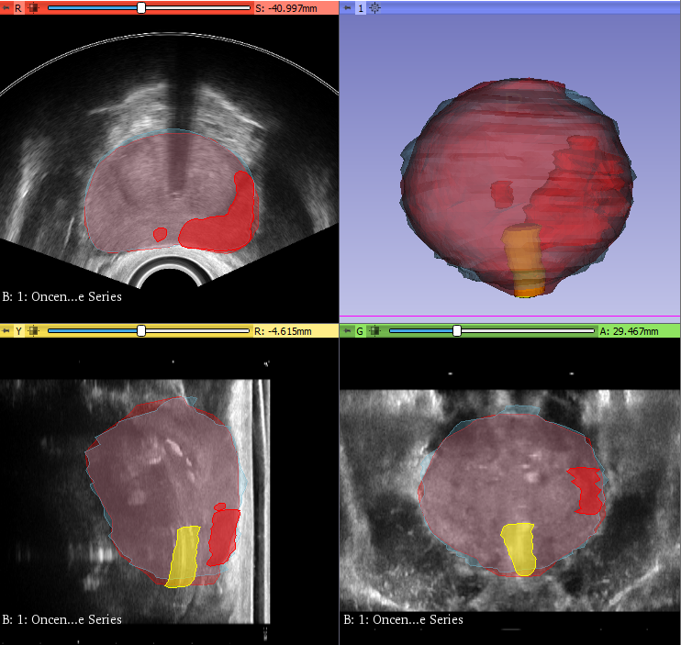
Learning objective
This tutorial demonstrates how to perform contour propagation (‘fusion’) of prostate MRI contours onto ultrasound for brachytherapy planning and guidance
Fusion done: MRI contours superimposed on ultrasound prostate

Slide 3
Overview
Install required software
Load data from DICOM
Contour propagation
Evaluate results
Export propagated contours to DICOM

Slide 4
1/1. Install 3D Slicer
Download 3D Slicer preview from https://download.slicer.org/
Find the downloaded 3D Slicer package on your computer
Follow the usual steps to install an application
Different for each operating system

Slide 5
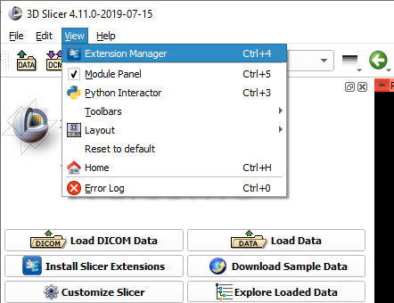

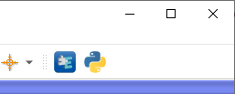
1/2. Install SlicerRT extension
or

Slide 6
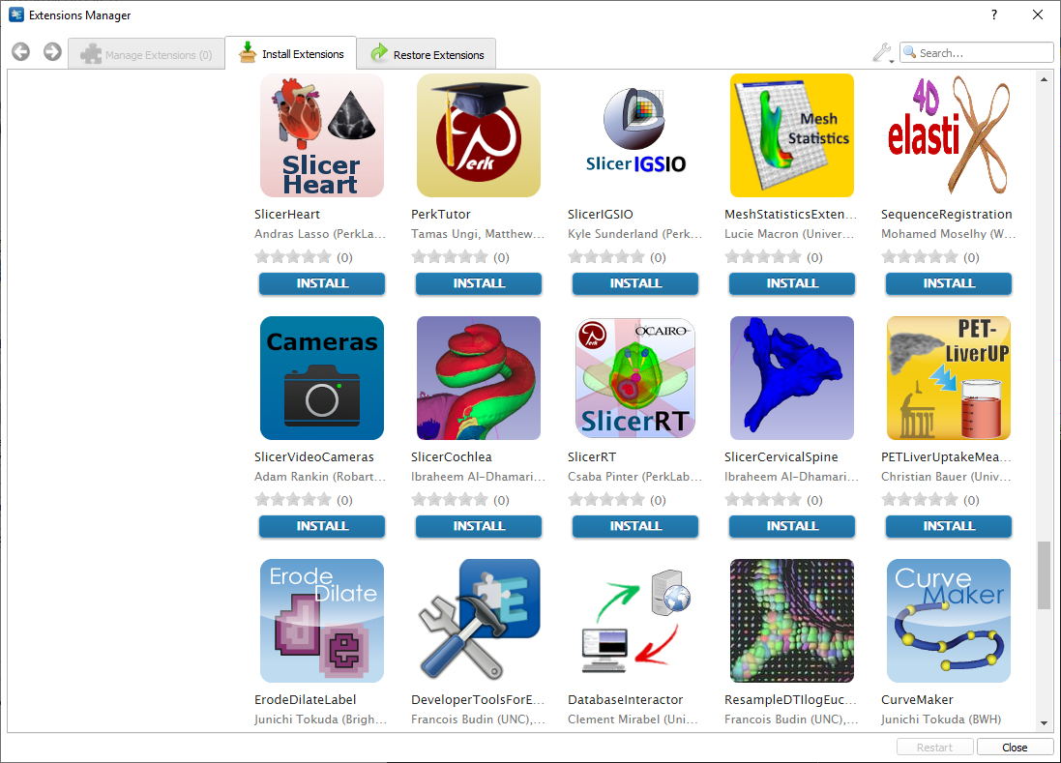
1/3. Install SlicerRT extension

Slide 7
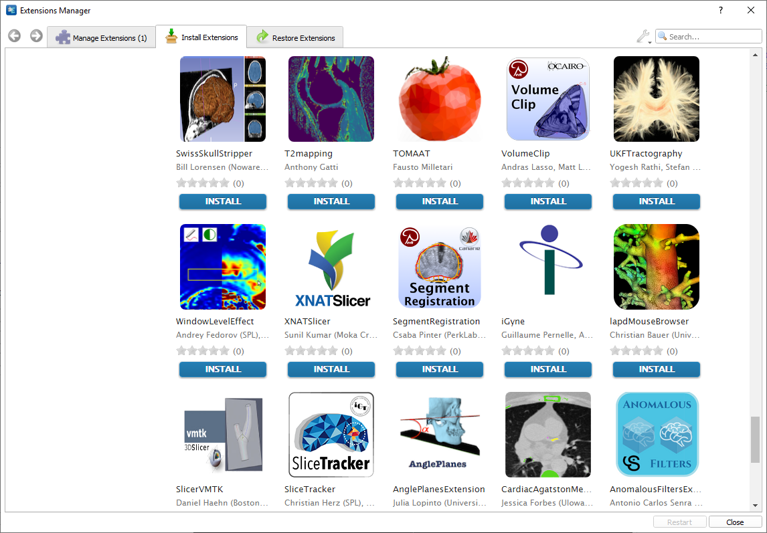
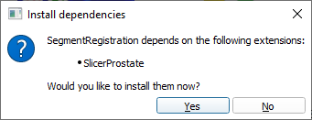
1/4. Install SegmentRegistration extension

Slide 8
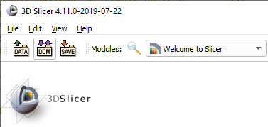
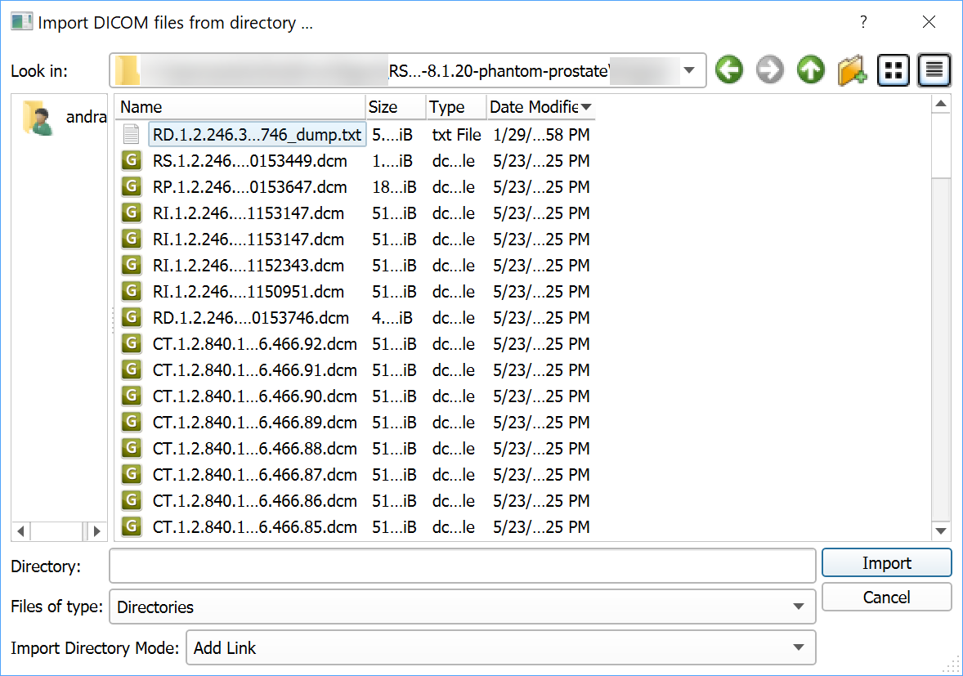
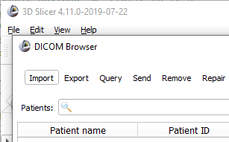
2/1. Import DICOM dataset

Slide 9
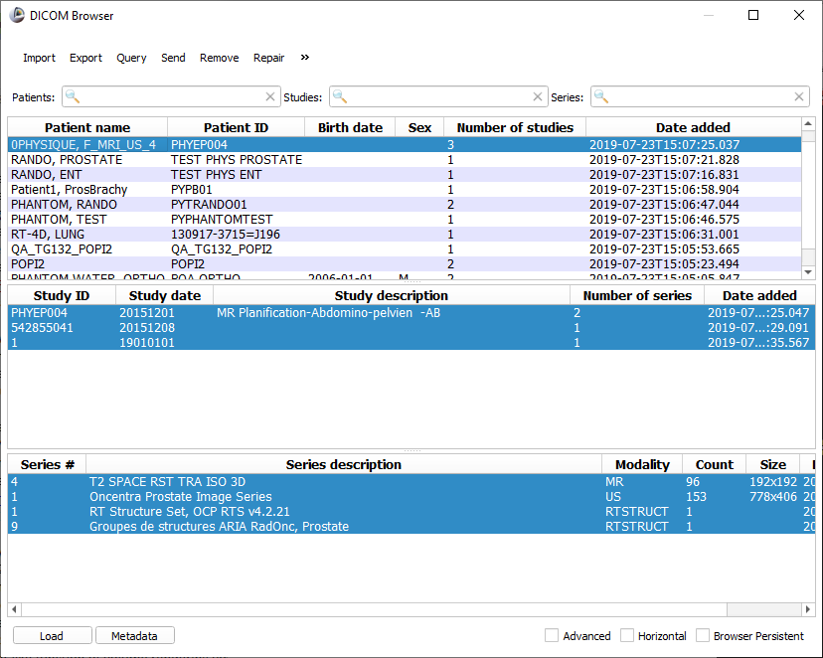
2/2. Load DICOM dataset
1. Load studies containing both the MRI and the US images and segmentations
2. Use Ctrl+click for multiple selection
3. Click ‘Load’

Slide 10
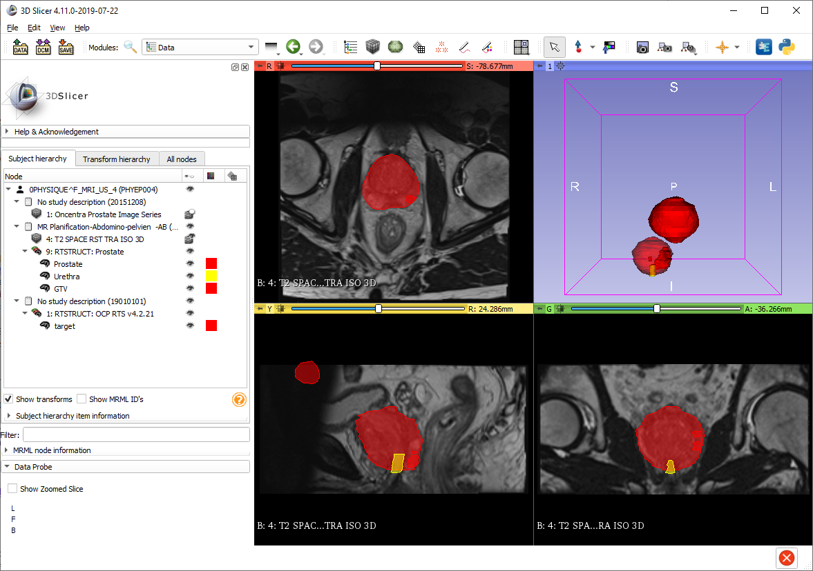
2/3. Data loaded
Data loaded
Switch to Data module to check loaded objects

Slide 11
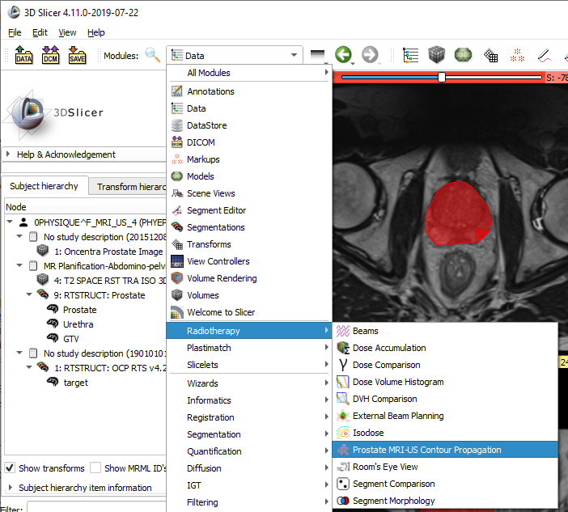
3/1. Switch to Prostate MRI-US Contour Propagation module

Slide 12
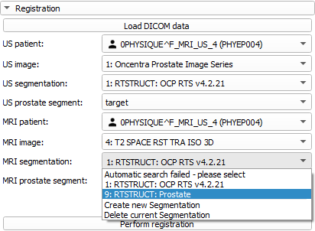
3/2. Select data objects and perform fusion
Data will be pre-selected automatically based on DICOM hierarchy, but need to make sure it’s correct.
1. Review selection in each drop-down box and change if needed
2. Click ‘Perform registration’ button

Slide 13
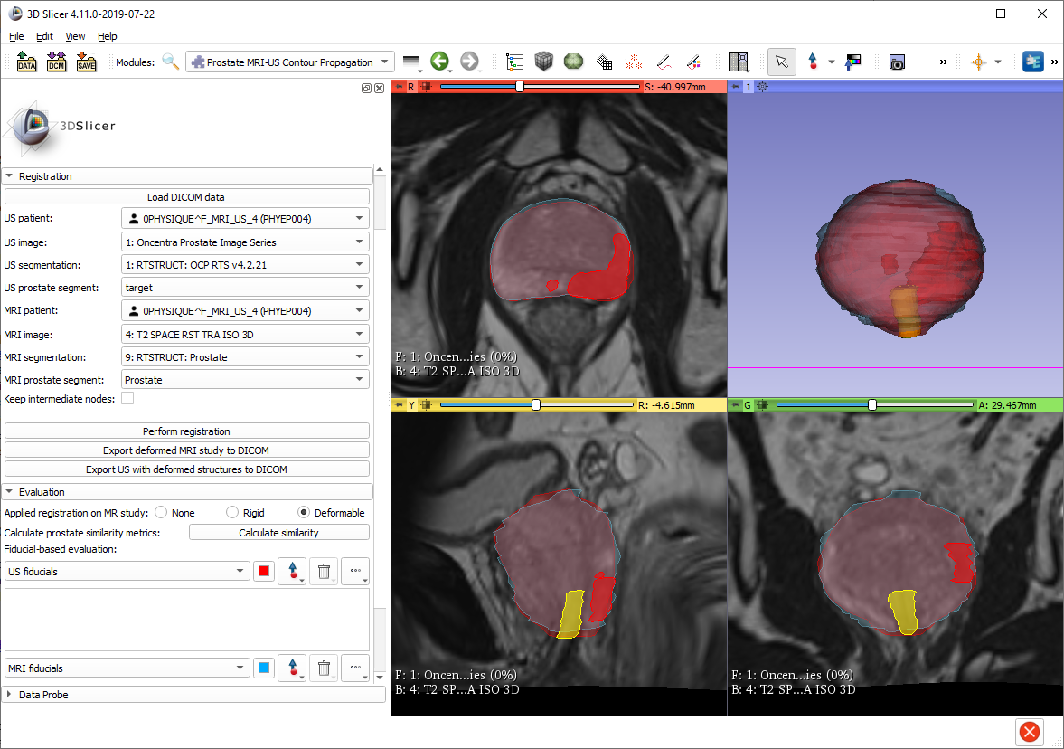
4/1. Check registration stages

Slide 14
4/2. Calculate similarity metrics

Slide 15
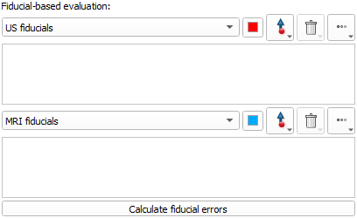
4/3. Fiducial-based evaluation
If target registration error (TRE) needs to be calculated, then use the Fiducial-based evaluation section:
1. Place fiducials at important anatomical positions on the US image
2. Repeat for MRI
3. Click ‘Calculate fiducial errors’ button

Slide 16

5/1. Export propagated contours to DICOM
To use the propagated contours in a planning or guidance system, they need to be exported to DICOM.
Two different DICOM export options are available that export the propagated data in the existing studies by a single button click.

Slide 17

Congratulations!

