Slide 1

TITLE
Exploring Sustainable Growth Opportunities in Michoacan Mexico
A Comprehensive Analysis of Endemic Plants and Strategic Implementation Strategies

Slide 2
Table of contents
Endemic Plants from Michoacan Mexico
Key Features
Benefits of Adoption
Steps to Implementation
Timeline of Events
SWOT Analysis of Product Launch
Revenue Growth in 2023
Benefits vs. Costs
PESTEL Analysis: Market Environment
Maslow's Hierarchy of Needs
01
02
03
04
05
06
07
08
09
10
TITLE

Slide 3
TITLE
Endemic Plants from Michoacan Mexico
Palmillo de Michoacan
Cupreata Agave
Michoacan Pine
Michoacan Oak
Michoacan Magnolia
A rare palm species native to the region.
Known for producing mezcal, a traditional Mexican spirit.
Endemic pine tree species found in the highlands of Michoacan.
A symbol of strength and resilience in the local ecosystem.
Beautiful flowering tree species unique to the area.
Exploring Sustainable Growth Opportunities in Michoacan Mexico
1

Slide 4
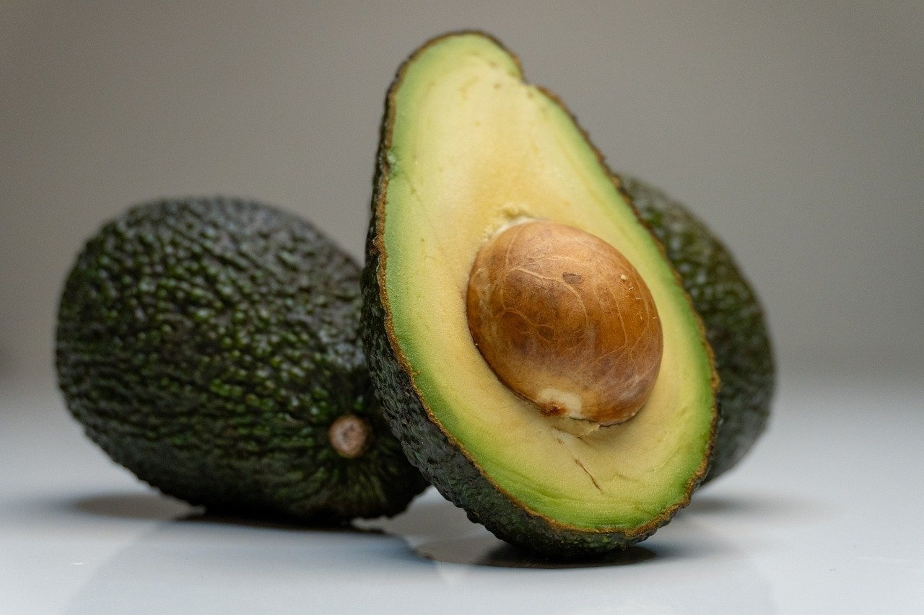
TITLE
Key Features
Avocado Trees
Pine Trees
Oyamel Fir Trees
Endemic to Michoacan
Known for high-quality Hass avocados
Abundant in the region
Provide essential habitat for local wildlife
Unique to Michoacan's high-altitude forests
Serve as a critical overwintering site for monarch butterflies
Exploring Sustainable Growth Opportunities in Michoacan Mexico
2

Slide 5
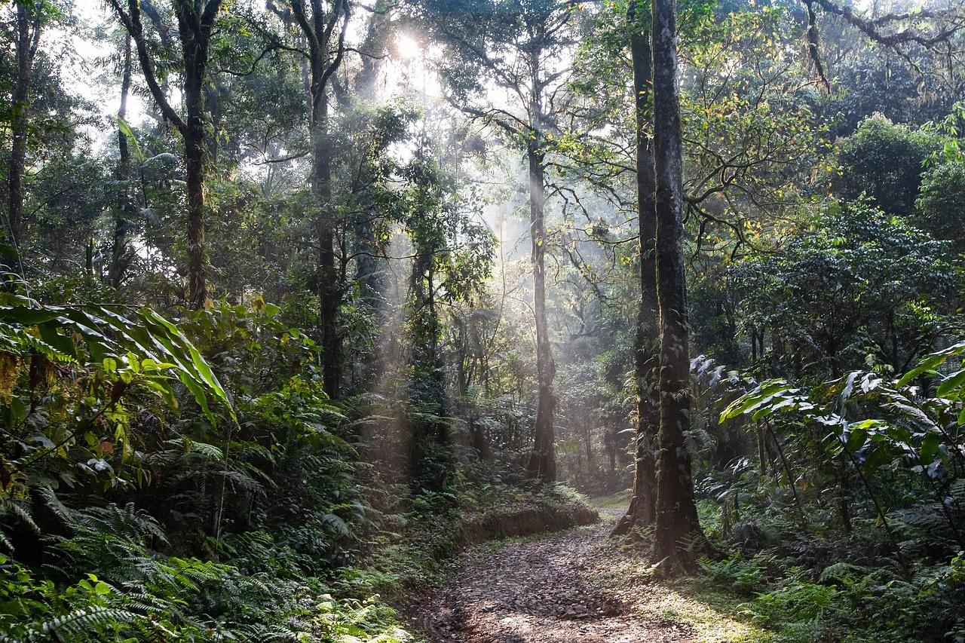
TITLE
Benefits of Adoption
Preservation of Biodiversity
Environmental Sustainability
Protects unique and rare plant species native to Michoacan, Mexico.
Supports the ecosystem by maintaining the balance of endemic plants.
Cultural Heritage Conservation
Economic Opportunities
Safeguards traditional knowledge and practices associated with endemic plants.
Stimulates eco-tourism and sustainable agriculture, benefiting local communities.
Exploring Sustainable Growth Opportunities in Michoacan Mexico
3

Slide 6
Steps to Implementation
TITLE
01
02
03
04
05
Identify Endemic Plants in Michoacan
Conduct Ecological Surveys
Establish Conservation Areas
Implement Sustainable Cultivation Practices
Collaborate with Local Communities
Research and compile a list of native plant species exclusive to the region.
Assess the current status and distribution of endemic plants in Michoacan.
Designate protected zones to safeguard the habitats of endemic plant species.
Promote eco-friendly farming techniques to preserve endemic plant populations.
Engage with residents to raise awareness and involve them in conservation efforts.
Exploring Sustainable Growth Opportunities in Michoacan Mexico
4

Slide 7
Timeline of Events
2021
Launch of conservation efforts to protect the endemic flora of Michoacan, promoting sustainable growth opportunities.
2008
Declaration of the agave landscape of Tequila as a UNESCO World Heritage site, showcasing sustainable agriculture practices.
TITLE
1937
Establishment of the Paricutin volcano, leading to unique ecological adaptations in the region.
1860s
Discovery of the Monarch Butterfly Biosphere Reserve, home to various endemic plant species.
1500s
Arrival of Spanish conquistadors led to the introduction of new plant species to Michoacan.
Exploring Sustainable Growth Opportunities in Michoacan Mexico
5

Slide 8
TITLE
S
W
Strengths
Weaknesses
SWOT Analysis of Product Launch
Unique selling proposition: Utilizing rare endemic plants from Michoacan Mexico.
Sustainable sourcing practices: Appeal to environmentally conscious consumers.
Limited availability: Challenges in scaling production due to the endemic nature of the plants.
Higher production costs: Processing and extracting from rare plants may increase manufacturing expenses.
O
T
Opportunities
Threats
Growing demand for natural products: Tap into the increasing market for organic and sustainable goods.
Differentiation in the market: Stand out from competitors by offering a truly unique product.
Regulatory hurdles: Compliance with stringent regulations on the use of endangered plant species.
Potential imitation: Risk of competitors replicating the concept with synthetic alternatives.
Exploring Sustainable Growth Opportunities in Michoacan Mexico
6

Slide 9
TITLE
Revenue Growth in 2023
Introduction of Endemic Plants
Collaboration with Botanical Gardens
Expansion of Eco-Tourism
Online Sales Platform
Educational Workshops
Increase revenue by showcasing the unique and diverse endemic plant species of Michoacan, Mexico.
Partner with local botanical gardens to promote and sell endemic plants, driving revenue growth.
Develop eco-tourism initiatives centered around showcasing Michoacan's endemic plants to attract more visitors and increase revenue.
Launch an online platform to sell seeds, plants, and products derived from endemic plants, tapping into a wider market and boosting revenue.
Offer workshops on the cultivation and care of endemic plants to generate revenue through participation fees and product sales.
Exploring Sustainable Growth Opportunities in Michoacan Mexico
7

Slide 10
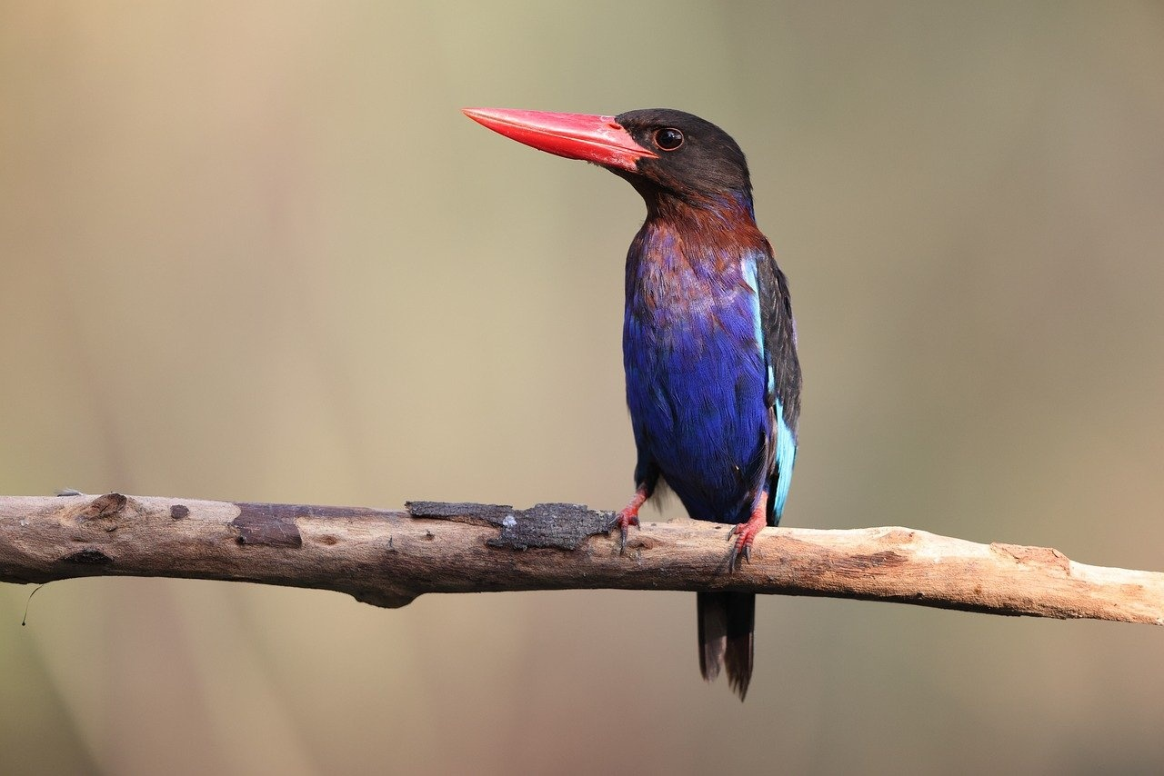
TITLE
Benefits vs. Costs
Benefits of Endemic Plants from Michoacan Mexico
Costs of Endemic Plants from Michoacan Mexico
Rich biodiversity supporting ecosystem health
Potential for unique pharmaceutical discoveries
Threat of habitat destruction due to urbanization
Challenges in sustainable harvesting practices
Exploring Sustainable Growth Opportunities in Michoacan Mexico
8

Slide 11
PESTEL Analysis: Market Environment
TITLE
E
S
T
E
L
Political
Economic
Social
Technological
Environmental
Legal
Government policies supporting conservation efforts for endemic plants.
Regulations on sustainable harvesting practices.
Growing demand for endemic plants in the global market.
Economic incentives for local communities engaging in sustainable cultivation.
Cultural significance of endemic plants in traditional ceremonies.
Increasing awareness and appreciation for biodiversity conservation.
Advancements in biotechnology for propagation of rare endemic species.
Digital platforms facilitating direct sales of endemic plant products.
Impact of climate change on the distribution of endemic plants.
Conservation efforts to protect natural habitats of endemic species.
Intellectual property rights protection for endemic plant species.
Compliance with international trade regulations for endangered plants.
Exploring Sustainable Growth Opportunities in Michoacan Mexico
9

Slide 12
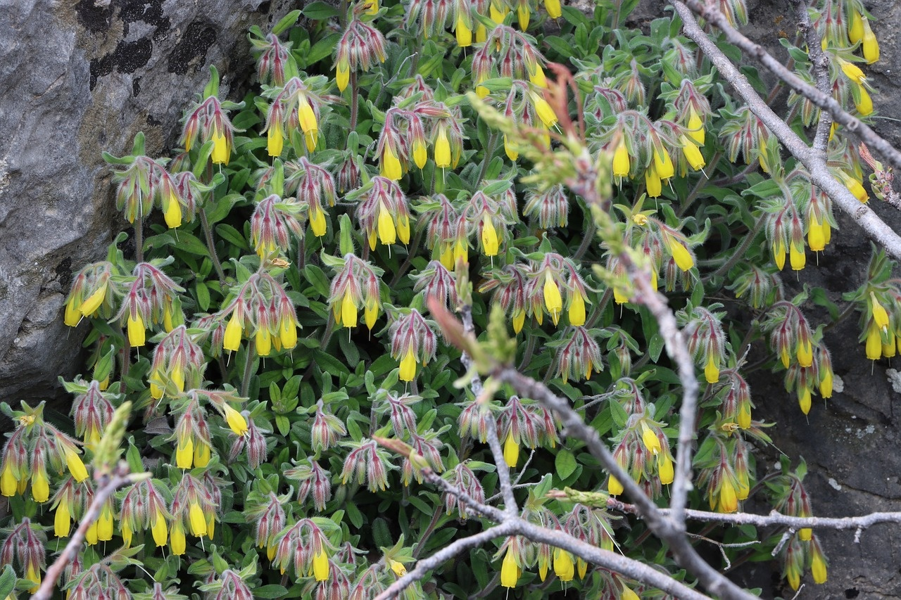
TITLE
Maslow's Hierarchy of Needs
Endemic Plants of Michoacan Mexico
Exploring Sustainable Growth Opportunities in Michoacan Mexico
10

