Slide 1
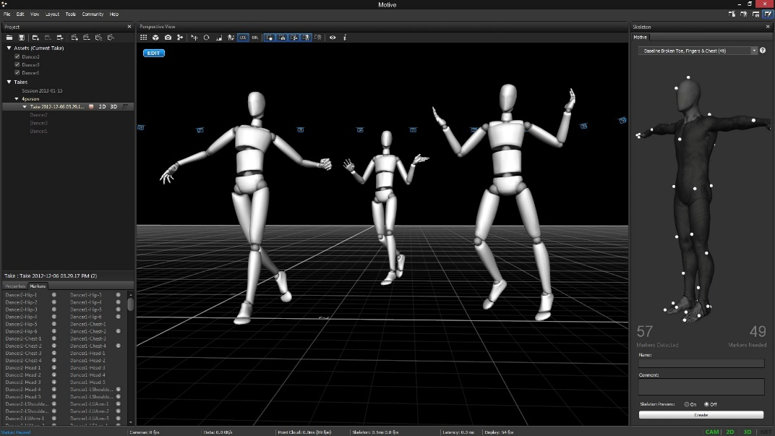
Methods: Step 1
Analyzing which data we actually need
Collect motion capturing data
Image Source: https://optitrack.com/

Slide 2
Methods: Step 1
Designing a python application to intercept data between OptiTrack and Unity
OptiTrack
Python-Interface
Unity
Prediction

Slide 3
Methods: Step 2
Creating and training the neuronal network models
Validating predictions with already gathered data
Tuning of the hyperparameters
Creation of a Unity application to display the data collected via motion capturing and adapted with the help of the NN

Slide 4
Methods: Step 3
Conducting user study for performance measuring
Level of presence
Limb ownership

