Slide 1
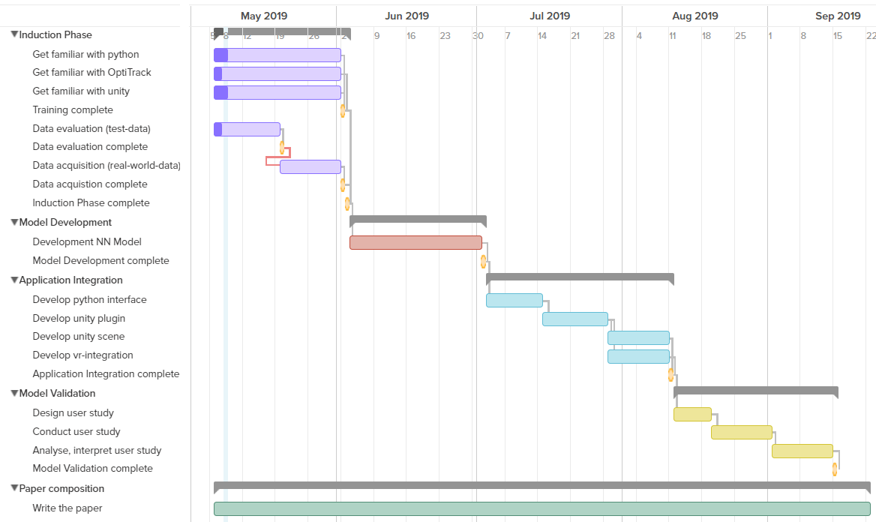
Project Plan

Slide 2
User Stories
As user I want to move in VR without latency to have a realistic experience
As developer I want to create a VR without latency in order to ensure an optimal immersion
As scientist I want to monitor the effects of latency on the users' immersive experience in VR in order to compare various latency levels with those of various users
As scientist I want to measure the effects of latency towards the users' performance in VR in order to quantify those.

Slide 3
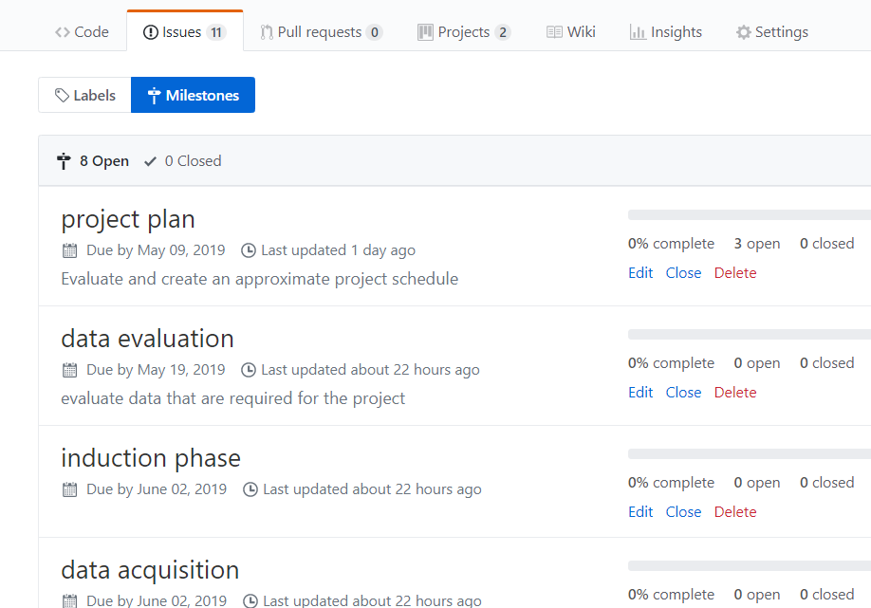
GitHub

Slide 4
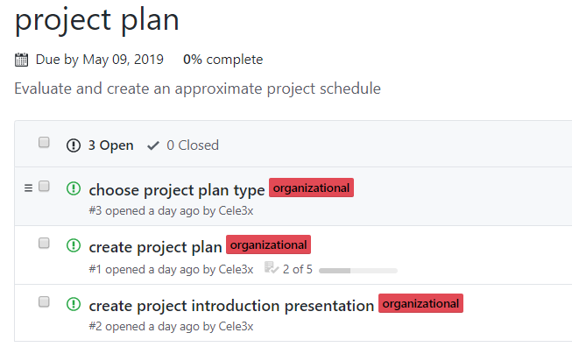
GitHub

Slide 5
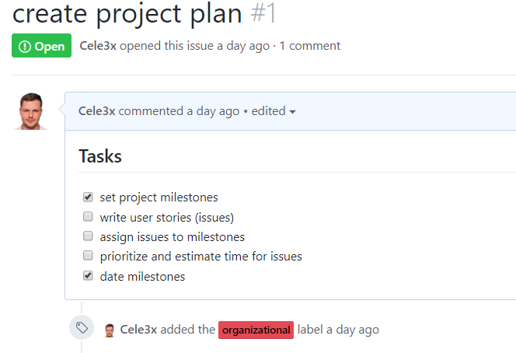
GitHub

Slide 6
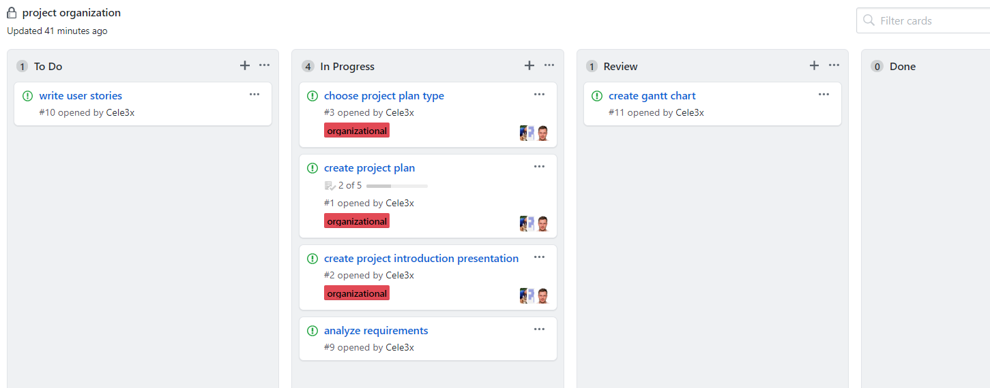
GitHub

