Slide 1
Using Artificial Neural Networks to Predict Avatar Movement in VR

Slide 2
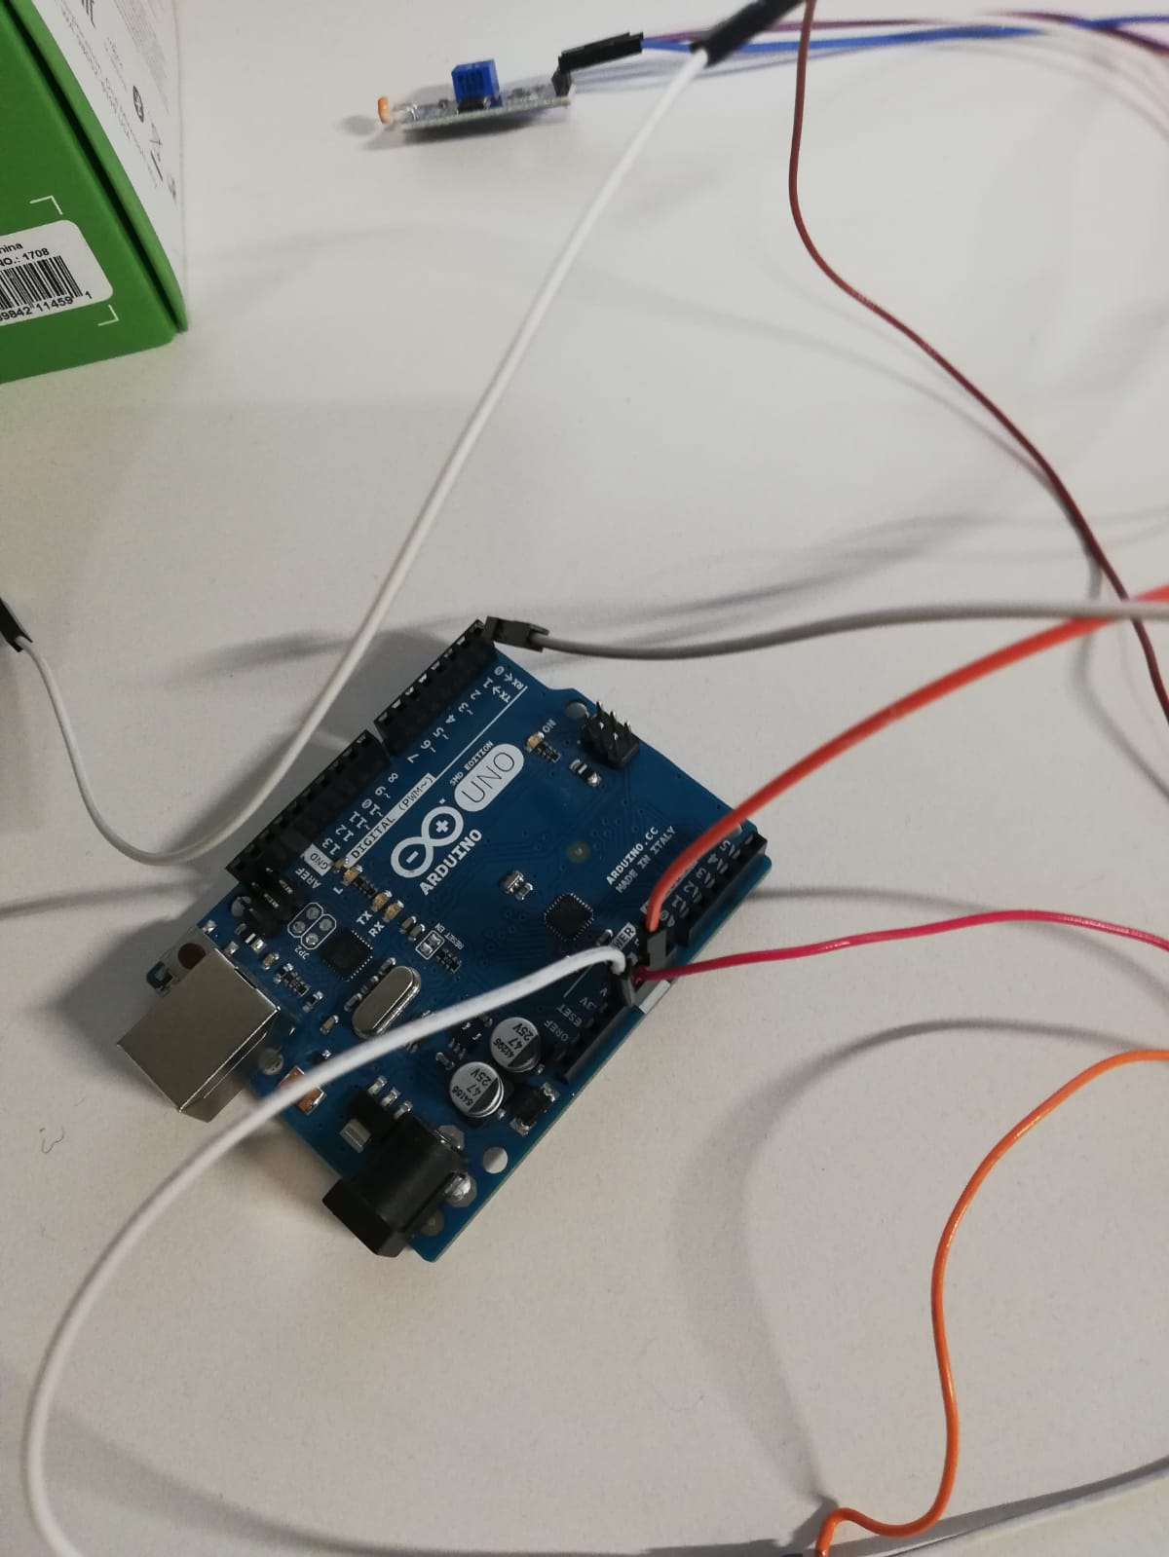
Latency Test Framework

Slide 3
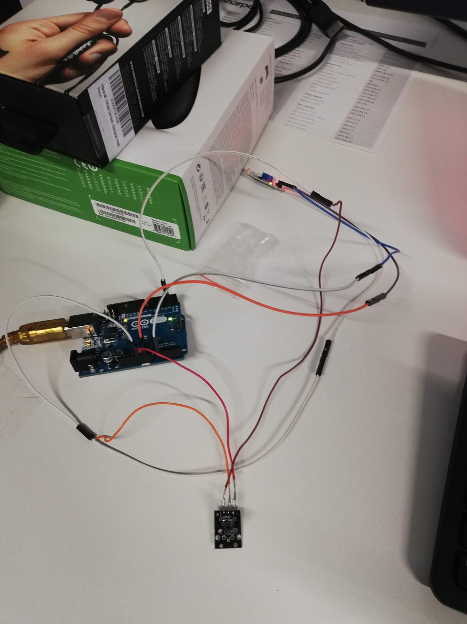
Latency Test Framework

Slide 4
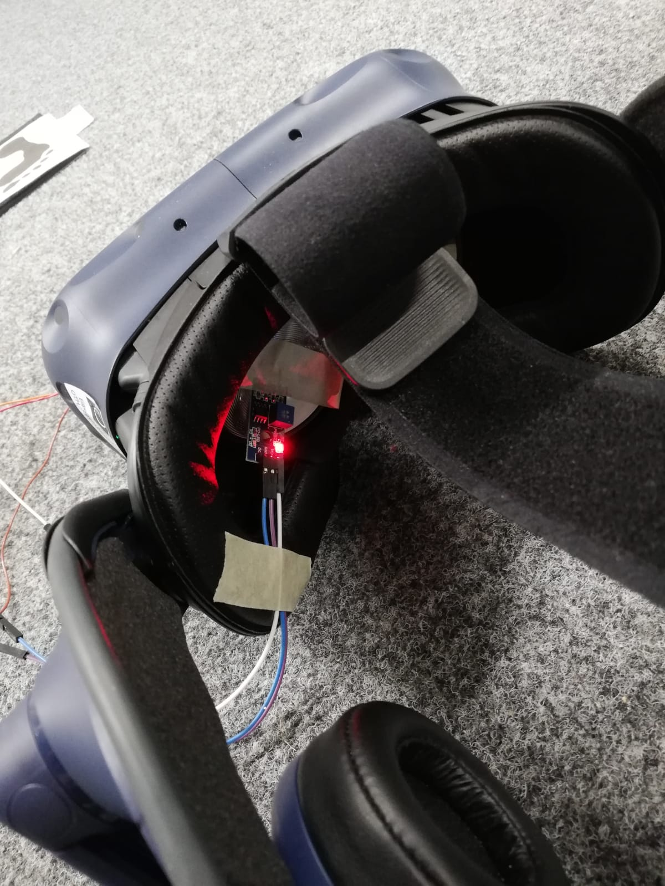
Latency Test Framework

Slide 5
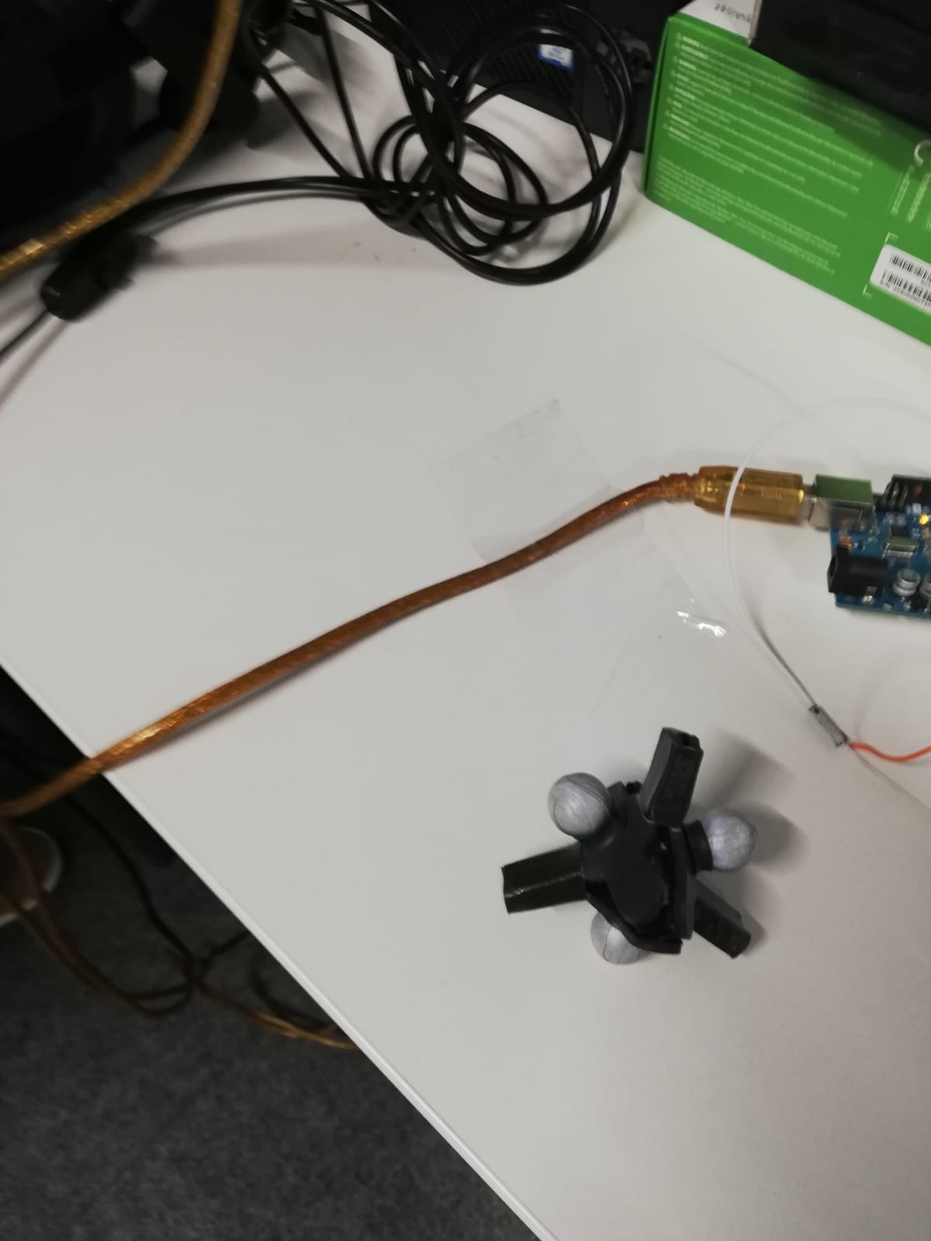
Latency Test Framework

Slide 6
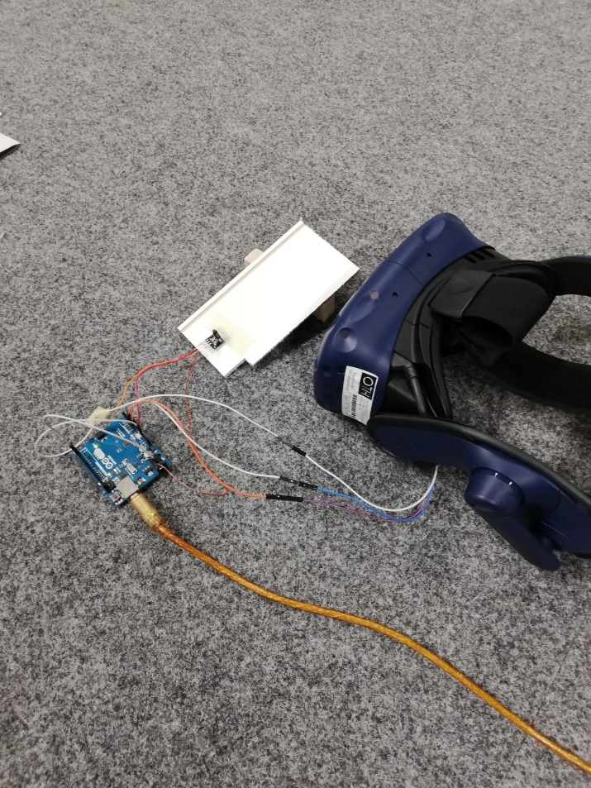
Latency Test Framework

Slide 7
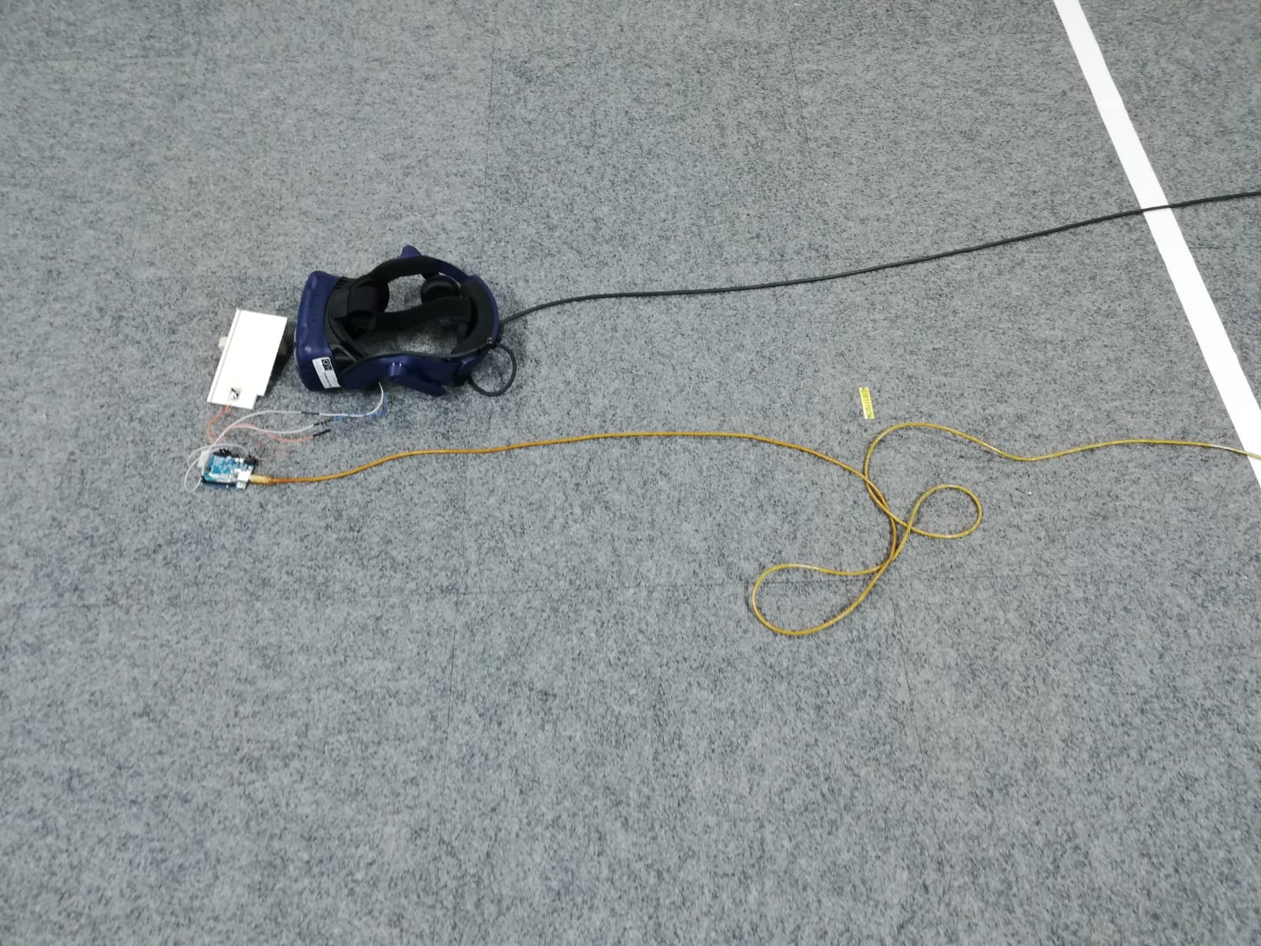
Latency Test Framework

Slide 8
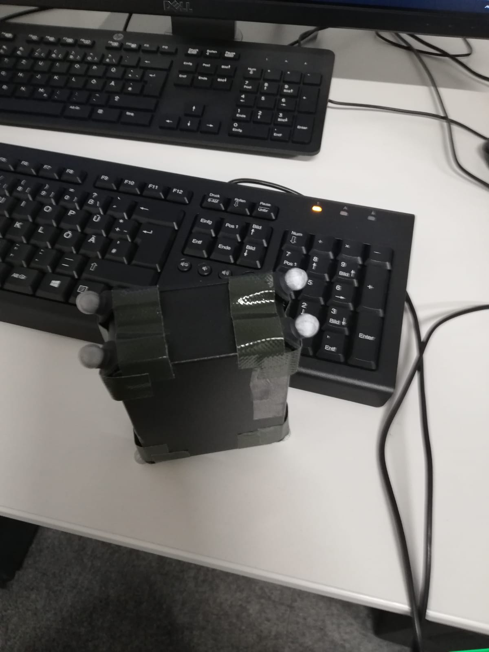
Latency Test Framework

Slide 9
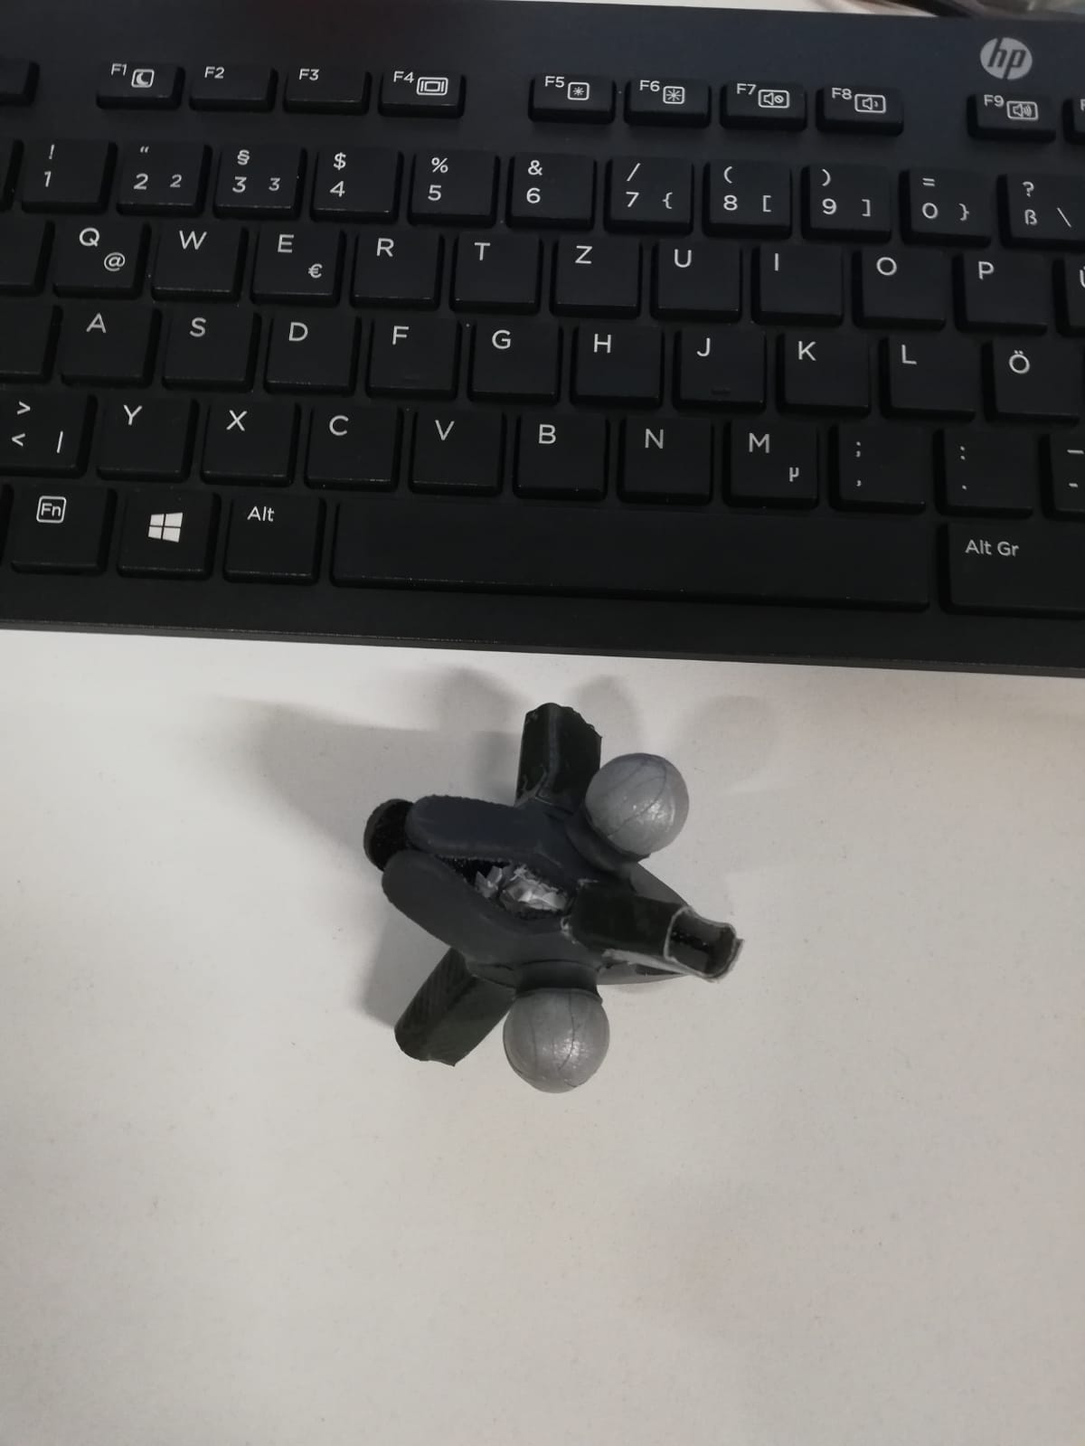
Latency Test Framework

Slide 10
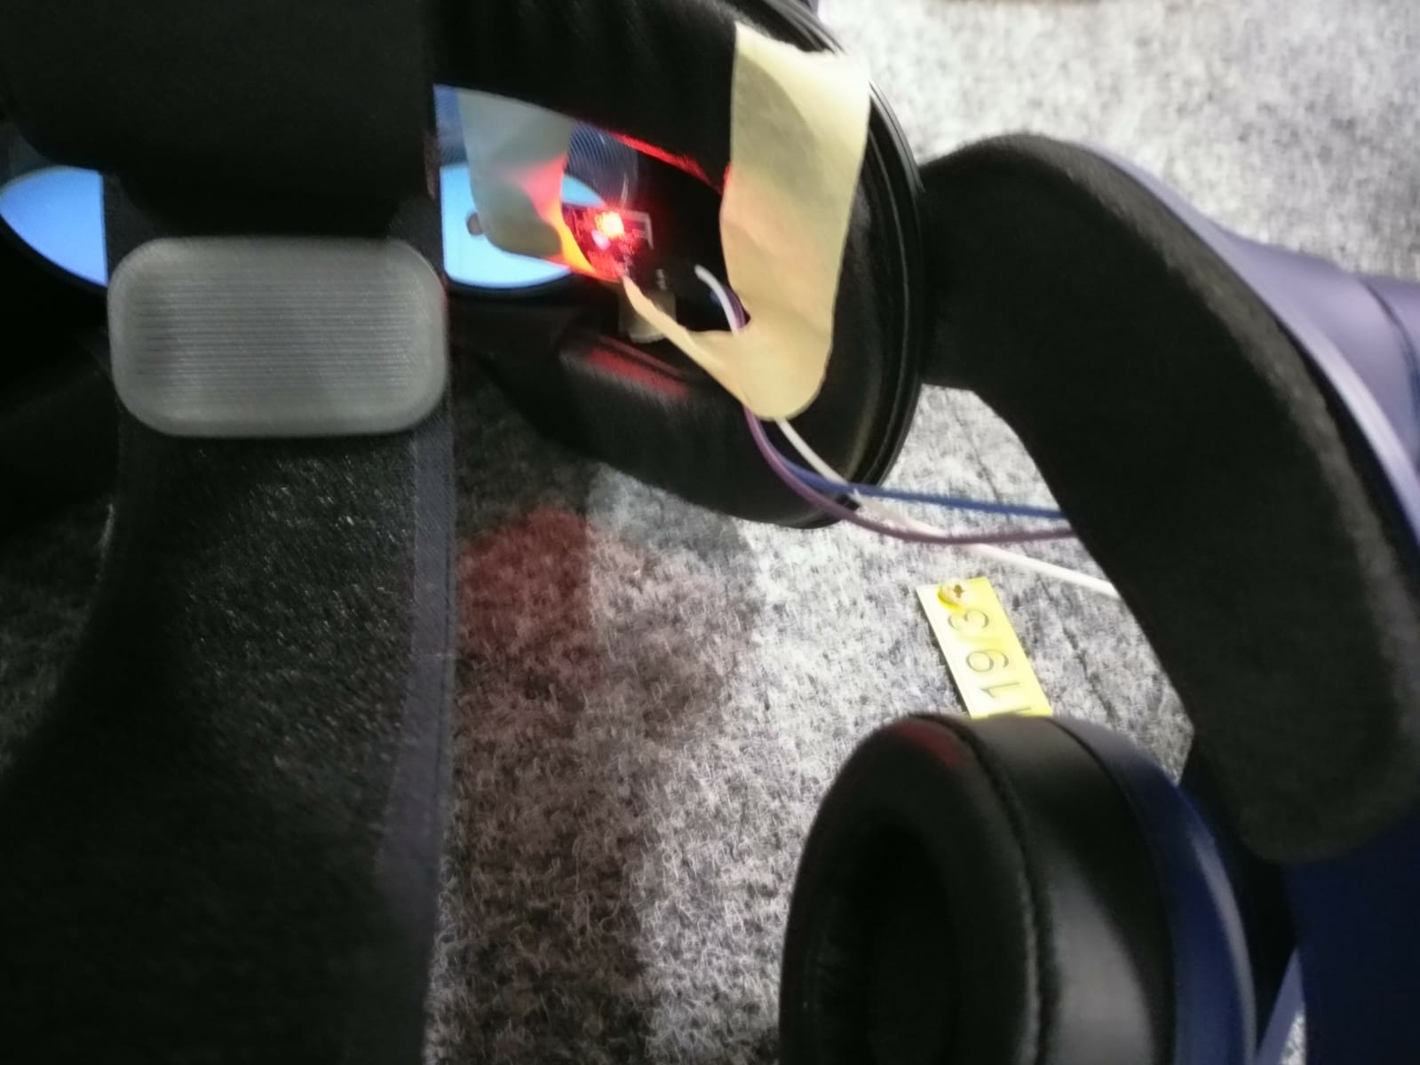
Latency Test Framework

Slide 11
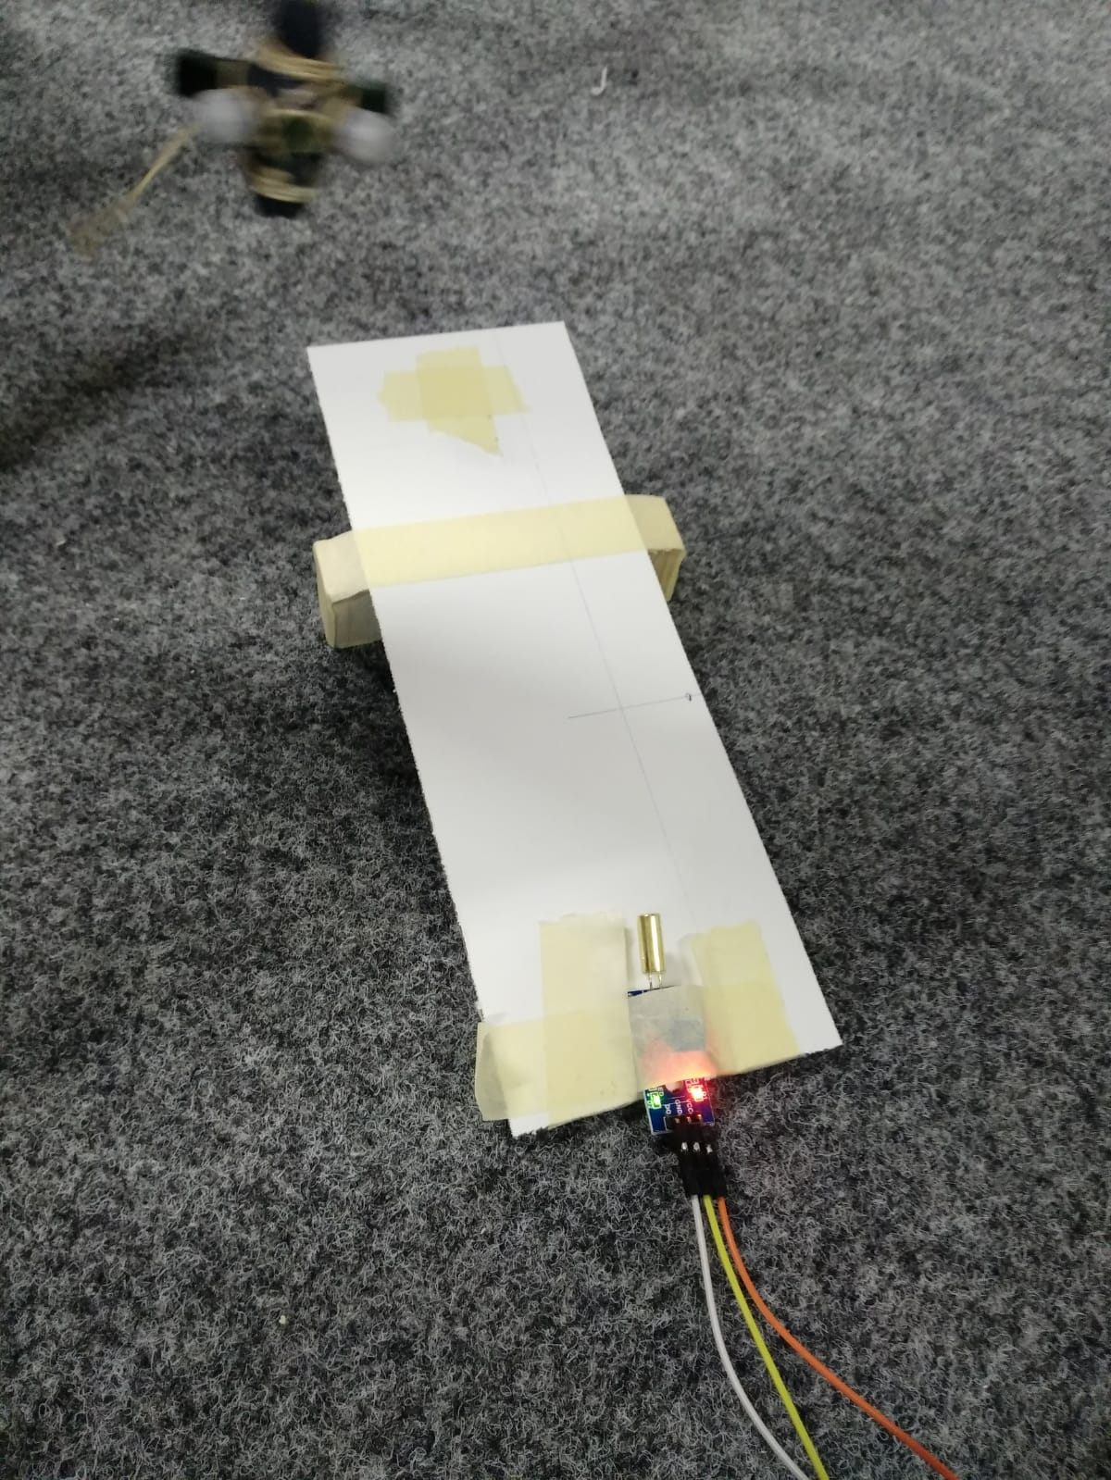
Latency Test Framework

Slide 12
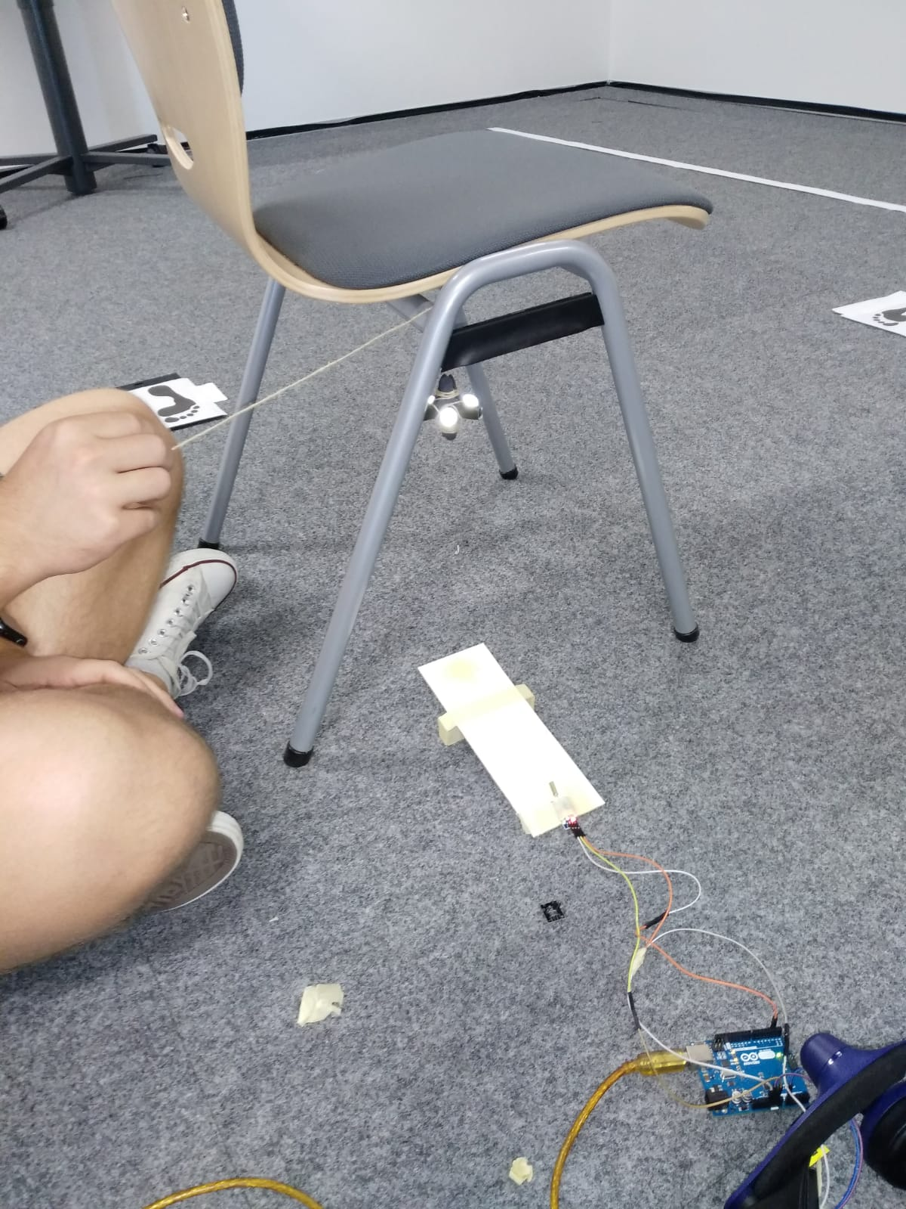
Latency Test Framework

Slide 13
Python Interface
OptiTrack
Python-Interface
Unity
Prediction

Slide 14
Next Steps
Performing the latency test series
Motion data acquisition framework
Gathering test data for NN training

Slide 15

Vielen Dank für Ihre Aufmerksamkeit!

