Slide 1
Using Artificial Neural Networks to Predict Avatar Movement in VR

Slide 2
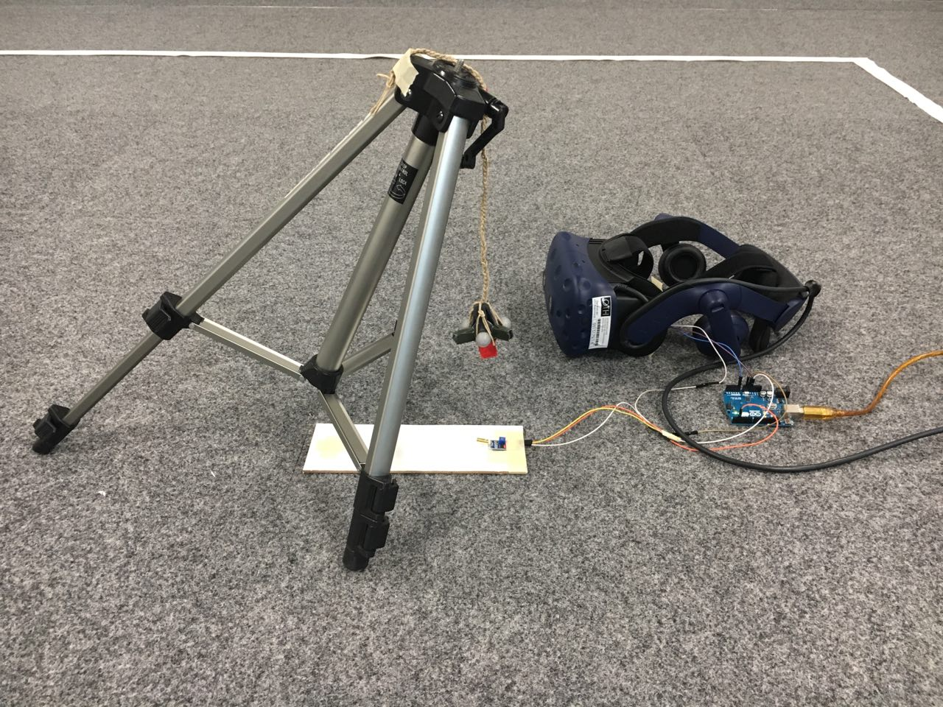
Latency Test Framework

Slide 3
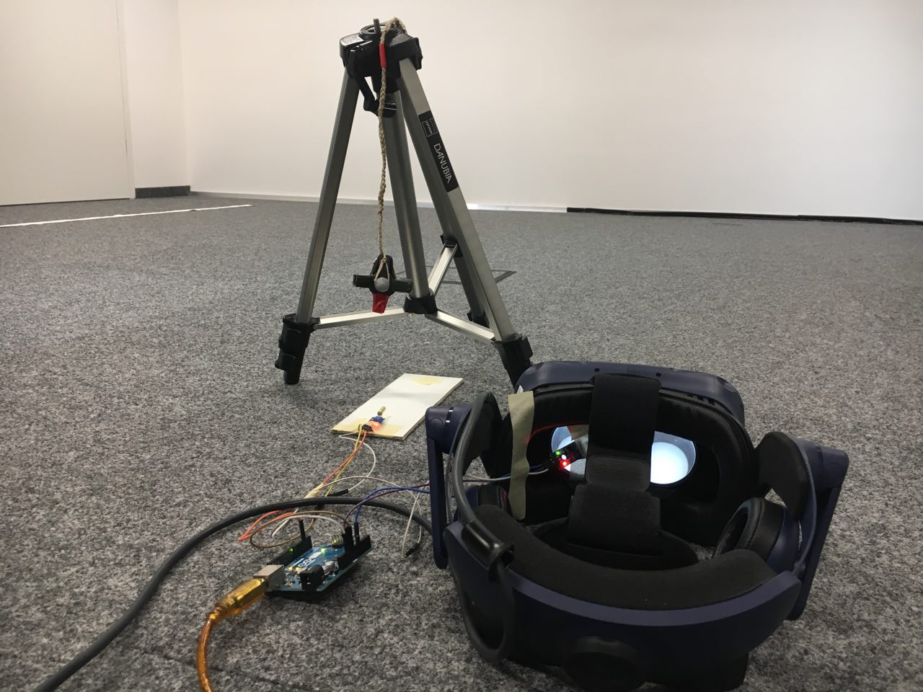
Latency Test Framework

Slide 4
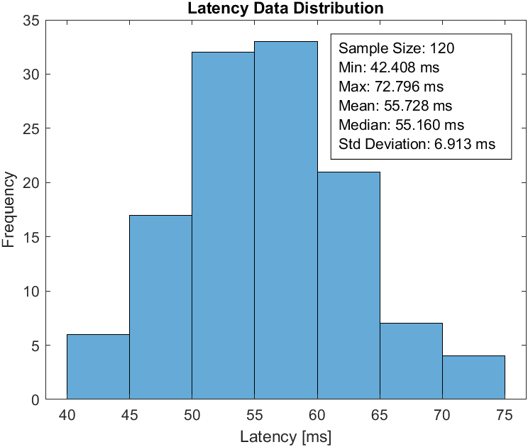
Latency Test Framework

Slide 5
LTF Conclusions
Zero latency reached by prediciting mean of LTF data (~55ms)
NN will support prediction spectrum around mean, f.e.
How to handle „over“ prediciting, f.e. if predicition@55ms & RT-Latency@42ms(min LTF data)?
RT-Latency est. | Prediciton | VR-Model
~55ms | 55ms/14 Frames@240Hz | 0 ms
~55ms | 39ms/10 Frames@240Hz | 16 ms
~55ms | 25ms/6 Frames@240Hz | 30 ms

Slide 6
Next Steps
Motion data acquisition framework
Gathering test data for NN training

Slide 7

Vielen Dank für Ihre Aufmerksamkeit!

