Slide 1
Using Artificial Neural Networks to Predict Avatar Movement in VR

Slide 2
Problem: Transmission Frame Loss
34
35
38
40
?
?
?
…
…
Frame Sequence

Slide 3
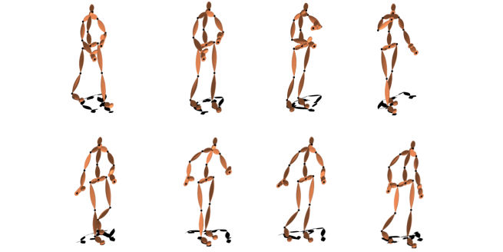
Problem: Scientific Motions for User Study
https://ps.is.tuebingen.mpg.de/publications/butepage-cvpr-2017

Slide 4
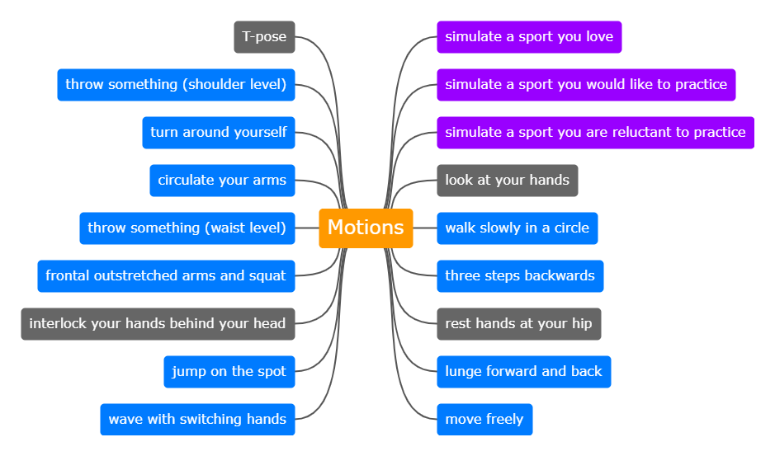
Defining Motions for User Study

Slide 5
Next Steps
Defining user study motions
Gathering test data for NN training

Slide 6

Vielen Dank für Ihre Aufmerksamkeit!

