Slide 1
Using Artificial Neural Networks to Predict Avatar Movement in VR

Slide 2
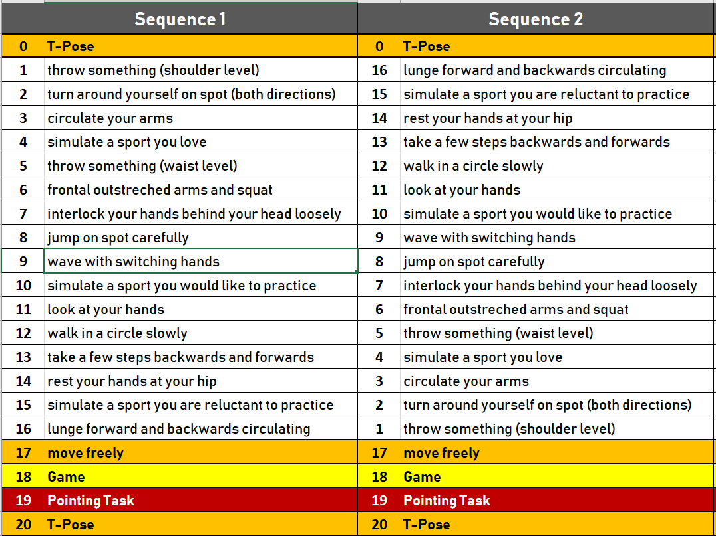
Defined data acquisition tasks

Slide 3
Movement Prediction Progress
First reasonable dataset to train first nns
3,25 GB raw
6,5 GB augumented data (mirrored)
Dataset is divided by tasks

Slide 4
Linear regression approach
Linear approach using a neural net without activation function
207 Input Neurons
4096 Neurons Dense Layer
207 Output Neurons

Slide 5
Dense Neural Network
Basically LR with Activationfunction
Tested various AF
Sigmoid
Softmax
TanH

Slide 6
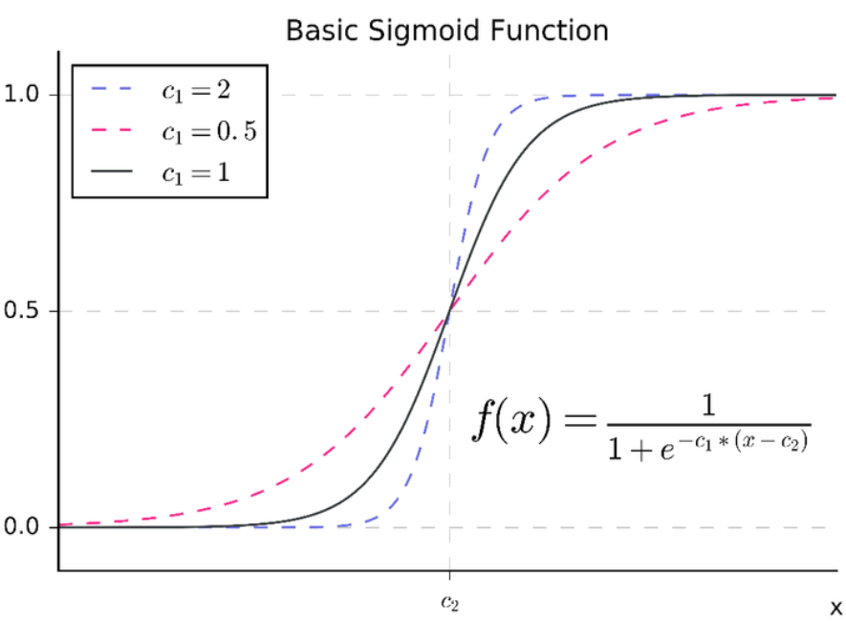
Recurrent Neural Network
Using CuDNNGRU
Nvidia optimized gated recurrent unit
Acitivation with sigmoid
AdaDelta Optimizier
With reversed LR-Decay function
LR increase when hitting EGoVG
Different batchsizes
Different sequenze lengths
Different hyperparamter
Amazing results so far…

Slide 7
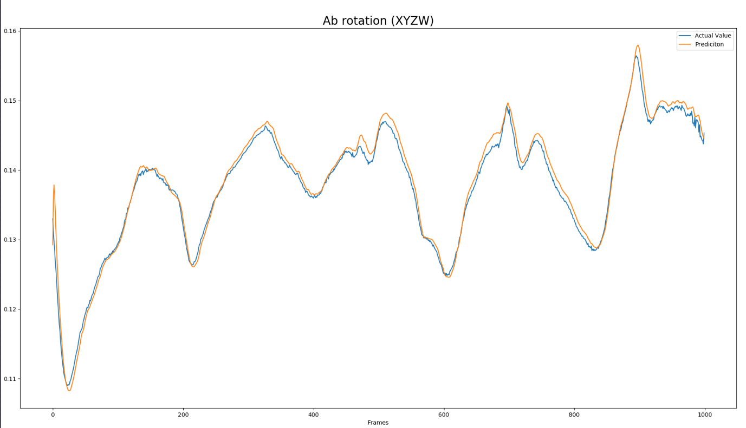

Slide 8
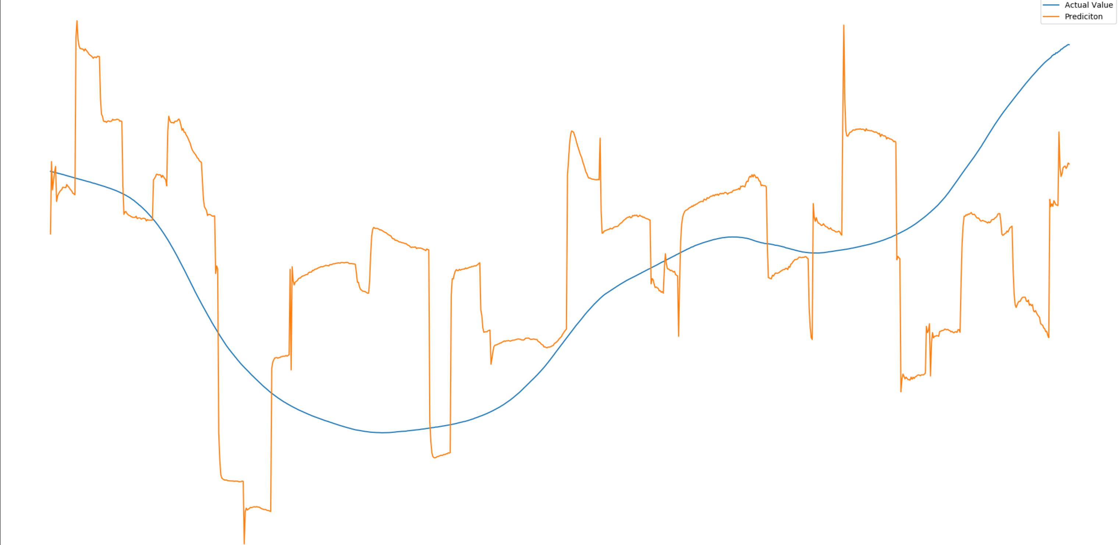

Slide 9
Next steps Neural Net:
Hyperparamter Optimation
Establish one Model, on method
Frame2Frame or Joint2Joint
Optimize Model further
Increase computing power
This is especially needed if Frame2Frame is established

