Slide 1
NORTHERN RAIL PLACEMENT

Slide 2
VIRTUALISATION
Virtualisation is a series of technologies that allows dividing of physical computing resources into a series of virtual machines, operating systems, processes or containers. It is often used to make virtual computers or resources.
PROS:
CONS:
Allows multiple systems to run on the same piece of hardware, because of this for example money is saved on buying and maintaining individual servers when one physical server can be bought and can be made to run several different virtual servers
Virtualised machines can easily be managed as they can be created, shut down and assigned resources at will without much needed setup or equipment
Allows multiple Operating Systems to run on one physical machine
If the physical machine fails, all the virtual machines also fail
If there are any security vulnerabilities, they apply to all the Virtual Machines also
Some virtualisation software needs licencing OR purchase of licences to use Operating Systems on the Virtual Machines
With enough Virtual Machines, monitoring and managing them will eventually become complex and difficult

Slide 3
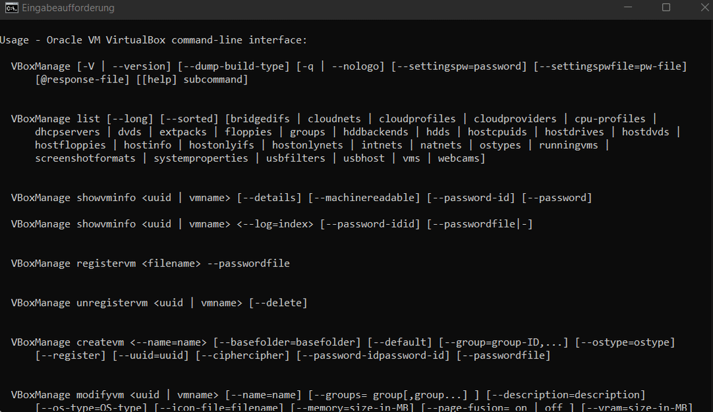
VBoxmanage
VBoxManage is the Command Line Interface (CLI) for the Oracle VirtualBox software that allows the creation of Virtual machines (VMs). It is a tool that can be used to create, delete, attach virtual hard disks and ISO files and manage computer resources used by the VMs.
Some advantages include the ability to automate repetitive tasks with scripts; it’s ability to multi-manage VMs and its ability to be used remotely. However, in order to do so you need to know the correct syntax that allows you to operate VBoxManage and due to its nature of being a CLI the GUI is less than user friendly. These are among the disadvantages of VBoxManage – the high technical knowledge bracket.

