Slide 1
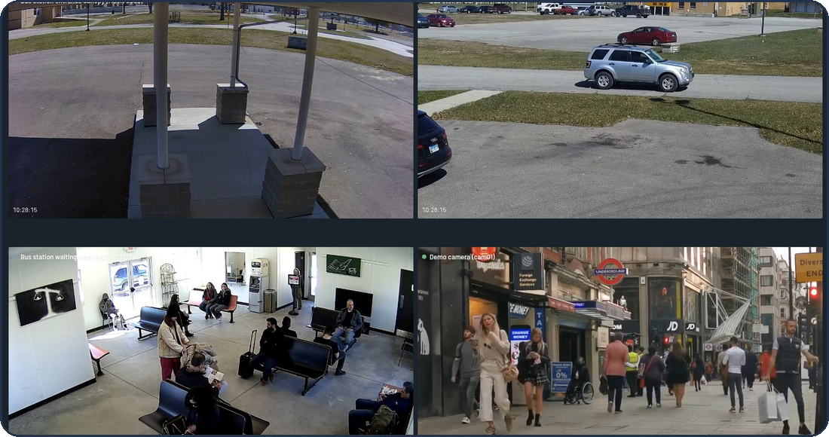
INTERNSHIP PROJECT · 2026
GenAI-VMS
Reasoning-based video analytics for CCTV
Search what happened in plain words
Understand an incident phase by phase
Ask questions, get answers that cite their evidence
4 GB
0.22 s
100 %
GPU is all it needs
fast search, median
models can run locally
Divyansh · Jatin
Notes:
Open with the one-sentence version: GenAI-VMS turns hours of CCTV into something you can search, question and read, on a single laptop. Say the three verbs on the slide: search in plain words, understand an incident phase by phase, ask questions and get cited answers. The picture on the right is the real application running on the demo footage. Today's walk-through goes from the problem, through the architecture, to what we measured and what we did not manage.

Slide 2
01 · THE PROBLEM
Nobody can watch every camera
Today
With GenAI-VMS
Nine cameras record nine hours of video every hour
Finding one moment means scrubbing for hours
Reviewing yesterday means watching it again
An alert says something happened, not why
One tired person is the search engine
Understands every clip
people, objects, tracks, zones
Searches in plain words
“a person carrying a suitcase”
Raises and checks alerts
rules first, then a vision model
Writes cited reports
every claim points at evidence
Understand each clip once
Store it as searchable data
Let models read the data
Built to run on one laptop: 4 GB GPU, local models, no cloud needed. Six weeks, two builders.
GenAI-VMS · reasoning-based video analytics for CCTV
2 / 12
Notes:
Start with the human problem. A site with nine cameras records nine hours of video every hour and nobody can watch it. Finding one moment, 'the man in the red jacket yesterday evening', means scrubbing. Our idea has three steps: understand every clip once, store the result as data, and let language models read that data instead of the pixels. Finish by naming the constraint: all of it runs on one laptop with a 4 GB GPU, built in six weeks by two people.

Slide 3
02 · ARCHITECTURE
The system on one page
1 · Get the video in
record and store
Cameras
RTSP or simulator
MediaMTX
live re-broadcast
Ingestion
10 s segments + keyframes
MinIO
video + pictures
2 · Understand it
the digital twin
Perception
YOLO11 · ByteTrack · SigLIP 2
Digital twin
one JSON per 10 s clip
Indexer
files it for search
Postgres + Qdrant
facts + meaning vectors
3 · Notice and check
events and alerts
Events
6 rules on the twin
VLM gate
“is it real?” yes / no / unsure
Correlation
links cameras by map + time
Alerts
open → ack → resolved
4 · Explain and answer
the GenAI part
Search
fast · reason · image
Reasoning
phases + cited report
Assistant
chat, 7 fixed tools
Reports
daily + incident PDF
Timeline
lanes + cases
LLM gateway: every model call goes through it
Ollama (local) · Gemini / Groq (cloud) · cache · validation
API: login, roles, live push → React dashboard
FastAPI · WebSocket alerts · presigned video links
GenAI-VMS · reasoning-based video analytics for CCTV
3 / 12
Notes:
This is the whole system. Read it top to bottom. Lane one records video: cameras into MediaMTX, ingestion cuts it into ten-second segments and stores them in MinIO. Lane two understands it: perception detects and tracks objects and writes a digital twin, a JSON description of the clip, which the indexer files into Postgres and Qdrant. Lane three notices things: rules propose events, a vision model checks them, correlation links cameras, alerts reach the operator. Lane four is the GenAI part: search, incident reasoning, the assistant, reports. Everything that needs a model goes through one gateway. Kafka carries small messages with links, never video.

Slide 4
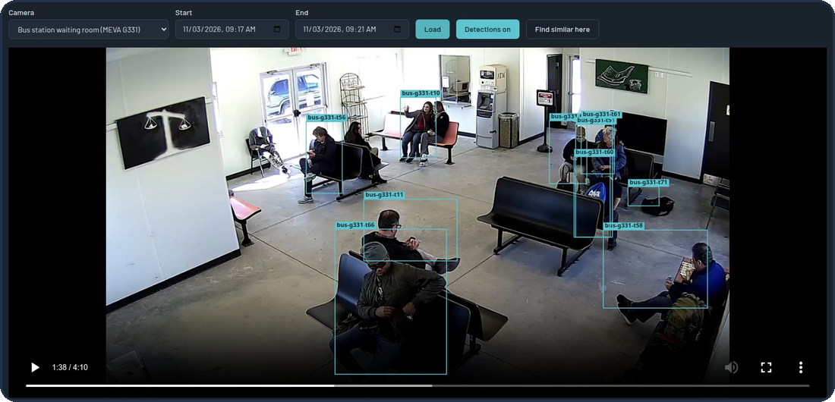
03 · FROM VIDEO TO DATA
How a 10-second clip becomes data
1
Ingest
2
Perceive
3
Digital twin
4
Index
Camera video arrives over RTSP
Cut into 10 s segments
One keyframe per second
Announced on Kafka (segment.v1)
YOLO11 finds people, bags, vehicles
ByteTrack gives each an id
Zones and attributes
SigLIP 2 makes picture vectors
One JSON per 10 s segment
Objects, tracks, zones, vectors
Stands in for the video in most questions
Drawn over playback
Facts go to PostgreSQL
Meaning vectors go to Qdrant
Captions join a text index
Searchable within seconds
Why this design
Understand once, reuse everywhere: search, events and reports all read the twin
No video on Kafka: messages are small and carry s3:// links
Safe restarts: consumers validate, write idempotently, then commit
966 MB of GPU for the whole perception step
Playback: the boxes and ids are the digital twin, drawn over the video
GenAI-VMS · reasoning-based video analytics for CCTV
4 / 12
Notes:
Follow one ten-second clip. Ingestion cuts the live stream into segments and keeps one picture per second. Perception finds people, bags and vehicles, gives each one a track id so we can follow it, and also computes picture embeddings. All of that is written as one JSON file per segment, the digital twin. The indexer files the facts in Postgres and the meaning vectors in Qdrant. The screenshot shows the twin drawn over the playback: the boxes and ids are not painted on the video, they come from the data. Design rule: Kafka messages carry s3:// links, never video, and consumers are idempotent, so a crashed service can simply re-read and re-write.

Slide 5
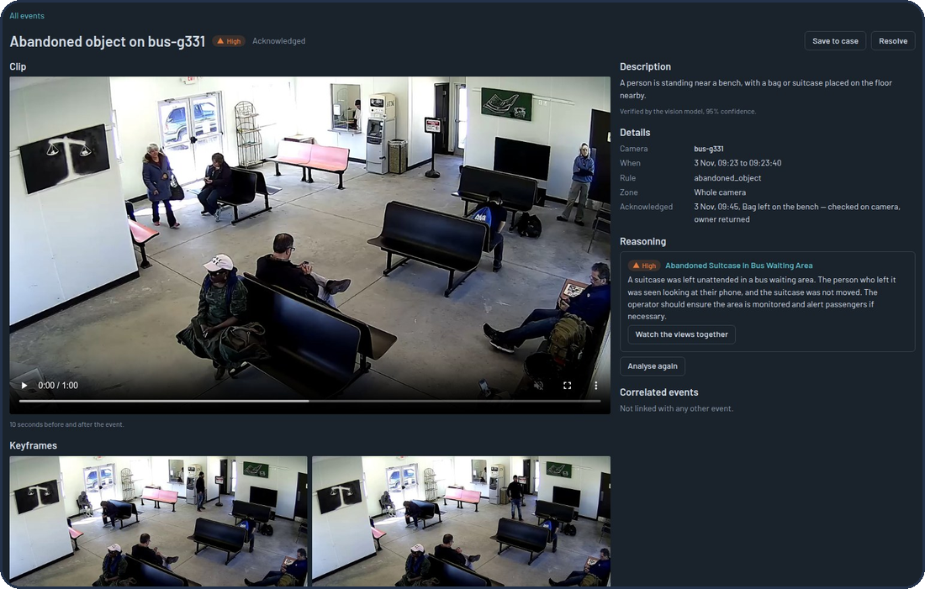
04 · EVENTS AND ALERTS
Events: cheap rules, then a vision model checks
Digital twin
per 10 s clip
6 rules
cheap, every segment
Candidate
“something may be wrong”
VLM gate
looks at the pictures
Verdict
yes · no · unsure
Alert
pushed live
Six rules
Loitering · Crowding · Abandoned object · Running · Intrusion in a restricted zone · Intrusion after hours
The gate's verdict
yes → verified: becomes an alert
no → rejected: kept for audit, never shown
unsure or model down → skipped: alerts anyway, marked unchecked
Replay on 3 cameras: 25 candidates → 10 verified (3 high severity), 15 rejected as false alarms
One event: the clip, its keyframes, the model's caption and its confidence
GenAI-VMS · reasoning-based video analytics for CCTV
5 / 12
Notes:
Events work in two stages because the two things we need are in tension: cheap and thorough, versus accurate. Six simple rules run on every segment's twin and produce candidates. Then a vision model looks at the actual pictures and answers yes, no or unsure. Yes becomes a verified event and an alert; no is kept for audit but never shown. In today's replay of three bus-station cameras the rules produced 25 candidates; the gate verified 10 and rejected 15 as false alarms. Alerts have a lifecycle, open, acknowledged, resolved, and are pushed live over a WebSocket.

Slide 6
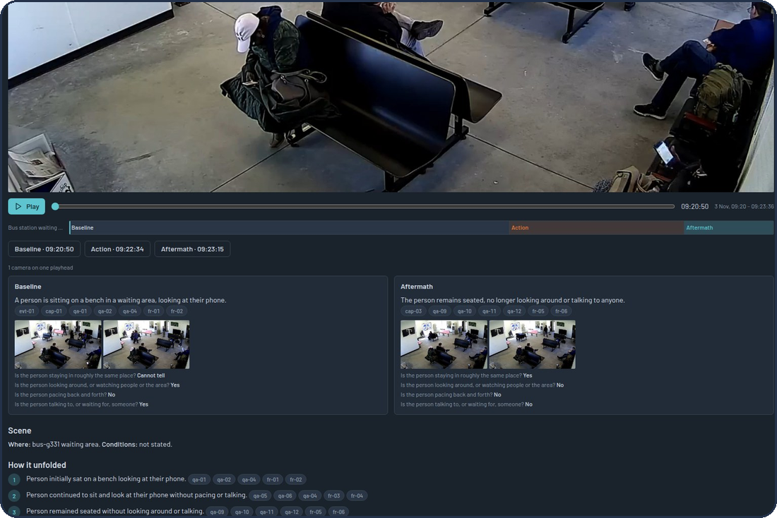
05 · INCIDENT REASONING
Incidents: what happened, phase by phase
Baseline
normal, before
Precursor
something starts
Escalation
it builds
Action
the event itself
Aftermath
what follows
1
Link across cameras
A camera map (overlap or transit links) and a time window group events into one incident.
2
Analyse
A click, or automatic for severe events. A vision model places the five phases on the timeline.
3
Read each phase
Two frames plus questions from a question bank. Every answer becomes evidence with an id.
4
Write the report
Every claim must cite evidence ids; uncited claims are dropped. The report says what it cannot tell.
The report: phase timeline, per-phase evidence chips, “What this report cannot tell”, PDF export
GenAI-VMS · reasoning-based video analytics for CCTV
6 / 12
Notes:
An event tells you something happened; an incident report tells you what happened and why. First, correlation groups events from different cameras into one story using a camera map: overlap links for two views of one area, transit links for walking from one camera to the next. When an operator clicks Analyse, a vision model places five phases on the timeline: baseline, precursor, escalation, action, aftermath. For each phase it reads two frames and answers questions from a question bank; every answer becomes evidence with an id. Then a language model writes the report, and every claim must cite evidence ids; a claim without a citation is dropped. The report also states what it cannot tell, and records which model wrote it and how long each step took.

Slide 7
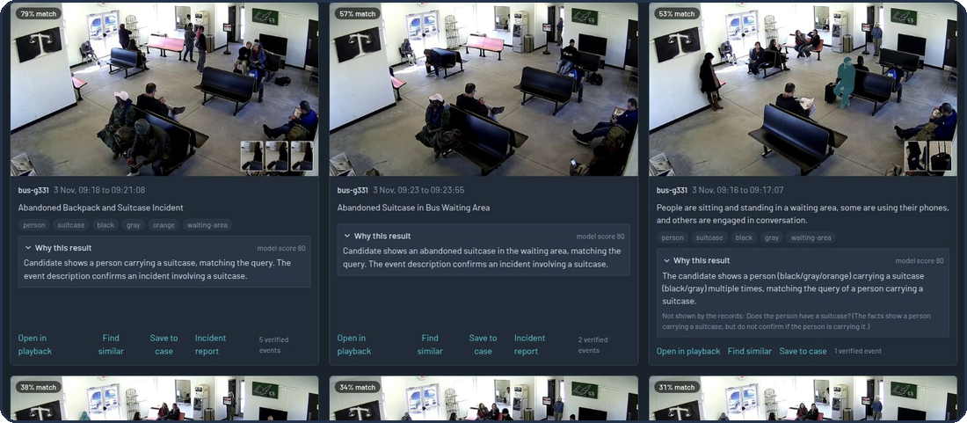
06 · SEARCH
Search in plain words
FAST · about 0.2 s
REASON · about 15 s
Sentence → vector (SigLIP 2) and a text query
Pictures and captions searched, merged with Reciprocal Rank Fusion
Hits within 10 s on a camera become one window
Top 30 fast candidates, re-read by a language model
Scores 0–1 and says what it could not confirm
Final score: 40 % fused rank + 60 % model
More ways in
Search by image: upload a photo or a frame
Find similar here: draw a box on a paused frame
Object outlines: 1.3 s first time, 9 ms cached
Every hit opens the recording, event or report
Right clip in the top 10 on real footage: 67 % reason, 56 % fast, 24 % random
Reason mode: each hit says why it matched and what the records could not confirm
GenAI-VMS · reasoning-based video analytics for CCTV
7 / 12
Notes:
Search has two speeds on purpose. Fast mode turns the sentence into a vector and a text query, searches pictures and captions, and merges the two rankings with Reciprocal Rank Fusion, in about a fifth of a second. Reason mode takes the top thirty candidates and lets a language model re-read each one, score it, and say what the records could not confirm; that takes around fifteen seconds on this laptop. The screenshot shows 'Why this result'. You can also search by image, find similar to a box you draw on a paused frame, and see object outlines. In our 36-query benchmark on real footage, reason mode finds the right clip in the top ten for 67 percent of queries, fast mode 56 percent, random 24 percent.

Slide 8
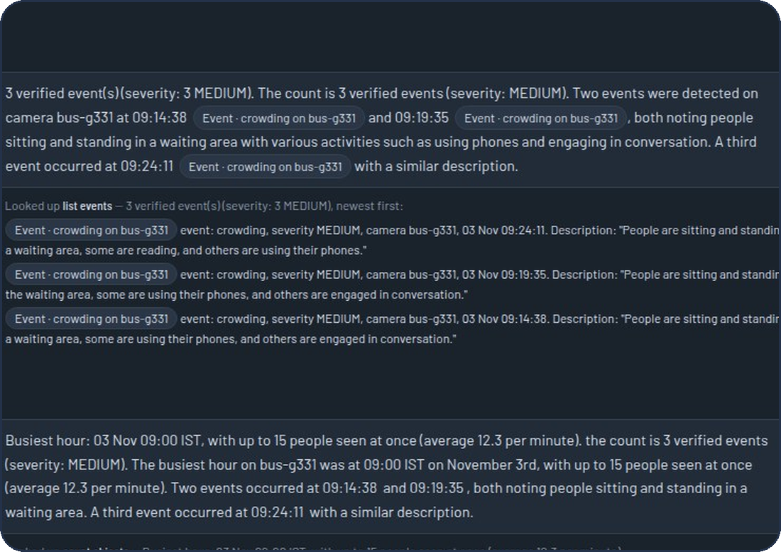
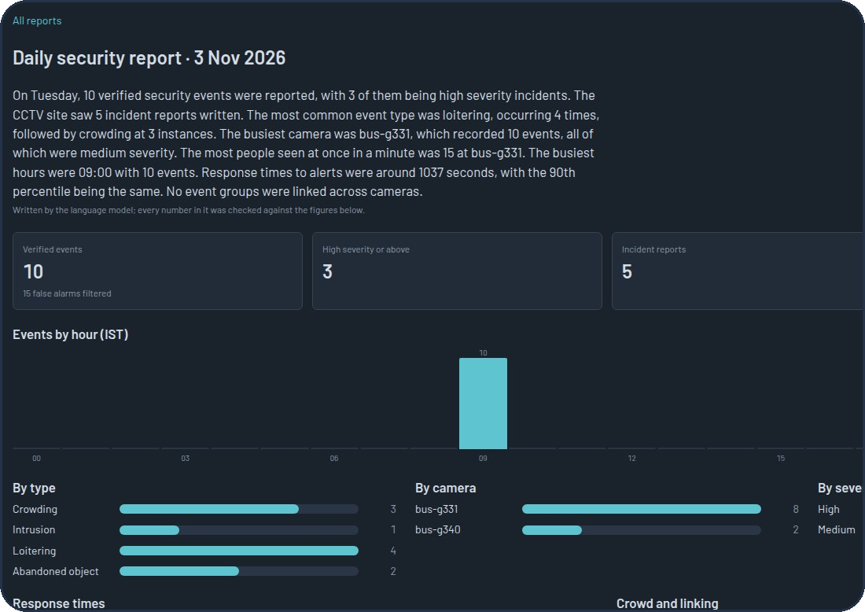
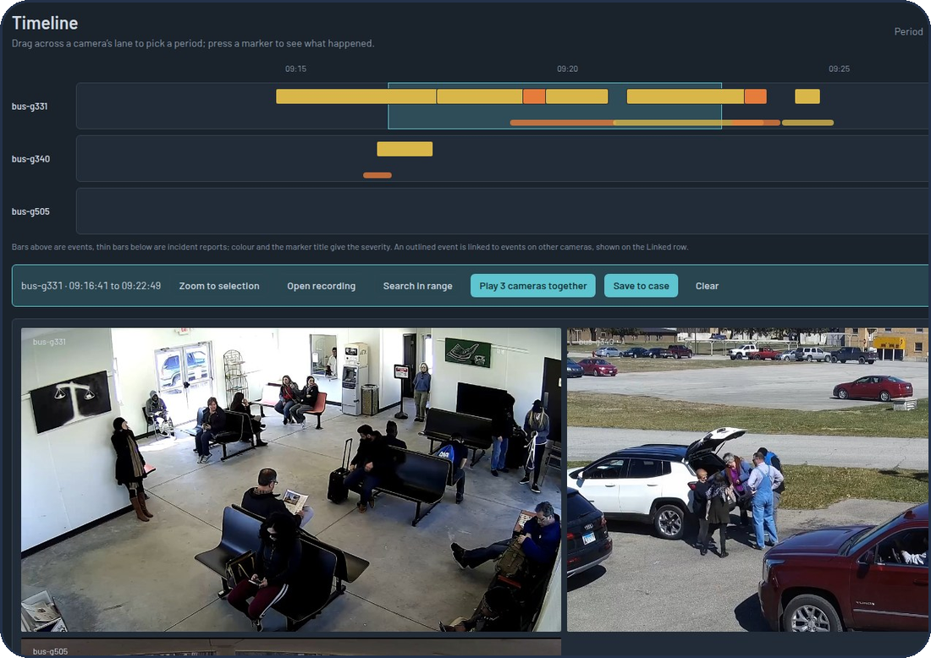
07 · ASK, REPORT, REVIEW
Ask, report, review
Assistant
Daily report
Timeline and cases
Chat about the cameras in plain language
Seven fixed lookups, at most four per answer: it never writes SQL
Shows what it looked up; cites real records
Facts come from fixed queries; the model only writes the narrative
Every number in it is checked against the facts
Written each morning, or on demand; PDF export
A lane per camera: events and incident reports
Select a period: zoom, search inside it, or play all cameras in sync
Save events, reports and footage moments to a case
GenAI-VMS · reasoning-based video analytics for CCTV
8 / 12
Notes:
Three more ways to use the same data. The assistant answers questions in chat but can only use seven fixed, parameterised lookups, at most four per answer, so it never writes SQL and cannot invent a query. Every answer shows what it looked up and cites real records. The daily report takes its facts from fixed queries; the language model only writes the narrative, and every number in it is checked against the facts. The timeline shows a lane per camera, lets you select a period and play all cameras in sync from one playhead; cases collect evidence for an investigation.

Slide 9
08 · THE GENAI MACHINERY
GenAI on a 4 GB laptop GPU
1 · A task name
e.g. phase_tg, search_rerank, daily_narrative
Rules of the road
The GPU lease: one chair
Nothing calls a model directly
Structured answers are validated and retried
Prompts are versioned files
Every output keeps provenance: model, prompt, latency
Only one heavy model sits on the GPU at a time. A Redis lease (30 s, renewed while working, 900 s hard limit) decides who; everyone else waits or degrades.
2 · The registry
config/models.yaml: task → model per profile
Model
Job
On this laptop
YOLO11 + ByteTrack
detect and track
resident
3 · A profile
local (Ollama) · hybrid · cloud (Gemini, Groq)
SigLIP 2
picture + text vectors
966 MB with YOLO
qwen2.5:3b
text reasoning
0.25 s warm
4 · The call
cache · schema check + retry · fallbacks · provenance
qwen2.5vl:3b
looks at frames
3.1 / 5.4 / 11 s for 1 / 2 / 4 images
Qwen2.5-VL-3B + LoRA
fine-tuned phase model
trained on this GPU in ~50 min
GenAI-VMS · reasoning-based video analytics for CCTV
9 / 12
Notes:
The hard constraint is the 4 GB GPU. Two ideas make it work. First, the LLM gateway: no service calls a model directly. It asks for a task by name, the registry says which model serves that task in the current profile, local, hybrid or cloud, and the gateway adds caching, schema validation with retry, fallbacks and provenance. Second, the GPU lease, the 'one chair' idea: only one heavy model sits on the GPU at a time and a Redis lease decides who. We even fine-tuned a vision model with LoRA on the same card; it took about fifty minutes. The table is what each model costs on this laptop.

Slide 10
09 · PLATFORM
Reliable, secure, deployable
Reliable
Secure
Deployable
Consumers: validate → idempotent write → commit
Failures retry, then go to a dead-letter queue
Language model down? Live view, playback and fast search keep working
A chaos test: every invariant held
JWT login; roles admin, operator, viewer checked on every request
Rate limits on login, search, assistant
Video links are presigned and expire in 15 minutes
Audit log; no face recognition by design
Docker Compose profiles: infra, core, perception, genai, obs
Kubernetes manifests validated, not yet applied to a cluster
Prometheus and Grafana
About 3,000 tests; versioned contracts with fixtures
VIDEO
MediaMTX · FFmpeg · MinIO (S3)
MESSAGING AND DATA
Kafka · PostgreSQL · Qdrant · Redis
AI
YOLO11 · ByteTrack · SigLIP 2 · Qwen2.5-VL · Ollama · LoRA
APPS AND OPS
Python 3.11 · FastAPI · React + Vite + Tailwind · Docker Compose · Kubernetes
GenAI-VMS · reasoning-based video analytics for CCTV
10 / 12
Notes:
What makes it more than a demo. Reliability: every Kafka consumer validates, writes idempotently, then commits; failures retry and then go to a dead-letter queue. We run a chaos test and every invariant held. And the rule is degrade, don't die: if the language model is down, live view, playback and fast search keep working. Security: JWT login, three roles checked on every request, rate limits, video links that expire in fifteen minutes, an audit log, and no face recognition by design. Delivery: Docker Compose profiles, Kubernetes manifests validated but never applied to a cluster, Prometheus and Grafana, about three thousand tests. The strip at the bottom is the stack.

Slide 11
10 · RESULTS
What we measured
0.22 s
15.5 s
966 MB
3,000+
fast search, median
reason search, median
GPU memory for perception
automated tests
Does search find the right clip? (36 queries, real footage)
Assistant lookups: baseline → after routing fixes
Real-footage run (October): 30 of 30 loitering candidates verified, 9 of 9 doorway intrusions rejected by the gate
GenAI-VMS · reasoning-based video analytics for CCTV
11 / 12
Notes:
Everything on this slide was measured, not estimated. Top row: fast search answers in 0.22 seconds at the median, reason search in about 15 seconds, the whole perception step fits in 966 MB of GPU memory, and we have about three thousand automated tests. Left chart: on 36 plain-language queries over real MEVA footage, how often the right clip appears in the top 1, 5 or 10 results; reason mode beats fast mode, which beats random. Right chart: the assistant's objective checks, whether it chose the right tool, camera and day, before and after we fixed its routing. The October real-footage run is the last line: the gate verified all thirty loitering candidates and rejected all nine doorway intrusions.

Slide 12
11 · HONEST LIMITS
Honest limits and next steps
What we did not manage
Next steps
The fine-tuned phase model (mIoU 0.354 vs 0.274) gains only on labels made by a rule, not on labels a person made
Cloud-VM and Kubernetes deployments are written and validated, never run on real infrastructure
The clean retrieval ablation and the operator usability study are not done
Cross-camera linking uses time and the camera map; it never recognises people
Stored footage expires after 24 h, so a demo needs a fresh replay
Label more incidents by hand; retrain and test on those only
Run the stack on a real VM and exercise the hybrid and cloud profiles
Run the usability study with real operators
Close correlation groups later, so late-judged events still link across cameras
Index daily reports into the assistant's knowledge
Thank you · Questions?
The demo video, the study guide and the source are in the repository
GenAI-VMS · reasoning-based video analytics for CCTV
12 / 12
Notes:
End with honesty; it is a strength. The fine-tuned phase model scored mIoU 0.354 against 0.274 for the untrained model, but the entire gain is on labels that were made by a rule; on labels a person made there is no measurable gain, so we do not claim it understands phases better. The cloud VM and Kubernetes deployments are written and validated but never run on real infrastructure. A clean retrieval ablation and the operator usability study are not done. Cross-camera linking uses time and the camera map, never faces or appearance. Next steps are on the right. Close by inviting questions, and mention the demo video, study guide and source in the repository.

