Slide 1
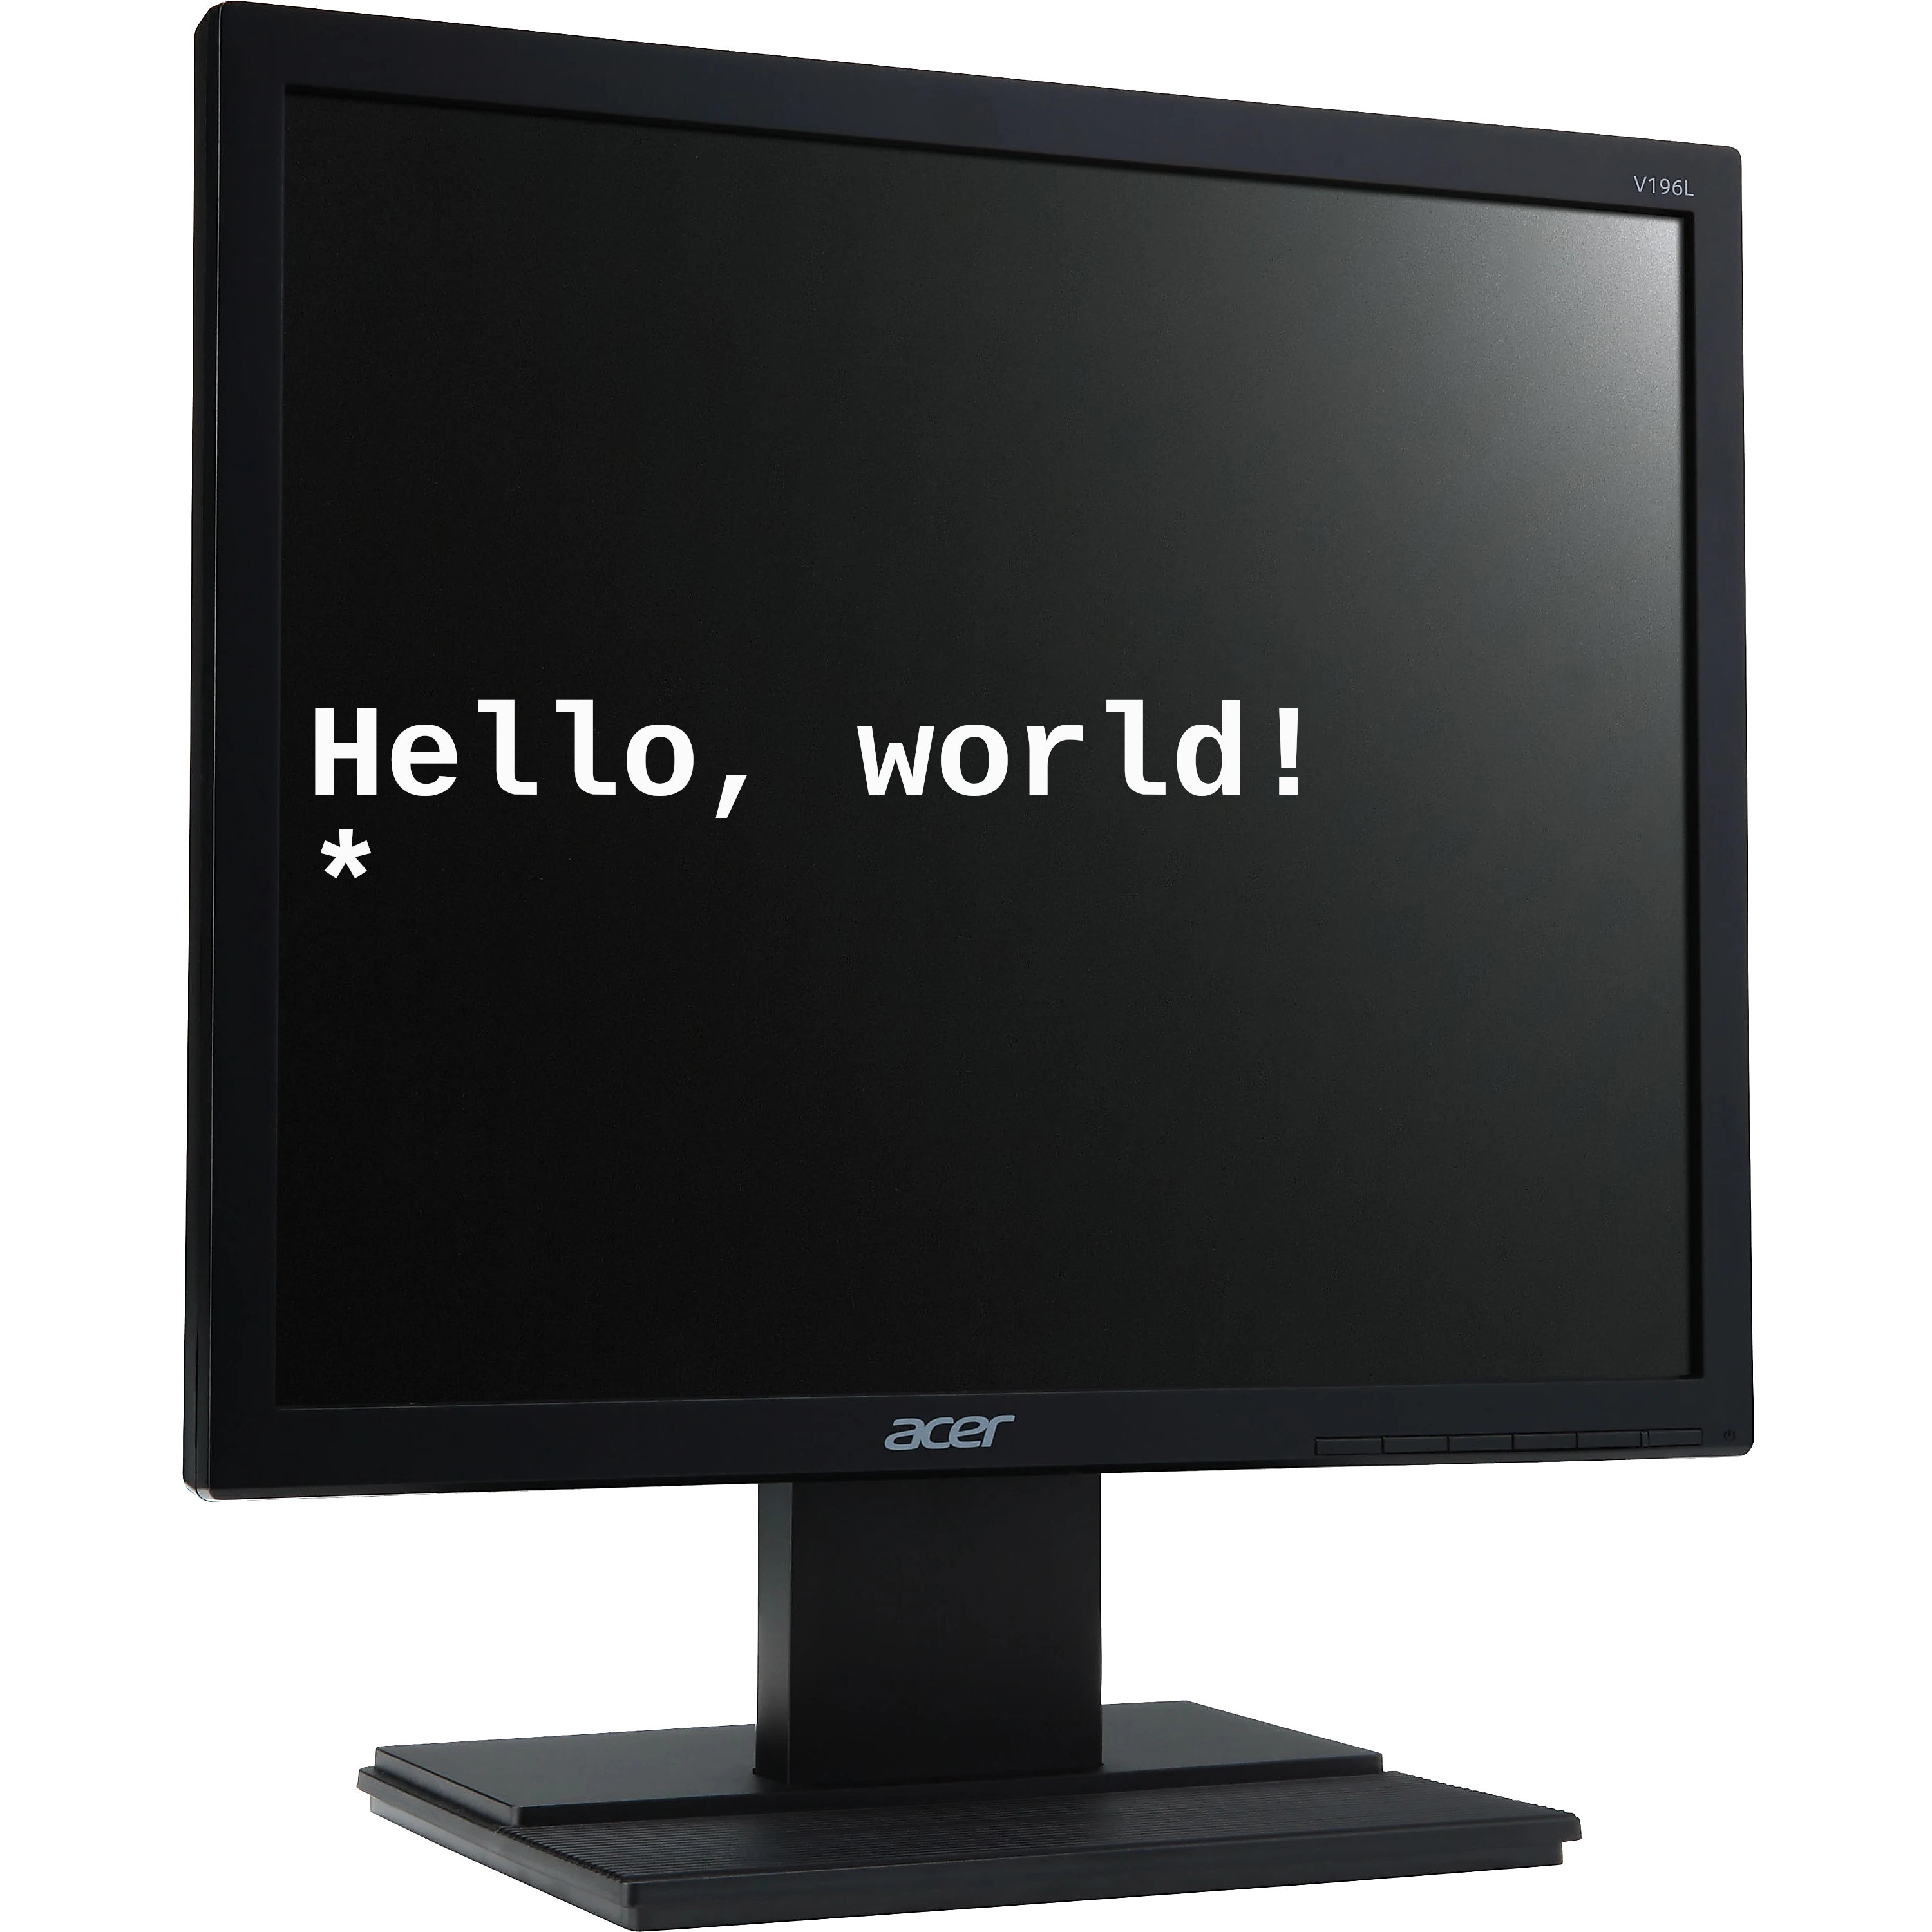
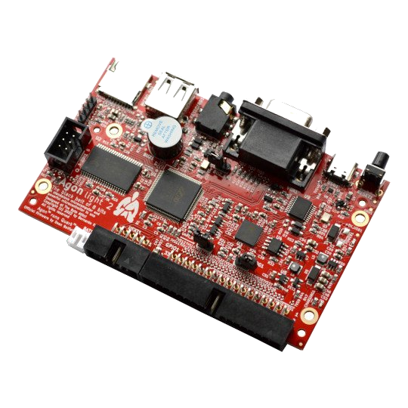
Hello, Agon!
Hello, World with the Agon Light?
BBC BASIC
eZ80 Assembly
and even C!

Slide 2
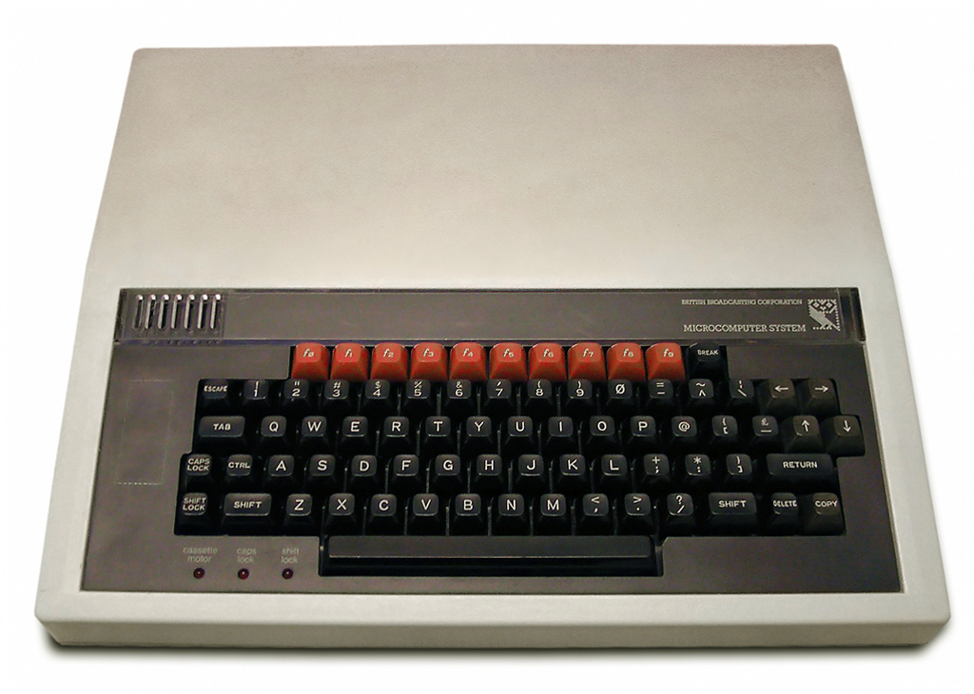
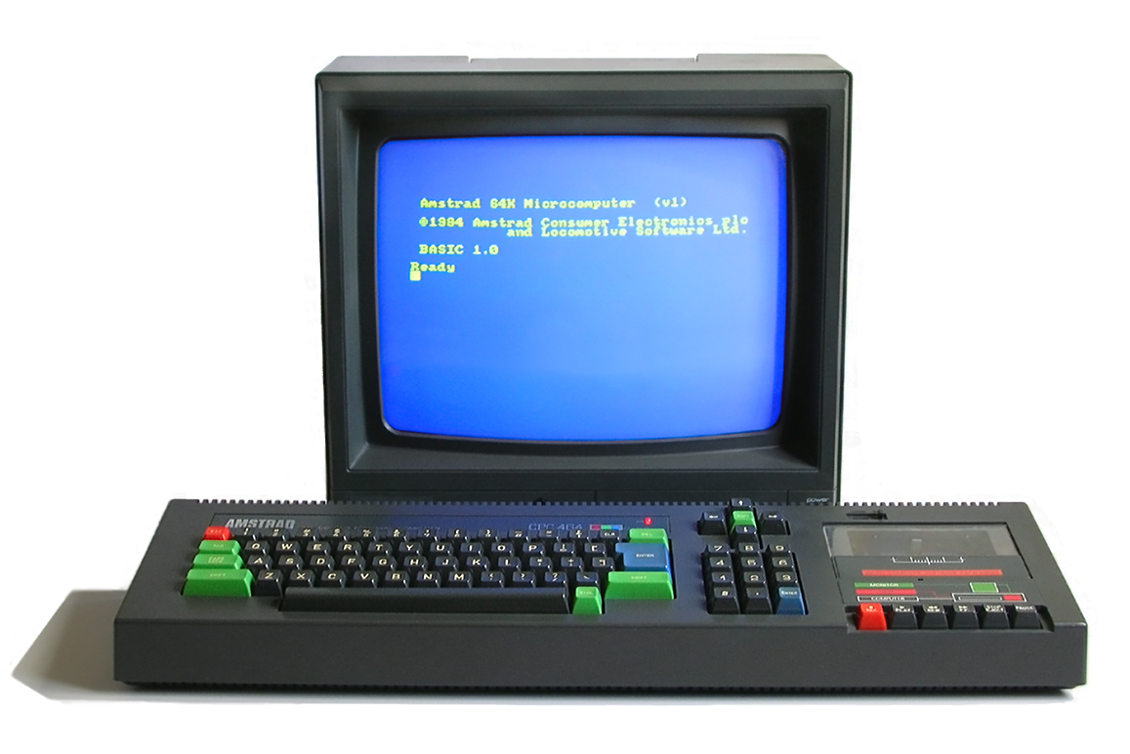
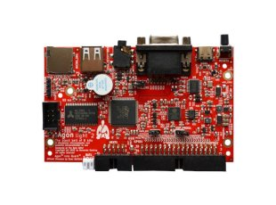
BBC BASIC
Created by Sophie Wilson for Acorn
  6502 in BBC Micro
Ported to Z80 by R. T. Russell
  Originally selected Acorn while at BBC
Adapted for Agon by Dean Belfield
  a.k.a. “Break Into Program”
  Also wrote MOS & VDP

Slide 3
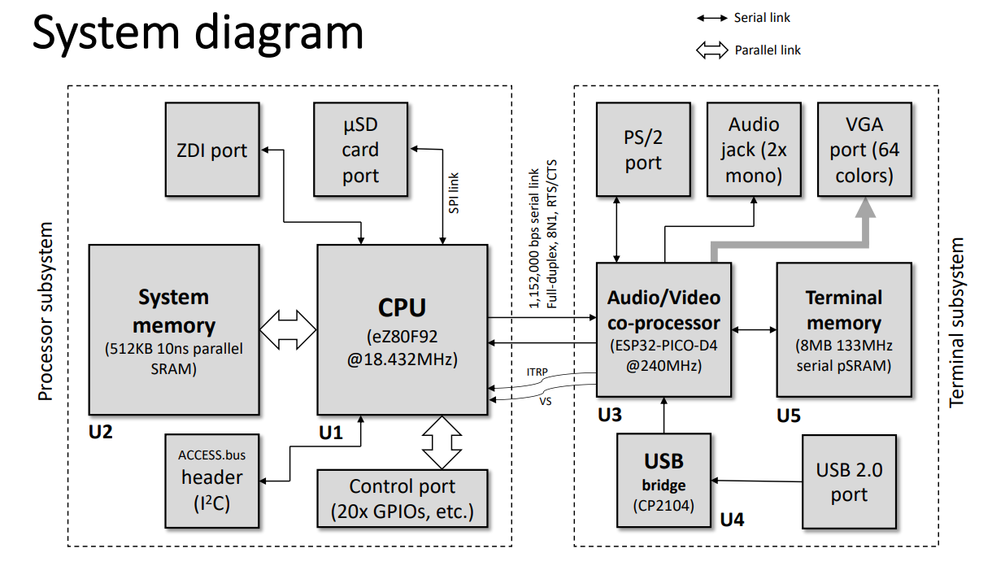
Agon Light System

Slide 4
Agon Light Software
VDP: FabGL audio/video/keyboard adapter
  Arduino program running on ESP32
MOS: Simple OS for μSD and additional I/O
  C/Assembly program running on eZ80
  Loaded from built-in flash
  Sends VDU commands to ESP32 via UART
BBC BASIC
  Z80 assembly program running in MOS
  Loaded from μSD

Slide 5
eZ80 Assembly Language
Using ADL (Address and Data Long) mode
MOS API: Special restart vectors in RAM
  $00 (reset), $08 (MOS command)
  $10 (VDU character), $18 (VDU string)
ez80asm
  Runs anywhere – even on Agon!
Extra window dressing for MOS

Slide 6
SDCC: Small Device C Compiler
Linux/Mac/Windows cross-development
Supports many microcontrollers and small CPUs
  eZ80 in Z80 mode only, for now
Requires C library implementation for Agon
  putchar/getchar implemented so far

