Slide 1

slithy VLOGS #25
Can I Make
Actually FUN?

Slide 2
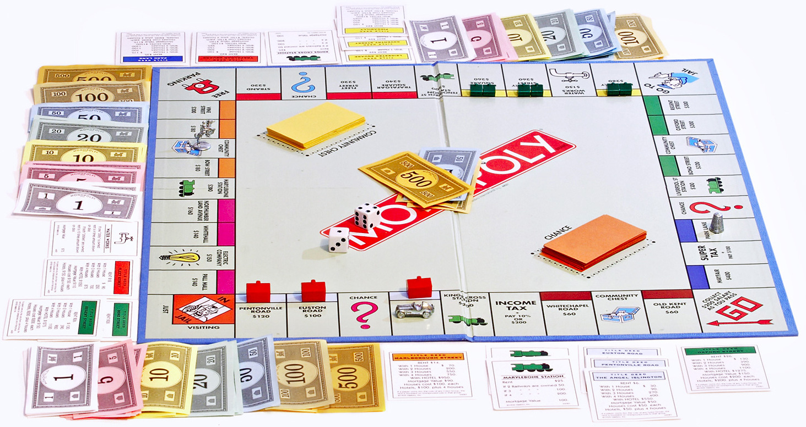

More Retro Than Retro
“Monopoly” released by Parker Brothers in 1935
More than 275 million copies sold!

Slide 3

But Why?
Original game still stuck in 1935
Requires 3 players to be interesting
Games can last 3 hours or more!
Patent expired – countless clones!

Slide 4

How Do We Make It FUN?
Make it faster
Simplify the mechanics
Remove the fluff
Get up and move!

Slide 5

Introducing Movopoly
Mobile Web Application
Your house becomes the board!
Kid-friendly
Experience unique for each house
Free and open source!

