Slide 1





slithy VLOGS #26
MAKING
Let LAMP
Show the Way!

Slide 2
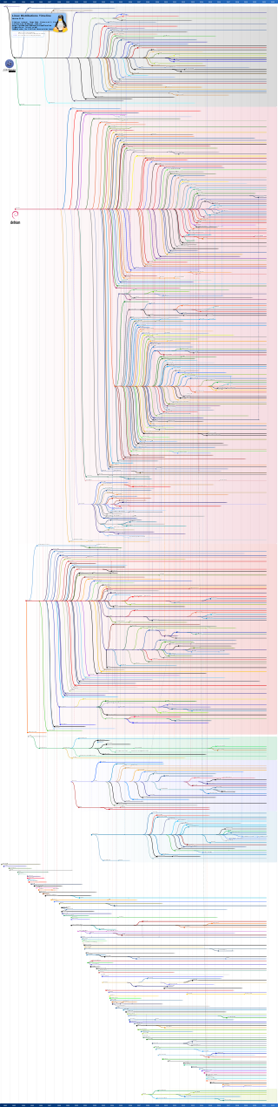
L is for Linux
Technically, GNU/Linux
Linux Kernel: Linus Torvalds in 1991
  Low-level control, no user environment
GNU User Environment: Richard Stallman in 1983
  POSIX-compatible software with no kernel
First distributions with Linux kernel and GNU utilities released late 1991.

Slide 3

A is for Apache
Apache HTTP Server (httpd) released 1995
Supplanted NCSA HTTPd
Both created by Rob McCool
CGI: Common Gateway Interface

Slide 4

M is for MySQL
MySQL relational database management system created by Swedish company in 1995
  Bought by Sun Microsystems in 2008
    Bought by Oracle 2010
M is increasingly for MariaDB
  Forked from MySQL in 2009
  Large investments from Intel, Alibaba

Slide 5
P is for PHP
“Personal Home Page” released by Rasmus Lerdorf in 1995
Now “PHP: Hypertext Preprocessor”
Main implementation sponsored by Zend
P is often for Perl or Python

Slide 6
1995!
In 1993, there were 130 websites
  January: NCSA Mosaic
1994: 2,738
  December: Netscape Navigator
1995: 23,500
  August: Microsoft Windows 95 and Internet Explorer

