Slide 1
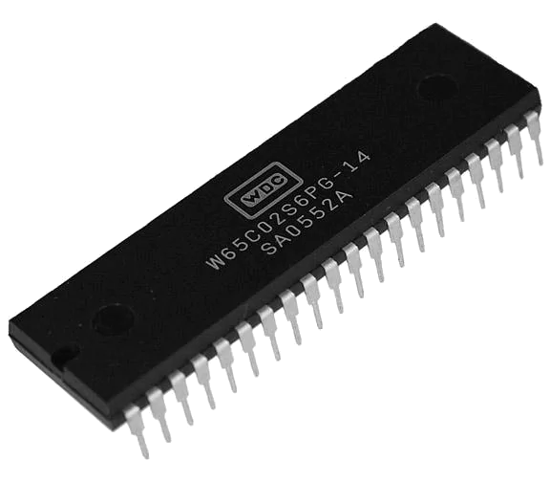

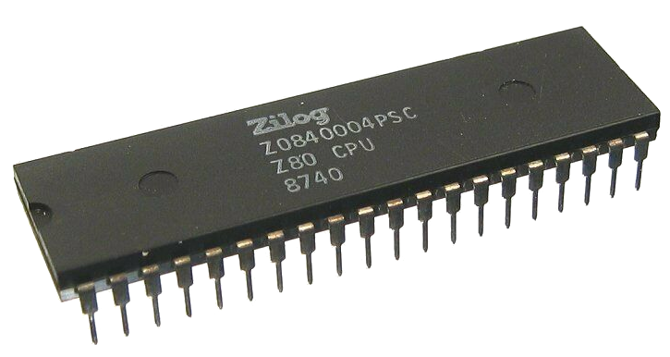

slithy VLOGS #16
8-Bit Battle Royale
ROUND 2:
Assembly!

Slide 2
Final BASIC Leaderboard
Commander X16: 0:23
BBC Micro: 1:37
Amstrad CPC 464: 1:39
Atari 800: 2:16
Apple ][: 2:45
Commodore 64: 3:23
Sinclair ZX Spectrum: 4:33 (0:34 for Next @ 8x Turbo)

Slide 3
Final BASIC Leaderboard
Commander X16: 0:23
BBC Micro: 1:37
Amstrad CPC 464: 1:39
Atari 800: 2:16
Apple ][: 2:45
Commodore 64: 3:23
Sinclair ZX Spectrum: 4:33 (0:34 for Next @ 8x Turbo)

