Slide 1
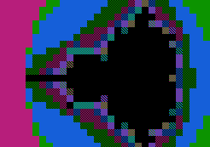
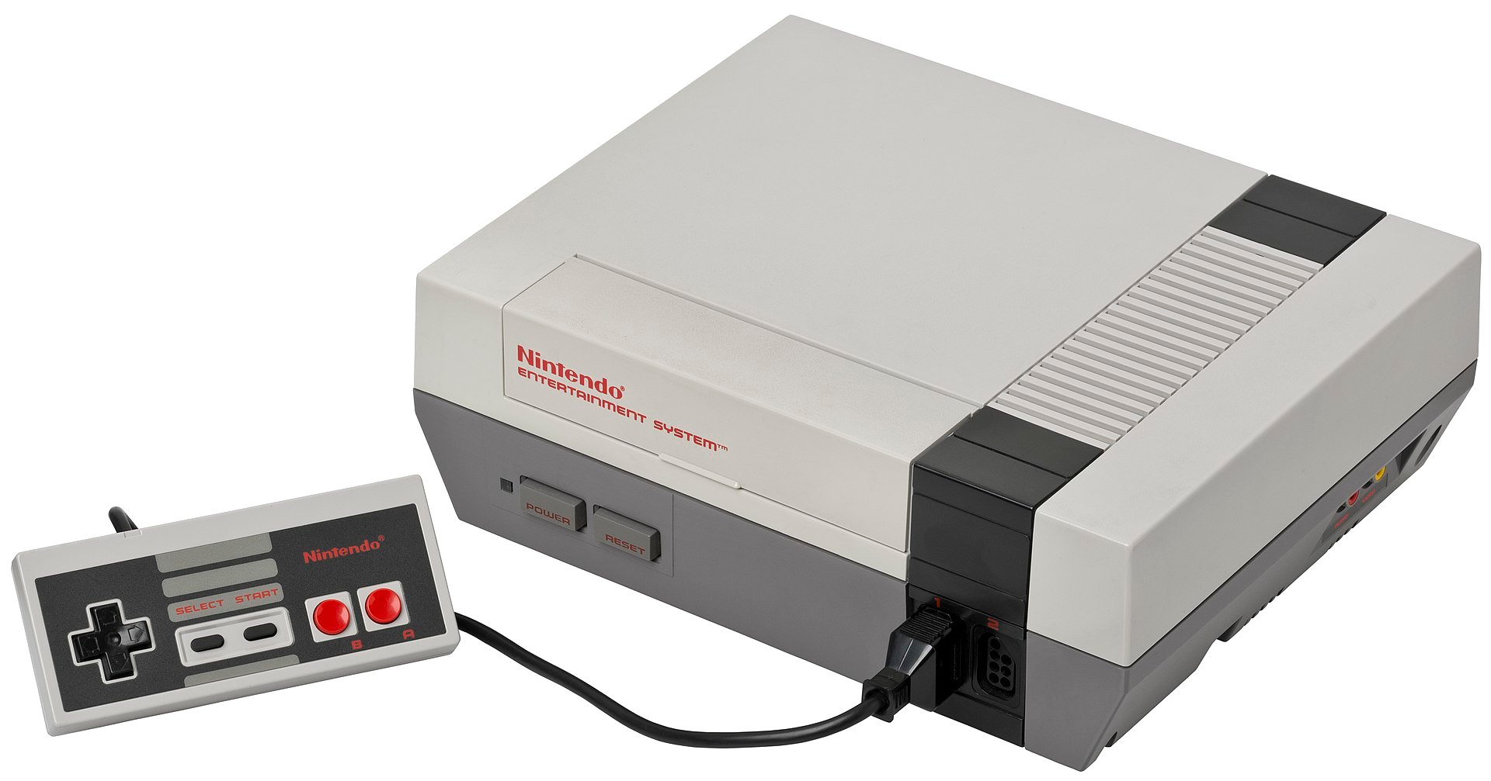
slithy VLOGS #20
8-Bit Battle RoyalE
Nintendo
power!

Slide 2
Assembly Leaderboard
Commander X16: 3.2
BBC Micro: 12.7
Amstrad CPC 464: 12.9
Sinclair ZX Spectrum: 13.5
Commodore 64: 26.4

Slide 3
Now You’re Playing With Power!
Memory: 2kB RAM, 2kB VRAM, 8kB CHR-ROM, 16kB+ PRG-ROM, maybe more?
Graphics: Picture Processing Unit (PPU)
  Background: 8x8 characters/tiles
    “4” 32x30 “nametables”
    4 4-color palettes, defined in “attribute tables”
    2D scrolling
  Sprites: Up to 64 8x8 or 8x16 sprites
    DMA for sprite attributes
    4 other 4-color palettes
    Z-depth priority (behind or in front of background)
    2-axis flipping
Sound:
  4 waveform generator voices (2 pulse, 1 triangle, 1 noise)
  7-bit PCM

Slide 4
Nametables
$2000 | $2400
$2800 | $2C00
A
C
$2000 | Row 0 Patterns
$2020 | Row 1 Patterns
⁝ | ⁝
$2380 | Row 28 Patterns
$23A0 | Row 29 Patterns
$23C0 | Row 0&1 Palettes
$23C8 | Row 2&4 Palettes
⁝ | ⁝
$23F0 | Row 26&27 Palettes
$23F8 | Row 28&29 Palettes
B
D

Slide 5




Patterns and Palettes
Pattern: 8x8 2bpp tile
Palette: 2-bit index (0-3)
  Background color + 3
Palette 0 Palette 1 Palette 2 Palette 3
Back- ground |  | 1 | 2 | 3 |  | 1 | 2 | 3 |  | 1 | 2 | 3 |  | 1 | 2 | 3

Slide 6
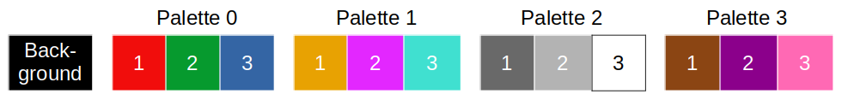
Attribute Limitations
Attribute | Name
$23C0 | $2000
$23C8 | $2020
$23D0 | $2040
$23D8 | $2060
0:0 | 0:1 | 1:2 | 1:3
0:1 | 0:2 | 1:3 | 1:1
2:2 | 2:3 | 3:1 | 3:2
2:3 | 2:0 | 3:0 | 3:2
0:0 | 0:1 | 0:2 | 0:3
1:1 | 1:2 | 1:3 | 2:1
2:2 | 2:3 | 3:1 | 3:2
3:3 | 1:0 | 2:0 | 2:2

Slide 7
Dithering to the Rescue!
15 different patterns using one palette

Slide 8
Assembly Leaderboard
Commander X16: 3.2
BBC Micro: 12.7
Amstrad CPC 464: 12.9
Sinclair ZX Spectrum: 13.5
Nintendo Entertainment System: 16.2
Commodore 64: 26.4

