Slide 1
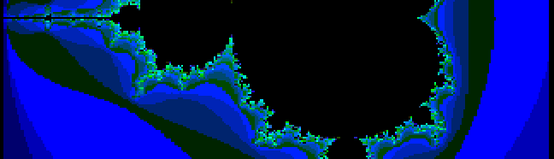

slithy VLOGS #23
8-BIT BLAZING!

Slide 2
ZX Spectrum Next Video
ULA (Uncommitted Logic Array)
  Spectrum Video Mode (Legacy)
  Enhanced ULA
    Timex Sinclair Double Buffering
    Timex Sinclair Hi-Res Mode (512x192)
    Timex Sinclair Hi-Color Mode (8x1 color blocks)
    LoRes Layer/Radasjimian Mode (128x96, 256 colors)
Layer 2, Tile Map, Sprites

Slide 3
Video Layers
ULA, Layer 2, Sprites order configurable
Tile Map may be swapped or combined with ULA
Layer 2 may be combined with Blending Layer?

Slide 4
Layer 2
Independent Pixels, Palette
3 Bitmap Modes
  256x192, 256 colors
  320x256, 256 colors
  640x256, 16 colors

Slide 5
Results
Commander X16
  320x240, 48 colors: 12:08
ZX Spectrum Next
  LoRes, 128x96, 22 colors: 0:20
  Layer 2, 320x256, 48 colors: 3:30

