Slide 1
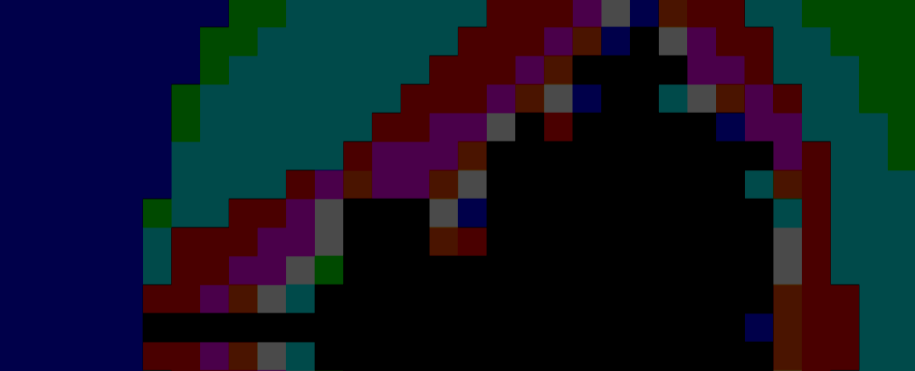
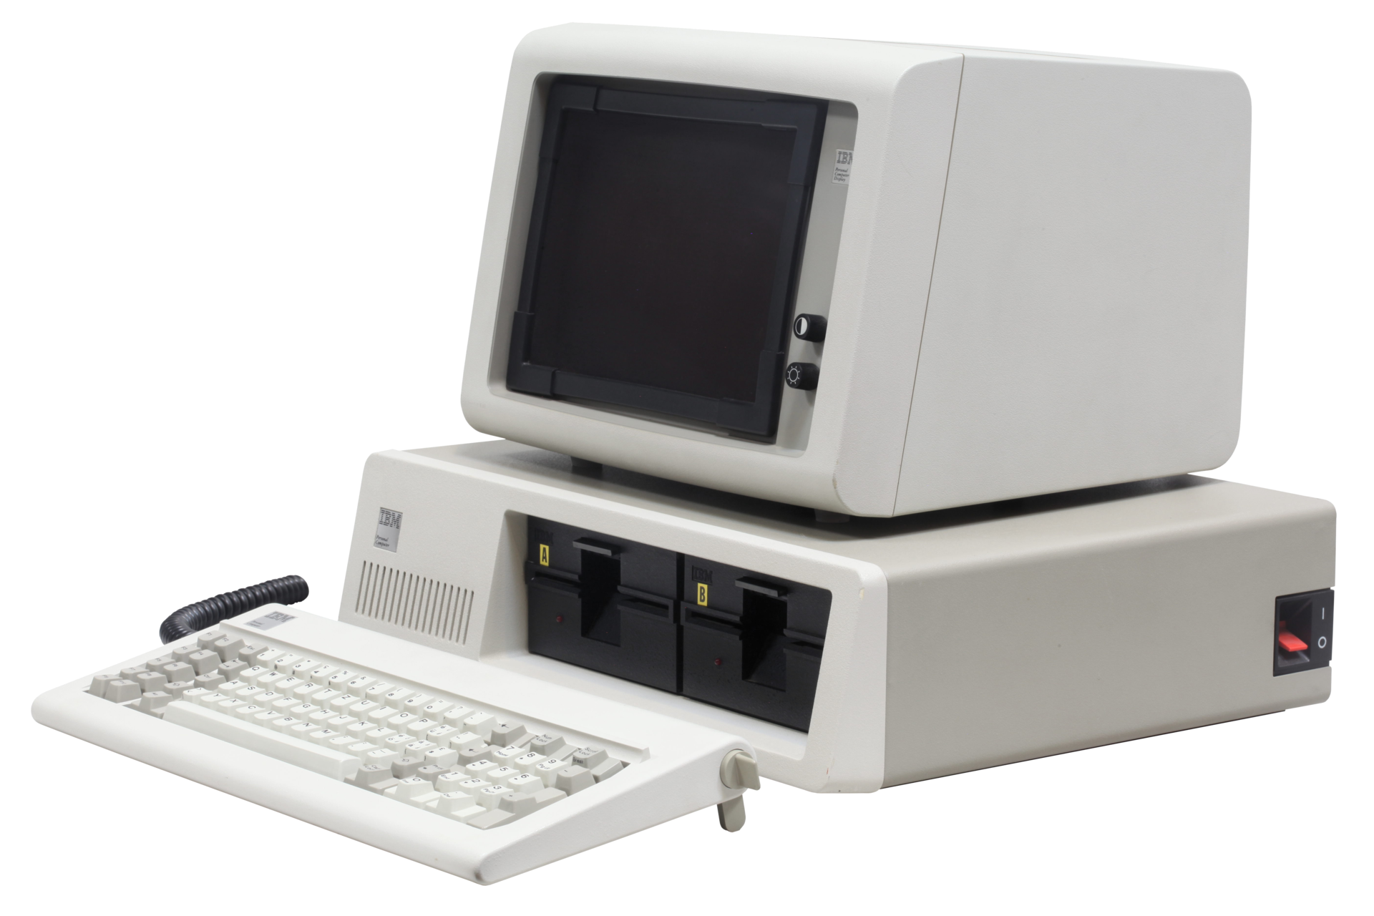
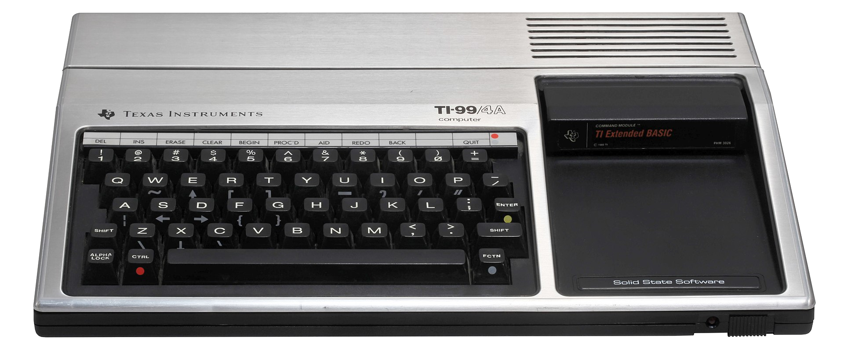
slithy VLOGS #29
16-BIT
BATTLE ROYALE

Slide 2
What is 16-Bit?
Technology!
Marketing!
Nostalgia!

Slide 3
Technology!
Processor
Memory
Memory
Mgt
External
Data Bus:
Registers
Address Bus:
ALU
Internal Data Bus:

Slide 4
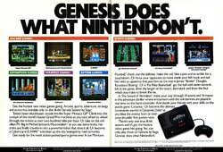
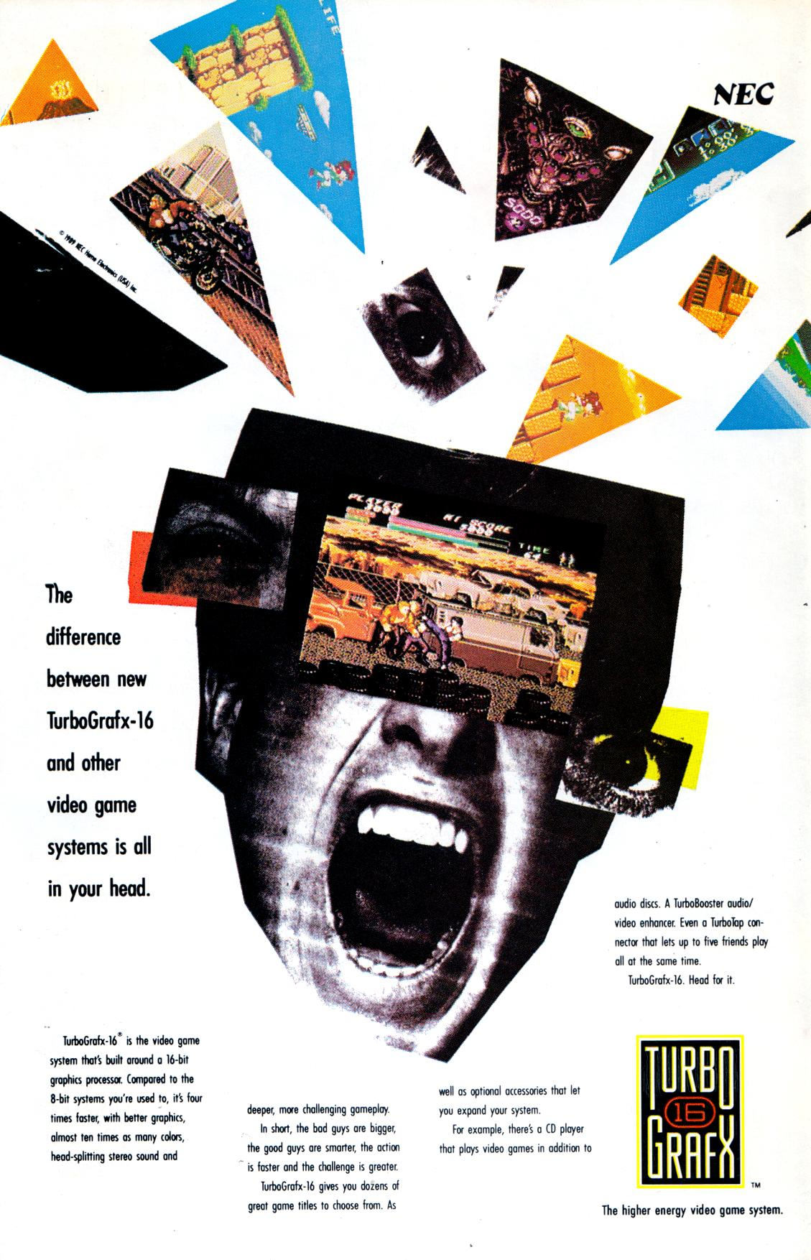

Marketing!

Slide 5
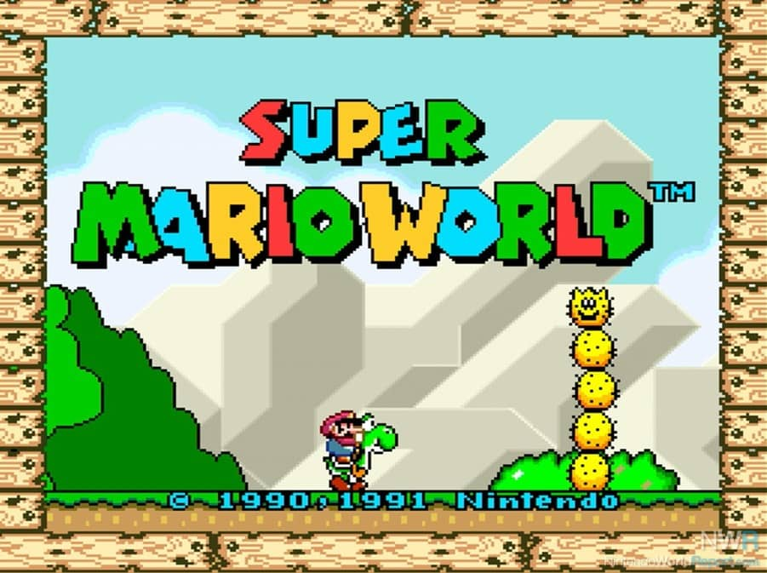
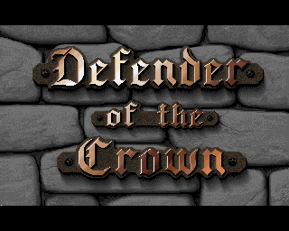
Nostalgia!

Slide 6
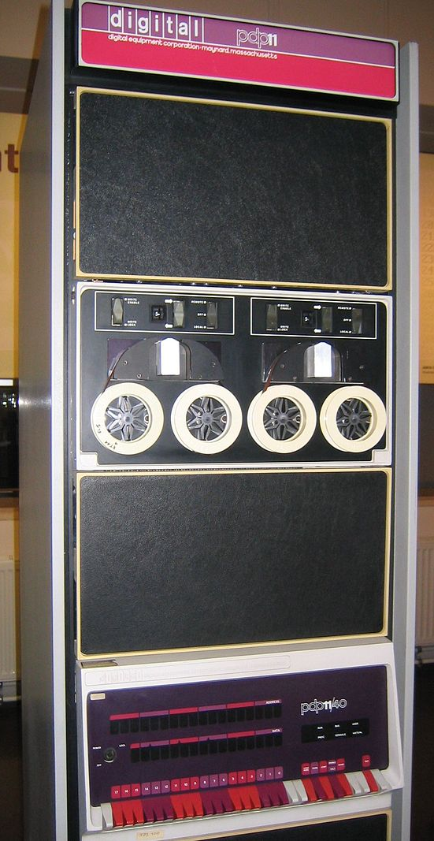
The Dawn of 16-Bit
First Microprocessors 4-bit, then 8-bit
16-Bit “Minicomputers”
16-Bit Microprocessors
  National IMP-16 (1973)
  TI TMS9900 (1976)
  Intel 8086 (1978)

Slide 7
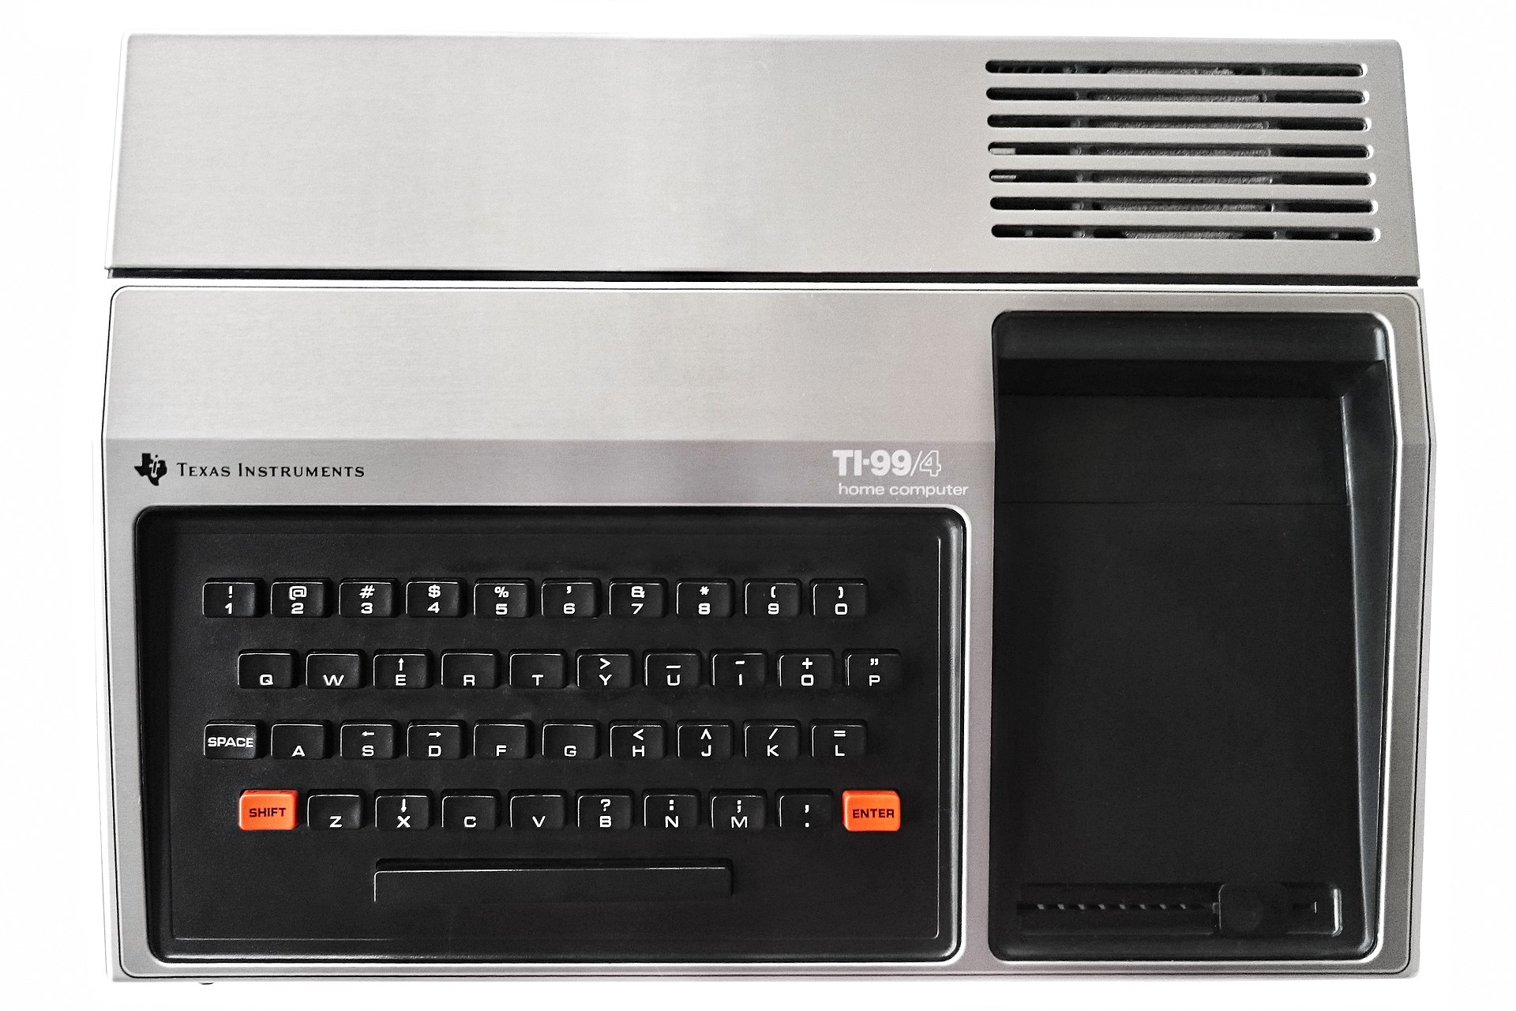
1979
Texas Instruments TI-99/4 Released
  $1,150 in October 1979
Bad Keyboard
No Software
Only 20,000 sold through 1981

Slide 8

1981
Texas Instruments TI-99/4A
  $525 in June 1981
  $99 when discontinued March 1984
IBM Personal Computer 5150
  $1,565 in August 1981
  16 kB RAM, monochrome, no floppy

Slide 9
8-Bit BASIC Leaderboard
Commander X16: 0:23
BBC Micro: 1:37
Amstrad CPC 464: 1:39
Atari 800: 2:16
Apple ][: 2:45
Commodore 64: 3:23
Sinclair ZX Spectrum: 4:33 (0:34 for Next @ 8x Turbo)

Slide 10
16-Bit BASIC Leaderboard
IBM PC/AT 5170: 0:42
IBM PC 5150: 2:51
TI-99/4A: 6:04

