Slide 1
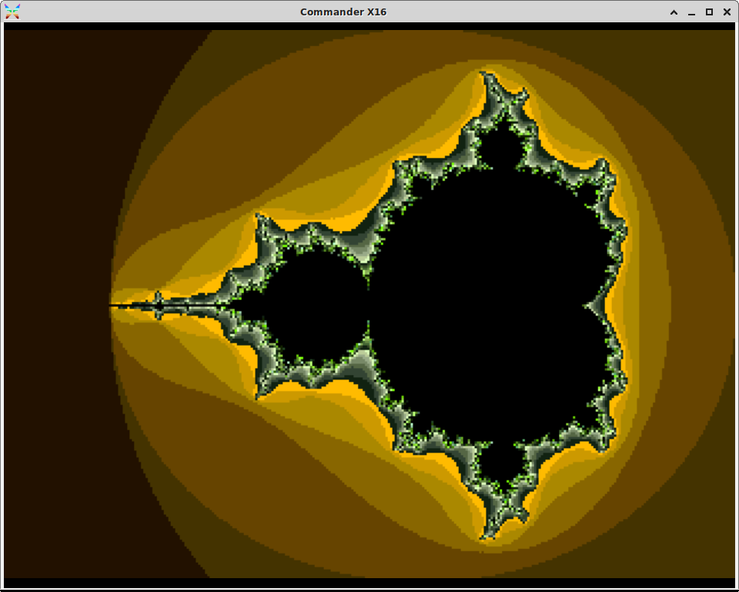





slithy VLOGS #21
8-Bit Battle RoyalE
NEXT LEVEL!

Slide 2
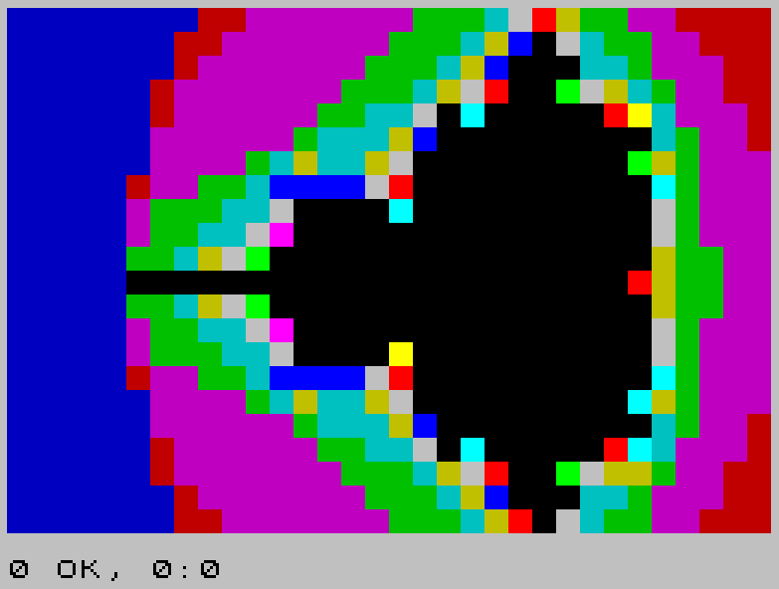
Assembly Leaderboard
Commander X16: 3.2
BBC Micro: 12.7
Amstrad CPC 464: 12.9
Sinclair ZX Spectrum: 13.5
Nintendo Entertainment System: 16.2
Commodore 64: 26.4

Slide 3
Commander X16
8MHz 65C02
640x480 pixels, 256 colors
129,472 bytes VRAM
320x240 @ 48 max iterations
  BASIC: 1:12:34
  Assembly (16.8 fixed point): 0:12:08

Slide 4
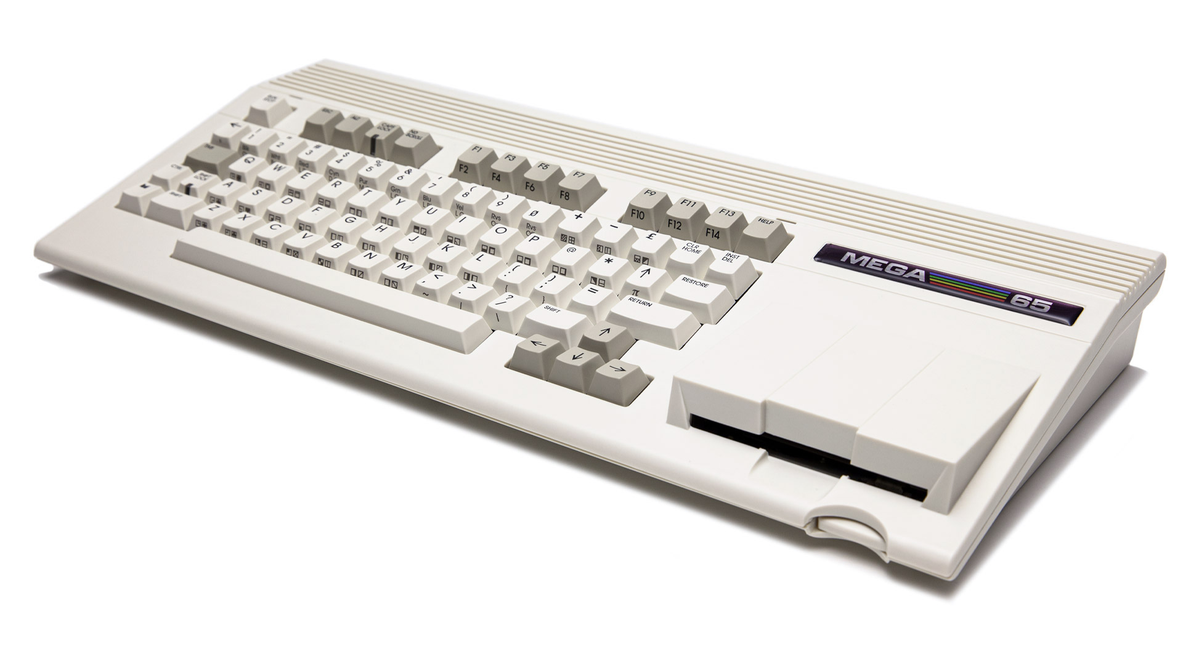
Mega65
Based on Commodore 65
40.5 MHz 45GS02
720x576 pixels, 256 colors
An actual 3.5” floppy drive!
Oliver Graf’s Mandelbrot Explorer 65
  320x200 @ 48 max iterations

Slide 5
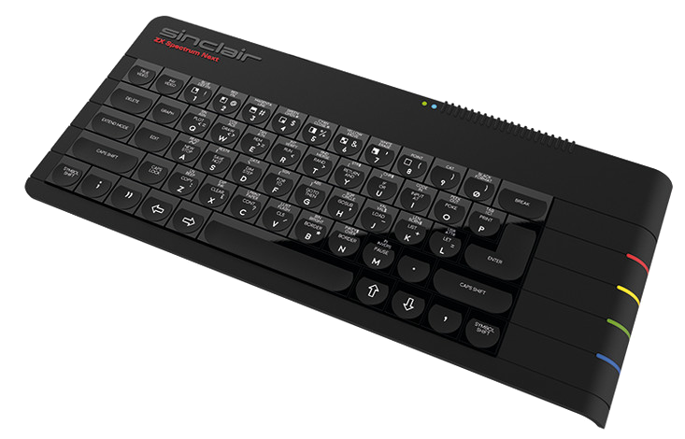
ZX Spectrum Next
Backward compatible with original Sinclair ZX Spectrum
28 MHz “Z80N” in FPGA
  Complete Z80 plus new instructions
512x192 pixels, 256 colors
“LoRes” Video Mode
  128x92 pixels, independently colored

Slide 6
What’s Your Dream?
SPEED!
  Mega65
BACKWARD COMPATIBILITY!
  ZX Spectrum Next
GRAPHICS!
  Commander X16

