Slide 1


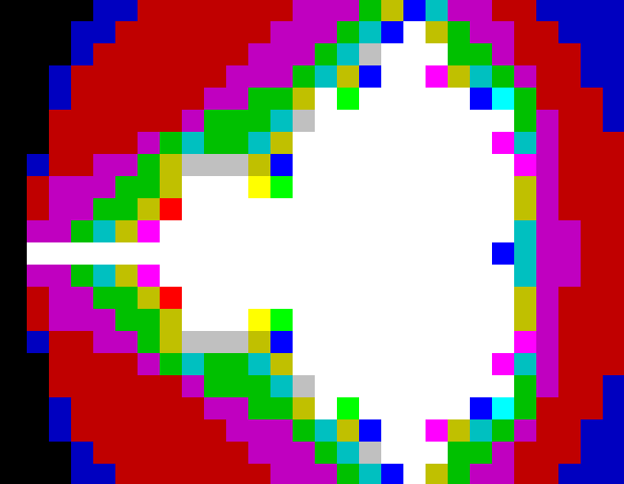
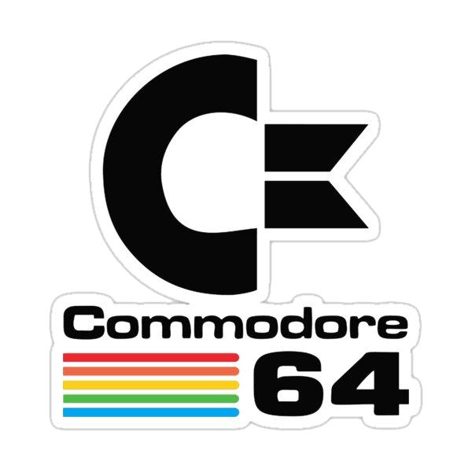


slithy VLOGS #14
8-Bit
Battle Royale!
vs.
vs.

