Slide 1

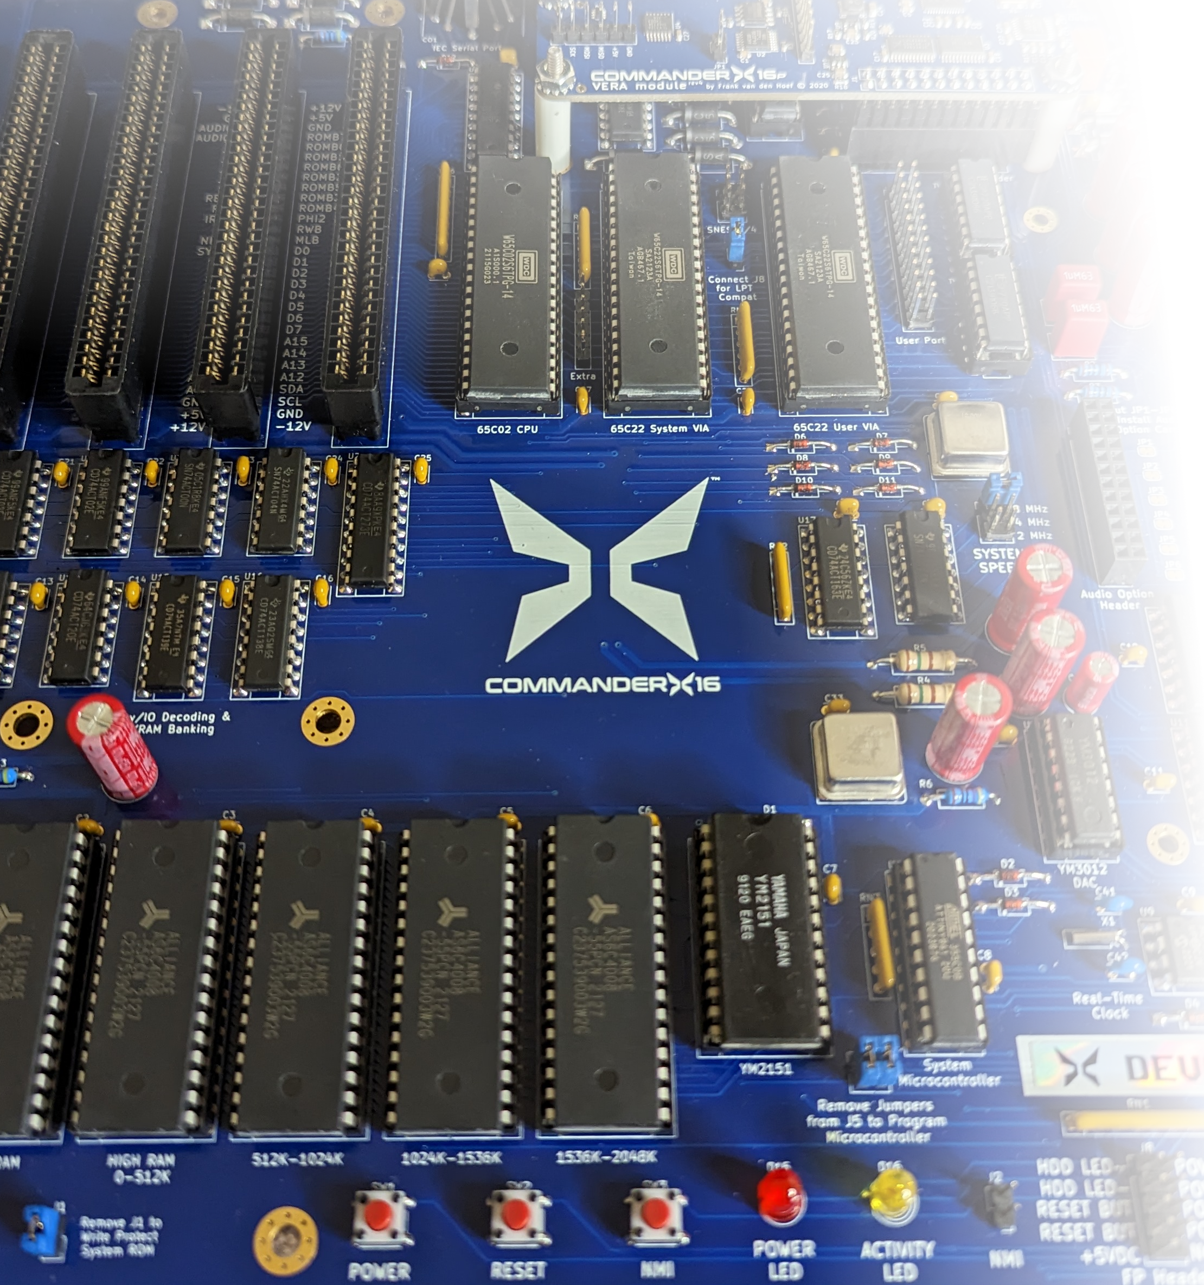
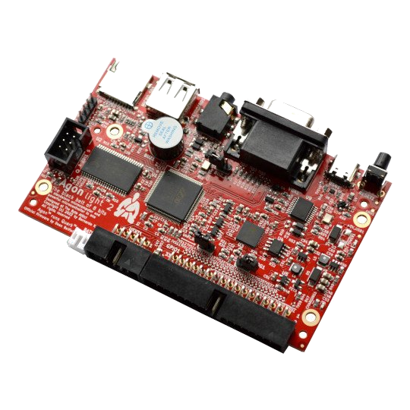
8-Bit Battle Royale
X16 vs agon:
hardware!

Slide 2
BASIC Leaderboard
Commander X16: 0:23
BBC Micro: 1:37
Amstrad CPC 464: 1:39
Atari 800: 2:16
Apple ][: 2:45
Commodore 64: 3:23
Sinclair ZX Spectrum: 4:33 (0:34 for Next @ 8x Turbo)

Slide 3
Assembly Leaderboard
Commander X16: 3.2
BBC Micro: 12.7
Amstrad CPC 464: 12.9
Sinclair ZX Spectrum: 13.5
Commodore 64: 26.4

Slide 4
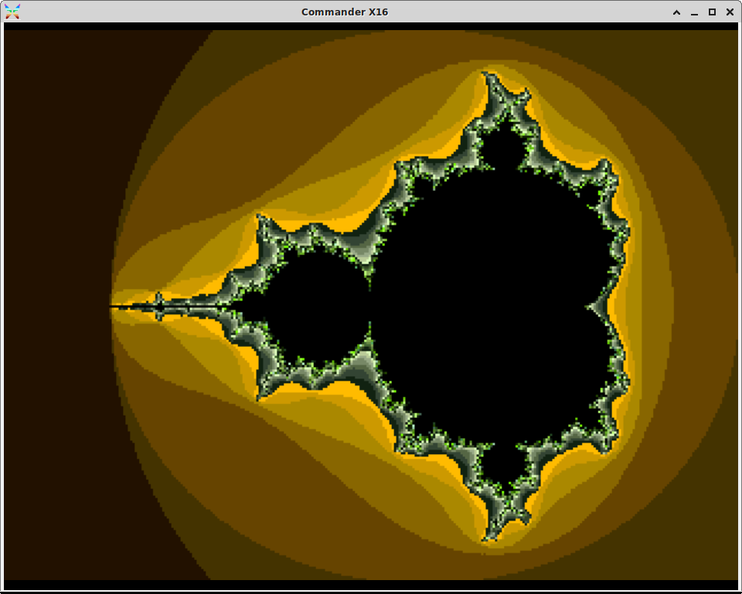
Commander X16 Bitmap Layer
8MHz 65C02
640x480 pixels, 256 colors
129,472 bytes VRAM
320x240 @ 48 max iterations
  BASIC: 1:12:34
  Assembly (16.8 fixed point): 0:12:08

Slide 5
Agon Graphics
Serial terminal to ESP32 running FabGL
  Optimized for text
64 colors at 320x240
Bitmaps only updated holistically
  4 bytes per pixel
No tilemap
  Bitmaps/sprites arbitrarily placed
Vector drawing faster

Slide 6
Final BASIC Leaderboard
Agon Light 2: 0:06
Commander X16: 0:23
BBC Micro: 1:37
Amstrad CPC 464: 1:39
Atari 800: 2:16
Apple ][: 2:45
Commodore 64: 3:23
Sinclair ZX Spectrum: 4:33 (0:34 for Next @ 8x Turbo)

Slide 7
Assembly Leaderboard
Agon Light 2: 1.5
Commander X16: 3.2
BBC Micro: 12.7
Amstrad CPC 464: 12.9
Sinclair ZX Spectrum: 13.5
Commodore 64: 26.4

