Slide 1


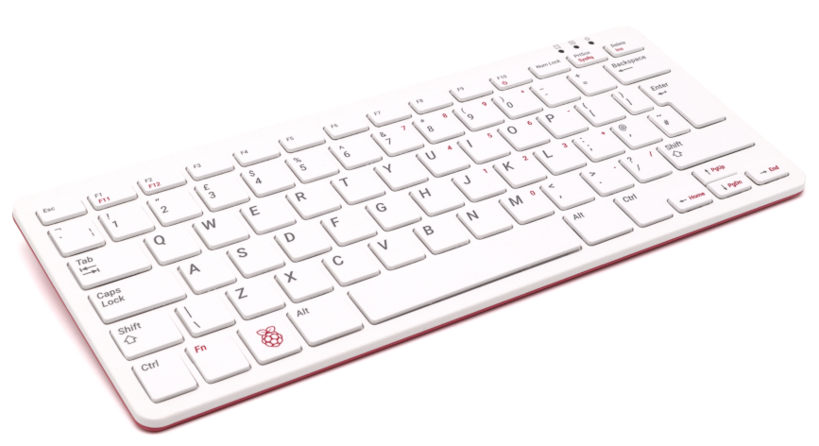
HOW IS THIS
$80 “TOY”
FASTER THAN A
GAMING LAPTOP?

