Slide 1
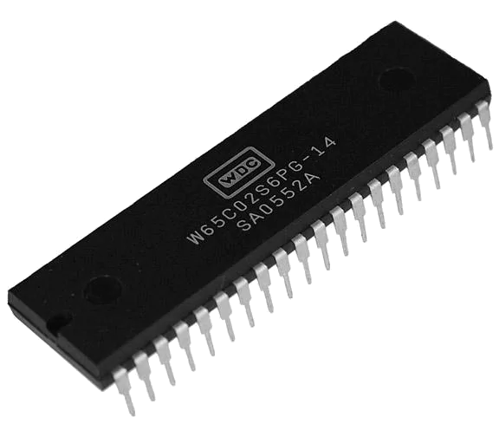


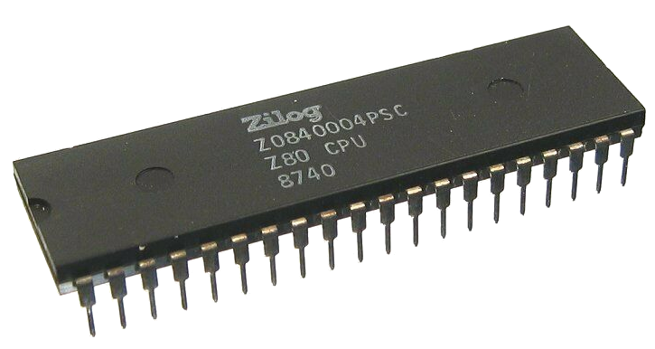


slithy VLOGS #17
8-Bit Battle Royale
ROUND 2 Done:
Top speed!

Slide 2
Final BASIC Leaderboard
Commander X16: 0:23
BBC Micro: 1:37
Amstrad CPC 464: 1:39
Atari 800: 2:16
Apple ][: 2:45
Commodore 64: 3:23
Sinclair ZX Spectrum: 4:33 (0:34 for Next @ 8x Turbo)

Slide 3
Assembly Leaderboard
Commander X16: 3.5
Sinclair ZX Spectrum: 20.5
Commodore 64: 26.5

Slide 4
Final Assembly Leaderboard
Commander X16: 3.2
BBC Micro: 12.7
Amstrad CPC 464: 12.9
Sinclair ZX Spectrum: 13.5
Commodore 64: 26.4

