Slide 1
Hello, NES!
“Hello, World!”
on a Nintendo?
A little
easier?
A little
easier?

Slide 2
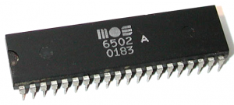
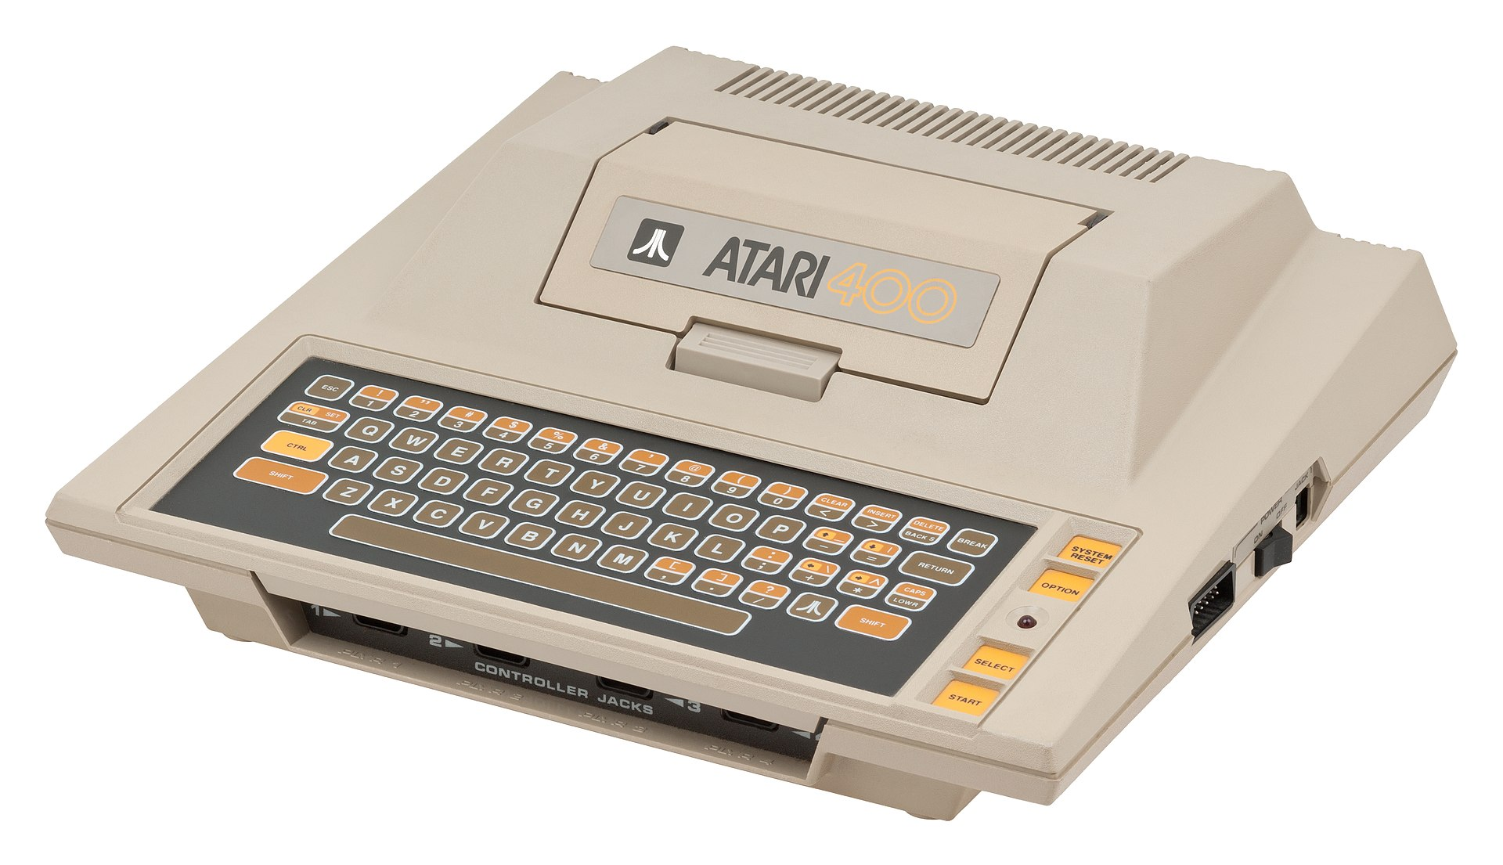
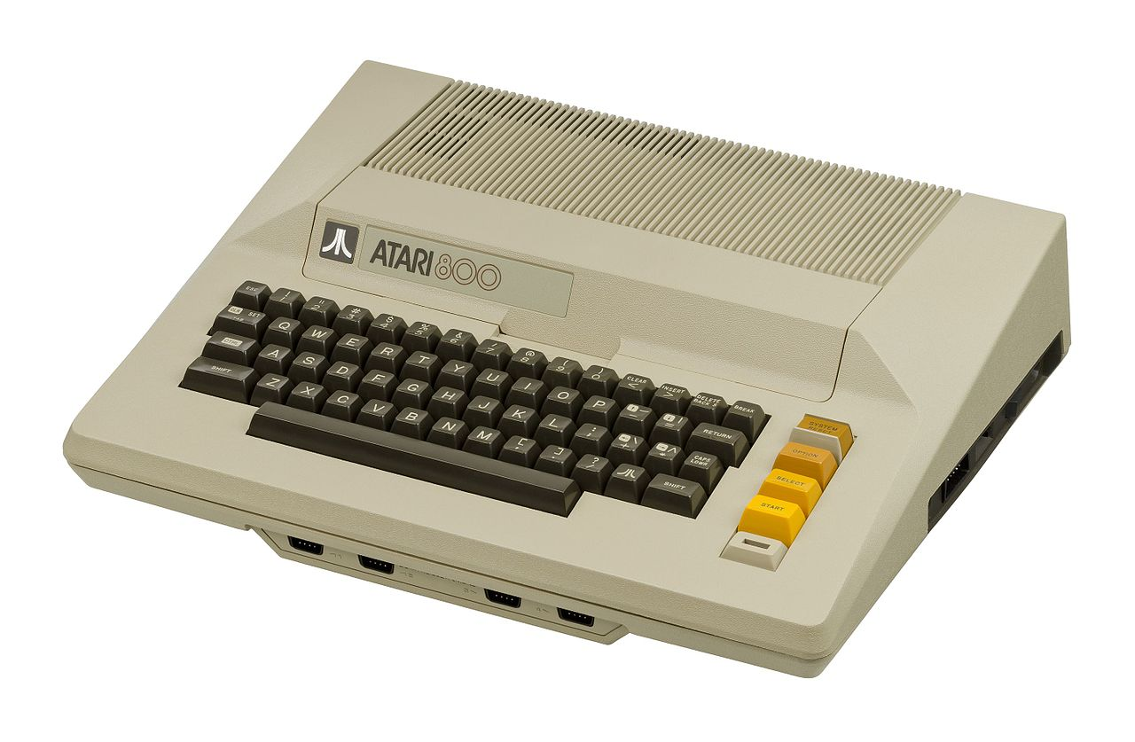
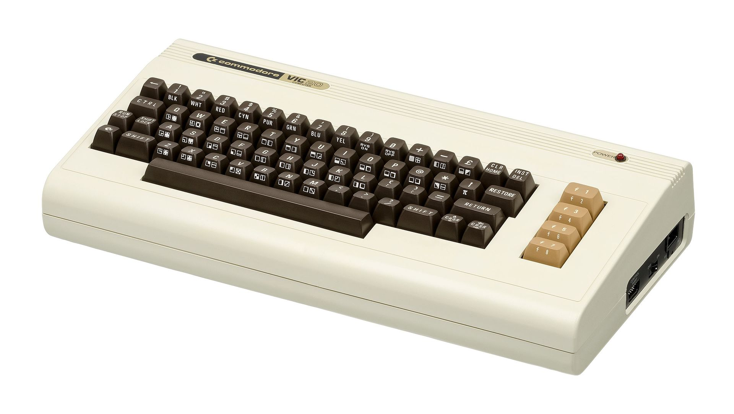
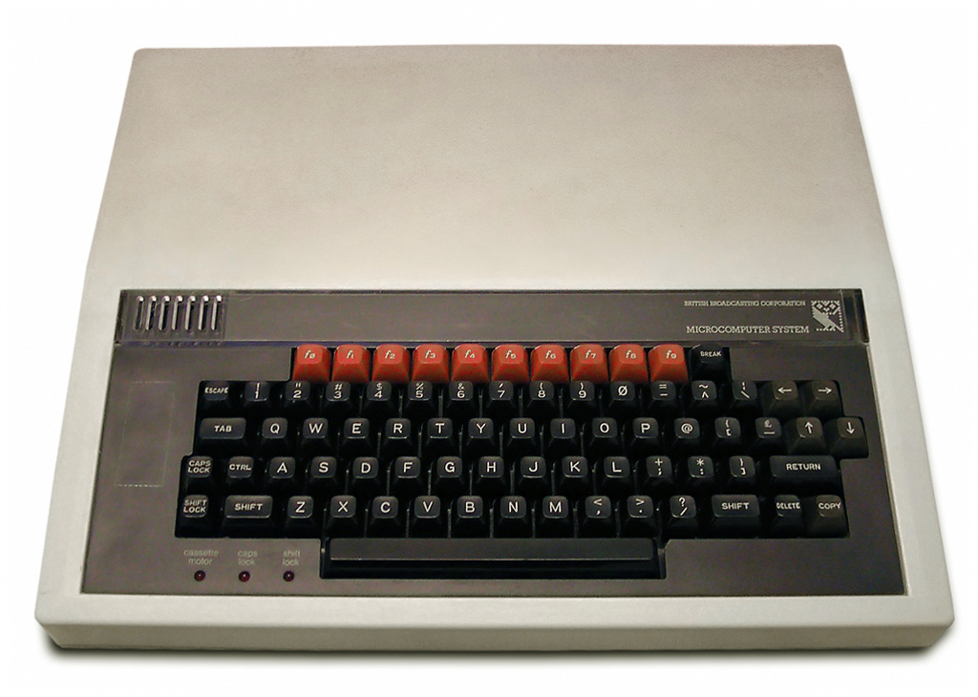
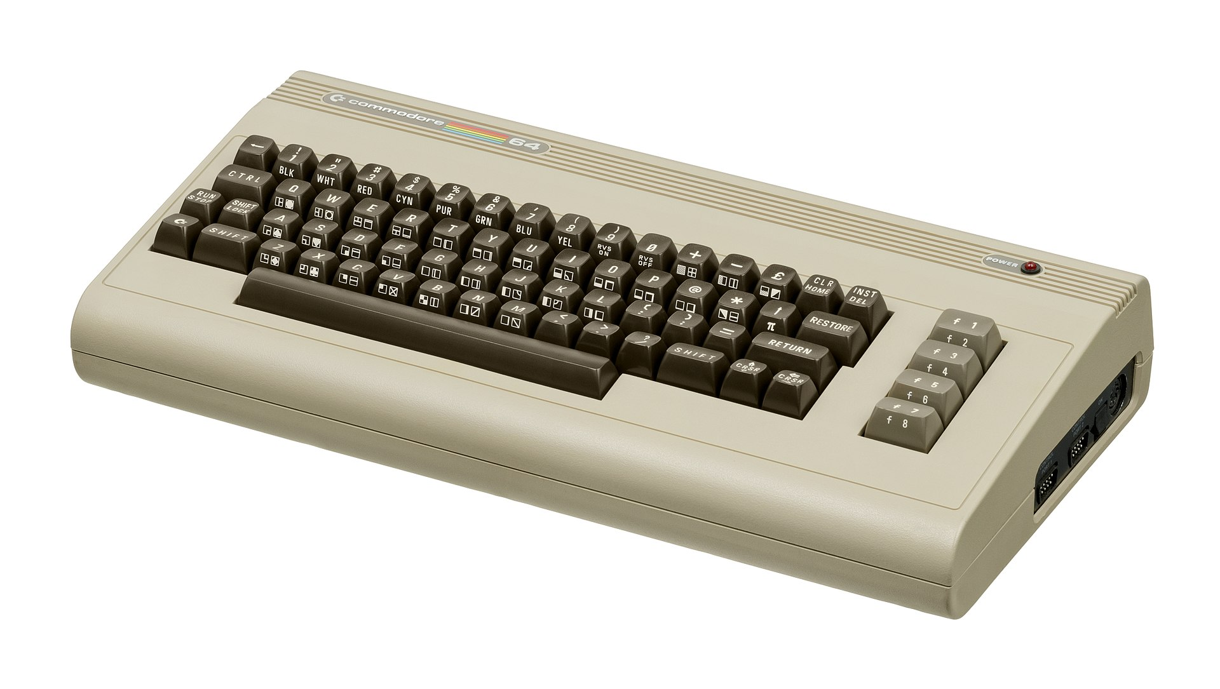
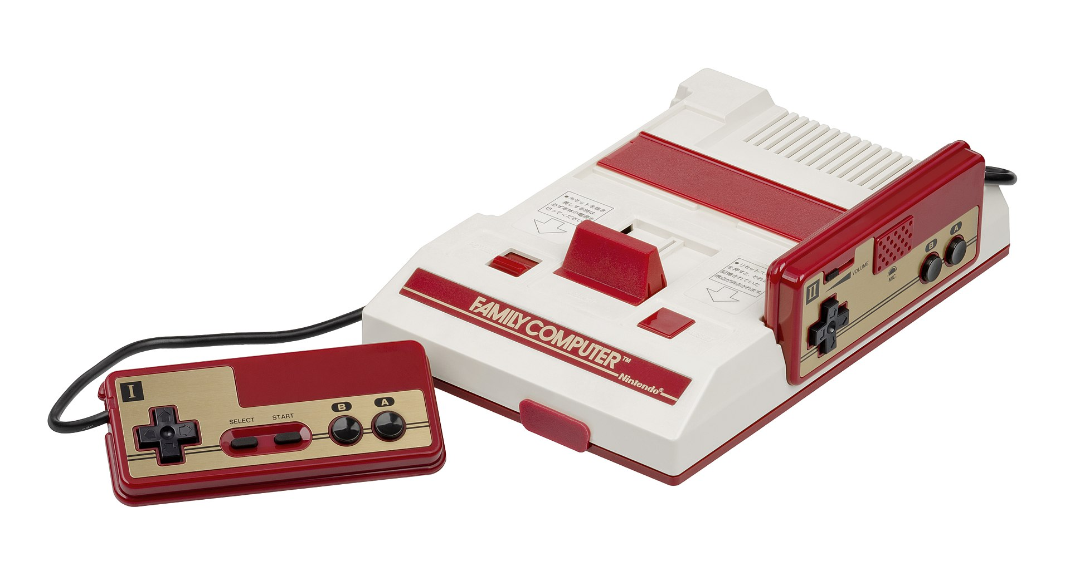
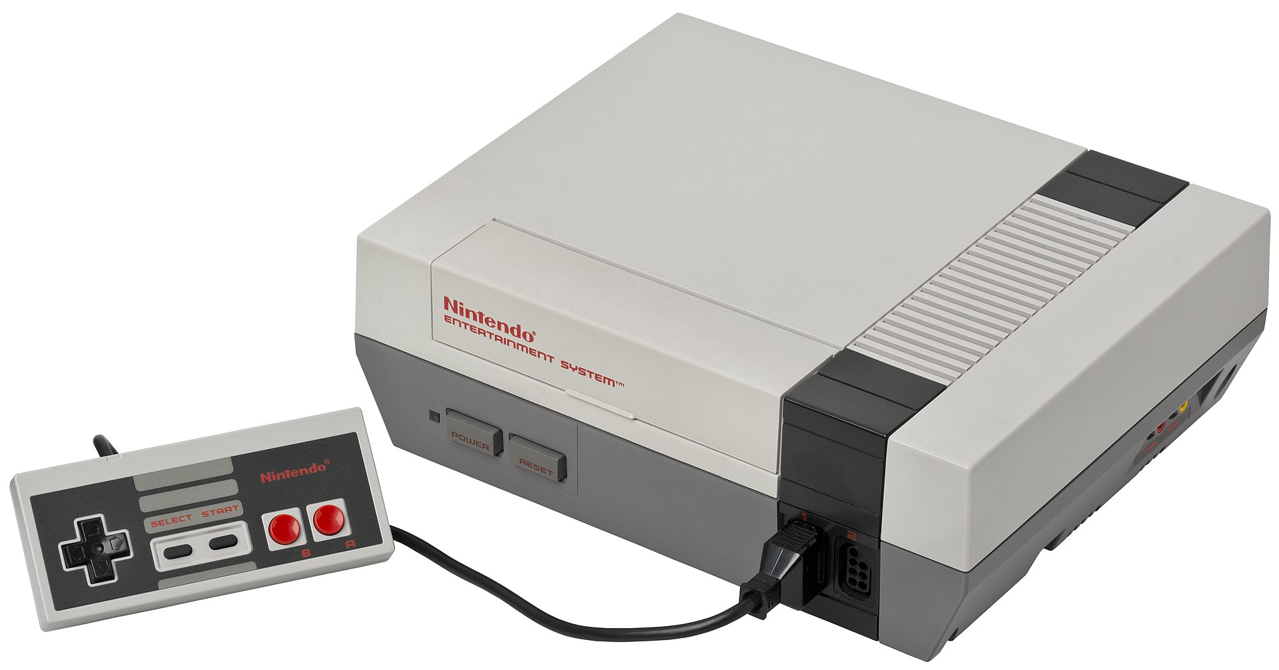
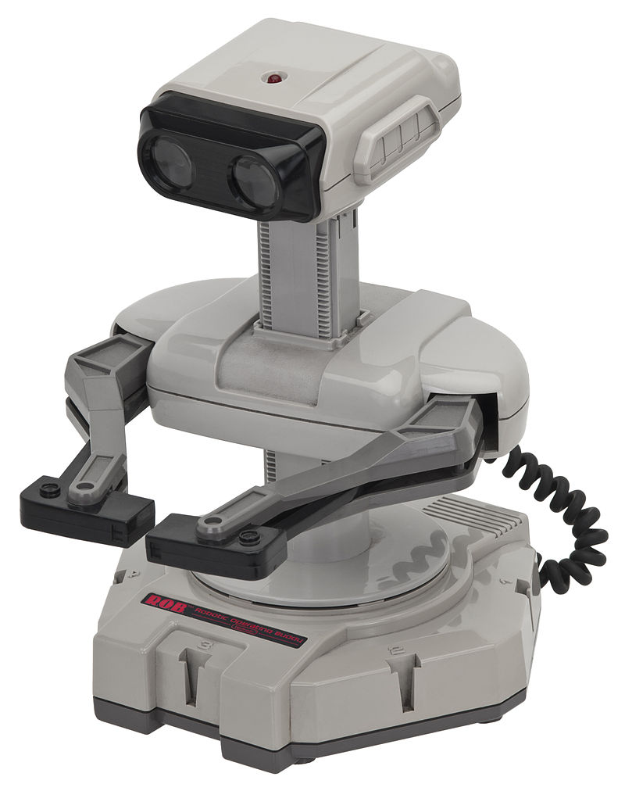
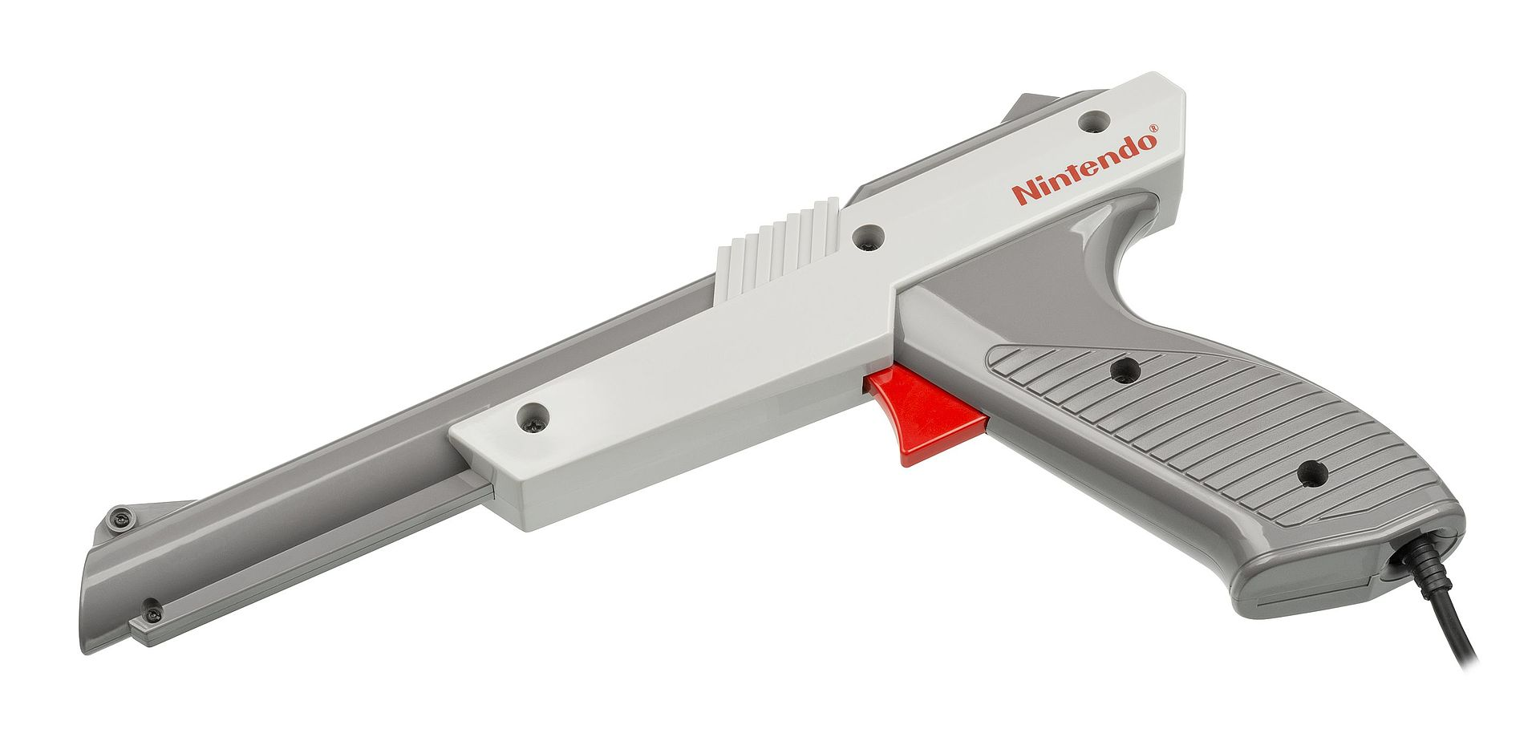
Golden Age of the 6502
1979:
$549.95/$999.95
1980:
$299.95
1981:
£235/£335 ($457/$652)
1982:
$595
1983:
¥14,800($61.35)
$179.99
1985:

Slide 3
Now You’re Playing With Power!
Memory: 2kB RAM, 2kB VRAM, 8kB CHR-ROM, 16kB+ PRG-ROM, maybe more?
Graphics: Picture Processing Unit (PPU)
  Background: 8x8 characters/tiles
    “4” 32x30 “nametables”
    4 4-color palettes, defined in “attribute tables”
    2D scrolling
  Sprites: Up to 64 8x8 or 8x16 sprites
    DMA for sprite attributes
    4 other 4-color palettes
    Z-depth priority (behind or in front of background)
    2-axis flipping
Sound:
  4 waveform generator voices (2 pulse, 1 triangle, 1 noise)
  7-bit PCM

Slide 4
Nametables
$2000 | $2400
$2800 | $2C00
A
C
$2000 | Row 0 Patterns
$2020 | Row 1 Patterns
⁝ | ⁝
$2380 | Row 28 Patterns
$23A0 | Row 29 Patterns
$23C0 | Row 0&1 Palettes
$23C8 | Row 2&4 Palettes
⁝ | ⁝
$23F0 | Row 26&27 Palettes
$23F8 | Row 28&29 Palettes
B
D

