Slide 1

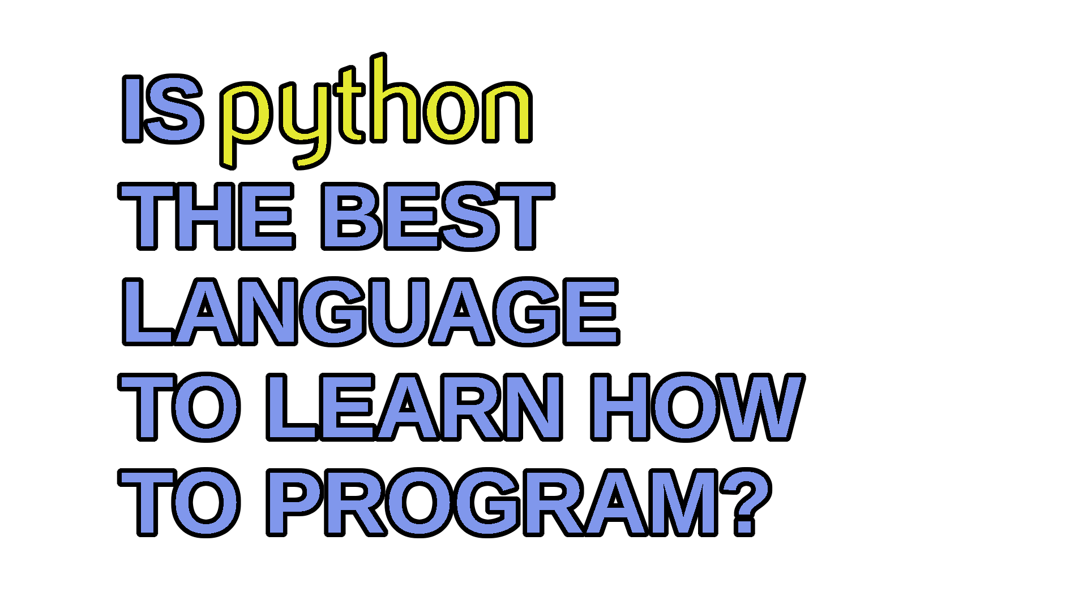
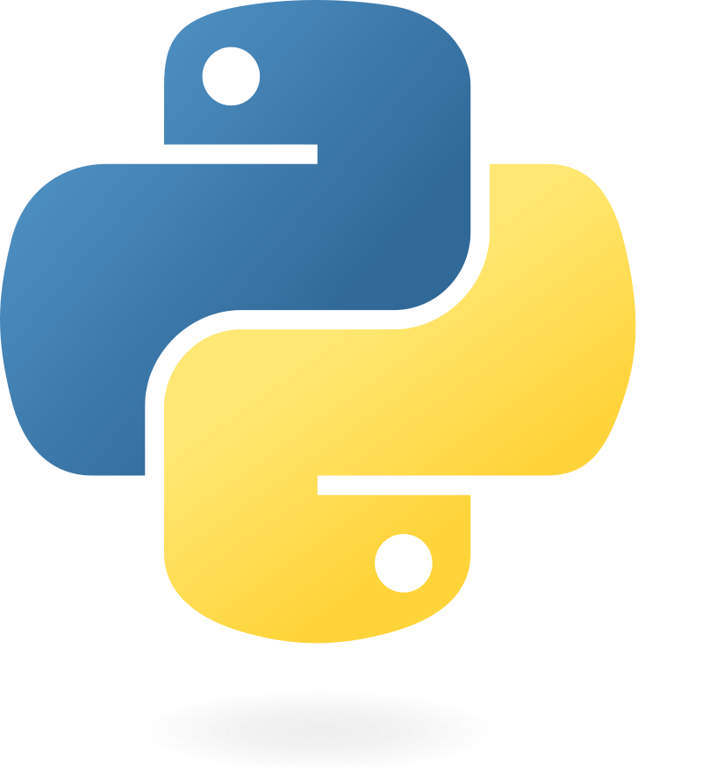
NEW SERIES!

Slide 2
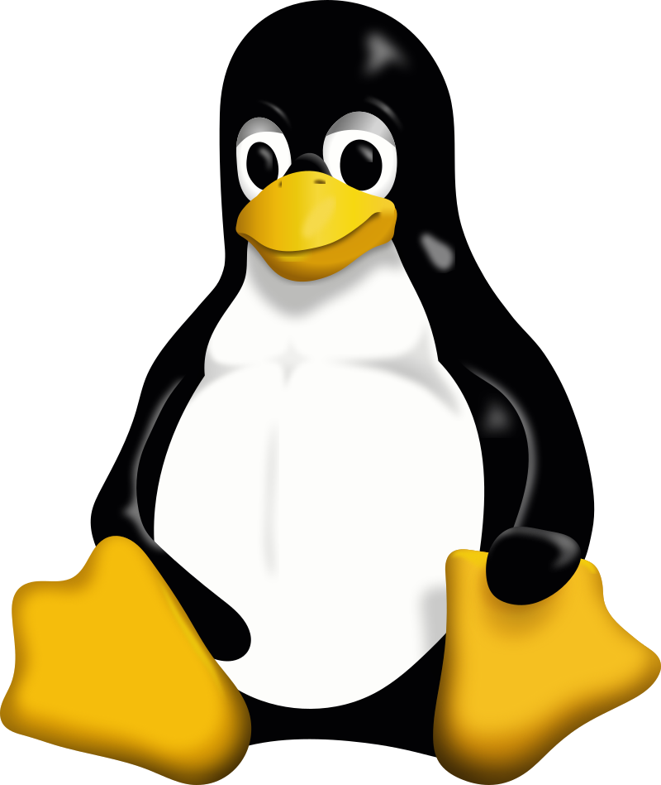





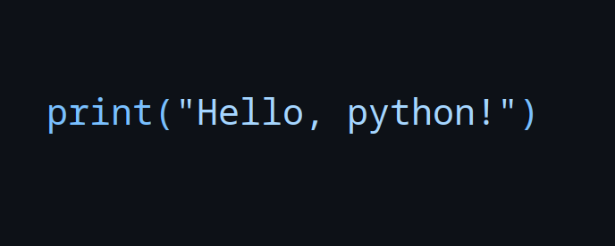

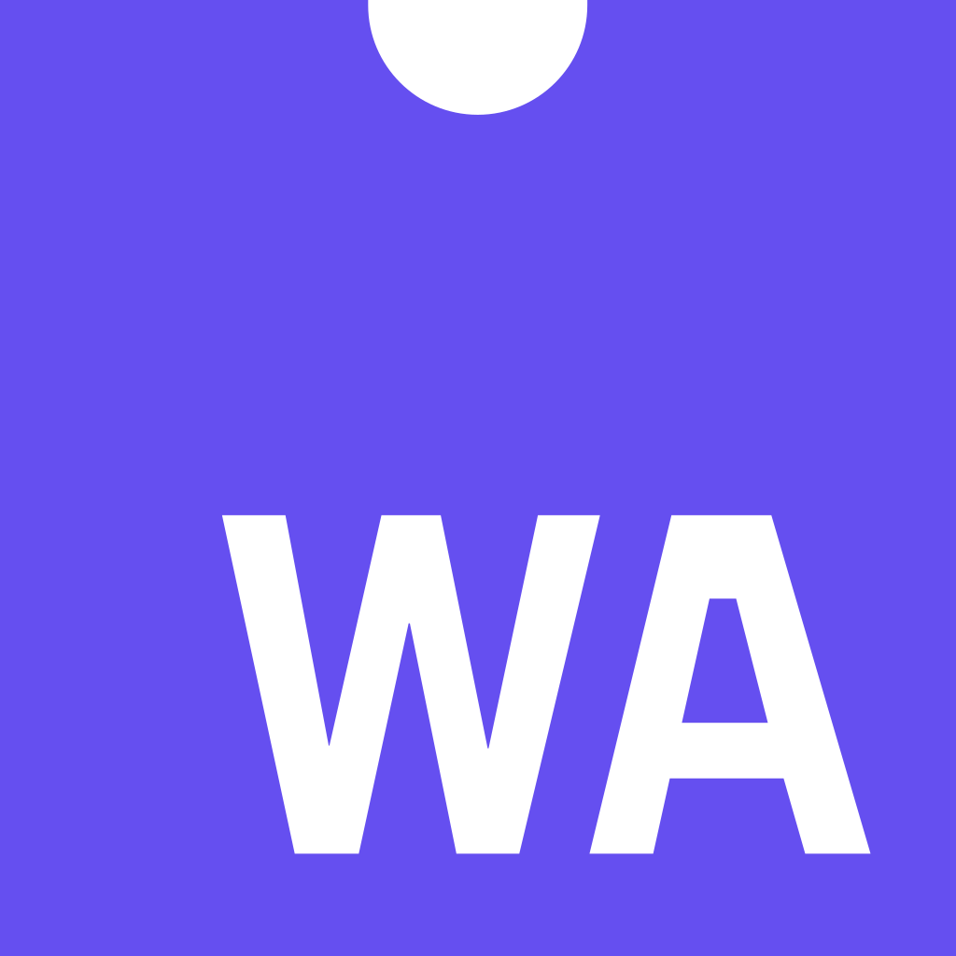
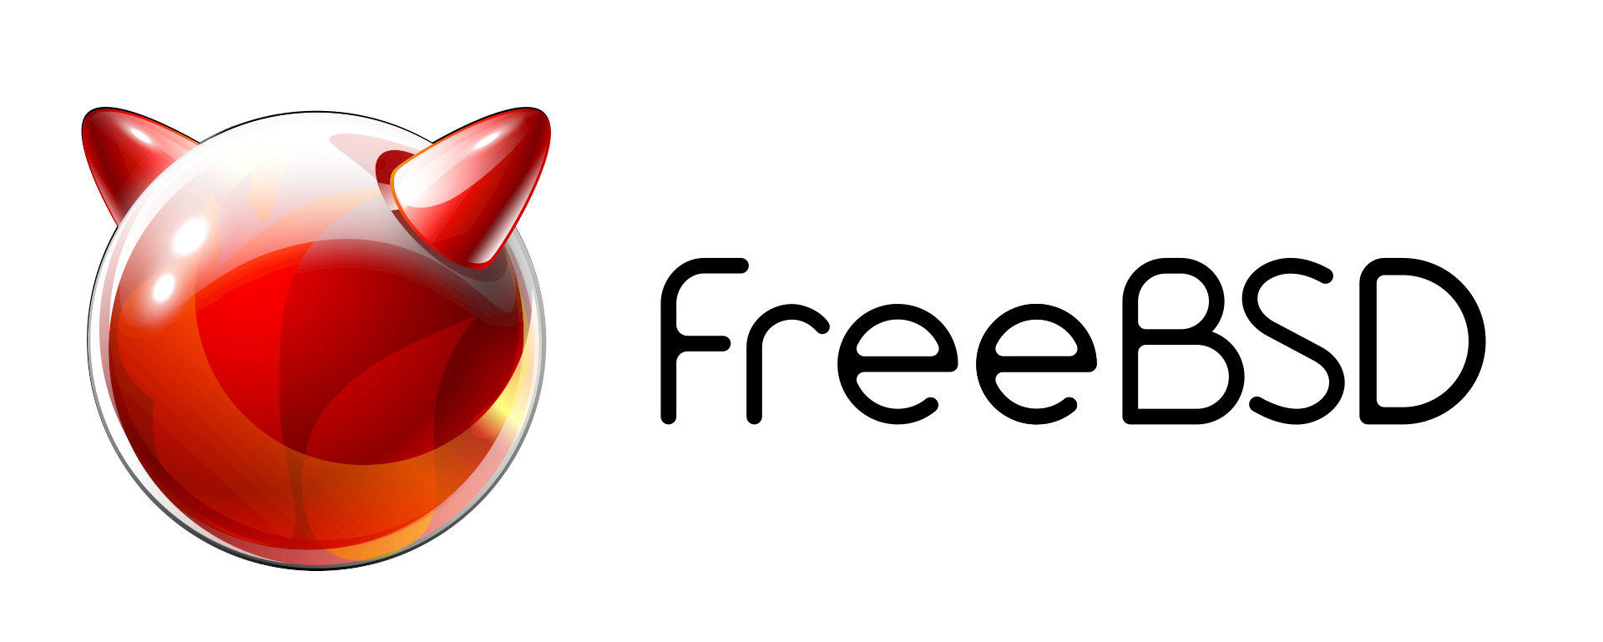
Python is Everywhere!

Slide 3

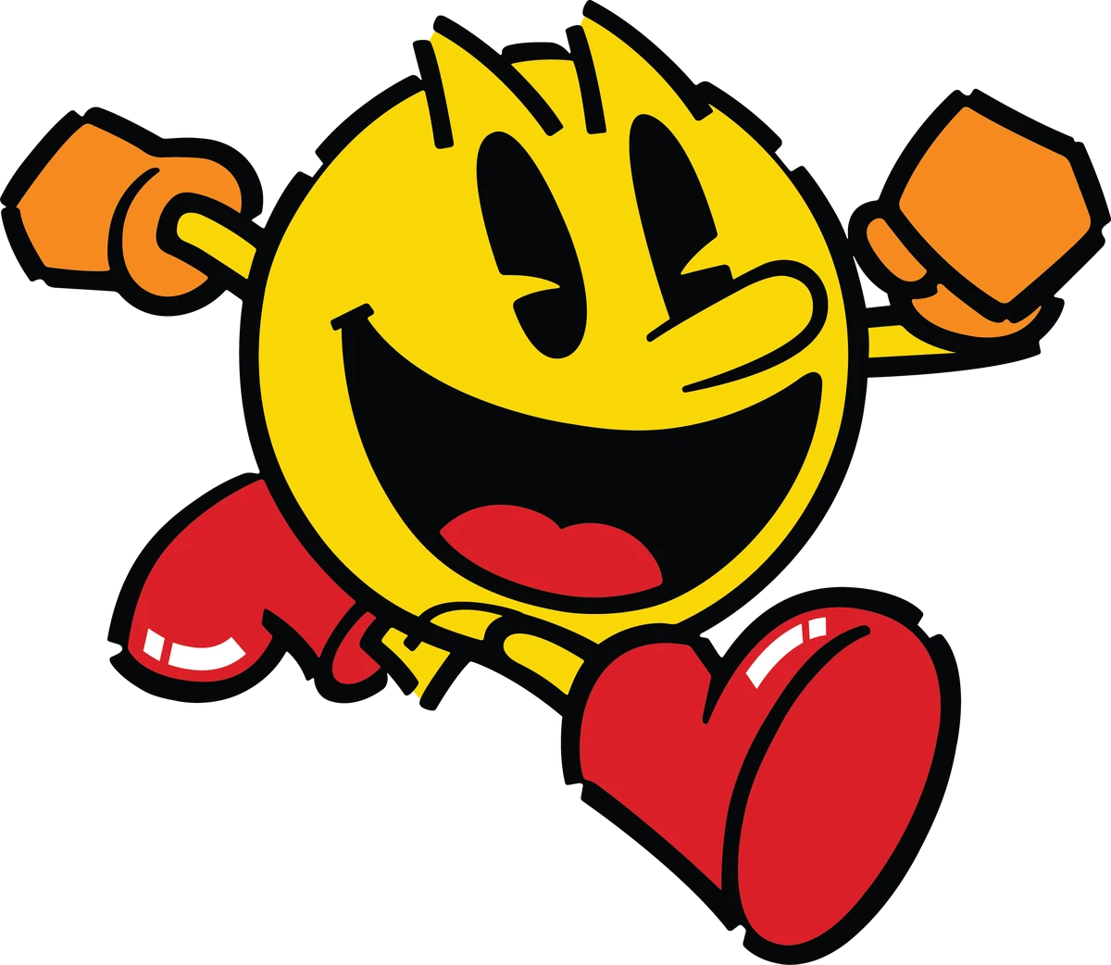

Python is Versatile!
Education
Artificial Intelligence / Machine Learning
Statistical Modeling / Data Science
Games!

Slide 4

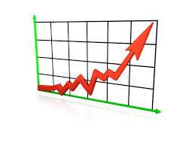
Python is Retro!(?)
1989: Started by Guido van Rossum
1991: Python 0.9
1994: Python 1.0
2000: Python 2.0
2009: Python 2.7

Slide 5
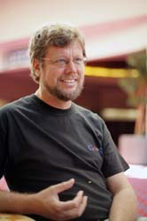
Python is Mature!
2008: Python 3.0
A tale of two languages
2020: End of Python 2.7
“BDFL”

Slide 6



Python is Python!
CPython: one implementation to rule them all.
PyPy: the fast one!
Jython: the one for Java...

Slide 7
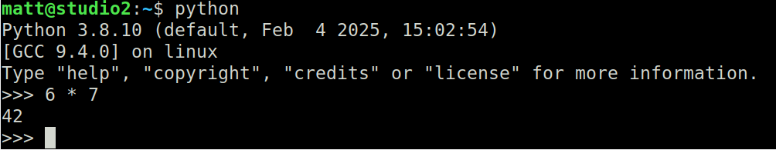
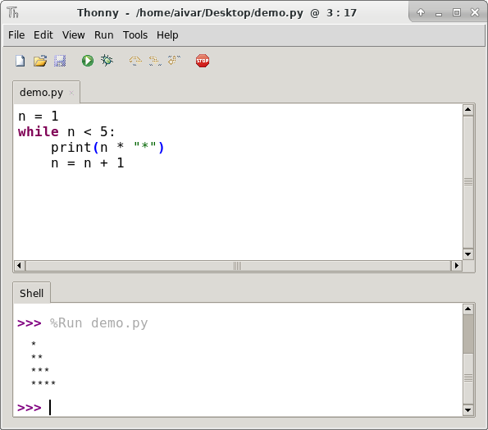

Python is Interactive!

Slide 8

Python is for You!
No experience necessary!
Tutorial recommended for ages 12 and up
  Or for younger, ambitious kids!
Each lesson 30-45 minutes
Learn all the basics
Create your own game!

Slide 9



Thanks for Watching!
Like, Comment, Subscribe!
Become a Member!
Become a Patron!
  Family: Andrew C. Young – Electron Star Collapse – Jimmy Dansbo
  Friends: Michael McDonnell – Smeedy-build1970
  Acquaintances: Andreas_S – Anthony Colquhoun – David Cohen – Harold Jones
  Ian Young – Leo Paesen – Michael Ketchen – Ronnie Simpson – Scott Teague
  Sohl – Tim Soderstrom – Vince Valenti

