Slide 1


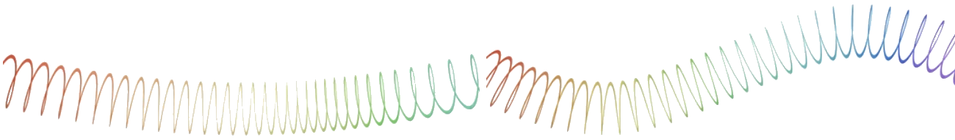
Programming in python
for Beginners
Lesson 3: Lists and Loops

Slide 2
What did we learn last time?
How to parse use input
Classes and objects
Attributes and methods
If/Else statements
Boolean (True or False) values and expressions
Built-in classes, including float

Slide 3
What’s a List?
I

Slide 4



Thanks for Watching!
Like, Comment, Subscribe!
Become a Member!
Become a Patron!
  Family: Andrew C. Young – Electron Star Collapse – Jimmy Dansbo
  Friends: Michael McDonnell – Smeedy-build1970
  Acquaintances: Andreas_S – Anthony Colquhoun – David Cohen – Harold Jones
  Ian Young – Leo Paesen – Michael Ketchen – Ronnie Simpson – Scott Teague
  Sohl – Tim Soderstrom – Vince Valenti

