Slide 1

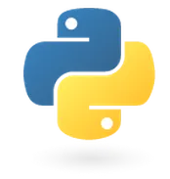
Programming in python
for Beginners
Lesson 1: The Basics
print("Hello, python!")

Slide 2
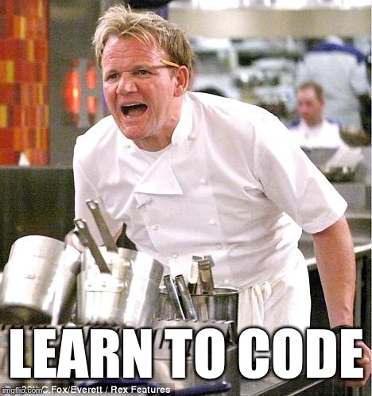

What Is Code?

Slide 3
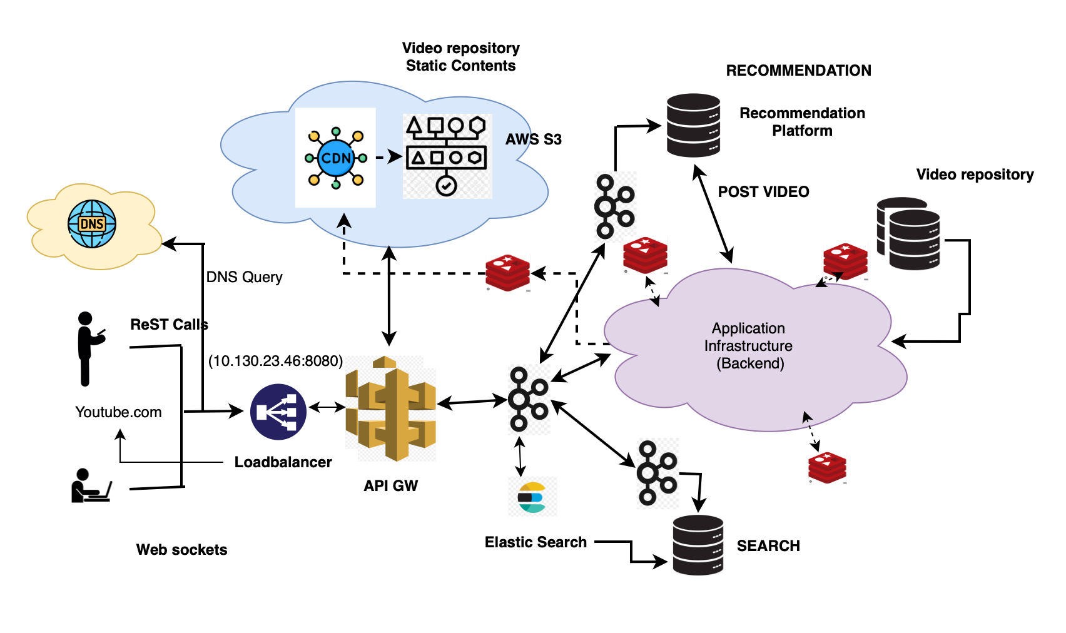
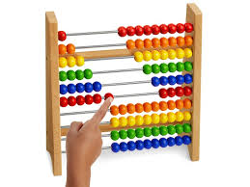
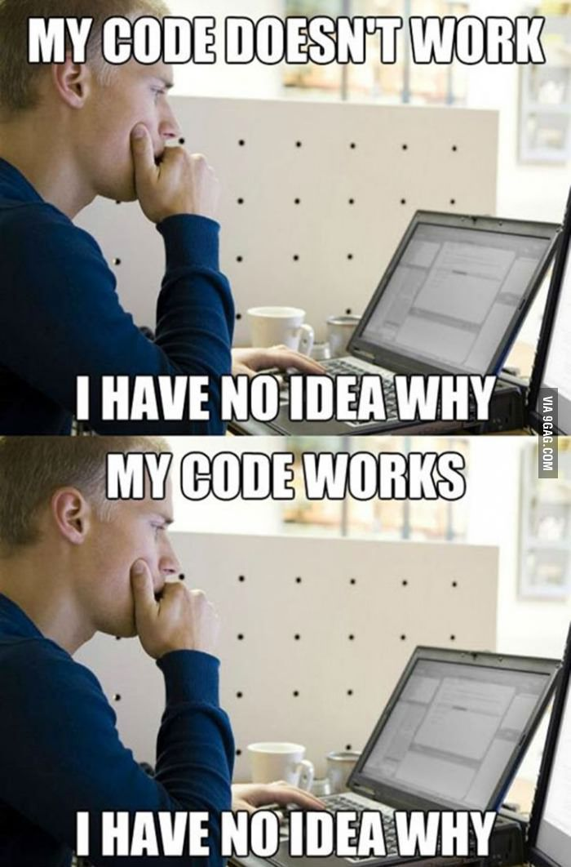
What is Code?
code [kōd] noun: Instructions for a computer

Slide 4

What is Python Code?
Easier than machine code!
Interpreted, high-level
  More friendly for humans!
  Easy for beginners to learn
print("Hello, python!")

Slide 5
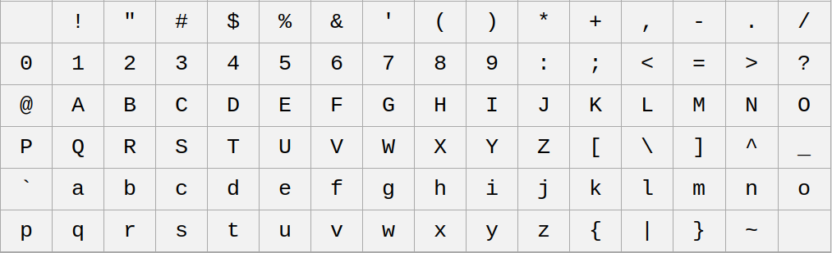




What is Plain Text?
It’s just text!
No formatting
No graphics
Word Processors: Rich Text
Text Editors: Plain Text

Slide 6

What is Thonny?
An IDE (Integrated Development Environment)
  A text editor… with benefits.
Free and open source!
Made for python beginners

Slide 7
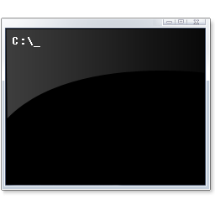


What Just Happened?
Code: print("Hello, python!")
Printing: Writing text to the user
Command Prompt: >>>
  Exchanging text with the computer
  Uses shell

Slide 8
What is a Function?
Parentheses
print("Hello, python!")
Function
name
Argument:
“string”
“A function is just somebody else’s code.” -- Matt Heffernan

Slide 9
Review Time!
Code: The instructions for a computer, and the process of writing it.
Text Editor: App for writing plain text
IDE: A text editor with programming tools
Shell: App for typing text commands
Function: Code to call from other code
Arguments: Input to a function call
String: A sequence of characters in quotes

Slide 10
What is a Variable?
x = 2
y = x + 3
message = "Hello, python!"
print(message)

Slide 11
What is a Type?
TypeError: can only concatenate str (not "int") to str
Primitive types: Number, String
x = 42 # type: int
y = x + 58 # type: int
message = "The value of y is " # type: str
Concatenation: adding strings together
  "str 1, " + "str 2" = "str 1, str 2"

Slide 12
What is a Return Value?
No argument, no return value
  exit()
Argument(s), no return value
  print("I’m an argument!")
Argument(s) and return value
  yvaluestring = str(y)
No argument, but a return value
  mylocals = locals()

Slide 13
How do you Write a Function?
def printvalue(value):
print("The value is " + str(value))

Slide 14
What did we learn today?
How to code!
Installed and used the Thonny IDE
Wrote programs with built-in functions
Wrote our own function
Arguments and return values
Used the shell to test code
Variables and values
Types of values: strings and integers

Slide 15



Thanks for Watching!
Like, Comment, Subscribe!
Become a Member!
Become a Patron!
  Family: Andrew C. Young – Electron Star Collapse – Jimmy Dansbo
  Friends: Michael McDonnell – Smeedy-build1970
  Acquaintances: Andreas_S – Anthony Colquhoun – David Cohen – Harold Jones
  Ian Young – Leo Paesen – Michael Ketchen – Ronnie Simpson – Scott Teague
  Sohl – Tim Soderstrom – Vince Valenti

