Slide 1
slithy VLOGS #33
ROCKET88
ROCKET88
ROCKET88
A New 8-Bit Architecture
Preliminary Design

Slide 2
Backronym!
Retro
Obsolete
Computational
Kernel for
Electronic
Transacting,
8-bit external data bus,
8-bit internal data bus

Slide 3
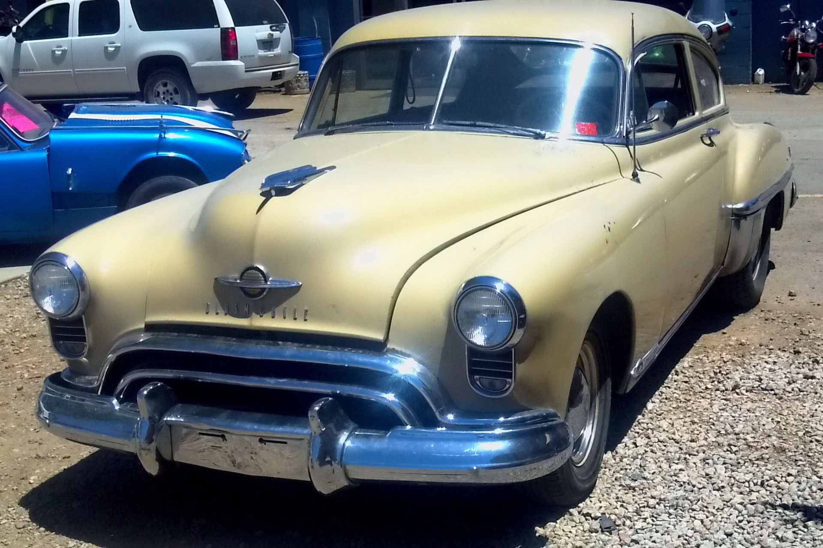
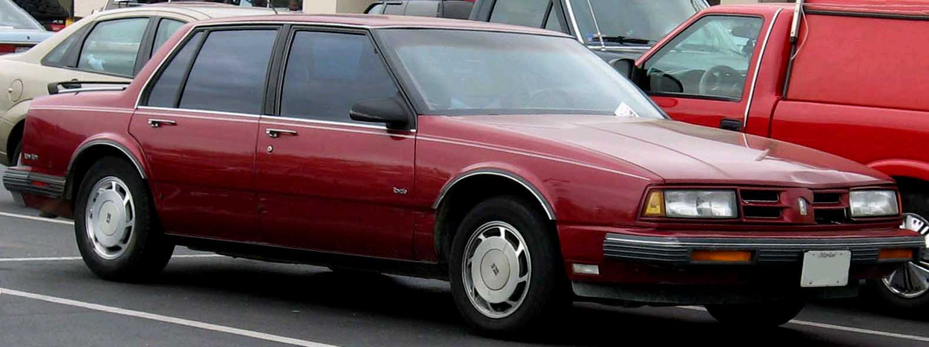
The Original “Rocket 88”
Sold by Oldsmobile 1949-1991
“Rocket” V8 replaced by “3800” V6
V6 Eighty-Eight sold until 1999

Slide 4
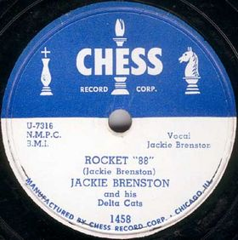

The Legacy of Rocket 88

Slide 5
Components
Address Bus [16]
External Data Bus [8]
Memory Controller
Internal Data Bus [8]
Registers
RADDR
Instruction Decoder
RL,RR
ALU

Slide 6
Registers
RADDR
A
B
C
DD
EE
PC
SP
P
RL
RR

