Slide 1
Hello, SNES!
“Hello, World!”
on a
Super Nintendo?
Not any
easier!
Not any
easier!

Slide 2
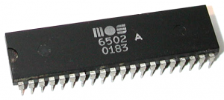
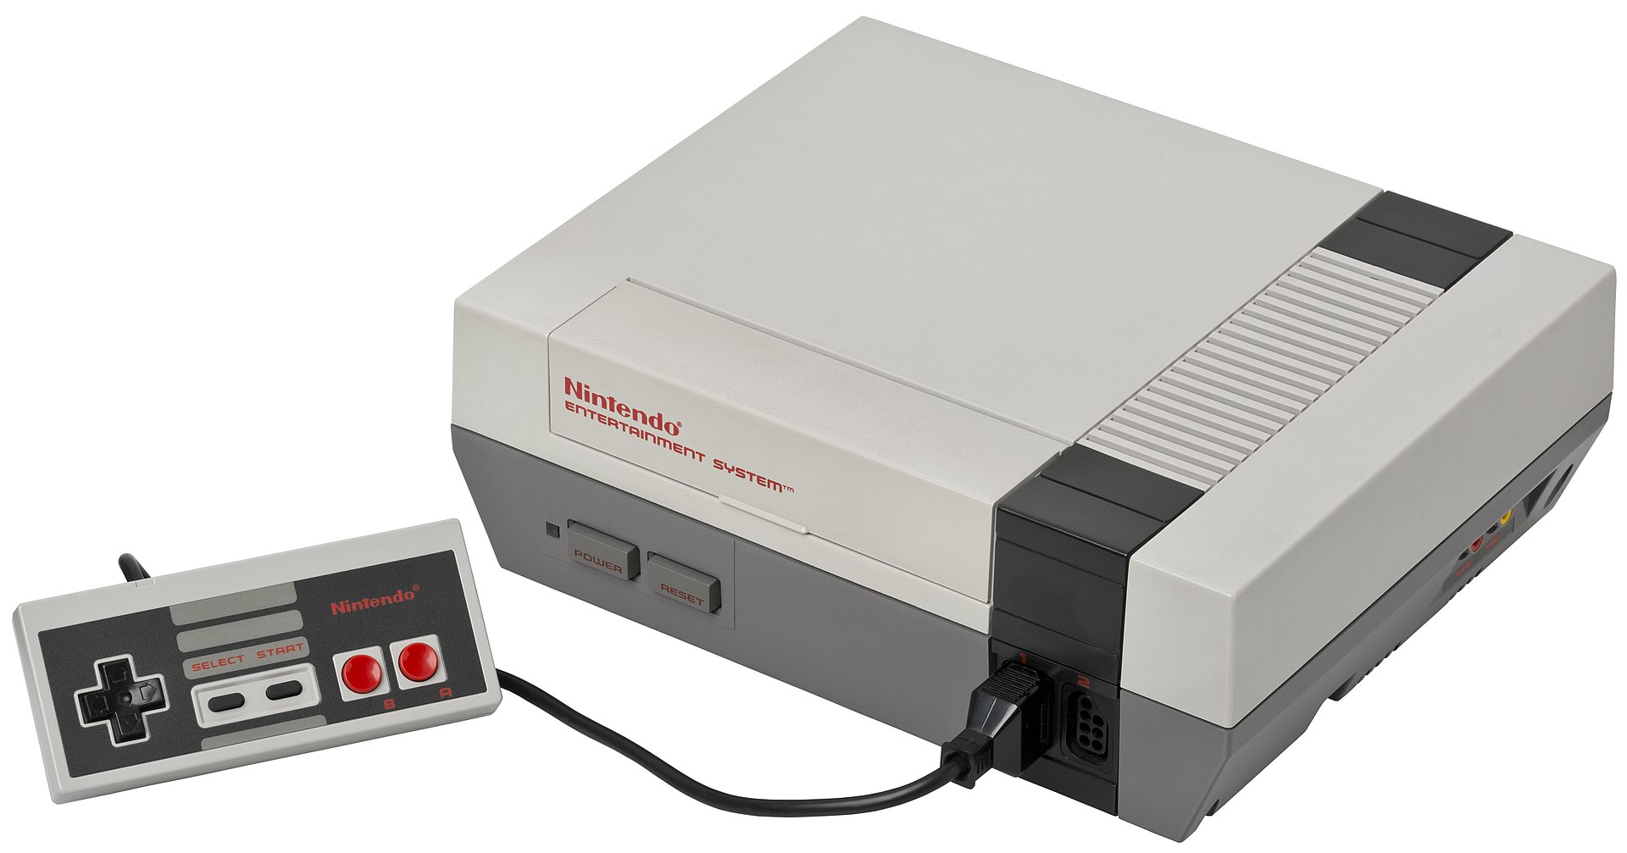
Endless Autumn of the 6502
1979:
$549.95/$999.95
1980:
$299.95
1981:
£235/£335 ($457/$652)
1982:
$595
1983:
¥14,800 ($61.35)
1985:
$179.99

Slide 3
Now You’re Playing With SUPER POWER!
CPU: Ricoh 5A22 (65816 w/ DMA, 2 address buses, display interrupts, parallel I/O)
Memory: 128k CPU RAM, 64k Video RAM, 64k Audio RAM, 32k ROM Banks
Graphics: Picture Processing Unit (PPU – same name, different chips)
  Background: 8x8 or 16x16 characters/tiles
    Up to 4 separate layers, 2 priorities per layer
    8 different modes
    Independent 2D scrolling
    Matrix transformation (Mode 7)
  Sprites: Up to 128 8x8, 16x16, 16x32, 32x32, 32x64, 64x64 sprites (2 sizes at once)
    Z-depth priority (interleaved with background layers)
    2-axis flipping
Sound: S-SMP
  Dedicated 8-bit CPU
  8 stereo 8-bit sample voices, effects with 16-bit DSP

