Slide 1
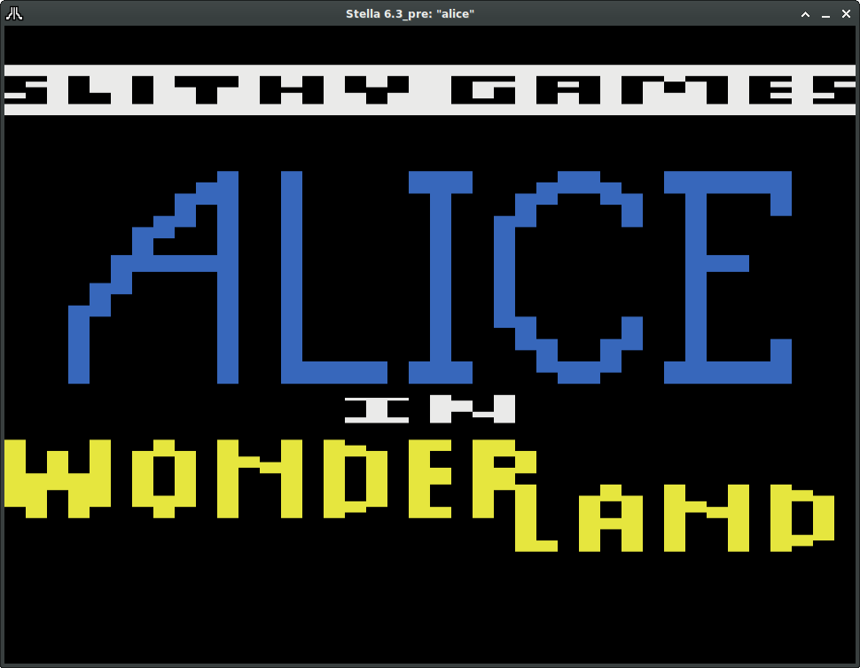
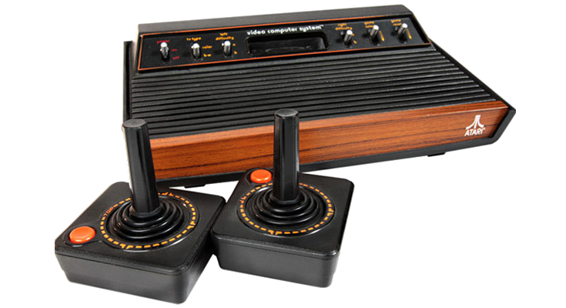
For the Atari 2600

Slide 2
Sound and Music
Audio Channel 0: Music
  Macros for initializing and looping
  Macros defining available pure tone notes D#3 to C7
Audio Channel 1: Sound
  Macros for cuing and playing
4-byte tone entry
  AUDFx, AUDCx, AUDVx, Duration (60 Hz screen cycles)

Slide 3
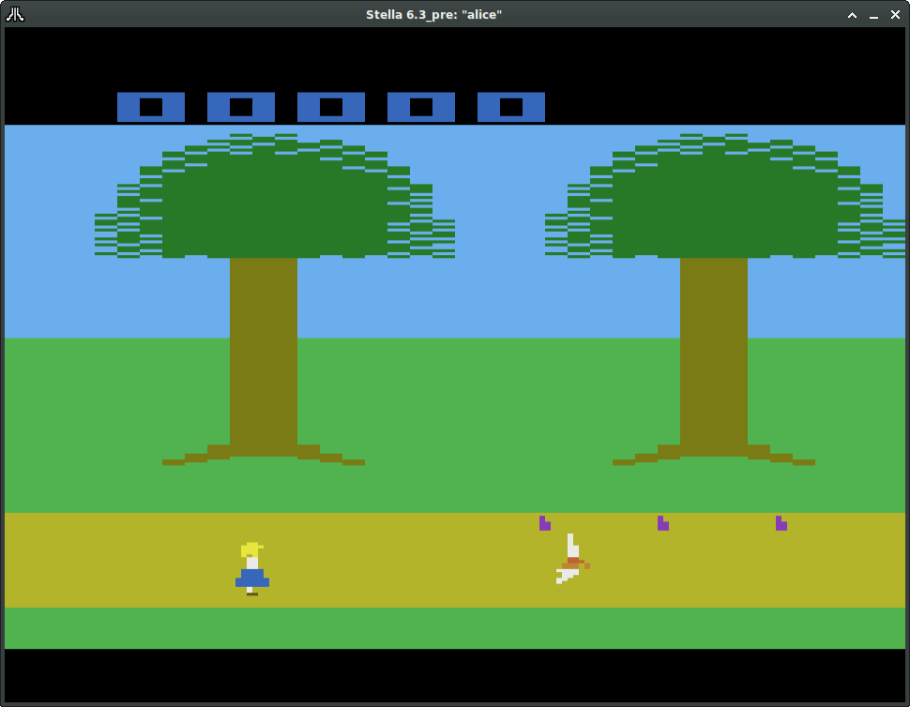
Level 1: Follow the White Rabbit
Score (Dynamic Playfield)
Trees (Static Playfield,
Repeated)
“Drink Me” Bottles
(Missile 0, Missile 1, Ball)
Alice (Player 0)
White Rabbit/Collision Switch
(Player 1)

Slide 4
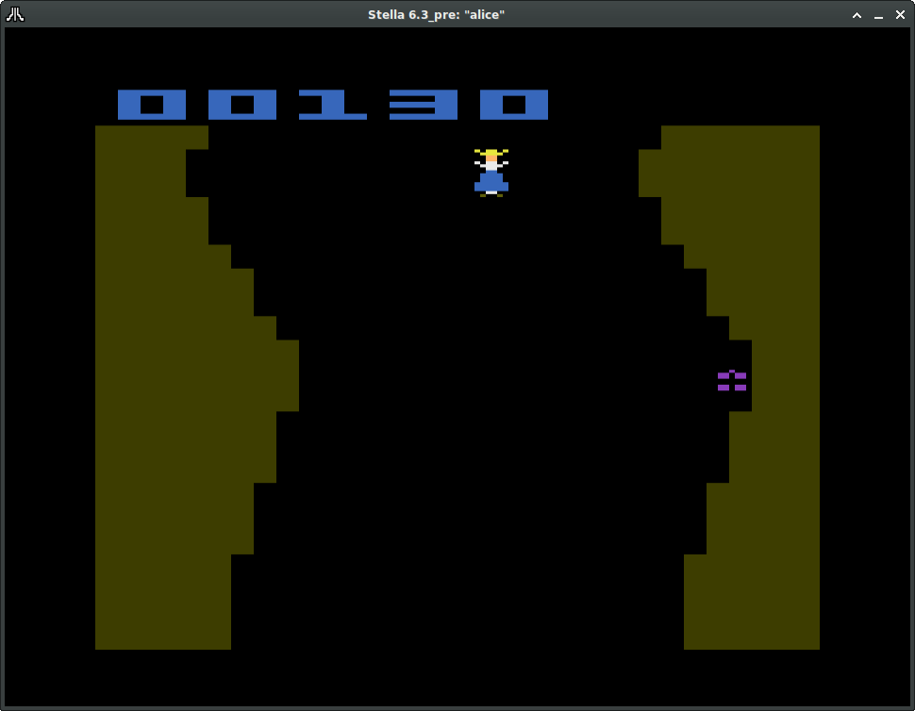
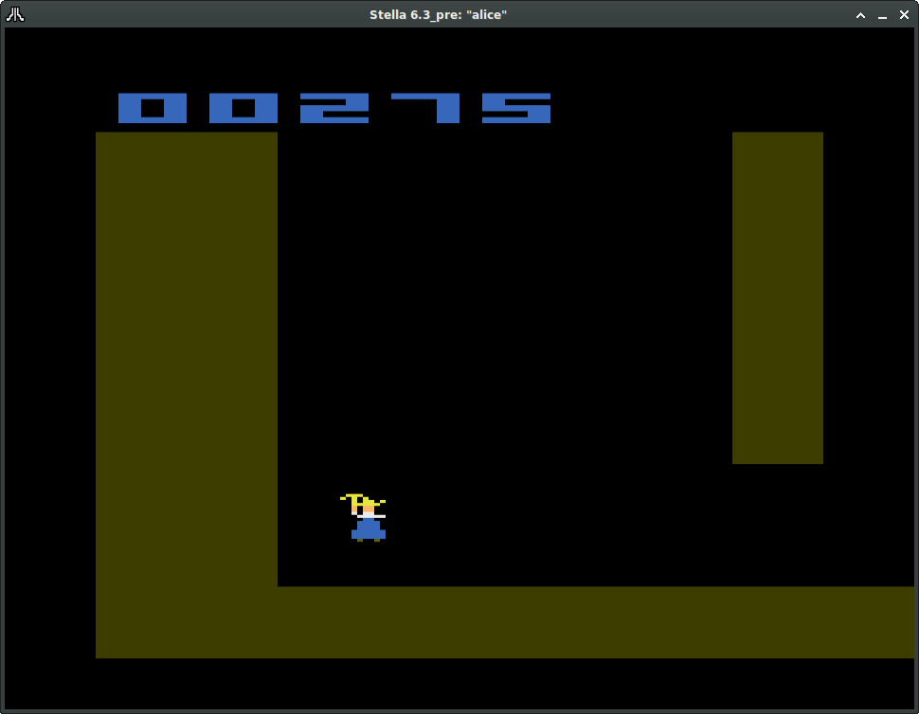
Level 2: Down The Rabbit Hole
Alice (Player 0)
Cakes/Umbrella
(Player 1)
Collision Switch
(Player 1)
Walls: Dynamic Playfield
Walls: Static Playfield

