Slide 1
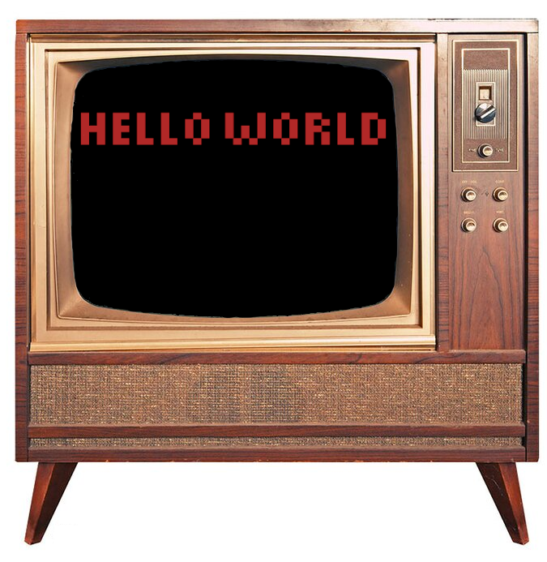
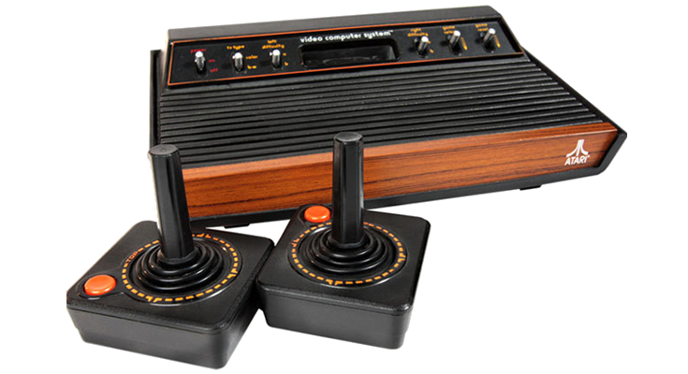
Hello, 2600!
“Hello, World!”
on an Atari?
NOT
EASY!
NOT
EASY!

Slide 2
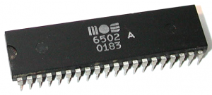
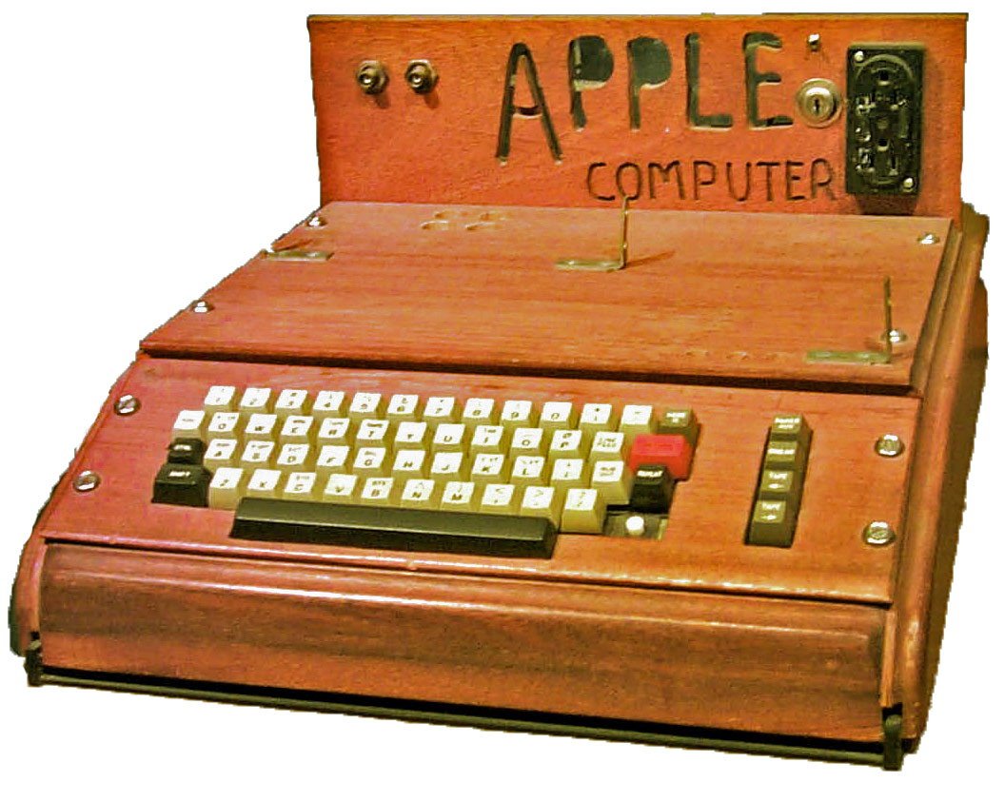
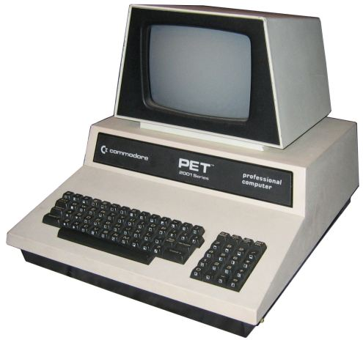
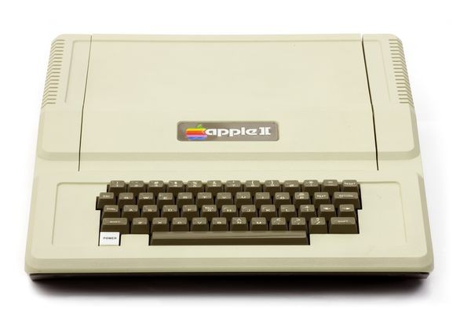
Early History of the 6502
June
1976:
$666.66
200 Sold
January
1977:
$795.00
100,000 Sold
June
1977:
$1298.00
6,000,000 Sold
September
1977:
$199.00
30,000,000 Sold!

Slide 3
Hello, Text?
No Character Generator
Only 128 BYTES of RAM, no Video RAM
Maximum ROM: 4 kB
  6507 CPU: Only 13-bit addressing
Manual Video Synchronization
  40x192 Playfield “bitmap”
  Race the Beam!

Slide 4
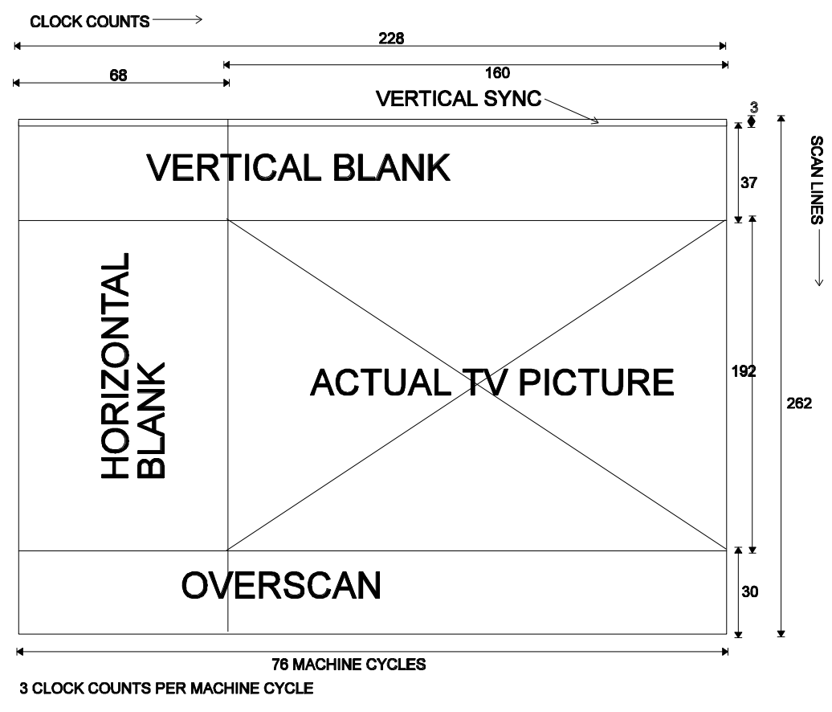
NTSC Timing

Slide 5
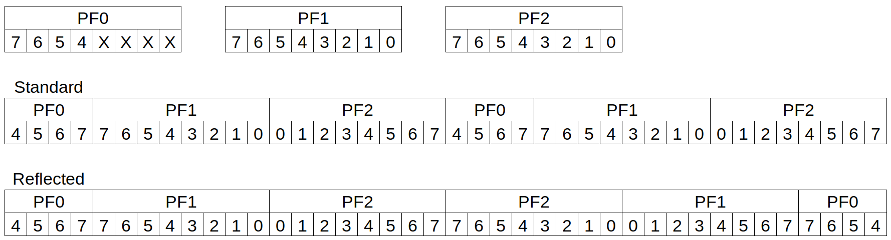
TIA Playfield

Slide 6
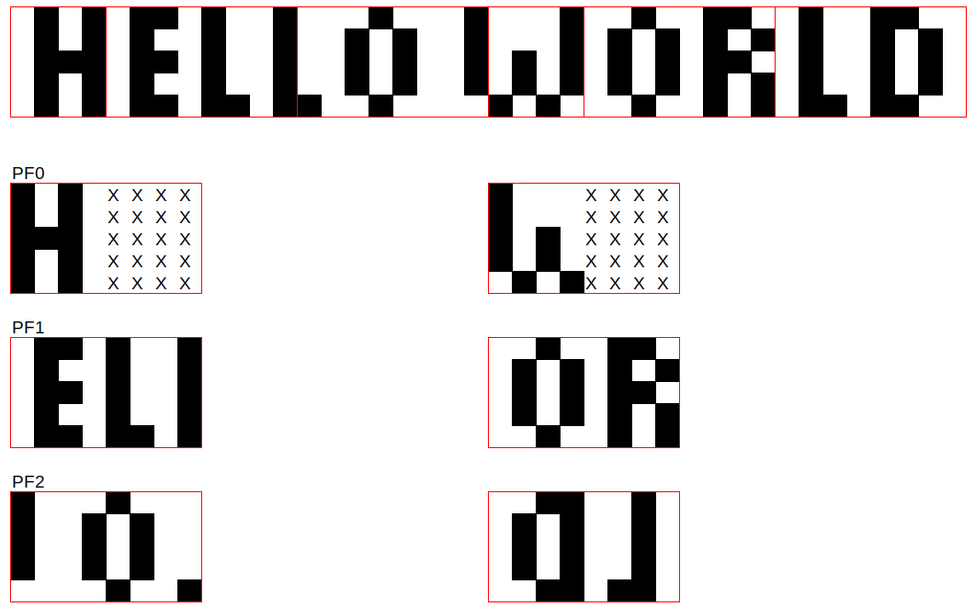
Building a Bitmap

