Slide 1


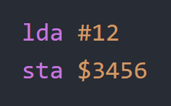
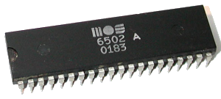
How to Program in Assembly Language for the
Lesson 1: The Basics

Slide 2
Definitions
A human-readable set of mnemonics that represents a processor’s machine language
Assembly Language:
The binary code that a processor executes from memory
Machine Language:
10101001
00001100
10001101
01010110
00110100

Slide 3
What is an Assembler?
Like a compiler, an assembler converts assembly language into machine language.
Develop on multiple platforms, target single processor family
Examples for the 6502 family:
  ca65 (part of the cc65 toolchain)
  ACME
  dasm
  Kick Assembler (KickAss)
  CBM .prg Studio

Slide 4
6502 Architecture
Data
Bus
Address
Bus
A
A
P
N V – B D I Z C
X
S
- $0100
Y
PC
7 0
15 0

Slide 5
Mnemonic Syntax
Operation
Mnemonic
(3 letters)
Operand
Mnemonic
(mode syntax)
Assembly Instruction: lda #1
Machine Instruction (hex): A9 01
Machine Instruction (binary): 10101001 00000001
Operation Code
(Opcode)
Operand
(0-2 bytes)

Slide 6
Our First Assembly Program
Assembly Language Machine Language (hex)
lda #1 A9 01
inc
1A
sta $1000
8D 00 10

Slide 7

Mnemonics
Hexadecimal
Opcode
Accumulator
Cross-assembler
Zero Page

