Slide 1

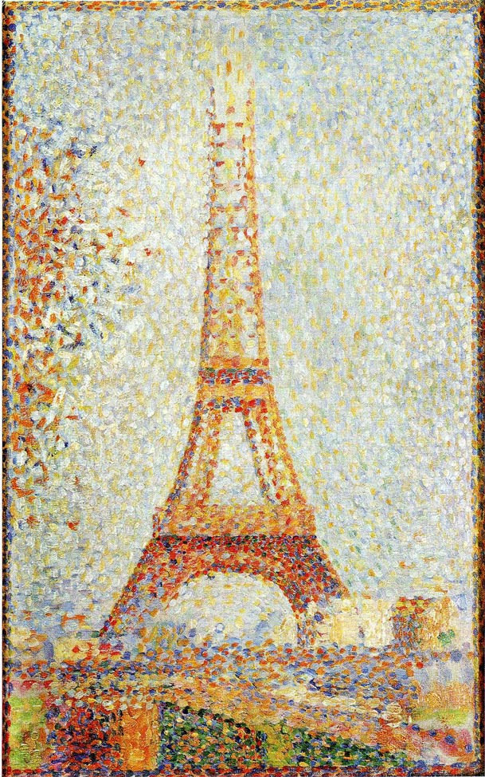
How to Program in Assembly Language for the
Lesson 15: Bitmap

Slide 2
VERA Bitmap Modes
Each VERA layer can be any tile or bitmap mode
320 or 640 pixels wide
Variable color depth, one palette offset per layer
  1bpp, 2-color graphics
  2bpp, 4-color graphics
  4bpp, 16-color graphics
  8bpp, 256-color graphics
No scrolling

Slide 3
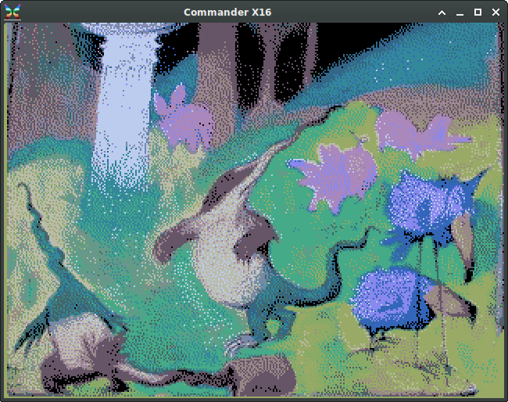
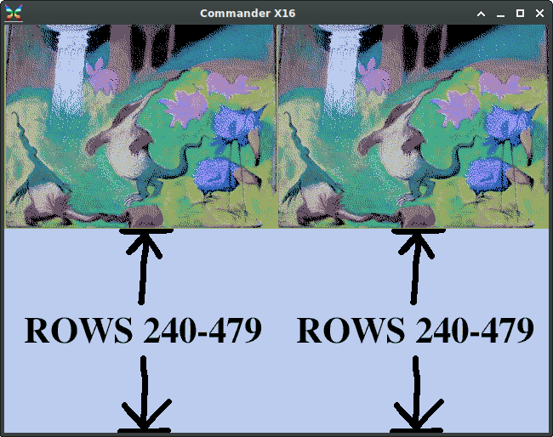
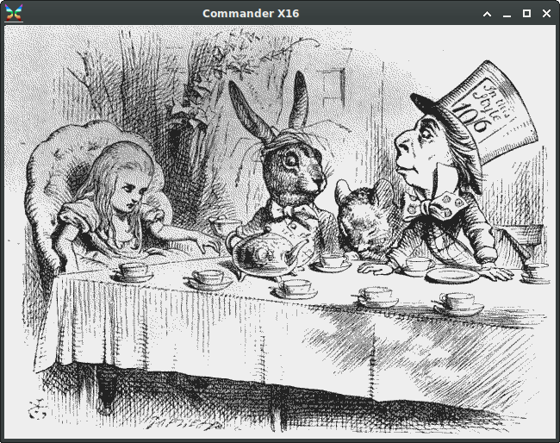
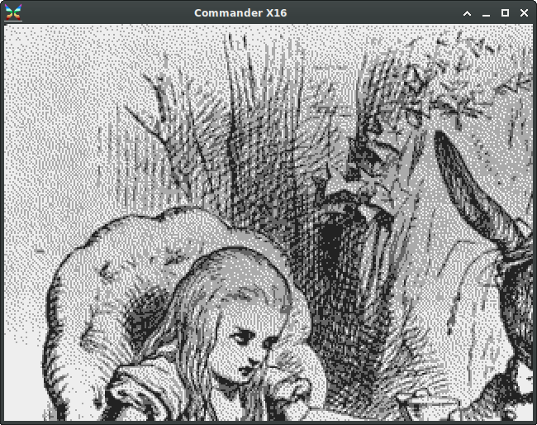
Bitmap Widths
320-pixel bitmaps repeated horizontally when screen width > 320
640-pixel bitmaps cropped to corner when screen width < 640
320 x 240
640 x 480
640 x 480
320 x 240

Slide 4
Bitmap Layer Configuration
L0_CONFIG: $9F2D; L1_CONFIG: $9F34
  Map Height/Width: Unused
  T256: Unused
  Bitmap Mode: 1 = bitmap mode
  Color Depth: 0 = 1bpp; 1 = 2bpp; 2 = 4bpp; 3 = 8bpp
L0_TILEBASE: $9F2F; L1_TILEBASE: $9F36
  Tile Base Address: Bitmap address >> 11 (2kB alignment)
  Tile Height: Unused
  Tile Width: 0 = 320 pixels; 1 = 640 pixels
L0_HSCROLL_H: $9F31; L1_HSCROLL_H: $9F38
  H-Scroll (11:8): Palette offset (0-15)
Map Height | Map Width | T256 | Bitmap Mode | Color Depth
Tile Base Address (16:11) | Tile Height | Tile Width
Unused | H-Scroll (11:8)

Slide 5

1bpp Bitmap
Each byte: 8 pixels
  320x240 bitmap: 9600 bytes
  640x480 bitmap: 37.5 kB
Colors: First two of any 16-color palette offset
  Default:
  0: Always Transparent
  1: Remapped to 17, 33, 49, etc.
Good enough for…
  Original Macintosh!
  GEOS!
0 | 1 | 0 | 1 | 1 | 0 | 1 | 0
5A

Slide 6
Higher Color Depths
2bpp 4 colors Each byte: 4 pixels 320x240: 18.75 kB 640x480: 75 kB | 4bpp 16 colors Each byte: 2 pixels 320x240: 37.5 kB 640x480: 150 kB 640x404: 126.25 kB | 8bpp 256 colors (full palette) Each byte: 1 pixel 320x240: 75 kB 640x480: 300 kB 640x202: 126.25 kB

Slide 7
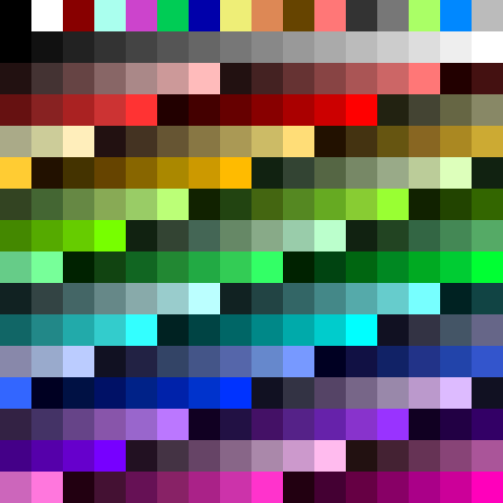
Palette Offsets
All bitmaps require specific palette offset (0-15)
Color index 0 transparent regardless of depth or offset
8bpp: Color indexes 1-15 remapped if non-zero offset, 16-255 unchanged
Transparent
PO 0
PO 1
PO 2
PO 3
PO 4
PO 5
PO 6
PO 7
PO 8
PO 9
PO 10
PO 11
PO 12
PO 13
PO 14
PO 15
0 | 0 | 0 | 2 | 2 | 0 | 0 | 0
0 | 0 | 2 | 8 | 8 | 2 | 0 | 0
0 | 2 | 8 | 7 | 7 | 8 | 2 | 0
2 | 8 | 7 | 5 | 5 | 7 | 8 | 2
8 | 7 | 5 | 6 | 6 | 5 | 7 | 8
7 | 5 | 6 | 4 | 4 | 6 | 5 | 7
5 | 6 | 4 | 0 | 0 | 4 | 6 | 5
6 | 4 | 0 | 0 | 0 | 0 | 4 | 6
0 | 0 | 0 | 2 | 2 | 0 | 0 | 0
0 | 0 | 2 | 8 | 8 | 2 | 0 | 0
0 | 2 | 8 | 7 | 7 | 8 | 2 | 0
2 | 8 | 7 | 5 | 5 | 7 | 8 | 2
8 | 7 | 5 | 6 | 6 | 5 | 7 | 8
7 | 5 | 6 | 4 | 4 | 6 | 5 | 7
5 | 6 | 4 | 0 | 0 | 4 | 6 | 5
6 | 4 | 0 | 0 | 0 | 0 | 4 | 6
0 | 0 | 0 | 2 | 2 | 0 | 0 | 0
0 | 0 | 2 | 8 | 8 | 2 | 0 | 0
0 | 2 | 8 | 7 | 7 | 8 | 2 | 0
2 | 8 | 7 | 5 | 5 | 7 | 8 | 2
8 | 7 | 5 | 6 | 6 | 5 | 7 | 8
7 | 5 | 6 | 4 | 4 | 6 | 5 | 7
5 | 6 | 4 | 0 | 0 | 4 | 6 | 5
6 | 4 | 0 | 0 | 0 | 0 | 4 | 6
PO 0 PO 1 PO 15
1bpp
2bpp
4bpp

Slide 8
Draw Vertical Line
Assuming: 320x240 4bpp bitmap at $04000
A: color (0-15); X: start row; Y: length; set global variable for column
column: .word 0 @set_addr: lda column lda column
start_row: .word 0 lsr column+1 clc sta $9F20 ; ADDR_L
color: .byte 0 ror column adc start_row @draw_loop:
mask: .byte 0 ldx #5 sta column lda $9F23 ; DATA0
draw_vert: @mult32: lda column+1 and mask
sta color asl start_row adc start_row+1 ora color
stx start_row rol start_row+1 adc #$40 sta $9F24 ; DATA1
stz start_row+1 dex sta column+1 dey
lda #$F0 bne @mult32 stz $9F25 ; CTRL = 0 bne @draw_loop
sta mask lda column lda #$D0 ; stride = 160 rts
lda #$01 clc sta $9F22 ; ADDR_H
bit column adc start_row lda column+1
bne @set_addr sta column sta $9F21 ; ADDR_M
ldx #4 lda column+1 lda column
@shift_loop: adc start_row+1 sta $9F20 ; ADDR_L
asl color sta column+1 inc $9F25 ; CTRL = 1
lsr mask asl start_row lda #$D0 ; stride = 160
dex rol start_row+1 sta $9F22 ; ADDR_H
bne @shift_loop asl start_row lda column+1
rol start_row+1 sta $9F21 ; ADDR_M

Slide 9
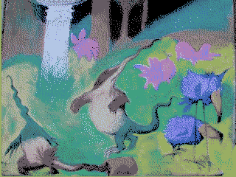
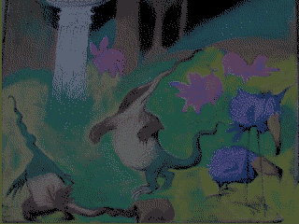
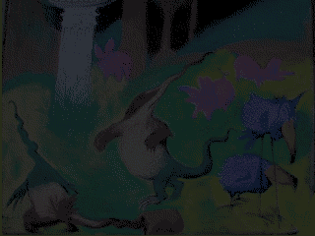
Example Program
Fading Cycle

