Slide 1

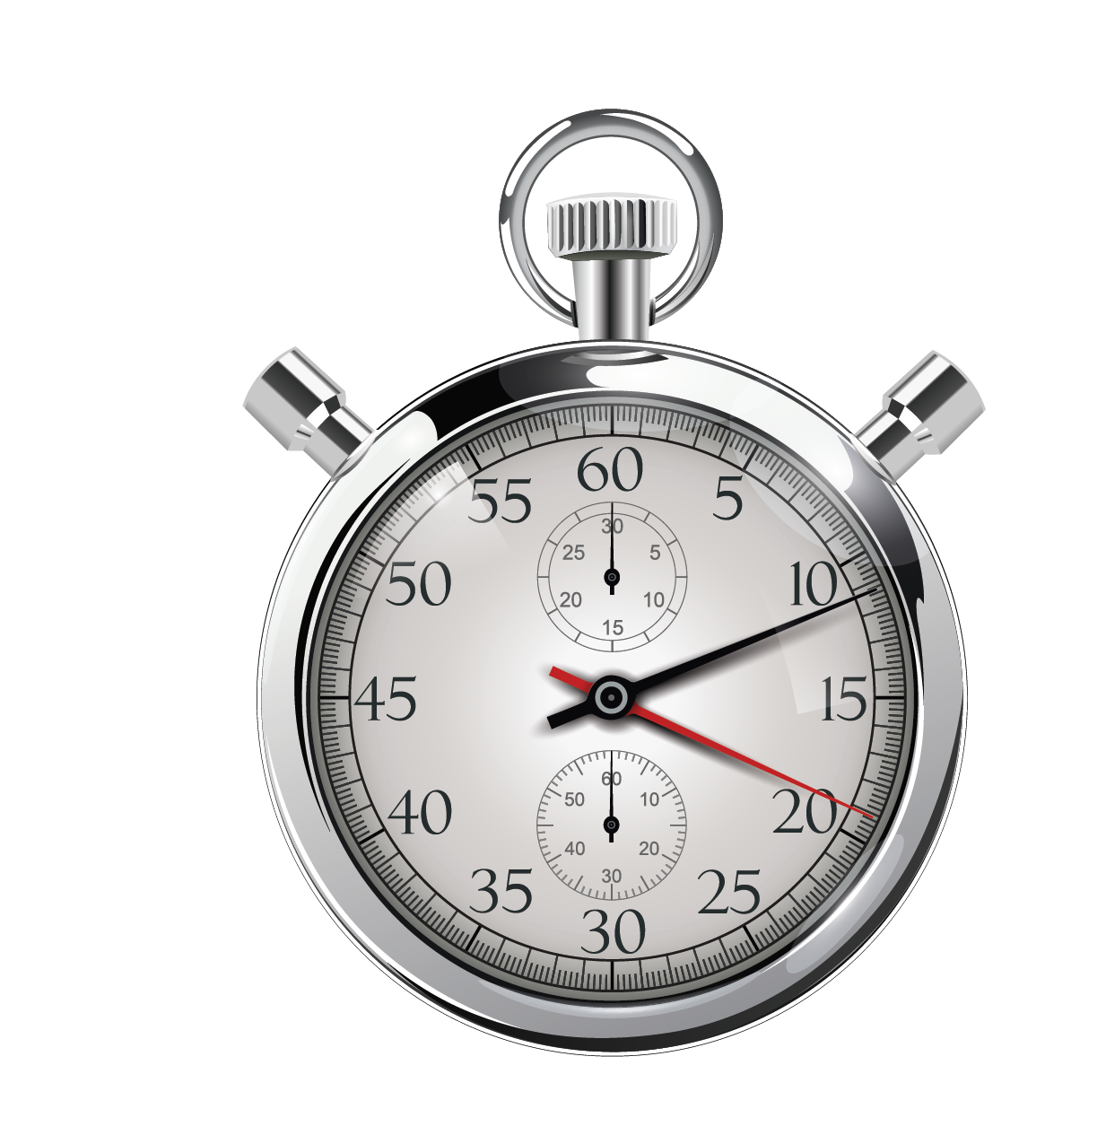
How to Program in Assembly Language for the
Lesson 16: All in the Timing

Slide 2
VSYNC Timing
Fixed 60Hz cycle
  16.6666… ms
  ~133,333 8 MHz CPU cycles
Once per frame, at beginning.
Requires custom IRQ handler
Requires non-trivial math to convert to hours/minutes/seconds
  No stored counter = No automatic real time clock

Slide 3
Instruction Timing
Just a bunch of NOPs
  Loops, blocks, etc.
  2 CPU cycles per NOP (250 ns)
Old-school, brute-force
Not scalable
Only for uninterrupted, non-operational delays

Slide 4
LINE Interrupts
Granularity in-between VSYNC and NOPs
Precise to beginning of display raster line
  VGA:
    480 lines per frame
    31.78 μs
    ~ 254 8 MHz CPU cycles
  Interlaced:
    240 lines per frame (only even lines)
    63.49 μs
    ~ 507 8 MHz CPU cycles

Slide 5
VERA Interrupt Control
IEN (Interrupt ENable): $9F26
  Default: $01 (VSYNC IRQ enabled)
ISR (Interrupt Service Routine): $9F27
  Read-only, during IRQ ISR
  AFLOW set at startup (PCM FIFO empty)
IRQ Line (7:0): $9F28
  Default: $00 (IRQ Line = 0)
IRQ Line(8) | - | - | - | AFLOW | SPRCOL | LINE | VSYNC
Sprite Collisions | AFLOW | SPRCOL | LINE | VSYNC

Slide 6
Split Layer
Make top half of layer 1 16-color text, bottom half 256-color text.
IRQVec = $0314 sei custom_irq:
VERA_ien = $9F26 lda #<custom_irq lda VERA_isr
VERA_isr = $9F27 sta IRQVec bit #$01
VERA_irqline_l = $9F28 lda #>custom_irq beq @check_line
VERA_L1_config = $9F34 sta IRQVec+1 lda #$60
default_irq: .addr 0 lda #$03 sta VERA_L1_config
sta VERA_ien bra @continue
setup_irq: lda #240 @check_line:
lda IRQVec sta VERA_irqline_l bit #$02
sta default_irq cli beq @continue
lda IRQVec+1 rts lda #$68
sta default_irq+1 sta VERA_L1_config
@continue:
lda #$03
sta VERA_isr
jmp (default_irq)

Slide 7
Real Time Clock (RTC)
Set to local time (or whatever!) by user
Year, Month, Day, Hours, Minutes, Seconds, Jiffys
Set once, get many times
Updated each VSYNC
New kernal subroutines
  Use “16-Bit ABI” zero page “registers”
  clock_set_date_time = $FF4D
  clock_get_date_time = $FF50
Not functional after year 2155 😢

Slide 8
16-Bit ABI
Leverages zero page to create 16 virtual 16-bit registers for Kernal
Only used for subroutine scratch memory and I/O
  Addresses still available for general use otherwise
Zero page $02-$21 can be modified by any subroutine that uses ABI
$02 | r0 | r0L
$03 |  | r0H
$04 | r1 | r1L
$05 |  | r1H
... | … | …
$20 | r15 | r15L
$21 |  | r15H
r0 – r5: Arguments/Return values
r6 – r10: Return values
r11 – r15: Scratch

Slide 9
clock_set_date_time
ROM Address: $FF4D
Year = 1900 + r0L
Month = r0H
Day = r1L
Hours (0-23) = r1H
Minutes = r2L
Seconds = r2H
Jiffys (0-59) = r3L

Slide 10
clock_get_date_time
ROM Address: $FF50
r0L = Year - 1900
r0H = Month
r1L = Day
r1H = Hours
r2L = Minutes
r2H = Seconds
r3L = Jiffys

Slide 11
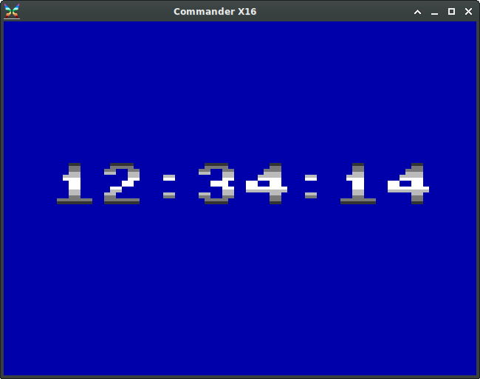
Example Program
Fancy Clock

